Slide 1
Stage 1 Agriculture
Implementation Workshops
Term 3, 2016

Slide 2
Subject Renewal
an overview of the new science subjects
options and pathways
possible programming flexibilities
assessment requirements
task design – focus on what is new
an overview of the learning and assessment plan approval process (QA cycle)

Slide 3

Subject Renewal – Why?
Australian Curriculum
Learning and Assessment
are changing

Slide 4

Subject Renewal
Capabilities
Content
Skills
Guiding Principles
Quality Learning
Engaging
Innovative
Quality Assessment
Manageability

Slide 5
Stage 1 Science Subjects
Stage 1 subjects 2017 | Stage 2 subjects 2018
Agriculture | Agricultural Production Agricultural Systems
Biology | Biology
Chemistry | Chemistry
Earth and Environmental Science | Earth and Environmental Science
Physics | Physics

Slide 6
Stage 1 Science Subjects
Pathway options Stage 1 subjects | Stage 2 subjects from 2018
Agriculture | Agricultural Production Agricultural Systems
Biology | Biology
Chemistry | Chemistry
Earth and Environmental Science | Earth and Environmental Science Physics
Physics

Slide 7

Capabilities
I can work collaboratively and safely
I am literate and numerate
I can analyse and devise solutions
I can use technology to create a new way of thinking
I am open-minded
I can make ethical and responsible decisions
I am capable
Notes:
We will provide an overview of elements of the subject outline, which are applicable to all Stage 1 science subjects.

Slide 8

Capabilities
Integrated Australian Curriculum General Capabilities
  Literacy
  Numeracy
  Information and communication technology capability
  Critical and creative thinking
  Personal and social capability
  Ethical understanding
  Intercultural understanding
Notes:
We will provide an overview of elements of the subject outline, which are applicable to all Stage 1 science subjects.

Slide 9
General Capabilities
For example:
Critical and creative thinking
analysing and interpreting from different perspectives, develop logical conclusions, devising imaginative solutions, envisaging consequences, significance of creative thinking on the development of biological knowledge and applications.
Personal and social capability
importance on health and well-being, personally and globally, taking initiative, working collaboratively, planning effectively, following procedures effectively safely, gauging the impact of biology in society.
Ethical understanding
considering the implications of investigations, making ethical decisions based on an understanding of biological principles, need to plan for the future, protect and sustain the biosphere, responsible participation in social, political, economic, and legal decision-making.

Slide 10
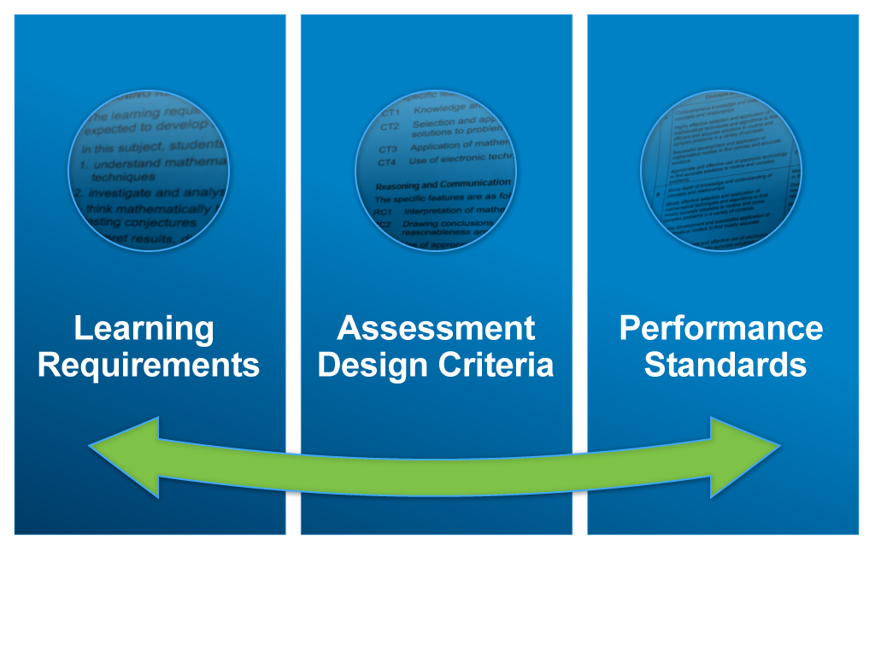
Capabilities

Slide 11
Learning Requirements
apply science inquiry skills to design and conduct biological investigations, using appropriate procedures and safe, ethical working practices
obtain, record, represent, analyse, and interpret the results of biological investigations
evaluate procedures and results, and analyse evidence to formulate and justify conclusions
develop and apply knowledge and understanding of biological concepts in new and familiar contexts
explore and understand science as a human endeavour
communicate knowledge and understanding of biological concepts, using appropriate terms, conventions, and representations.

Slide 12
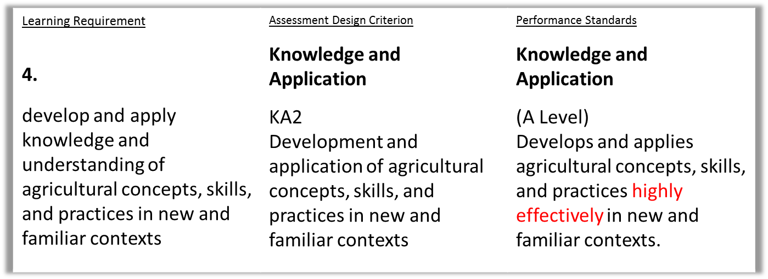
Learning Requirements to Performance Standards
Capabilities that are a focus for Learning Requirement 4:
•Critical/creative thinking •Personal/social capability
•Numeracy •Literacy •ICT

Slide 13
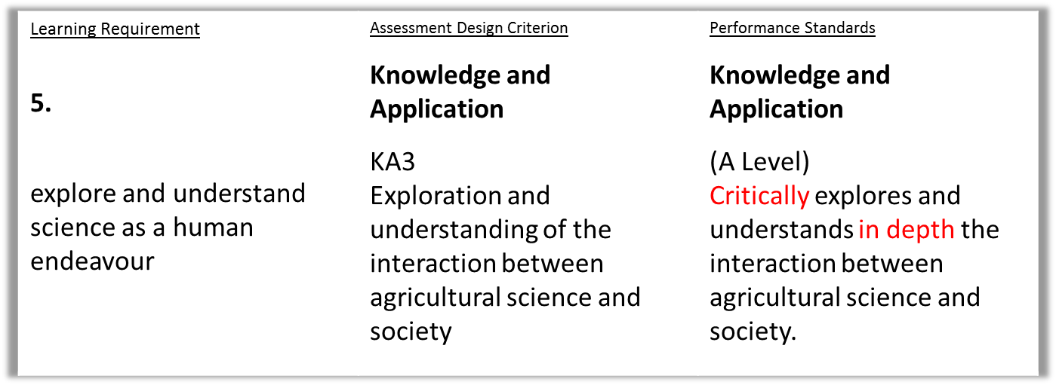
Learning Requirements to Performance Standards
Capabilities that are a focus for Learning Requirement 5:
Personal and social capability
Ethical understanding

Slide 14
Subject Outline Structure
  Columns: What is the difference between the two?
Notes:
The sections of the SO are very similar in format to those in the current SOs.
The content contains :topics, SIS and SHE.
Currently there is very little specification for Stage 1 subjects.
New SO has same format for St 1 and St 2.
Topics begin: BIG page 15, CME page 15, EES page 13, PYS page14.
In the current subject outline, the Stage 2 content is divided into two columns: Key Ideas and Intended Student Learning. This is what teachers used as the basis of their teaching and is the basis for writing the Stage 2 examination.
Click These 2 columns have been amalgamated into a single column on the LEFT HAND SIDE called Science Understanding but effectively still show the key idea with an elaboration of what students need to know/be able to do/understand in the dot points underneath.
This column will serve the same purpose as the previous two columns – the basis for a teaching, learning and assessment program and now they are shown in both Stage 1 and Stage 2.
The writing of the examination for Stage 2 is based on the Science Understanding and Science Inquiry Skills in the LH column.
The column on the RHS is used to provide suggestions of contexts for activities. These draw out all three strands, and include examples of innovative strategies.
Note these are ONLY suggestions – we could not fit them all in.
Wording from the subject outline…………..provided as a guide only.
They are neither comprehensive nor exclusive. Teachers may select from these or choose to use others.
RHS also contains some comments to show where concepts links to other parts of the SO
Handover

Slide 15


Subject Outline Structure
  Symbols
  What do they mean?
  possible teaching and learning strategy
  possible science inquiry activity
  possible focus on science as a human endeavour
  ⬧

Slide 16

Science Inquiry Skills

Slide 17
Science Inquiry Skills

Slide 18
Science Inquiry Skills
Discussion questions
  What is familiar?
  What is new?
  What are the implications for your teaching and assessment?

Slide 19
Science as a Human Endeavour
1. Communication and Collaboration
global enterprise, clear communication, international conventions, and review and verification of results, international collaboration
2. Development
development …. wide range of evidence, many sources, across disciplines, New technologies improve the efficiency , modify or replace models, theories, and processes.
3. Influence
advances …in one field can influence and be influenced by other areas of STEM, acceptance and use …influenced by social, economic, cultural, and ethical
4. Application and Limitation
scientists ..solutions, discoveries, design action for sustainability, evaluate economic, social, cultural, and environmental impacts, offer explanations, make predictions, beneficial or unexpected consequences; evaluation of risk, opportunities for innovation, informs public debate influenced by public debate; limit possible conclusions.

Slide 20
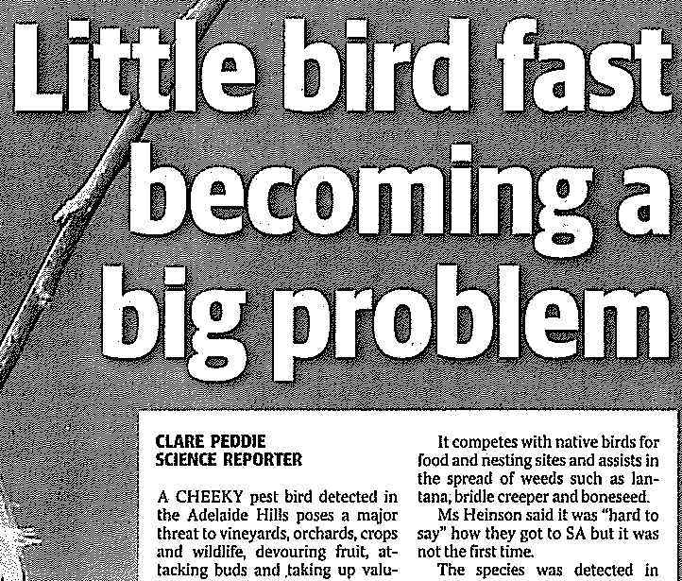
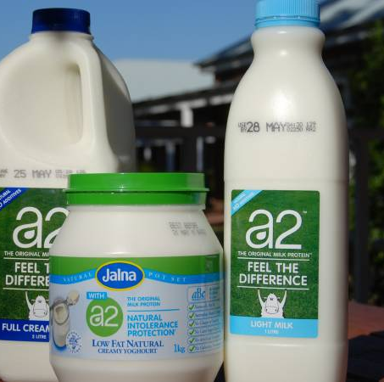
Science as a Human Endeavour
A2 Milk advertising claims under fire from rival Lion Group
A legal stoush between Japanese beverage giant Lion Group and the a2 Milk
Company has taken a fresh twist with an explosive cross claim alleging a2
engaged in deceptive and misleading conduct.
Lion's accusations, filed in the federal court, strike at the heart of a2 Milk's
marketing, product proposition and scientific and medical research.
It alleges representations that a2 milk makes many consumers feel better
than they do after drinking regular cow’s milk are false.
A2 Milk was founded in 2000 in New Zealand by scientist Dr Corran McLachlan, who,
the company's website says, discovered that cows naturally produce different types of
proteins in milk and these proteins affect people's health and wellbeing.
Lincoln Minerals gains initial approval for graphite mine north of Port Lincoln
The Eyre Peninsula is poised to become the nation's leading source for graphite — a mineral vital to the expansion of the renewable energy industry — after a project was given approval by the South Australian Government.
………… graphite which might eventually be used for a $1.2 billion solar energy power plant at Port Augusta planned by Solarstor.

Slide 21
How can I see
Science as a Human Endeavour
being integrated into my program?

Slide 22
Stage 1 Agriculture
(1AGU)
2 topics
Retains flexibility at Stage 1
Choose the aspects of topics
Choose the context
Choose the content appropriate to the cohort
Choose the time allocation to aspects/topics

Slide 23

Focus Questions
What ideas do you have for renewing your teaching programs?
How can you make use of the flexibilities in creating a program for your students?

Slide 24
Assessment Scope and Requirements
Assessment at Stage 1 is school based
  10-credit subject – four assessments
  AT1: Agricultural Explorations
  - at least practical exploration
  - one Science as a Human Endeavour exploration
  AT2: Applications – at least one
  20-credit subject – eight assessments
  AT1: Agricultural Explorations
  - at least two practical explorations
  - two Science as a Human Endeavour explorations
  AT2: Applications – at least two
Each assessment type – weighting of at least 20%
Include the opportunity for collaboration

Slide 25
Stage 1 Agriculture
Assessment Type 1: Agricultural Explorations
Practical Explorations
Deconstruct a problem
Opportunity to design investigation for which the outcome is uncertain
Collaboration and manipulation of apparatus
Science as a Human Endeavour exploration
Notes:
Word limits on prac and SHE 1000
Tested on current student work

Slide 26
Stage 1 Agriculture
Assessment Type 2: Applications
Under direct supervision – what does this mean?
What are the options for a SAT?
Appropriate for the cohort

Slide 27
Assessment
  Assessment Design Criteria
    Investigation, Analysis, and Evaluation
    Knowledge and Application
  Specific Features
      What is new or different?
      What is ‘missing’?
  Performance Standards

Slide 28
Performance Standards
  C = C
  2016 2017

Slide 29

Quality Assurance
Quality Assurance
planning

Slide 30
Learning and Assessment Plans
Simplified form with a cover sheet and the assessment overview page
Some pre-approved plans available from website
Examples of LAPs

Slide 31
Programs
  Themes
  Contexts

Slide 32
Focus Questions
Could you use a pre-approved learning and assessment plan (LAP)?
How might you adapt a pre-approved LAP?
What ideas do you have for new tasks?

Slide 33
Quality Assurance
Quality Assurance
planning
improving
clarifying
confirming

Slide 34
Stage 2 Agriculture Subjects in 2018
  Agricultural Production
  Agricultural Systems

Slide 35
Stage 2 Agricultural Production 2018:
Assessment
School Assessment (70%)
  Assessment Type 1: Agricultural Explorations
  Assessment Type 2: Applications
External Assessment (30%)
  Assessment Type 3: Production Investigation

Slide 36
Stage 2 Agricultural Systems 2018:
Assessment
School Assessment (70%)
  Assessment Type 1: Agricultural Explorations
  Assessment Type 2: Applications
External Assessment (30%)
  Assessment Type 3: Experimental Investigation

Slide 37
What’s next?
School planning – subjects to be offered
Your planning involves:
  familiarising yourself with the subject outline
  developing a teaching program
  selecting a pre-approved or DIY learning and assessment plan
  gathering and developing SHE resources
  developing new and interesting tasks

Slide 38
Best wishes for
Stage 1 Agriculture
Implementation
2017
Contact us if you have questions or suggestions for resources.

