Slide 1

Passport
to Thrive
A qualification for a changing world
The SACE Board Strategic Plan 2024–2027

Slide 2
Activating Identities and Futures 2025
Teaching and Learning Leader Conference

Slide 3

OFFICIAL

Slide 4
Session overview
Arriving at AIF Implementation
Compulsory Requirements
AIF Subject Intent
Operationalising AIF
Questions

Slide 5
Arriving at AIF Implementation
How did we get here, and what came before?

Slide 6








Key Drivers
Notes:
From some history, over the past few years the SACE has been exploring and responding to the significant educational reviews and reports, in order to meet the rising need of providing education to students for a changing world. The biggest one being the SACE Stage 2 review , which recommended a complete revitilisation of the PLP and RP aspects of the SACE. It asked to consider how the compulsory aspects of our certification were providing the opportunities for students to thrive in a succeed in a world that is rapidly changing.
Our other drivers were saying very similar things, such as
2 Shergold Review - particularly Recommendation 4 on pages 47-54 in which the SACE is referenced in regards to a Learner Profile) and Recommendation 16 on pages 49-54
3 OECD Education 2030 – particularly pages 3 – 7, which references the capabilities students need in the future
4 Alice Springs (Mparntwe) Education Declaration - particularly pages 4 – 6 and 14-15 – to start thinking about the global goals for students in the future
5 Education for Human Flourishing is a deeper read on reframing the purpose of education
the SACE Board has worked with schools to reshape curriculum and assessment with the aim of enabling every student to thrive.

Slide 7

Using ‘thrive’ to reconceptualise curriculum, pedagogy, assessment, quality assurance, recognition and certification
Notes:
​
​

Slide 8
Revitalisi ng the PLP and RP
Students are living and learning in a local and global context that is changing rapidly.
They are engaging with learning and assessment differently.
2018
The SA Government undertook a Stage 2 Review to investigate what secondary education should look like for current and future generation of students.
“…teaching and learning in the senior years must evolve to support and challenge students to develop deep knowledge entwined with the capabilities to apply that knowledge in the world beyond school."

Slide 9
EIF & AIF Pilot: Pathway to Impact -> Benefits
Students have agency beyond EIF and AIF
Value in knowing what students are learning and why – Lifelong learning and transferable skills
Connection to school and real world
Students have a sense of self worth
Graduates prepared to take on challenges in a changing world

Slide 10

OFFICIAL

Slide 11
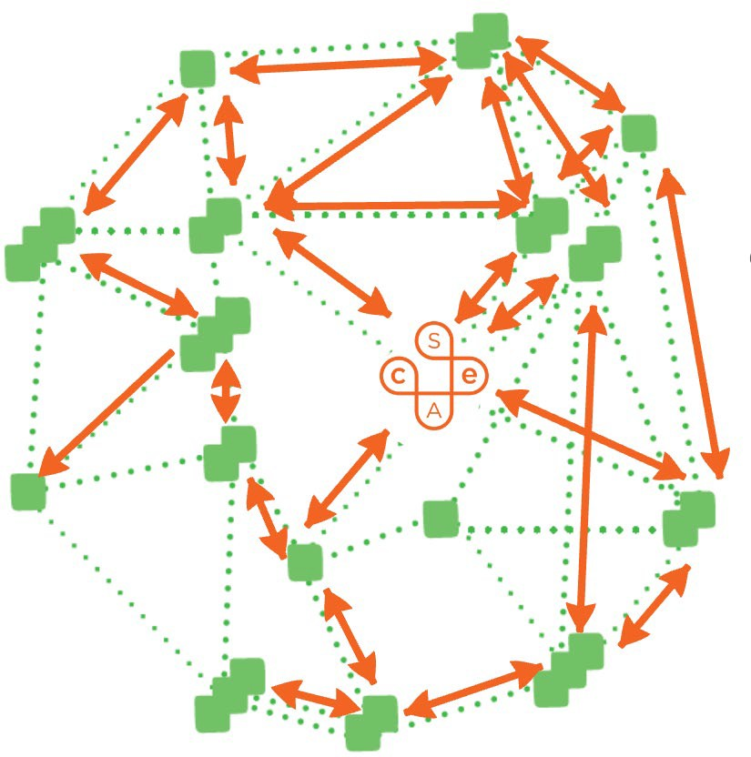
Activating Identities and Futures (AIF)
During 2023 (S1&S2)
Testing focused on
>6000
Involving school teaching and learning leaders in the implementation of professional learning for their school’s teachers
Students across SA & NT
64
Ensuring teacher practices support success for all students, including students who experience disadvantage
Schools representative of all levels of SEQ
Pedagogical change required to successfully deliver AIF across a diversity of teachers
GOVERNMENTCATHOLIC
INDEPENDENT
Role of school leadership in sponsoring and resourcing AIF

Slide 12
Learnings from EIF Implementation
More than 12,000 enrolments in EIF for 2024
2024 is the final year PLP can be delivered
Learnings schools have shared in implementing EIF
  Teachers shared they feel mostly confident in being a co-agent in their students’ learning (3.8/5)
  Teacher view that students are beginning to make decisions about their learning (3.7/5) and students can initiate some of their learning (3.6/5)
Notes:
EIF and AIF were designed to be a natural progression between them. So we wanted schools to be able to engage in the timeline – ideally your students are able to do EIF this year, with the same cohort going on to do AIF in the future.

Slide 13
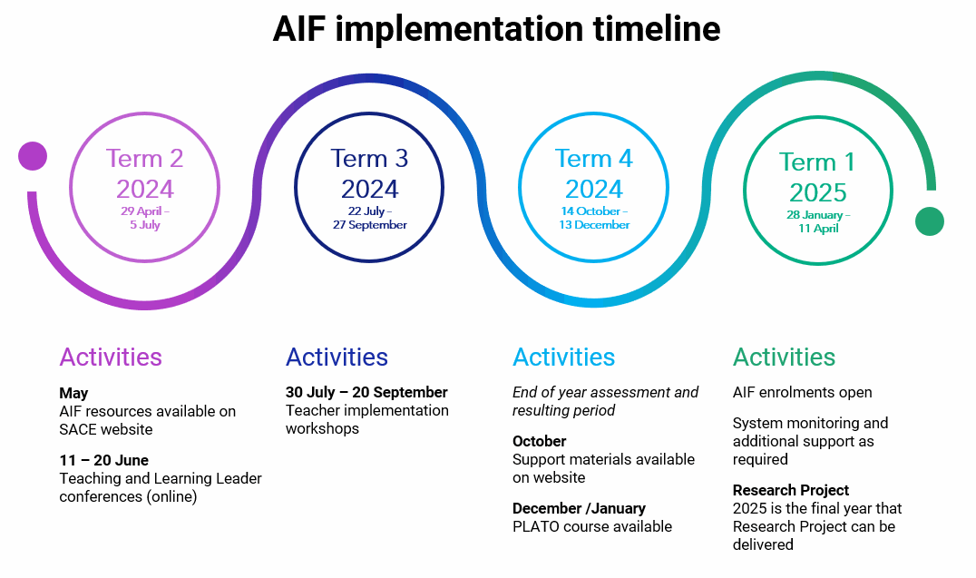
AIF implementation resources

Slide 14
AIF implementation resources
School communication pack
Letter to families
Slides for students
Subject resources
Subject Outline
FAQs on website
Modified Subject Outline
Subject blurb
Implementation support
Implementation timeline
Teaching and Learning Leader sessions
Teacher Implementation Workshops
Implementation Workshops
Student work samples

Slide 15
The relationship between EIF and AIF
Subject Outline excerpts
Exploring Identities and Futures (EIF) supports students to explore their aspirations.
The subject supports students to learn more about themselves, their place in the world, and enables them to explore and deepen their sense of belonging, identity, and connections to the world around them.
EIF prepares students for their SACE journey and the knowledge, skills, and capabilities required to be thriving learners.
As an introduction to the SACE, students will be empowered to take ownership of where their pathway leads: uncovering their interests, discovering the world, exploring work and/or further learning.
Activating Identities and Futures (AIF) aims to foster independent learning and the skills of lifelong learning in students.
AIF requires students to take greater ownership and agency over their learning as they select, test, and explore relevant strategies and perspectives in the pursuit of a Learning Goal of their choice.
They seek feedback on their learning processes, become metacognitive about their thinking, and make informed decisions to enhance their learning.
Notes:
Keeping in mind that there is an intentional relationship between EIF and AIF, here are some excerpts from the subject descriptions
EIF – learning about themselves and their preferences as learners and individuals – skills and capabilities through the context of a range of activities
Through to
AIF – reflecting and developing their strategies to learn and ways to be successful – skills and capabilities through the context of their chosen learning goal

Slide 16
The relationship between EIF and AIF
Stage 1 (EIF)
from 2024
Emerging Agency
I can choose
Emerging Self-Regulation
I am in control
Stage 2 (AIF)
from 2025
Activating Agency
I can choose and pursue
an individual path
Refining Self-Regulation
I can work out how to do it
Developing Self-Efficacy
I believe I can do it
Developing communication and reflection
I can think about my learning
and tell others what I have learnt
Exploring Metacognition
I can use how I think
to achieve my goals
Practicing Reflective Practice and Evaluative Judgement
I know and can justify my why
Notes:
The subjects work together where students go from grappling with concepts and how they play out with their own identity and experience, and then they move into AIF where they begin to apply their learning in key areas to better understand how they learn, refine their thinking and develop their capabilities.
Some projects or initial explored ideas in EIF can be extended into AIF, but there does not need to be a connection in what the focus of goals or topic choices are for students.
However, for some students, continuing or extending on the same focus area can lead to better engagement. The learning should be new and more complex, building into the stage 2 subject.

Slide 17
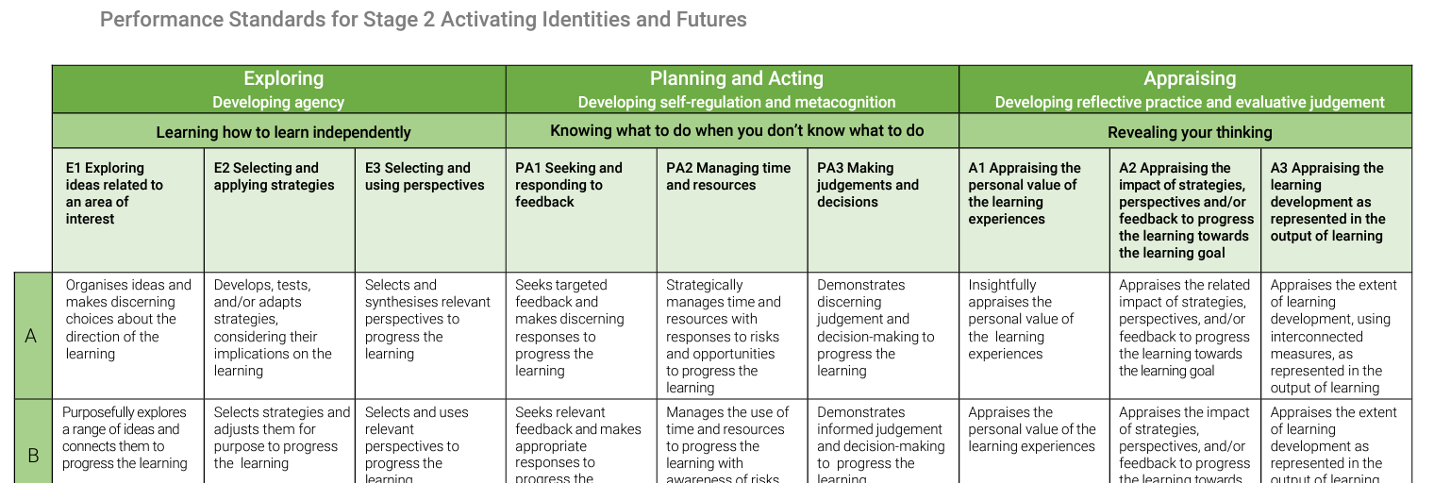
Value what you measure or measure what you value
Learning Requirements reflected in Assessment Design Criteria
Intent written in student friendly language

Slide 18
Compulsory Requirements
How will SACE completion be affected by the implementation of AIF?

Slide 19
Compulsory requirements
AIF meets the Stage 2 compulsory requirements previously met by Research Project (RP)
In 2025, SA schools can choose to teach AIF or continue to teach RP
Schools will no longer be able to enrol students in RP from 2026
Research Practices will still be available
 | 2024 | 2025 | 2026
Research Project |  | Transition | Retired
Activating Identities and Futures | Prepare | Year

Slide 20
Compulsory requirements - 2024
Students only need to complete Activating Identities and Futures OR Research Project
While EIF and AIF are designed to be a progression, students can complete any combination of Stage 1 and Stage 2 compulsories
 | Stage 1 | Stage 2
2024 | Personal Learning Plan | Research Project | ü
2024 | Personal Learning Plan | Activating Identities and Futures | ü
2025 | Exploring Identities and Futures | Activating Identities and Futures | ü
2025 | Exploring Identities and Futures | Research Project | ü

Slide 21
Compulsory requirements
The additional opportunity for students who failed Research Project to resubmit will be continued for AIF
Students can only count AIF or Research Project to the completion of their SACE
They are precluded combinations for both SACE completion and the ATAR

Slide 22
AIF Subject Intent
What’s the purpose of AIF and its structure

Slide 23

Notes:
We’ve been listening to our stakeholders about the role they want us to play in realising our new strategy that they can co-own and drive.
The goal is to create a qualification for a changing world. We are committing 20 credits of a student's SACE for the opportunity to develop a qualification for a changing world.

Slide 24

Our world today
is fast-paced and
globally connected.
The learning journey
can’t be a race with
a finishing line
anymore.
Notes:
While we don’t want to feel daunted by how fast the world is spinning, its important to acknowledge that globalisation, technology, AI, neuroscience and data are causing major disruption to how we all live, learn and work.
This is having a significant impact wellbeing and the health and wellbeing of young people is core to their ability to thrive.
The flip side is that many of these forces are also opportunities for us to work on solutions together as what we do in response.
Creating a qualification that can stand up to this level of change is crucial if we are to give young people the skills, capabilities, knowledge and understanding they need

Slide 25
Passport
to Thrive
A qualification for a changing world
The SACE Board Strategic Plan 2024–2027
Notes:
Over the last three years, working together with schools, we have been testing different approaches to teaching, learning and assessment
Our new strategic plan is like a renewed commitment to ensuring every student can thrive – rather than just survive
But we have also been identifying where we can better support you by unlocking what you need to deliver the best outcomes for young people
We have also been looking at how we can better support schools with a roadmap to enable subject renewal and the implementation of recognition

Slide 26
Underpinning pedagogical approaches
Developing capacity to initiate and progress learning
Making decisions in partnership with teachers
Teacher as co-agent in learning
Feedback on task
Feedback on process
Feedback on self-regulation
Feedback
Agency
Developing capability to think about own thinking and learning
Evaluating own processes for learning
Authentic and varied
Supporting student strength and choice
Curated for self
Natural Evidence of Learning
Metacognition

Slide 27
Assessment in AIF
School assessment
  AT1 – Portfolio (35%)
  AT2 – Progress Checks (35%)
External assessment
  AT3 – Appraisal (30%)

Slide 28
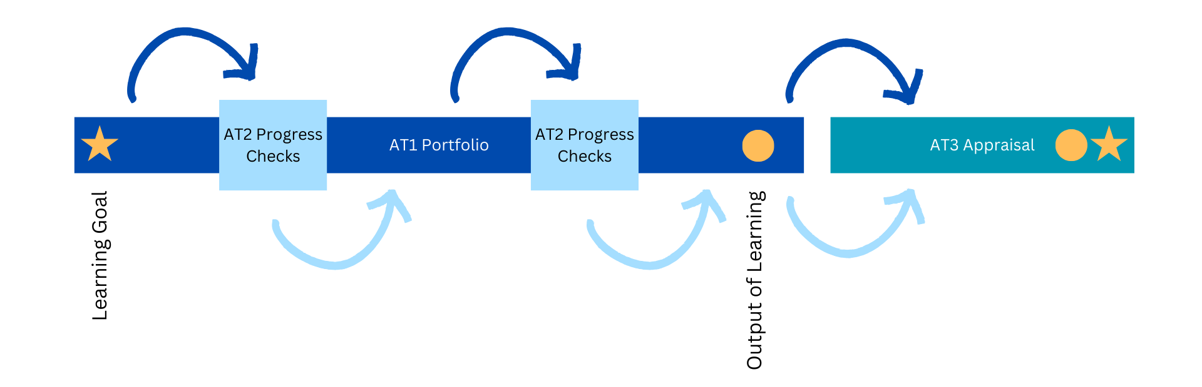
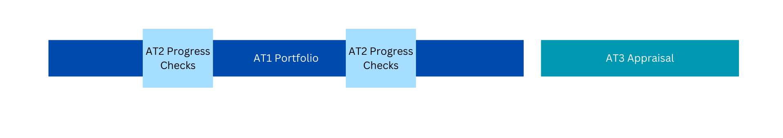
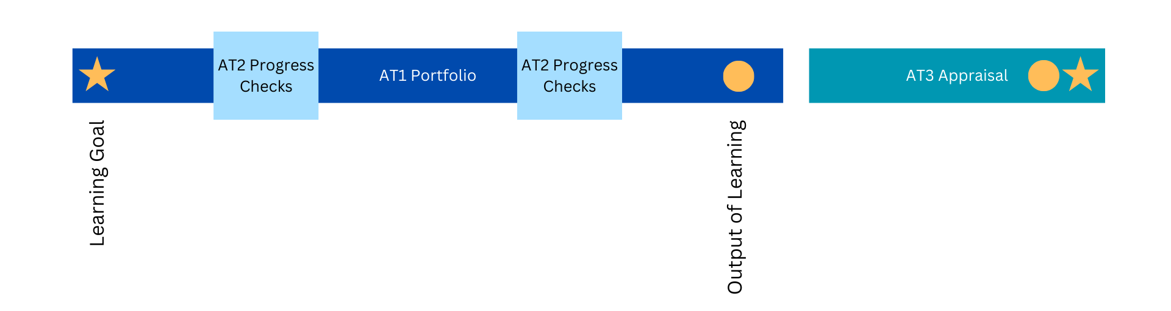
The learning goal and the output
This course is about progress towards or completion of the students’ learning goals, not the end product.
Notes:
This is an example of a process, and it seems to be the most common, or most typical experience. For the purposes of showing how the assessment types connect.
Consider how the progress checks could be both formal, informal, planned, or naturally occurring. Two are demonstrated as evenly distributed for visualisation purposes, and not indicative of recommended timing.
Students start with a learning goal. And that’s usually connected to something tangible – the output of learning. It’s not necessarily something finished, which is why we call it an ‘output’, rather than an ‘outcome’.
The output is valuable – we’re not formally assessing it, but it's important to exist and be present, for students to form part of the appraisal.

Slide 29
Agency and AIF
“Student Agency is rooted in the belief that students have the ability and the will to influence positively their own lives and the world around them. Student agency is defined as the capacity to set a goal, reflect and act responsibly to effect change“
(OECD 2030)
“It is about acting rather than being acted upon; shaping rather than being shaped; and making responsible decisions and choices rather than accepting those determined by others”
(OECD 2030)
“Having agency means participating in active learning rather than passive learning and trying to work things out for yourself. It's also being willing to experiment, learn, fail, and then try again.”
(SACE Strategic Plan 2020-2023)
Affirm students
Allow for choice
Celebrate failure, encourage risk
Respect for inherent dignity, individual autonomy including the freedom to make one’s own choices, and independence of persons”
Article 3: Convention on The Rights Of Persons With Disabilities (CRPD – UN General Assembly 2006)

Slide 30
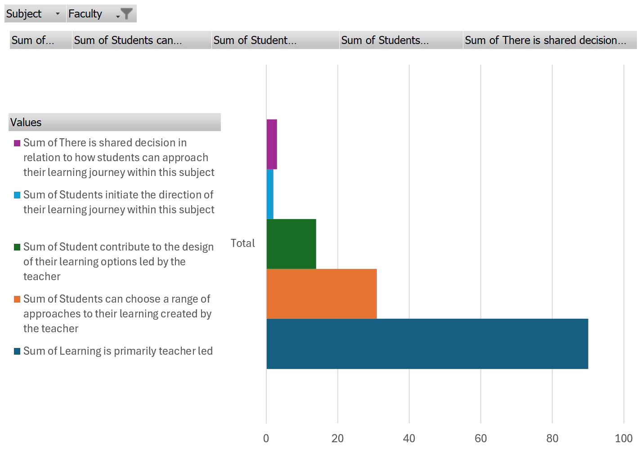
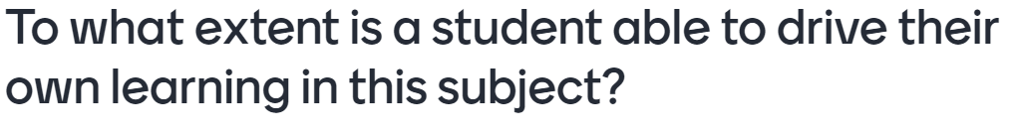
Notes:
This point-in-time data is a summary of over 650 responses from teacher at curriculum forums across all subjects

Slide 31
AIF Modified (2AFM10)
There is a modified AIF course
AIF was tested to see if students eligible for modified could achieve a C- or higher in the standard inclusive subject
Similar to EIF, AIF and AFM follow a one subject, two pathways approach
Student learning can transfer between the two courses as student moves across
Teachers will get more information about AFM at the educator workshops

Slide 32
The subject outline
On the AIF mini-site page
Encourage teachers to access and engage with the document
Both 2AIF10 and 2AFM10
Notes:
Encourage your teachers to refer to the website
We recommend starting with the subject outline prior to the workshops.

Slide 33
Operationalising AIF
What considerations are there for my site?

Slide 34
Timetabling
AIF is a 10 credit subject designed to be taught in one semester
Piloted in semester 1 (2022 and 2023)
The workload is commensurate with a one semester 10 credit subject

Slide 35
Who might be best placed to teach AIF
Schools have allocated AIF classes to teachers new to teaching SACE, teachers with and without RP experience, teachers in leadership positions, and teachers from across faculties or a range of subject matter expertise
Think about timetabling first, we know that there’s lots at play here
Notes:
Schools have allocated AIF classes to:
teachers new to teaching SACE – including new to teaching or those whose experience is in middle school
teachers with and without RP experience – some schools saying mixing the faculty brought new ideas and approaches as well as experience to the faculty
teachers in leadership positions,
and teachers from across faculties or a range of subject matter expertise

Slide 36
The relationship between EIF and AIF
Schools have used a range of timetabling and sequencing. The most common we have heard are:
  EIF in Year 10, AIF in Year 11
  EIF in Year 10, AIF in Year 12
  EIF in Year 11, AIF in Year 12
  EIF in Year 11 semester 1, AIF in Year 11 semester 2

Slide 37
Timing and sequencing
School consideration:
When are your students ready to engage with AIF?
The standard is Stage 2, and it is at the same level as other Stage 2 subjects; is your year 11 cohort ready for that?

Slide 38
Quality assurance
Front Loaded Moderation tested
Allows schools to have the standard confirmed and be present for the conversations

Slide 39
EIF and AIF Front Loaded Moderation
Builds capability within schools
Strengthens partnership and shared responsibilities
Provides timely actionable feedback
Feedback is relevant and authentic
Broaden the capability within the system
Strengthen high trust in teacher professional judgment
Professional learning and quality assurance

Slide 40
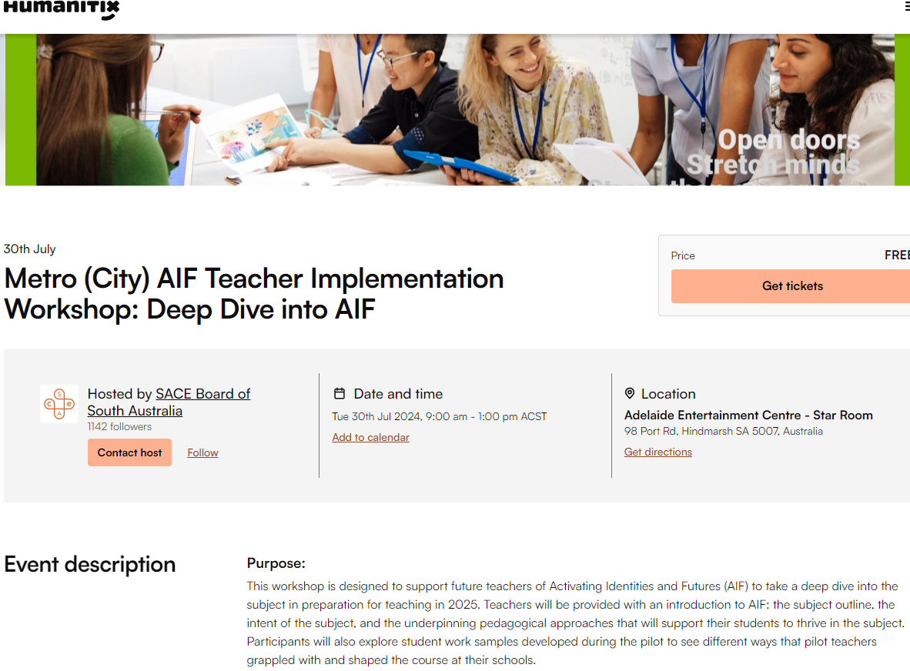
Educator Workshops and support
Prepare for implementation this year
Level of implementation support will not be the same next year
Book now for Educator Workshops (metro, regional, online)

Slide 41
Questions
Anything else on your list?

