Slide 1
PORTFOLIO
Student ……
STAGE 2 AIF
SACE NUMBER: ……..

Slide 2
PLANNING
WHAT ARE 3 THINGS YOU WOULD YOU LIKE TO LEARN ABOUT ? WHY?
WHAT ARE YOUR MAIN INTERESTS?
WHAT WOULD YOU LIKE TO LEARN MORE ABOUT? WHY?
DO YOU HAVE A PROBLEM YOU WOULD LIKE TO SOLVE?

Slide 3
PLANNING
+ What do I already know about each of the 3 topics?
+ What more do I want to learn or know about my 3 topics?
+ Which one idea is my favourite so far?

Slide 4
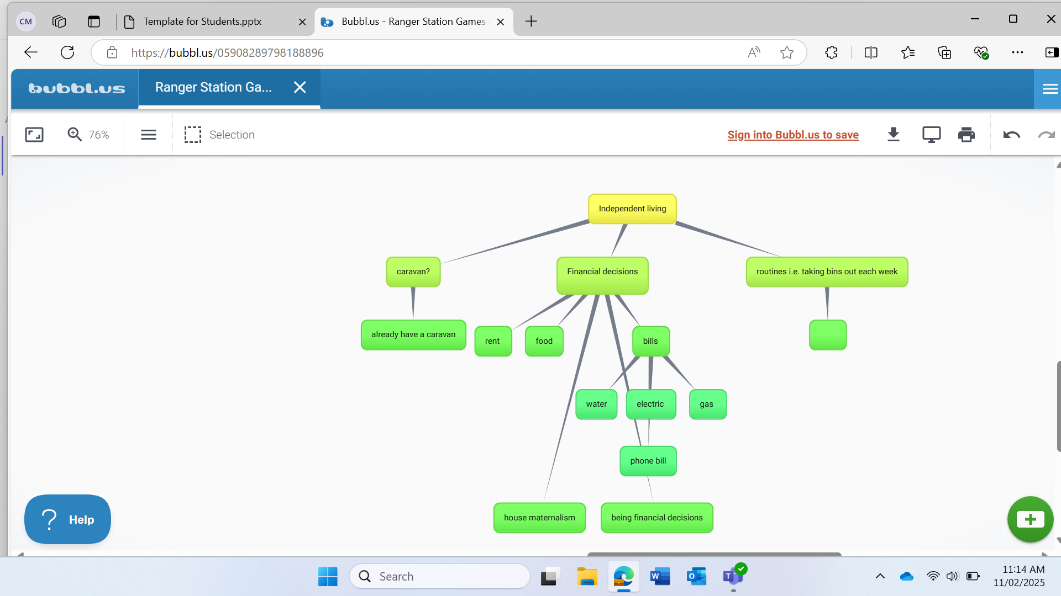
Complete 3 mindmaps for your 3 ideas on the next 3 slides. Add to them what you want to learn more about on each topic and explain why.
Mindmap 1.
Why? To have some privacy from my family. To have more control over my life.
How? Turn 18 and get senior wages. Look for a farmhand job. Need a car licence to be able to get to work. Look for a room mate. Find a rental property. Relocate to another town – Pt Lincoln – more services easier to get around.
Pros? Learn how to manage my own problems. Learn how to manage money and be financially responsible. Learn how to connect and be fair with other people.
Cons? Not having a parent to guide you. Might not be able to earn enough money to live on my own.

Slide 5
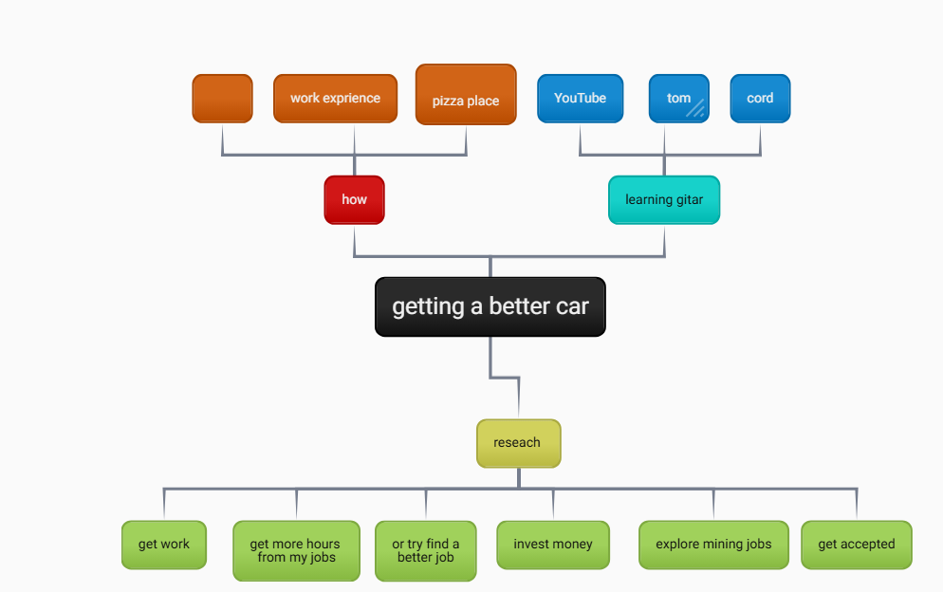
Mind map 2
Why? A faster car to be able to enter competitions.
How? Find a car for around $2000. Will need to do more work to save more money. Do some more research on the best value for money.
Pros? This will get me started to work towards getting a GT86 (car). Better car will give me more grip and more control, the lower the car the better grip it will have.
Cons? Uses more petrol. Insurance costs go up more. More expensive to run.

Slide 6
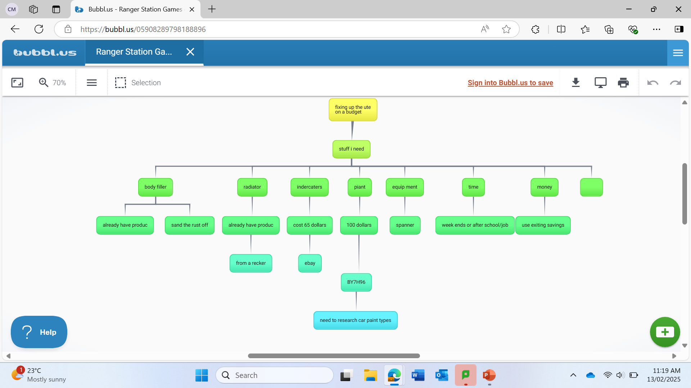
Mind map 3
Why? So I could go off road and rallying in the ute.
How? It would have been good to do it at home. I would have been able to rebuild the car
Pros? To make the car roadworthy and I could have enjoyed. Use current skills
Cons? It would be too expensive ($3000) and not enough time to do the project

Slide 7
Key Area 2:
Exploring futures and connections
Developing personal life skills and independence
Key Area 3:
Developing capabilities
Developing independent living skills
Developing and using support networks

Slide 8
Research how to live by myself and where I am going to stay. Use google, interview or survey people, Step dad, Mr ……., Centrlink
Ask an expert at Centrelink
Or ask …… at town Centrelink
how
who
Living independently
What you need
At school. Port Lincoln then city.
where
A plan create strategies to follow each week
why
when
I want to live by myself so I can get away from my brother
I have been told I am financially responsible. Now I need the knowledge of how to do it for the future
Soon as at school or home,
In class time I will make contact with people i.e. centrelink through email,

Slide 9
My Learning Goals
What are you planning to do?​
A PowerPoint of How to live independently as a young person
What are you specifically wanting to learn?​
To find out the cost to be able to do this so I know how to budget
What is your learning goal?​
A PowerPoint of How to live independently as a young person
What do you already know about this topic?​
I need a job to live independently
What strategies do you think you can use?​
Organized have good communication
How/Why​
Interview people to find out about the servicers available for independent living
How are you going to achieve feedback?​
Record interview, emails
What/whose perspectives will you use?​
My perspective, someone who is already living alone, ilsa
I would like to create a powerpoint of how to live independently as a young person, specifically wanting to find out the costs involved to do this so I know how to budget.

Slide 10
Value to self
Find the information on how to live on my own
How to live on my own
Best places to live
independence
Value to community
Pass on my knowledge to other teenagers
When I get a job to be able to afford to live independently, I will be providing a service or skills to my community.

Slide 11
STRATEGIES
Do some online research on Facebook Marketplace to see how much it costs to rent a room in Port Lincoln. Screenshot/Record information in my Powerpoint.
Research government websites for information about living independently such as Services SA – screenshot information and record it in my powerpoint
Contact Job Access (Aust Government) customer service to interview regarding support for young person with Autism trying to live independently. Have questions typed up and record answers as I go.
Contact ……. to make an appt time with her – try to make it during school time.
Create some questions for ……. for the interview – find out some information about Centrelink services and what they offer a young person to live independently. Voice record ……. responses.
Create a table of costs for living independently

Slide 12
STRENGTHS | OPPORTUNITIES
WEAKNESSES Procrastinator | THREATS

Slide 13
Week 10 | Week 11 | week1 | week2 | week3
Do some online research on Facebook Marketplace to see how much it costs to rent a room in Port Lincoln Screenshot/Record information in my Powerpoint. Research government websites for information about living independently such as Services SA – screenshot information and record it in my powerpoint | Contact Job Access (Aust Government) customer service to interview regarding support for young person with Autism trying to live independently. Have questions typed up and record answers as I go. Contact ……. to make an appt time with her – try to make it during school time. | Email …….. @eyreplus.com.au Create some questions for Ilsa for the interview – find out some information about services and what they offer a young person to live independently. Voice record …… responses. Apply the recording to the powerpoint. Record what you have learnt from the interview. | Contact a past student via email who lives in Adelaide and one who lives in (town). Create a survey of the cost of living independantly. Create a table of costs for living independently in Adelaide and (town).

Slide 14
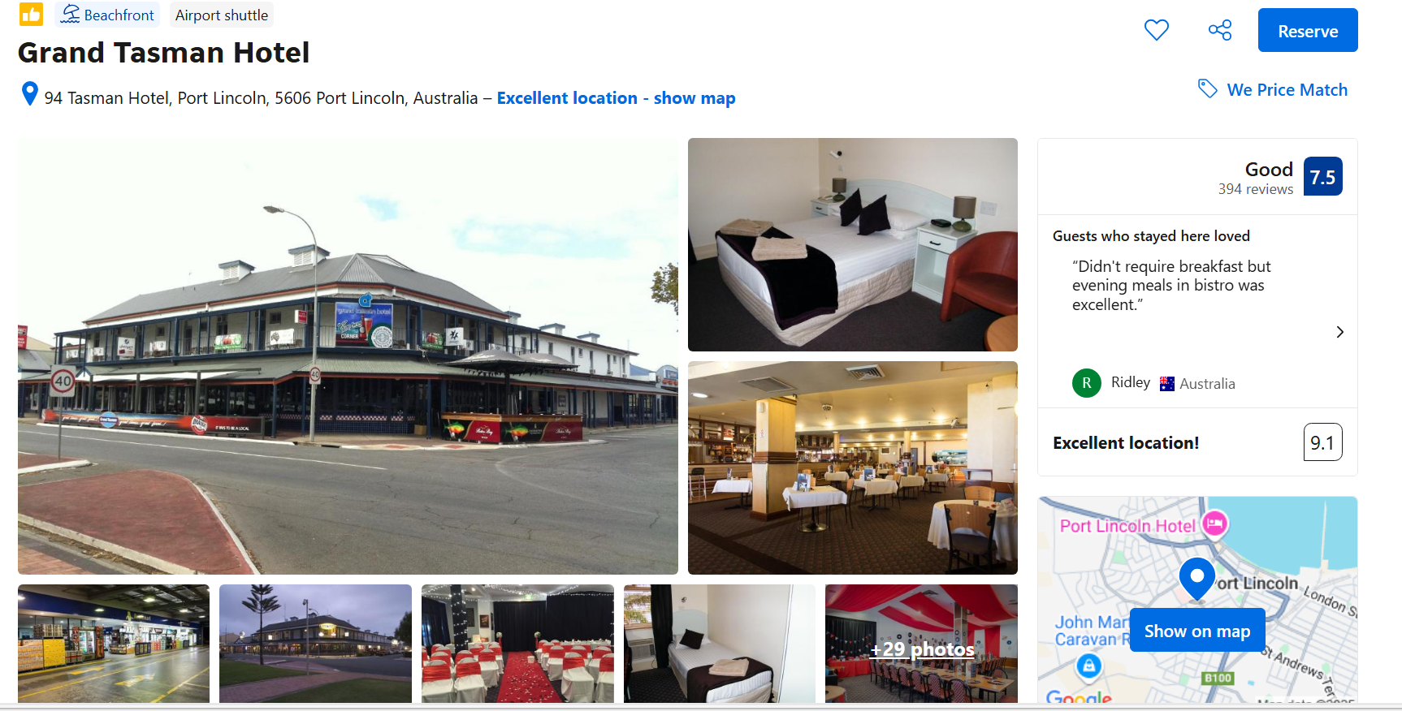
This place has a great location but at $81 a night it’s too expensive and could be too noisy as it’s a pub.

Slide 15
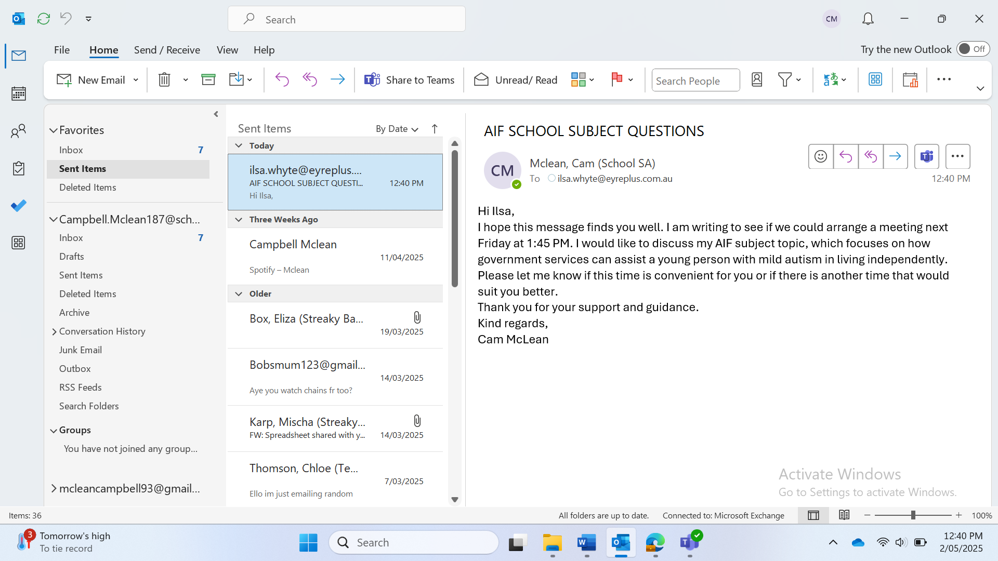

Slide 16
QUESTIONS FOR …….
Eligibility Criteria:
  What are the eligibility criteria for a young person with mild autism to access Centrelink services?
Available Services:
  What specific services and support does Centrelink offer to assist young people with mild autism in living independently?
Financial Assistance:
  Can you explain the types of financial assistance available through Centrelink for individuals with autism?
Application Process:
  What is the process for applying for these services, and are there any specific documents required?
Support Programs:
  Are there any programs or workshops provided by Centrelink that focus on developing independent living skills?
Additional Resources:
  Does Centrelink collaborate with other organisations to provide additional support or resources?
Challenges and Solutions:
  What are some common challenges faced by young people with mild autism when accessing Centrelink services, and how can they be addressed?

Slide 17
How much rent do you pay a week?
How much do you spend on food?
How much do you pay on bills such as water bill electric gas?
Was it difficult finding accommodation?
Do you use any gov services to assist with living?
Are you employed?

Slide 18
ATTACH ISLA'S INTERVIEW
MAIN POINTS FROM INTERVIEW

Slide 19
Week 3 | Week 4 | Week 5 | Week 6 | Week 7
Meet with …… and receive info about services to help with independent living Email …… and ….. with questions about living expenses Review information from Ilsa and make a plan to contact the services she provided | Contact Autism Connect regarding independent living skills, e.g cooking, cleaning, paying bills, managing money and general transition to independent living requirements Look at the disability gateway website to look for living options plus other housing resources provided by autism connect | Create a budget with a goal for independent living Discuss with mum if I have an NDIS support person and if I am on a NDIS plan. If I do I need to get the contact details from mum so I can engage with them to see what support they provide to help me transition from living with my parents to living independently in a shared house. | Look at apps that can be used to support independent young people living with Autism Look at peer support groups – Autism Connect have different social groups that a young person could join | Look at peer support groups – Autism Connect have different social groups that a young person could join

Slide 20
Hi Cam
No problem happy to help, Let me know if u need me to answer anything else.
How much rent do you pay a week?
$125 per person and I have 1 other housemate so we pay a combined amount of $250 per week.
How much do you spend on food?
I would estimate approximately $70-100 per week on groceries.
How much do you pay on bills such as water, electric, or gas?
All the bills are split between the 3 units on the block.
Water is usually $50 a quarter (which means a quarter is a 3 monthly basis)
Electricity is usually $50 a quarter as well
And we haven't had to pay for gas at this point.
Was it difficult finding accommodation?
I think finding accommodation can be difficult, but for me I honestly just met people who had connections or knew other people with a spare room etc.
Do you use any gov services to assist with living?
I currently do not but am in the process of submitting a claim for a youth allowance because i'm studying at university full time.
Are you employed?
Yess, i am employed
Email from ………

Slide 21
Email from …….
Hi ……..,
I would be happy to answer your questions for your AIF subject.
1. I currently pay $145 a week for rent.
2. I probably spent on average about $100 a week on food. It’s sometimes more or less.
3. It changes every quarter but my last bill was about $300 for gas, power and water. I live with 2 other girls so we split it between the 3 of us evenly.
4. I was really lucky when finding my accomodation. I didn’t find it to be difficult but I also rent privately and not through real estate, which is especially hard to find housing as you are competing against families of 4 who need it more than I do and have a more stable income :)
5. I currently receive about $150 a fortnight through Centrelink. Although this is based off of my mum and dad’s income unfortunately because I’m not over the age of 22, so it’s not much but it’s better than nothing. I have recently stopped studying though so these payments will stop as well.
6. I am currently employed casually at a cafe. I work about 20 hours a week at the moment.
Let me know if you have any further questions! Good luck with your AIF subject!
……….. ☺️

Slide 22
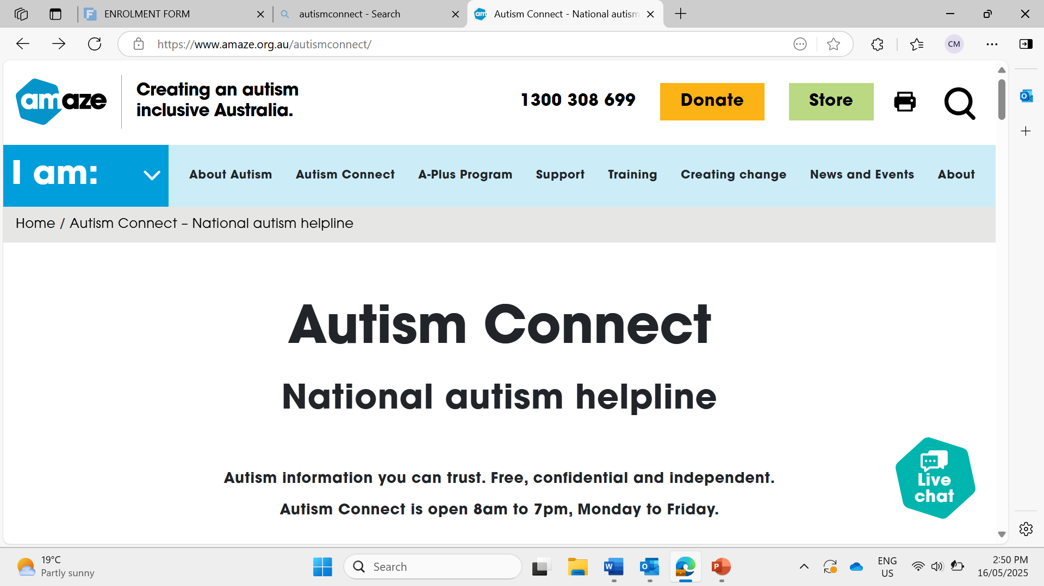
……. recommended me this web site to help me with living independently and to connect me to the services I need.

Slide 23
Autism Connect advisors offer expert advice in many areas, including:
exploring autism and Autistic identity
assessment and diagnosis support
school and education
the NDIS
transition to employment
behaviour and communication strategies
referrals to services peer support connections,
finding autism-friendly places and events, and
making environments accessible.
It is a phone service to help when leaving home.
The phone numberr is Autism Connect on 1300 308 699.

Slide 24
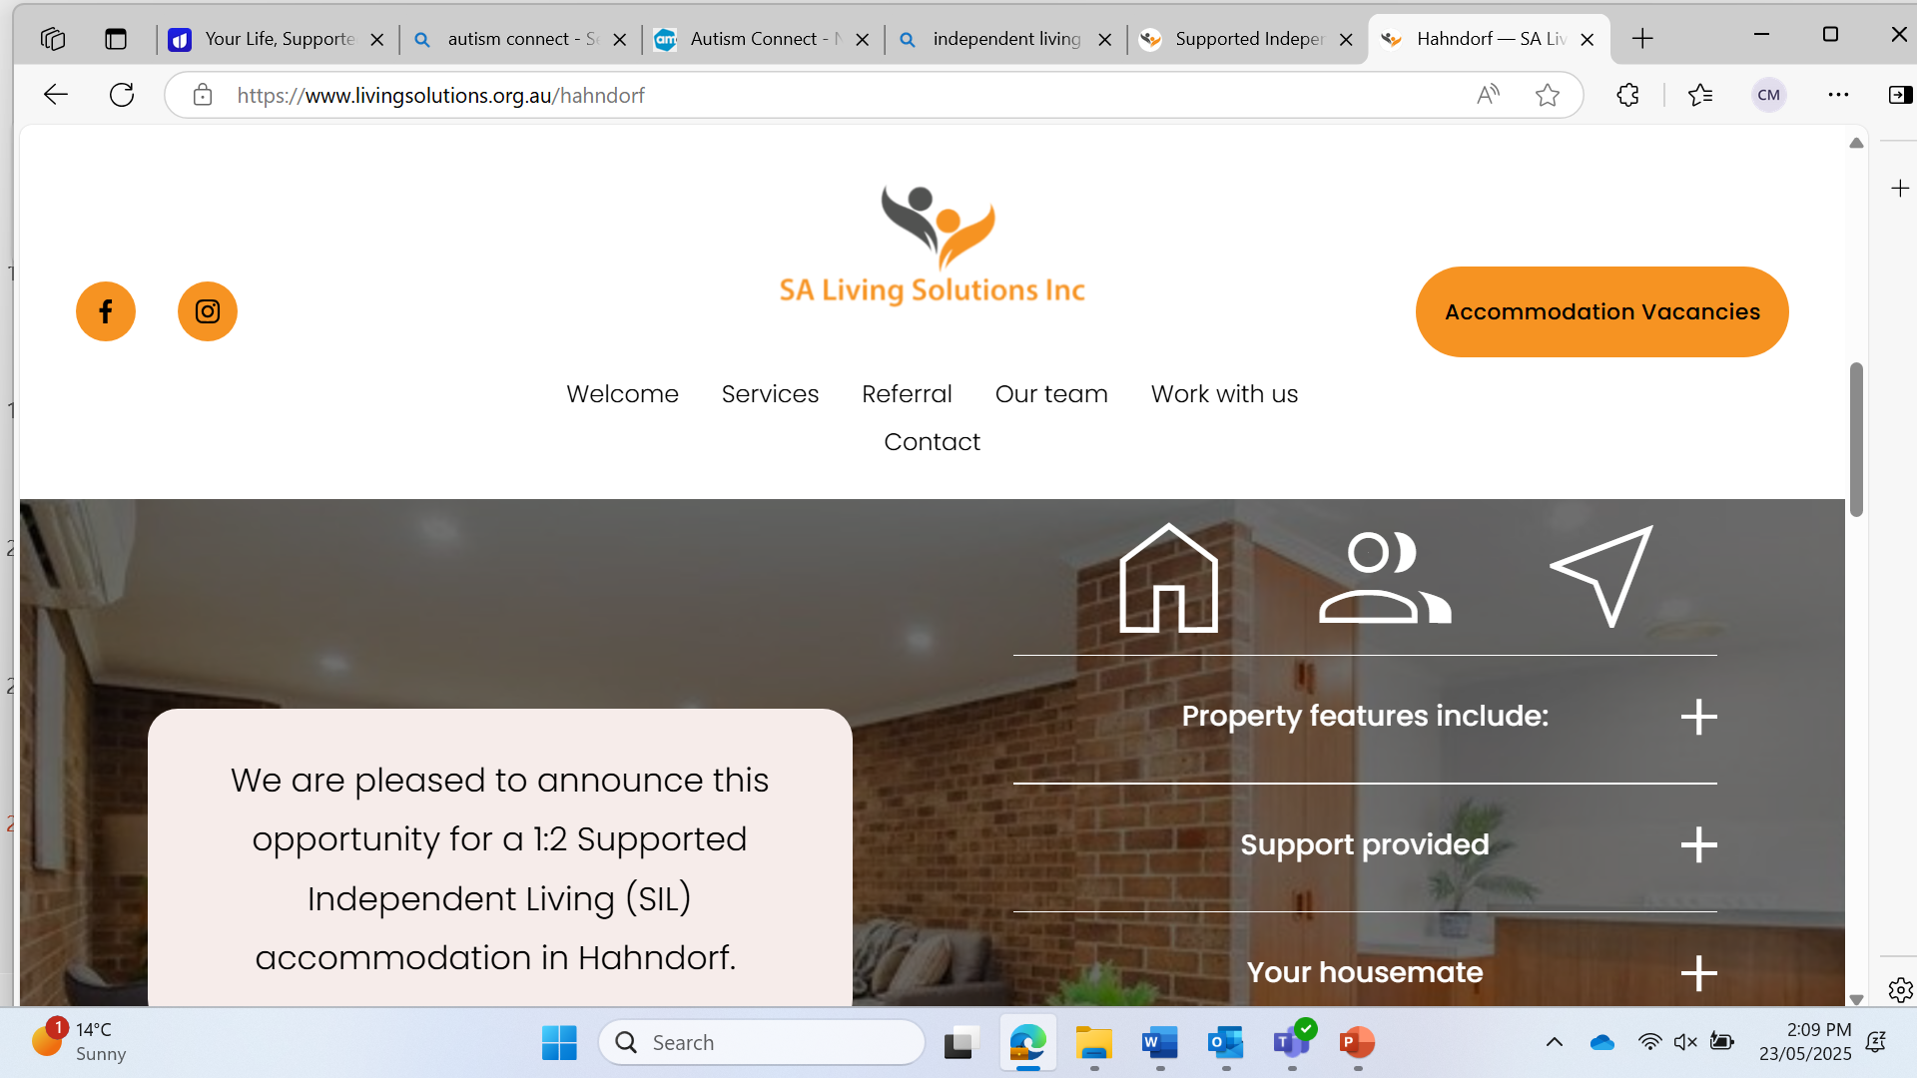
This web site dose not suit me as I can clean up after myself and is for people with higher needs disabilities.

Slide 25
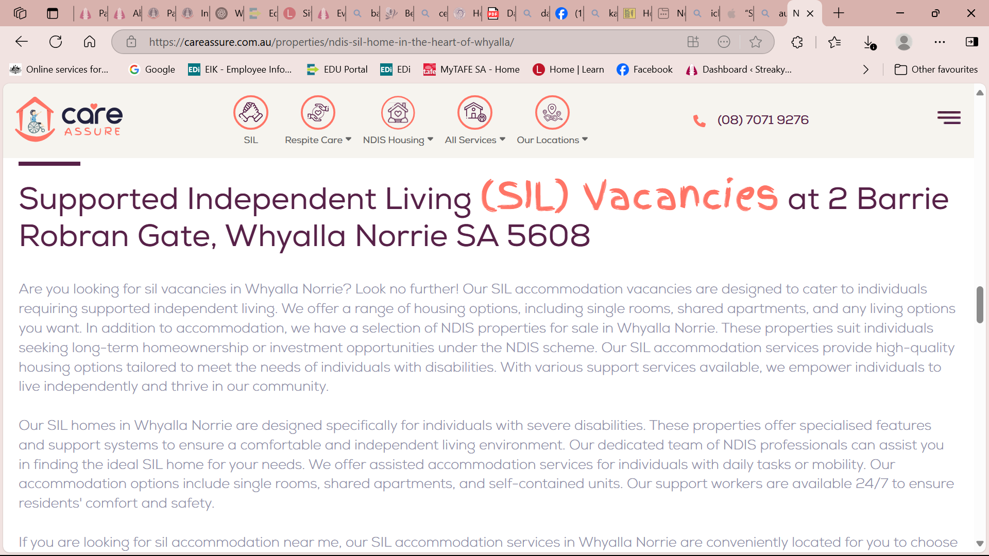
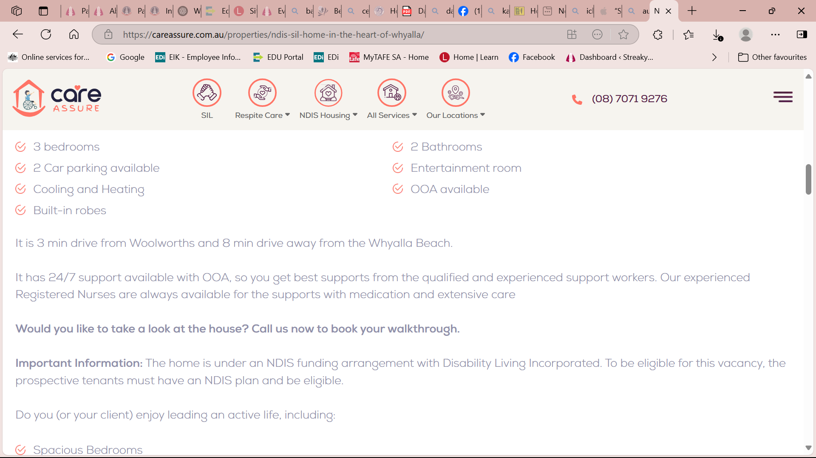
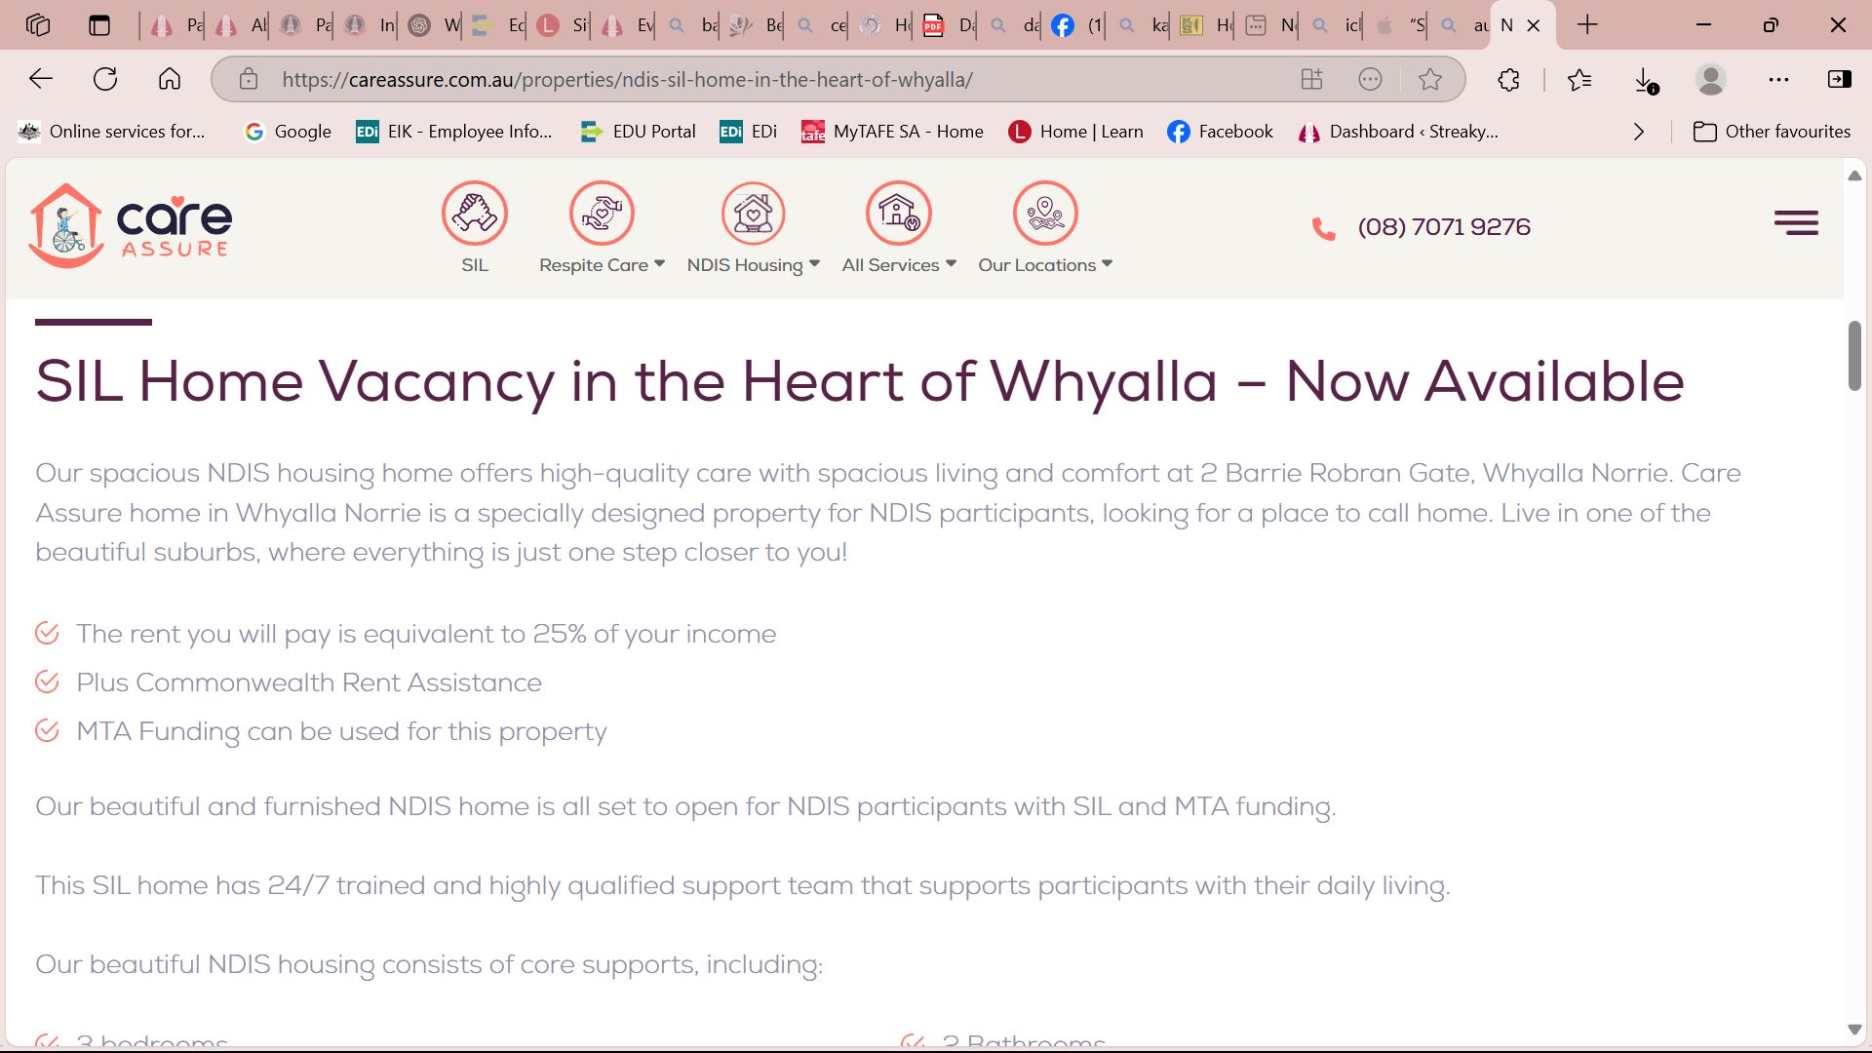
This is a great resource for independent living options, because it provides opportunities for me to live independently and have my own privacy, whilst sharing the costs of living.
These are great housing options but first I need to find out if I am on an NDIS plan, as in order to live in these houses I have to be on a plan. I will need to ask my mum if I am on a plan and then contact my NDIS support co-ordinator to get further advice on this.

Slide 26
NDIS
NDIS Support Co-Ordinator – katie
NDIS Plan –mild autism
Contact Details – Ph: 04

Slide 27
BUDGET FOR INDEPENDENT LIVING OF A YOUNG PERSON

Slide 28
Jayda and Gidgets budgets

Slide 29
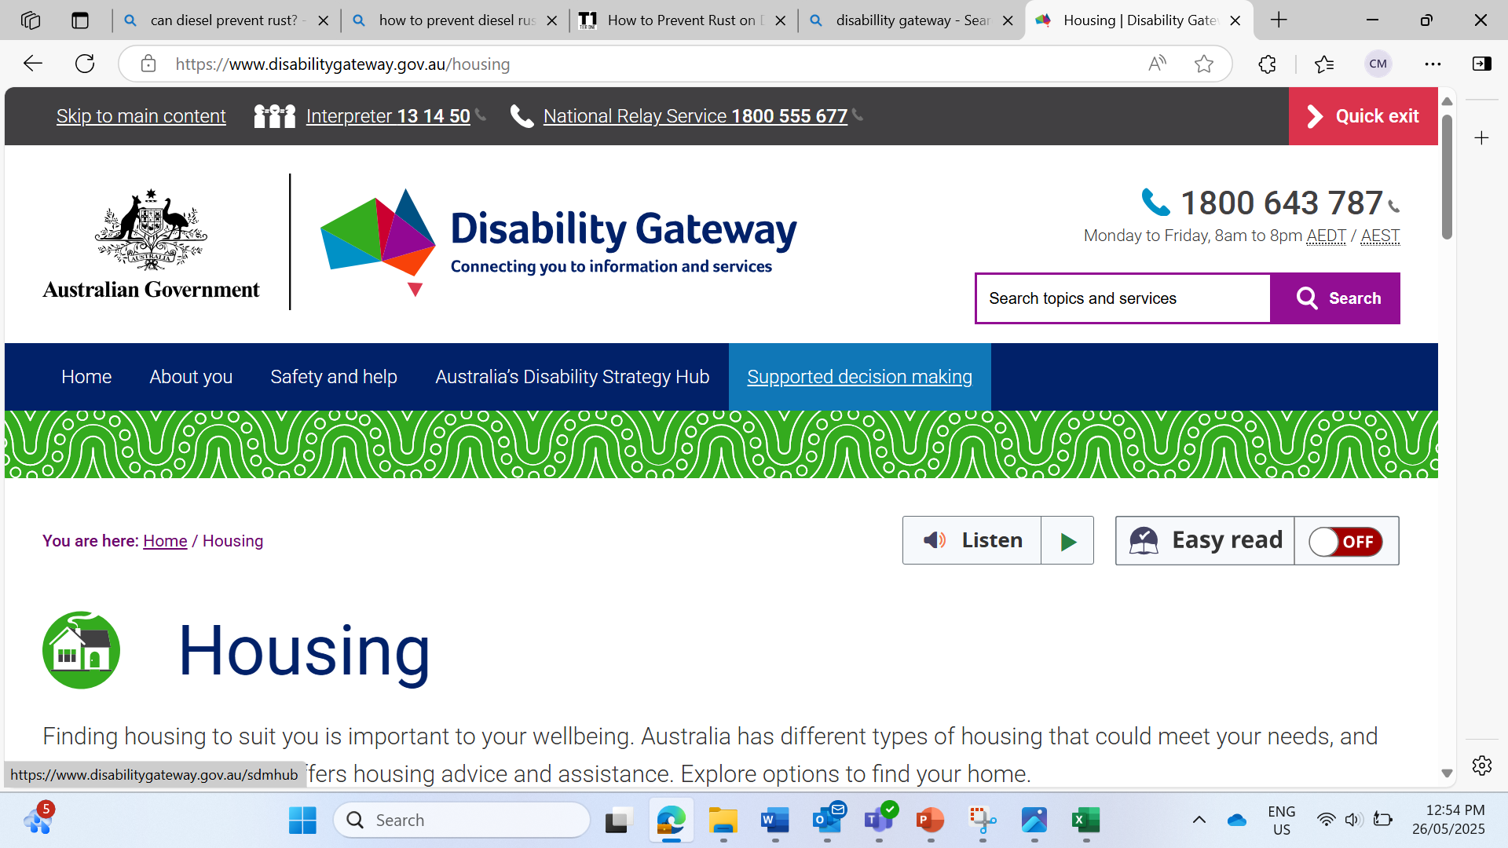
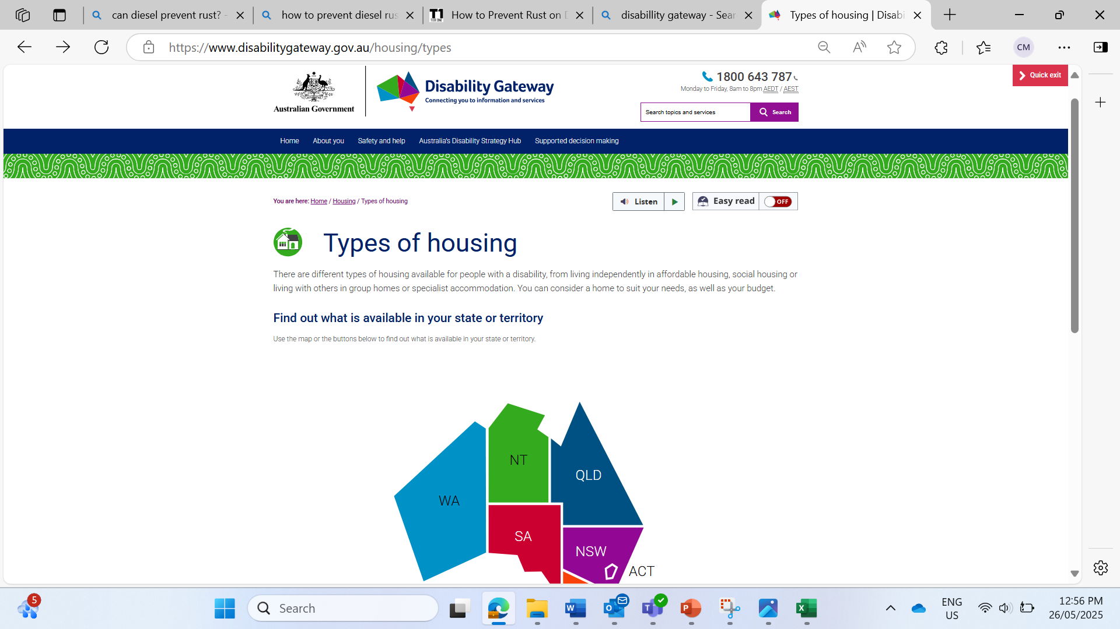
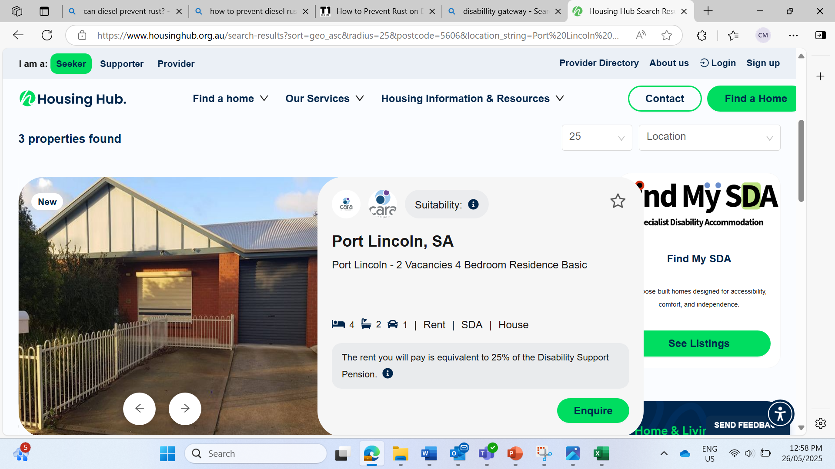

Slide 30
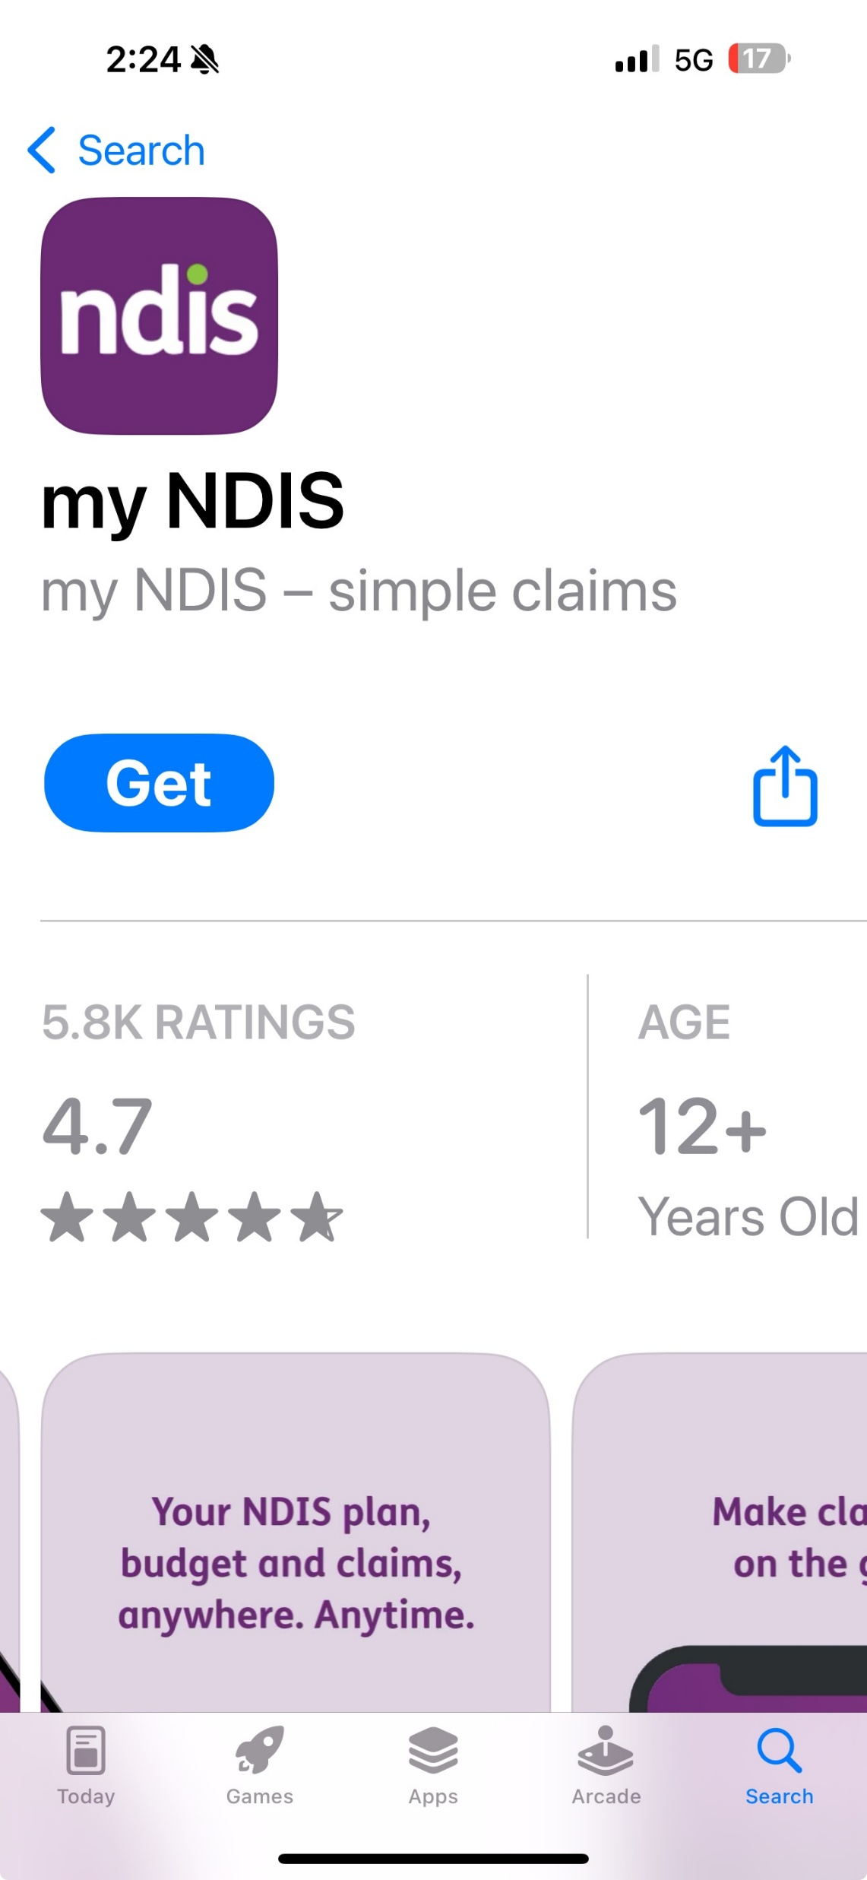
Lets you manage your Ndis plans on the go from your Iphone Allows you to make claims, check your balance and connects directly to my gov

Slide 31
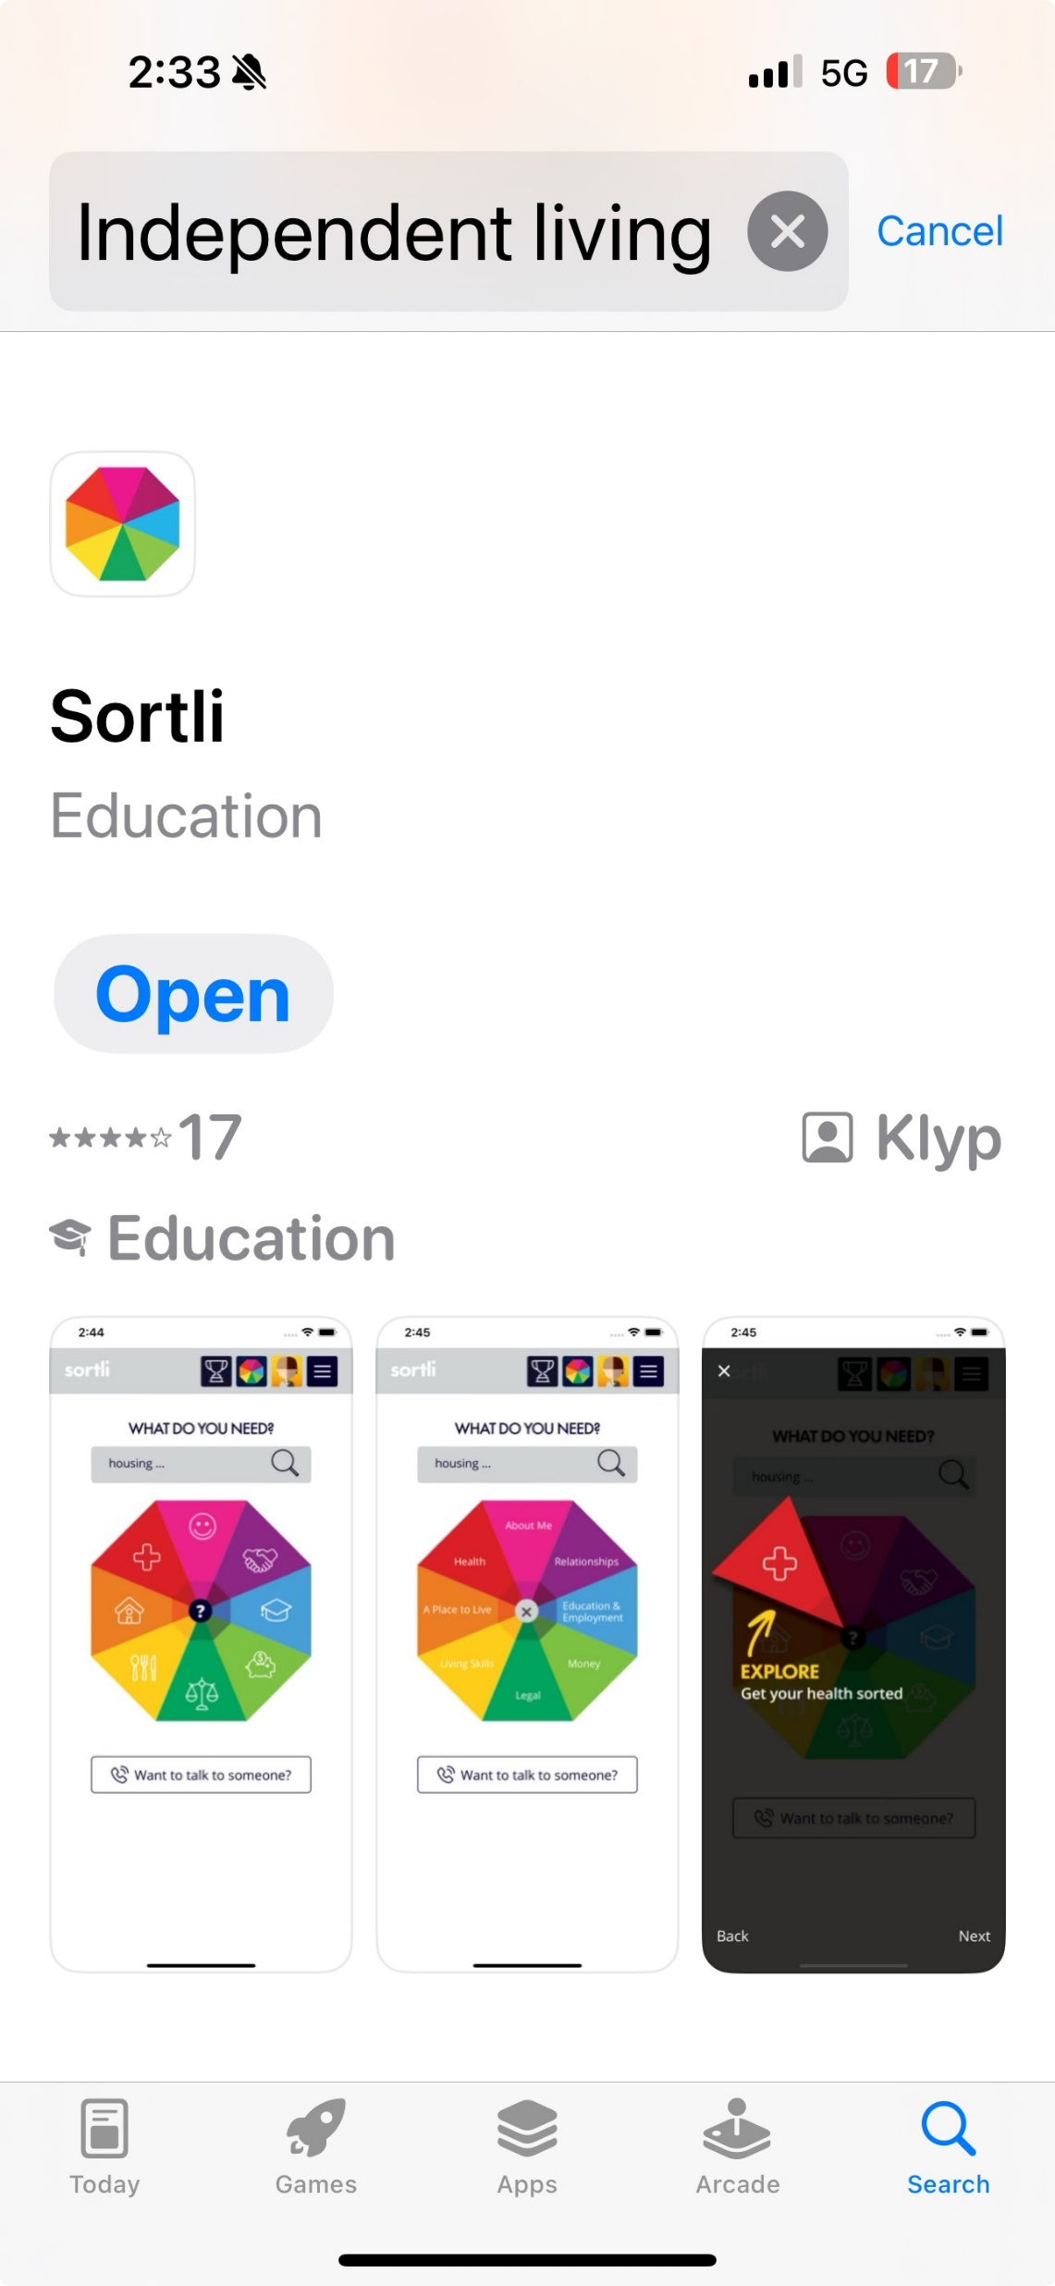
SORTLI APP
An app for young people to transition to independent living
Has 8 categories that might help a young person with information
Housing
Health and Wellbeing
Identity
Relationships
Education & Employment
Money/Budget
Legal Issues
Life Skills
Looks like it’s a helpful app with lots of relevant and helpful services, can set personal goals and find the information to help achieve them

Slide 32
SORTLI APP BUDGETTING If you would like to manage your budget by yourself, look at what bills and expenses you have, such as rent, electricity, phone, food and personal expenses (travel, entertainment). Look at when these bills come in – fortnightly, monthly, quarterly? Decide on how often and how much money you are going to put towards each account (e.g., power $10.00 per week, rent $250.00 per week). By putting aside small amounts of money every time you are paid, you are less likely to experience“bill shock” – when a high cost bill catches you by surprise – making it more likely you will have to go into other funds to pay for it. One suggestion is to keep your bill money, your food money and your spending money all separately. This will ensure that you won’t get tempted to spend your bill money on extra food, or your food money on going out on the weekend. It may take a couple of months to work out how much money you need to spend each week, but you could start keeping track of how much you spend before you move out. A budget sheet is a good way to help you organise your own money. A budget should always be reviewed every month or so to make sure you’re on track. 3 MAIN POINTS Budget separating needs and wants – categorise spending e.g. bill money, food money and spending money Decide on how often and how much money you are going to put towards each account e.g. weekly, fortnightly etc and $100, $200 etc Keep a budget sheet to stay on track

Slide 33
SORTLI JOBS – I NEED HELP TO GET A JOB
3 MAIN POINTS
Centrelink Employment Services
Help for young people with a disability – Services Australia – register through Centrelink Employment Services – this program will be replaced late in 2025 by Inclusive Employment Australia
get ready to work
train in specific job skills
write your resume
train in interview skills
look for jobs that suit you.
2. Job Access
Give help searching for jobs or creating resumes
Help to choose the right job – Career Explorer website Your Career – explore job opportunities, pathways and vacancies
3. Might need an Employment Service Assessment – assesses your barriers to work, capacity to work and types of employment that will be suitable

Slide 34
SORTLI JOBS – A PLACE TO LIVE
I need to apply for public housing
SA.GOV.AU - Register for housing – to register for public housing
  Check if you are eligible.
  Confirm the types of housing you want to live in.
  Use your Housing Connect account to register for housing.
  Don't have a Housing Connect account? Set up an account.
  Log in with Digital ID

Slide 35
BUDGET FROM BOSS – LOUIS

Slide 36
Key Area 5
Communicating and reflecting on learning

Slide 37
​
Reflecting on your learning experiences
I have learned that I can find reliable information about living independently by My employer helps me to manage money and fuel economy. I have also sourced the Money Smart government website which is a useful tool for budgeting.
One effective way I discovered to gather information is by using resources such as The Money Smart website for budgeting. Louis Robinson my boss for guidance and support. Ilsa Whyte, employment consultant at Eyre Plus, provided valuable information about special services for people with Autism, such as the Autism Connect website. She also provided a contact from Autism Connect that could assist with helping me find information and support with independent living.

Slide 38
3. I realised that asking questions and seeking advice from experts help me by To manage my money better and set budgets for food, bills and rent more accurately.
4. Researching has taught me I have to be over 18 and living independently to gain certain benefits such as Centrelink payments like rent assistance and job seeker. It has taught me how to handle difficult financial situations. I have also learnt that there is no disability government housing support in (town), however places such as Port Lincoln and Whyalla have disability housing.

Slide 39
5. Speaking to experts has been helpful because It has helped me with saving for my future. I have learnt some skills to help me when I move out of home such as doing my own car repairs to save money. It has also helped me to budget and make smarter choices when grocery shopping and fuel purchases.

Slide 40
​
​
Identifying growth and/or progress in learning
When I need support to help me live independently, I can contact My Louis Robinson for support. Family members in Port Lincoln. NDIS Services, Autism Connect, Centrelink.
I am beginning to understand the importance of managing personal finances by learning about Always having back up money incase you get stuck, for example, my car could break down or I have a higher bill unexpectedly such as electricity.
I am learning about the responsibilities involved in maintaining a household, such as Keeping it clean and tidy, maintaining it with repairing anything that breaks, keeping on top of bills. Cooking my own meals, doing the dishes.

Slide 41
4. Some of the things I now know about living independently are Being responsible for your own behaviour. Make sure you have reliable transport to get to work. Having a secure income.
5. I need to find out more about End of year financial processes such as taxation and superannuation.
6. I will present my learning as A Presentation

Slide 42
REFLECTION

Slide 43
WHAT DID I LEARN IN AIF?
How to manage bills
How to be on time with payments
Have at least $1000 sitting as emergency fund
Budgeting 50% to bill and needs 25% to wants 25% to saving
Manage food storage by putting dates and labels on food products
Keep rental houses clean or I will be evicted
Websites to find housing
An app called Sortli
$60 a week, $240 a month – I am currently paying

Slide 44
MORE THAT I LEARNED
How to write a professional email
How to get a job
BUDGETING
Finding HELPFUL APPS AND WEBSITES

Slide 45
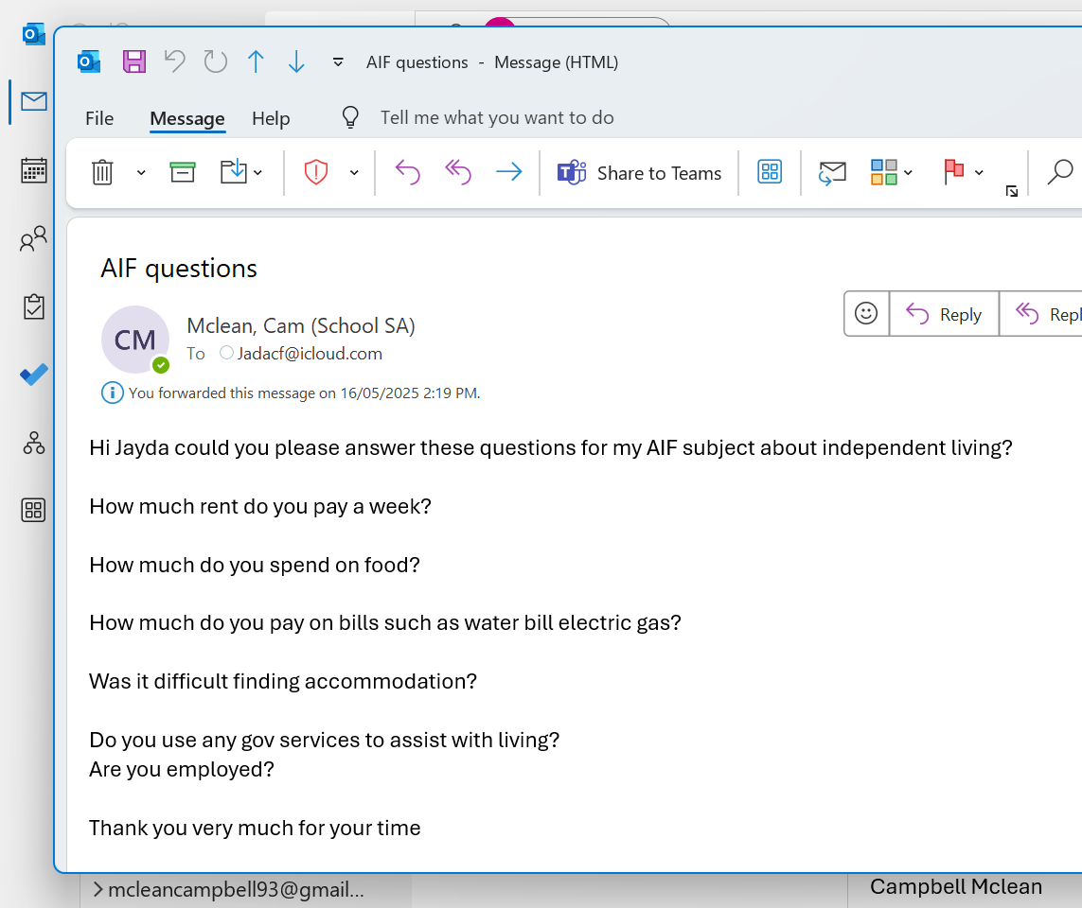
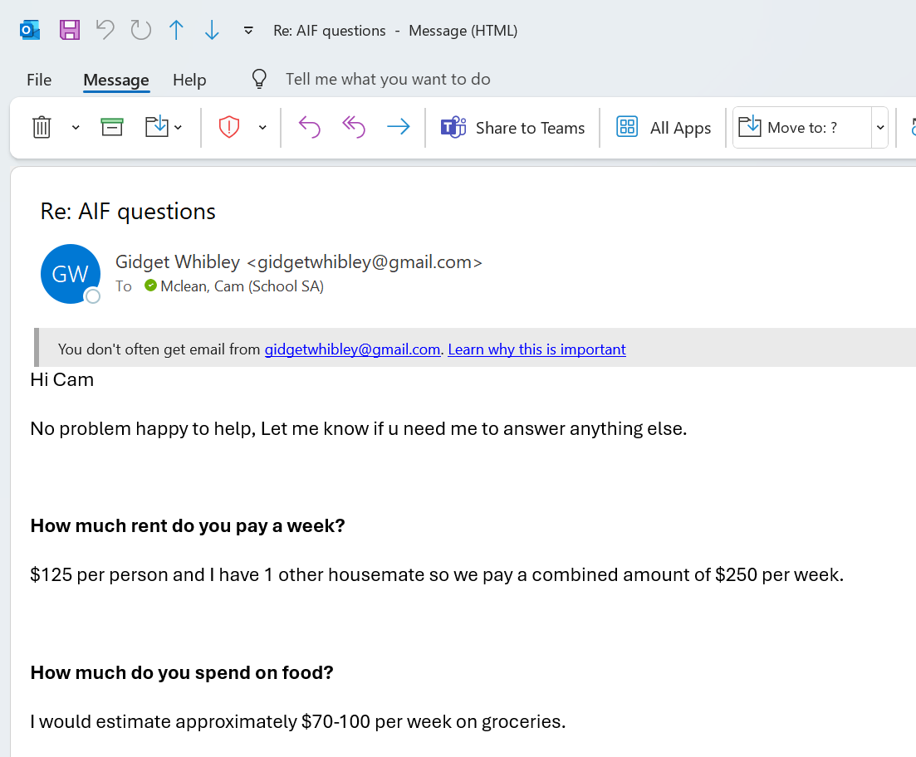
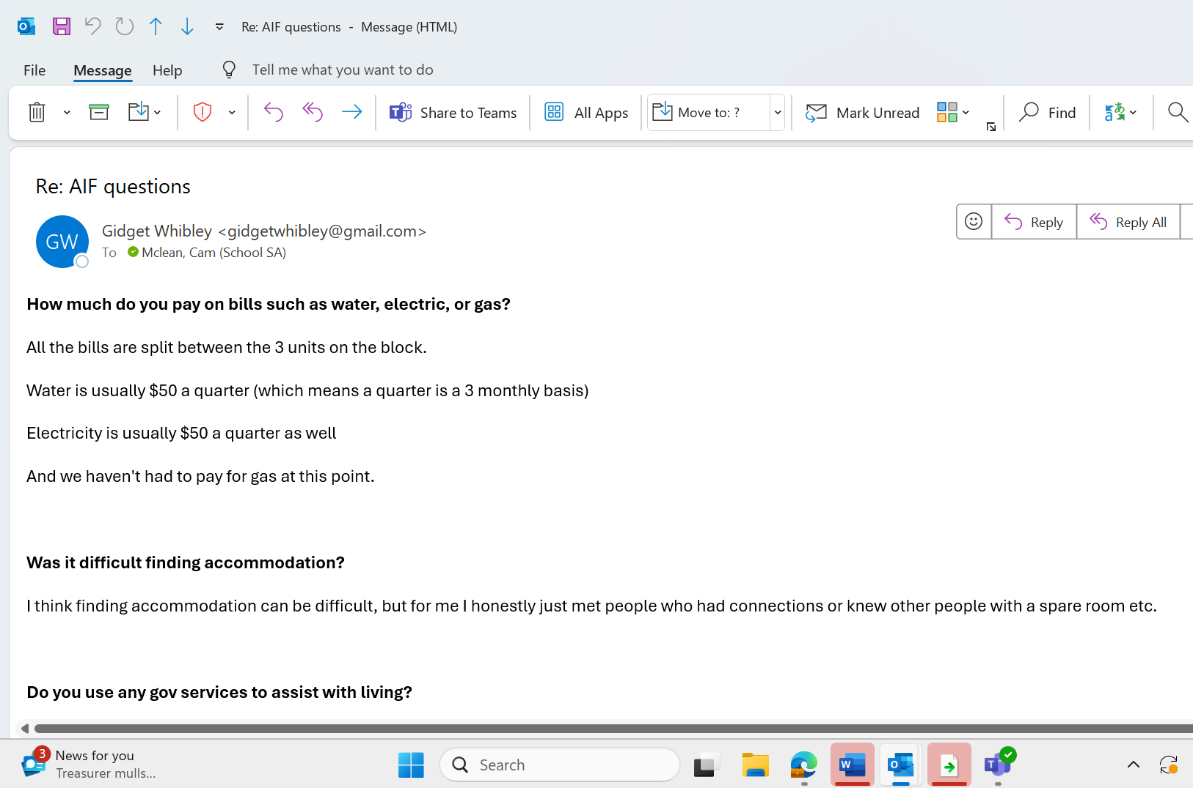
How did you improve your communication skills in AIF?
I talked to Mel Frick
Email to make contact with people like Ilsa, Jada and Gidget
I sent questions to people interviewed so they researched information before I went to the interview. I felt confident talking face to face with Ilsa.

Slide 46
How did you change your communication style for different people and situations?
Yes
When speaking to …….. I talk to him like a friend, not a boss. I feel like I can ask him anything and he really listens.
When speaking to …….. I needed to speak professionally, so I had to not joke around, get to the point so I wasn’t wasting her time and shook her hand and thanked her for the interview.
I thanked …….. for her answers at work

Slide 47
How did you use different technologies to communicate well?
I used email on my phone and laptop.
When writing an email I needed to reread it and get it checked before sending to make sure it was professional

Slide 48
How did you share your choices and decisions with others?
i tell them the plan and ask them for there opioin if they think it’s a good idea then I do it if its bad I asked them what I can make it better

Slide 49
How did you notice your growth or progress in learning?
It’s a better way for me to learn by talking to people and websites Bc with people I hear the word they speak and with web site I see a lot of info

Slide 50
How did you ask for and use advice in your learning?
I asked …… from school, …… my boss and ……. from (town) Visitor Centre (Centrelink agency)
I asked 3 people the cost of their weekly budget after looking at the Money Smart.
After speaking to …… I researched Money Smart, Autism Helpline and My NDIS app which were all useful

Slide 51
