Slide 1

Notes:
Acknowledgment of Country – Elizabeth close triptych entitled Shared Journey; One Path. The panels respectively represent agency, belonging and growth.

Slide 2
Welcome to the
AIF Modified Teacher Implementation Workshop

Slide 3



Workshop Purpose
Develop an understanding of the intent of AIF and AIF: Modified
Develop understanding of the concepts that underpin AIF: Modified
Develop understanding of the assessment requirements and what student work can look like.

Slide 4



OFFICIAL
Why is now the time for Activating Identities and Futures?
How did we get here?

Slide 5

Stage 2 Review:
to investigate what secondary education should look like for current and future generation of students
Passport to Thrive
AIF Pilot 1:
>1000 students
19 schools
2018
2020
2022
2023
2024
2025
SACE strategic plan:
Thrive
Elements of Thrive
Capabilities
Pilot Projects established
AIF Pilot 2:
>4000 students
63 schools
SA/NT
All SEQs
All Sectors
Modified option
AIF available to all schools
(last year to teach RP)
Notes:
So back in 2018 there was a review from the SA government who gave us some strong direction to look at what secondary education should look like, and more importantly, how the compulsory aspects of the SACE (PLP and RP) prepared students for the life ahead of them.
In 2020, we launched a strategic plan that built on research that showed creating space to deliberately support students to develop transferrable capabilities for a world beyond school is what would best enable them to thrive..
We established EIF, AIF, and the Learner Profile and Capabilities as pilot projects, and AIF went through its first pilot in 2022.
In 2023, we’ve seen a broad cross-section of more than 6000 students enrolled in AIF who have helped us test what would best allow this subject to deliver on its promise of enabling greater student agency as a vehicle to learn about learning.
That brings us to the SACE Board’s recently unveiled strategic plan, which seeks to deliver a passport to thrive – that is, students who complete the SACE possessing the ability to know what do when they don’t know what to do.
And then the reason we’re all here: 2025 is the year in which all students will have the opportunity to engage in AIF and AIF Modified

Slide 6
Say hello!
Take the time to introduce yourselves to the people at your table.
Discuss what you think the intent of Activating Identities and Futures is.

Slide 7
Stage 2 AIF
Refining self-regulation
I can work out how to do it
Stage 2 AIF Modified
Further developing agency
My choices are important
Exploring Metacognition
I can use how I think to achieve my goals
Practicing Reflective Practice and Evaluative Judgement
I know and can justify my why
Exploring future capabilities
I can build skills and connections to the world
Developing communication
I can communicate to show my learning the way I prefer
Practicing co-regulation and developing independence
I can access help and help myself
Activating agency
I can choose and pursue an individual path
AIF and AIF Modified
Intent
Notes:
There is a clear connection between AIF and AIF Modified, as shown through the links here. This framing was also co-developed with teachers from a range of modified settings, to ensure that there is inclusivity for all students.
In Stage 2 AIF, the intent includes activating agency, refining self-regulation, exploring metacognition and practicing reflective practice and evaluative judgement. This informs the drivers and intent of the course. This is similar in AIF Modified, where students further develop agency, practice co-regulation, explore future capabilities and develop communication.
In consultation with pilot schools, we saw that teachers and students found a focus on capabilities instead of exclusively metacognition was likely more valuable and inclusive. As such, you will see later this morning that Key Area 3: Developing capabilities has elements of metacognition to it, such as practicing decision making, or developing strategies to achieve personal learning, while still providing a broader range of focus areas for all students who may be engaged with the modified subject
For example, you may have a student in your classroom with extensive adjustments, where focusing on the effectiveness of their thinking doesn’t serve their best interests. You may have a student accessing Modified subjects in a mainstream setting, where the discussion of metacognition is relevant to all students in the classroom, including them.
For those who have had experience with a SACE modified subject previously, there is innovation in the way that AIF Modified can be implemented. We learnt from our pilot teachers that those who only access modified options for compulsory subjects, such as RP Modified, these students were able to achieve a C- or higher in AIF. However there was still a need identified for a separate AIF Modified Option.
As such , innovation for AIF required a pivot away from the typical model of valuing goal setting and task completion in modified subjects, to focusing on achieving learning for a purpose, and utilising natural evidence of learning for assessment.
This means students can start in AIF, and move from AIF or AIF modified depending on what support they need to succeed.

Slide 8




AIF: Modified concepts
Collaborating/connecting with others
Responding to advice
Sharing learnings
Supported by teachers and mentors
Progress learning
Co-agency to progress toward
a goal
Making decisions
Supporting regulation/co-regulation
Agency (and Co-Agency)
Communication and Reflection
Authentic and varied
Supporting student strength and decision making
Curated for individual
Natural Evidence of Learning
Metacognition /Capabilities
Developing capabilities
Evaluating processes for learning
Using support networks to implement decisions
Notes:
To support the intent, we have the following concepts which support the learning in the subject. Here is how this looks in AIF: Modified.
Agency and co agency, occurs throughout the decision-making process and the progress toward the student’s learning goal. Co agency recognizes that teachers, students, and/or caregivers/community, work together to help students progress towards their goal.
Regulation, particularly co regulation, involves supportive interactions where educators help students to respond to their needs – this is provided through a multitude of ways, such as coaching, modelling and relationship building. It is the foundation for developing self-regulation skills. This involves creating a safe and supportive environment where students’ needs are addressed through tailored support, educators initiate personalised strategies to assist students in developing regulation skills.
Natural evidence of learning is paramount throughout AIF and AIF: Modified, evidence should be authentic and varied, supporting students’ strength and decision making, and thereby, the evidence is curated for the unique individual in your classroom. Rather than ‘curated for the SACE Board’. Through this concept, we recognise how learning is diverse and cannot always be seen through one format.
Students develop capabilities, skills and/or connections to the world, using support networks to help their progress. The development of future capabilities is unique to the learner because each student has their own set of interests, strengths and goals. The skills they seek to develop for their future will vary widely. This is further highlighted under Key Area 3: Developing Capabilities, which may be applicable for a student when completing Part A of the course.
In regards to communication and reflection, this can be achieved or demonstrated in a way that is best suited to the student, or within their proximal development. The idea of ‘communication’ should be interpreted in its broadest possible form, whether that’s through verbal or communication aids for example,
Throughout our session today, many of these concepts will be explored further and used as discussion points when we interact with student samples of evidence. This will also likely inform some of your considerations for the classroom, and focus areas for your students.

Slide 9
Content of AIF and AIF: Modified
Activating Identities and Futures
Students take greater ownership and agency over their learning, learning how to learn.
They select strategies to explore, create and/or plan to progress towards a learning output
Activating Identities and Futures: Modified
Foster independent learning and the skills of lifelong learning in students.
Each student will have a different learning journey tailored to their learning goal, learning intention or purpose.
Notes:
The purpose of Activating Identities and Futures is for students to take greater ownership and agency over their learning as they select relevant strategies to explore, create and/or plan to progress an area of personal interest towards a learning output.
The AIF: Modified subject aims to foster independent learning and the skills of lifelong learning in students. The belief that students should be supported to positively influence their own lives and the world around them, is integral to the course. Each student will have a different learning journey tailored to their learning goal. And where the term goal is not preferred, this may be interpreted as a learning intention or purpose. Approaches, contexts, and strategies will vary to suit the individual student. Students showcase the achievement towards their learning goal with natural evidence of their learning.
Both the learning goal, and learning activities connected to it, should have purpose and value for the student, others, and/or the broader community. This learning builds on the capabilities, strategies, and insights developed in Stage 1 Exploring Identities and Futures (EIF) or the Stage 1 EIF: Modified subject.

Slide 10

One subject – two pathways
Modified version – completed pathway
Completion of AIF– graded pathway
Students are eligible to enrol in modified subjects on the grounds of documented or imputed disabilities that result in significant impairment in intellectual functioning and/or adaptive behaviours.
Students can use either pathway to result and complete AIF.
You may find there is a point where students pivot into one or the other.
AIF
Activating Identities and Futures
Notes:
As we journeyed through co-designing AIF, we were very happy to see that due to the flexibility of the subject and focus on the student, we were able to do something slightly different from what other SACE modified subjects are able to offer, which we call ‘one subject, two pathways’.
Students are eligible to enrol in modified subjects on the grounds of documented or imputed disabilities that result in significant impairment in intellectual functioning and/or adaptive behaviours.
The key areas listed in this modified subject outline align with the assessment types for the AIF subject outline.
This enables students to be included in classroom activities where AIF lessons are being conducted.
Eligibility does not mean the student has to be enrolled in AIF Modified. In collaboration with students, schools can choose when or if this enrolment in AIF Modified takes place depending on the preferred pathway.

Slide 11
Eligibility
  Students are eligible to enroll in modified subjects on the grounds of documented or imputed disabilities that result in significant impairment in intellectual functioning and/or adaptive behaviours.
  Eligibility must be evidence based showing students:
    cannot be addressed through reasonable adjustments under the Special Provisions Policy
    cannot meet, and/or provide evidence against, the performance standards of SACE subjects at C/C- level or higher because of their disability
    are, or will be, recorded on the NCCD database as requiring extensive or substantial adjustments
    https://www.sace.sa.edu.au/web/modified-subjects/teaching
Notes:
Schools are responsible for determining students’ eligibility for modified subjects following the eligibility criteria outlined in the Modified Subjects policy.
Schools hold these eligibility records for themselves and their own NCCD processes. However, case studies, an eligibility decision making flowchart, the Modified Subjects Policy and a School Use Eligibility Form are all available on the SACE website in the Teaching Modified Subjects area to assist school leaders with this process.
Once eligibility for Modified Subjects has been established once for a student, it does not need to be re-established for subsequent enrolments.

Slide 12
Enrolment implications
  “Access to modified subjects is intended for the small number of students with significant disabilities whose learning needs cannot be met through differentiation and reasonable adjustments in curriculum and/or assessment in SACE subjects under the Board’s Special Provisions in Curriculum and Assessment Policy.” (SACE Modified Subjects Policy https://www.sace.sa.edu.au/web/modified-subjects/policies )
  'This student has fulfilled the requirements of this
  qualification using one or more modified subjects.’
Notes:
In determining the appropriate pathway schools should consider the best interests of the student and the likely use of Modified Subjects in each individual pathway. When a student completes a Modified Subject it is indicated on the SACE Certificate. There is no such thing as a modified SACE just a SACE certificate with modified subjects in it.

Slide 13
NCCD and SACE Flexibilities Framework
Levels of Adjustment
NCCD Levels of Adjustment | Support provided within Quality Differentiated Teaching Practices (QDTP) | Supplementary Adjustments | Substantial Adjustments | Extensive Adjustments
SACE Flexibilities Framework | Quality Differentiation through Flexible Subject options and Reasonable Adjustments Special Provisions | Quality Differentiation through Flexible Subject options and Reasonable Adjustments Special Provisions | Quality Differentiation through Flexible Subject options and Reasonable Adjustments Special Provisions Modified Subjects | Quality Differentiation through Flexible Subject options and Reasonable Adjustments Special Provisions Modified Subjects
Notes:
It is important to note that Reasonable Adjustments are available to all students
The Disability Standards for Education requires adjustments to be made to ensure access to curriculum.
Students with diverse abilities who require adjustments can access these without necessarily being eligible for Modified Subjects.
Notice that Modified Subjects are only available in the Substantial and Extensive adjustment category, but adjustments are still available to students in the standard inclusive AIF subject.

Slide 14
Evidence of learning – “completed”
Completed
Teacher assigns result of “completed” based on evidence of authentic learning progress for a purpose
Not completed
Where there is insufficient evidence of authentic learning progress, students should be withdrawn or given additional time
Learning progress must be of an appropriate proximal achievement for the individual student
The teacher should assign a result of ‘not completed’ if learning is not scheduled to continue
Exploring Agency and/or futures and/or connections
AIF1 Student further explores agency and/or futures and/or connections with others
Planning and Implementing Action
AIF2 Student further engages with learning activities for a purpose
Communicating Evidence of Learning
AIF3 Student communicates evidence of learning in an authentic and personally relevant manner
Notes:
A point of difference between SACE Modified subjects and AIF Modified is what we mean by the term completed. Typically, when we refer to “completed” it means the goal has been completed, but in AIF the learning is about the progress not completing the goal. As such, the teacher assigns a result of ‘completed’ or ‘not completed’ for AIF: Modified based on evidence of authentic learning progress for a purpose aligned with the three specific features of the assessment criteria.
Learning progress must be of an appropriate proximal achievement for the individual student.
Where there is insufficient evidence of authentic learning progress, students should be withdrawn and given additional time to make the progress required. The teacher should assign a result of ‘not completed’ if learning is not scheduled to continue.
*The learning goal does not need to be completed to result, to result as completed the student shows evidence of progress for a purpose.

Slide 15
Modified Subjects – Assessment Design Criteria
Existing criteria for Modified subjects – 2 criteria, four features:
Development of Capabilities
DC1 Development of one or more capabilities.
DC2 Identification and exploration of learning needs and abilities, including development of skills in literacy, numeracy, and use of information and communication technologies.
Achievement against Personal Learning Goals
APLG1 Identification and development of personal learning goals.
APLG2 Demonstrated achievement against personal learning goals through, for example, decision-making, planning, participation, and reflection.
Notes:
Modified Subjects have always had Design Criteria. Although they exist in the Modified Subjects Outline, they are often shorthanded to “Develop capabilities, Achieve PL Goals”.
The existing Design Criteria had specific features that focused on developing capabilities, Identifying needs and developing skills, identifying goals and demonstrating achievement of these goals and these features are used in our Review processes.

Slide 16
AIF: Modified – Assessment Design Criteria
Assessment Design Criteria
Exploring Agency and/or futures and/or connections
AIF1 Student further explores agency and/or futures and/or connections with others
Planning and Implementing Action
AIF2 Student further engages with learning activities for a purpose
Communicating Evidence of Learning
AIF3 Student communicates evidence of learning in an authentic and personally relevant manner
Notes:
The innovation of this Modified Subject is that its Assessment Design Criteria are aligned to the standard AIF subject to provide a smooth transition between each variant. Learning in one can be presented and recognized for its value in the other.
The assessment design criteria is considered holistically across the subject, addressing:
Exploring Agency and/or futures and/or connections
AIF1 Student further explores agency and/or futures and/or connections with others
Planning and Implementing Action
AIF2 Student further engages with learning activities for a purpose
Communicating Evidence of Learning
AIF3 Student communicates evidence of learning in an authentic and personally relevant manner
The focus for these Assessment Design Criteria is the active student engagement in the purposeful learning activities of the AIF subject and the authentic communication of learning that happened.

Slide 17
Activating Identities and Futures (AIF)
AT3 Appraisal 30%
AT1 Portfolio 35%
AT2 Progress Checks 35%
Stage 2
If students have already done RP, they don’t have to do AIF as well
credits
Key Operational Information:
Teachers do not need to write a LAP
Is a Tertiary Admission Subject (SATAC approved as providing appropriate preparation for tertiary studies)
Available to all schools in SA from Semester 1, 2025
3 ASSESSMENT TYPES
Notes:
Overview
Before we dive into the two distinct parts of AIF: Modified, we would like to share an overview of the Activating Identities and Futures course. AIF is a 10 Credit, one semester subject. This subject is equivalent with 1 semester of work.
Students will likely start with developing a portfolio, where they will identify a learning goal and show their natural evidence of learning as they progress for AT1 Portfolio. As they work towards their learning goal, they’ll check in with their teacher - where they will show their decision making and metacognitive skills through the AT2 Progress Checks. Towards the end, students will appraise their learning and how they went in relation to developing the learning output in the AT3 Appraisal.

Slide 18
Part A: Portfolio
Natural Evidence of Learning

Slide 19

AIF: Modified Part A: Portfolio
AIF MODIFIED
PART
In Part A: Portfolio, students:
Explore ideas related to a learning goal of personal interest
At least one of these key areas:
Key Area 1: Exploring and Developing Agency
Identifying and developing strengths or talents
Exploring future goals and fulfilling aspirations
Exploring ways to express preferences and choices to others…
Key Area 2: Exploring Futures and Connections
Investigating a new hobby or leisure pursuit
Investigating what creates joy and fulfilment in life
Exploring transition pathways to future learning…
Key Area 3: Developing Capabilities
Developing strategies to achieve personal learning
Developing independent living skills
Using support networks to help implement decisions…
Key Area 4: Planning and Implementing Action
Exploring ideas and knowledge in an area of interest
Using tools, devices, or strategies to progress learning
Identifying problems and taking action to solve them…
A
Assessed holistically with Part B
Evidence of student learning development can be drawn from across the learning activities of the subject, and student achievement should be considered holistically.
For assessment, students present 3-5 samples of natural evidence of learning, collectively demonstrating achievement of the three assessment design criteria.
No prescribed format
Notes:
AIF Modified has been designed with two key parts, in which students show learning to address both parts. Students develop a learning goal, which may be based on but not limited to developing a skill, interest exploration or the transition to future pathways.
In Part A: Portfolio, students show their evidence of learning as they work towards their learning goal.
There are still ‘Key Areas’ available, as per the AIF Modified Subject Outline, that can be used in conjunction with their Learning Goal.

Slide 20
Part A – Learning goal
With assistance, students choose a learning goal…
The learning goal is within their proximal achievement
Designed to further increase their agency and/or future capabilities and/or connections with others
This may be based on:
the purposeful development of a skill
an interest exploration or enrichment
an independence or agency enabling activity
the transition to future connections beyond school
Notes:
Students choose a learning goal, within their proximal achievement. Proximal achievement refers to the concept of setting learning goals that are within a student’s zone of proximal development. Each learner’s zone of proximal development is distinct, and the level of support required will differ. Tailoring learning goals to each student ensures they receive the appropriate level of support.
By focusing on proximal achievement, students aim to undertake goals which demonstrate progress that is achievable with the support of others. The learning goal is unique to the learner and progresses in a supportive environment.
This may be based on:
• the purposeful development of a skill
• an interest exploration or enrichment
• an independence or agency enabling activity
• the transition to future connections beyond school.

Slide 21

Scenario
Learning Goal:
Plant and care for flowers.
Discuss what evidence could be collected to show the student’s progress towards their learning goal.
Notes:
Scenario: You have a student who’s learning goal is to plant and care for flowers.
Take a moment and think to yourself – what evidence could you view, or could they show, that demonstrates the students’ learning of planting and caring for flowers. When you’re ready, share your ideas with those on your table.
Facilitator – some ideas could be:
- photographs of the flowers at different stages
- voice recording of a conversation describing the appearance of the flowers
- teacher observations of skills demonstrated
- plans and feedback

Slide 22
Part A – Natural Evidence of Learning
Authentic collection of relevant material
Photos
Annotated articles
Recorded observations
Voice notes and transcripts
Scrap books and notes
Drawings and diagrams
Natural evidence of learning:
authentic and varied
student’s strength and choice
curated for self
Evidence is collected in a student’s learning portfolio
Notes:
Evidence of learning that takes place towards this goal is collected in a student learning portfolio.
Natural evidence of learning is authentic and varied, supports the student’s strength and choice, and is ultimately curated for self.
The portfolio contains a collection of natural evidence of learning, which demonstrates the student’s journey towards their learning goal.
This evidence should be an authentic collection of relevant material, for example: photos, annotated articles, recorded observations, voice notes, transcripts, scrap books, sticky notes, and/or diagrams. Many other forms of evidence are appropriate if relevant to the learning, but artificial curation of the material is not required. The content of each student’s portfolio will be as diverse as the student’s choice of learning goal.
We both value and acknowledge that teachers of Modified SACE Subjects are skilled in the collection of natural evidence of learning. This informs your collection of authentic evidence to demonstrate how a student has progressed and/or reached their learning goal across different areas. This is a similarity across Modified SACE Subjects and AIF: Modified, as well as, sticking true to the intent of the AIF subject outline.

Slide 23


Part A – Natural Evidence of Learning
Natural evidence of learning samples may consist of
but are not limited to:
images of the student engaged in individual or group learning
a creative product or experimentation with materials
natural evidence of an enrichment activity (bus/movie tickets, event program)
planning or reflection notes made with/by the student
photograph of an object representing independent achievement
secondary source material (evidence from home, community, or work placement)
before and after samples of work.
Notes:
Natural evidence of learning samples may include (but are not limited to):
photo of an object representing achievement
secondary source material (evidence from home or work placement)
before and after samples of work
Brief annotations, explaining how each piece of evidence represents the achievement of learning for a purpose, should accompany these samples of evidence.
These annotations can be developed by the student independently, with assistance, or be provided by an advocate appropriate to the student’s established reasonable adjustments. As a guide, learning annotations should be a maximum of 80 words or 2 minutes of oral/multimodal equivalent length for each sample of evidence.

Slide 24
Guest Speaker

Slide 25
Tell us about your experience with AIF: Modified, and what it was like implementing it in your classroom.
Please tell us about your school context and how this influenced the way that you planned, taught and thought about AIF: Modified?
What strategies do you use to help students reflect on their learning in AIF: Modified?
Could you share some insights on developing learning goals and demonstrating natural evidence of learning?
What would be your advice to other teachers who are about to teach AIF: Modified for the first time?
Guest
Speaker
Notes:
Additional Guiding questions here:
What was the most challenging thing for you at the beginning?
What did you try or do in response to this challenge?
What changed and how did you know?
What did you see in the students?
What did you learn from this experience?

Slide 26

Break

Slide 27
AIF: Modified concepts
Collaborating/connecting with others
Responding to advice
Sharing learnings
Supported by teachers and mentors
Progress learning
Co-agency to progress toward
a goal
Making decisions
Supporting regulation/co-regulation
Agency (and Co-Agency)
Communication and Reflection
Authentic and varied
Supporting student strength and decision making
Curated for individual
Natural Evidence of Learning
Metacognition /Capabilities
Developing capabilities
Evaluating processes for learning
Using support networks to implement decisions
Notes:
So far we have looked at the differences between AIF and AIF Modified, what Part A look likes and heard about what it’s like to teach this subject in the classroom. We’d now like to connect these experiences with the driving concepts of AIF and AIF: Modified, particularly capabilities and agency.

Slide 28



Capabilities
The development of capabilities and skills for the future is emphasized
in AIF: Modified.
The development of capabilities could connect to their role in the community and/or future goals they have as supported by others.
Key Area 3: Developing Capabilities
Developing strategies to achieve personal learning
Developing independent living skills
Using support networks to help implement decisions
Notes:
Development of capabilities is a potential focus area and one of the key drivers of the course. As seen in Key Area 3: Developing Capabilities – this may include
Developing strategies to achieve personal learning
Developing independent living skills
Using support networks to help implement decisions
Modified subjects often focus on capability development, AIF Modified takes a similar approach but allows the course content to be driven by each student's unique learning goals.
This is one of the concepts of AIF: Modified, and is essentially a part of the “content” of the subject. Students may be developing capabilities for a purpose, that is unique to them and could connect to their role in the community or future goals they have as supported by others. The development of capabilities and skills is celebrated and emphasized in AIF. A key driver of the student learning experience is the student working towards their learning goal. Capability development could be an authentic part of this, or could even be the students learning goal to develop a particular capability. We don’t however, expect capabilities to be included “just because”.

Slide 29

Agency: Students and Teachers
“Student Agency is rooted in the belief that students have the ability and the will to influence positively their own lives and the world around them. Student agency is defined as the capacity to set a goal, reflect and act responsibly to effect change“
(OECD 2030)
“It is about acting rather than being acted upon; shaping rather than being shaped; and making responsible decisions and choices rather than accepting those determined by others”
(OECD 2030)
“Having agency means participating in active learning rather than passive learning and trying to work things out for yourself. It's also being willing to experiment, learn, fail, and then try again.”
(SACE Strategic Plan 2020-2023)
Affirm students
Allow for choice
Celebrate failure, encourage risk
Respect for inherent dignity, individual autonomy including the freedom to make one’s own choices, and independence of persons”
Article 3: Convention on The Rights Of Persons With Disabilities (CRPD – UN General Assembly 2006)
Notes:
There is a big emphasis on Student Agency in AIF. This is similar for the AIF Modified pathway.
In AIF, what we define as agency as as follows on the slide
The recent Disability Royal Commission (2023) was committed to using a human rights approach to inform their work, and the human rights of people with disability underpinned many of their recommendations.
Respect for inherent dignity, autonomy and freedom to make choices is the first principle of the Convention on the rights of Persons with Disabilities.
The Commissioners regarded the “inherent dignity, individual autonomy and independence of all people with disability as fundamental to Australia becoming a more inclusive society”.
Awareness of rights and freedoms including the right to individual agency are key to empowering students with diverse abilities to thrive and stand up for themselves in the world they will live in as adults. This is also the goal of AIF – to give students the opportunity to develop lifelong skills.

Slide 30



Differentiation and Co-Agency
Quality differentiated teaching practice
Reasonable adjustments include increased teacher support (co-agency)
Flexible co-agency available to all students in this subject.
“Co-agency is when teachers and students become co-creators in the teaching-and learning process. The concept of co-agency recognises that students, teachers, parents and communities work together to help students progress towards their shared goals.” (OECD for 2030)
Notes:
This being said, We acknowledge for some students independent learning and agency is the goal, and they need you as their teacher and mentor to support them to develop these skills. Which is the role that teachers and mentors play in differentiation and co-agency.
What this looks like will differ from student to student, and You as the teacher know when you need to step in and when you may be able to step out for their growth.

Slide 31

Scaffolding learning and the development of agency
Supports the students in developing their thinking, taking risks and experimenting
Varied, open-ended, and promotes the development of
agency, self-regulation and self-efficacy for the learner
May differ between learners, between tasks, and across time
Notes:
Key Message: This same slide was present in the standard AIF Educator Workshop. It is not unique to AIF Modified.
Scaffolding isn’t always demonstrated using templates. It’s important to note that we sometimes use the terms ‘template’ and ‘scaffold’ interchangeably. While scaffolds might look like templates from time to time, there is a key distinction.
Scaffolding learning is appropriate
Scaffolding and development of agency can occur together
Goal is that scaffolding is reduced, altered or different over time
Unique to the student
The right support structures – doesn’t mean we can’t scaffold – the teacher role is the expert and to differentiate – know your students, support where needed and step back where appropriate
Amount of support can vary from student to student and from time to time

Slide 32
Develop and exercise agency
Students develop
and
exercise agency
Flexibility in approach and scope
Driven by student interest or passion
Students have voice and choice
Students act as decision-makers
Some elements are negotiable
End product may vary between students
Intentional, temporary scaffolding where required
Notes:
In AIF, agency can be developed and expressed in many different ways.
Posters – used to describe metacognition but could be used to help students make decisions

Slide 33
Discuss the opportunities for this student in developing agency and sharing co-agency.
Think of
a student in your class …

Slide 34
Part B:
Showcasing Learning

Slide 35
AIF: Modified Part B: Showcasing Learning
AIF MODIFIED
PART
For assessment, students present 3-5 samples of natural evidence of learning, collectively demonstrating achievement of the three assessment design criteria
B
In Part B, students select and showcase natural evidence of learning that best demonstrate their progress towards their learning goal.
With assistance, students engage in activities to reflect on and communicate the value and purpose of their learning, based on Key Learning Area 5:
Exploring Agency and/or futures and/or connections
AIF1 Student further explores agency and/or futures and/or connections with others
Planning and Implementing Action
AIF2 Student further engages with learning activities for a purpose
Communicating Evidence of Learning
AIF3 Student communicates evidence of learning in an authentic and personally relevant manner
Key Learning Area 5
reflect on and communicate the value and purpose of the learning for themselves and/or others
showcase how their evidence represents purposeful development or progress in their learning.
Assessed holistically with Part A
NEoL With
Annotations
Notes:
Key area 5:
Reflecting on learning experiences
Identifying growth and/or progress in learning
Recounting and/or demonstrating learning to an audience
A reminder that the criteria featured here is assessed holistically together with part A, so students can demonstrate criteria from both parts.

Slide 36
Planning to teach AIF: Modified

Slide 37
AIF: Modified
Learning from the pilot showed us there may be a ‘pivot point’:
A student may start in AIF and move to AIF: Modified
A student may start in AIF: Modified and move to AIF
Student does not pivot and results in the subject as initiated
Schools know their students best and, as such, are best placed to identify and implement reasonable adjustments for students with disability. Schools are responsible for recording decisions about eligibility for modified subjects in Schools Online. Schools can seek advice from the SACE Board to support the fair and equitable management of modified subjects’ eligibility
Notes:
Schools know their students best and, as such, are best placed to identify and implement reasonable adjustments for students with disability. Principals or their delegates are responsible for determining students’ eligibility for modified subjects in accordance with the SACE Modified Subjects Policy. Schools are responsible for recording decisions about eligibility for modified subjects in Schools Online. Schools can refer to SACE modified subjects resources on the SACE website and seek advice from the SACE Board to support the fair and equitable management of modified subjects’ eligibility
Learning from the pilot showed us there may be a ‘pivot point’ in the subject.
This means students can start in AIF, and move from AIF or AIF modified depending on what support they need to succeed.

Slide 38
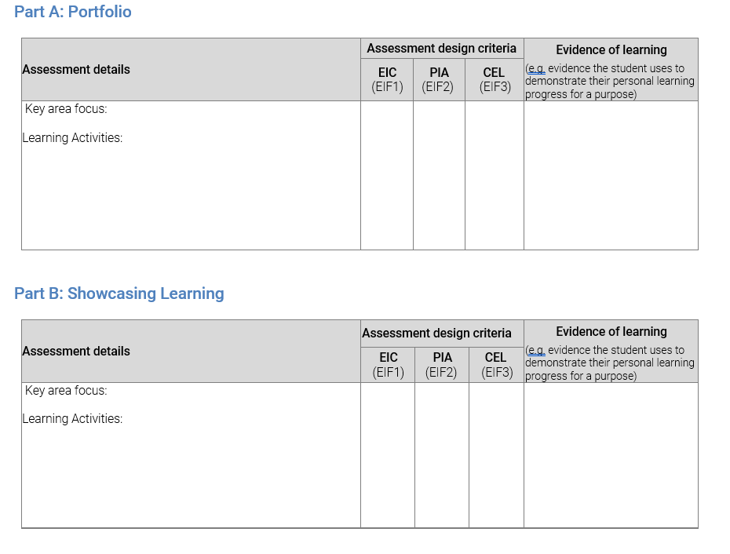
AIF: Modified School Planner
Assessment Design Criteria
Exploring Agency and/or futures and/or connections
AIF1 Student further explores agency and/or futures and/or connections with others
Planning and Implementing Action
AIF2 Student further engages with learning activities for a purpose
Communicating Evidence of Learning
AIF3 Student communicates evidence of learning in an authentic and personally relevant manner
Notes:
Working with student, caregivers, SACE Coordinator develop learning and assessment plan for AIF Modified.
School Planners are for school use only.
Teachers may make changes to the plan, retaining alignment with the subject outline.
The principal or delegate endorses the use of the plan, and any changes made to it, including use of an addendum.
The plan does not need to be submitted to the SACE Board for approval.
Part of this process will involve selected a Key Area for Part A (from key area 1 – 4 as stipulated in the AIF: Modified subject outline). It is important to consider which fits your student and their learning goal for Part A. They are intentionally broad and diverse to allow for a number of different, but authentic, key areas to apply.
For Part B, the key area focus is Key Area 5, communicating and reflecting on learning. When developing and implementing the LAP, the teacher decides where the assessment design criteria best aligns for the student. The assessment design criteria is considered holistically across Part A and Part B.
The AIF School Planner will be available via the website for 2025.

Slide 39
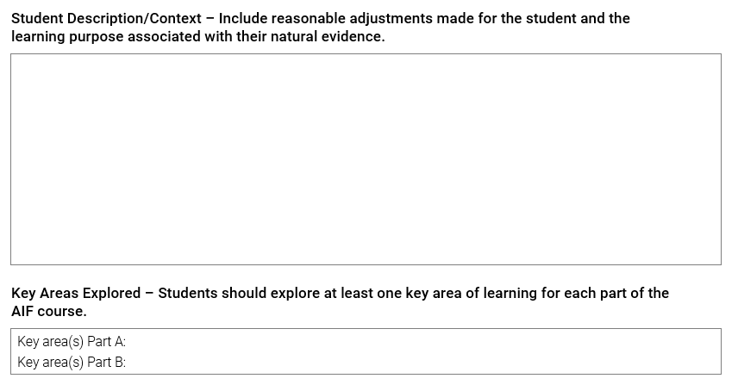
Natural Evidence of Learning template
The template is to be used as a guide to showcase the 3-5 samples of natural evidence of learning that support your assessment decision.
Notes:
When collecting evidence of learning for AIF: Modified, the SACE Board encourages the use of the Natural evidence of learning template. We have print out copies available to take with you today, and this resource will become available on our website ready for implementation early next year.
The template is to be used as a guide to showcase the 3-5 samples of natural evidence of learning that support your assessment decision. Multimodal presentation of this material is also acceptable where the student evidence and the learning annotations are clearly displayed.
There is a section for the Natural Evidence of Learning Annotation
Learning annotations can be developed by the student, prepared with advocate assistance, or provided as observations of the student in a learning environment, appropriate to the student’s established reasonable adjustments. As a guide, learning annotations should be a maximum of 80 words or 2 minutes of oral/multimodal equivalent length for each sample of evidence.
Importantly, your school will only be required to submit materials for Modified Review if your site is due for Modified Subject Review. If so, you supply the Stage 2 AIF: modified – Natural Evidence of Learning Assessment Record

Slide 40
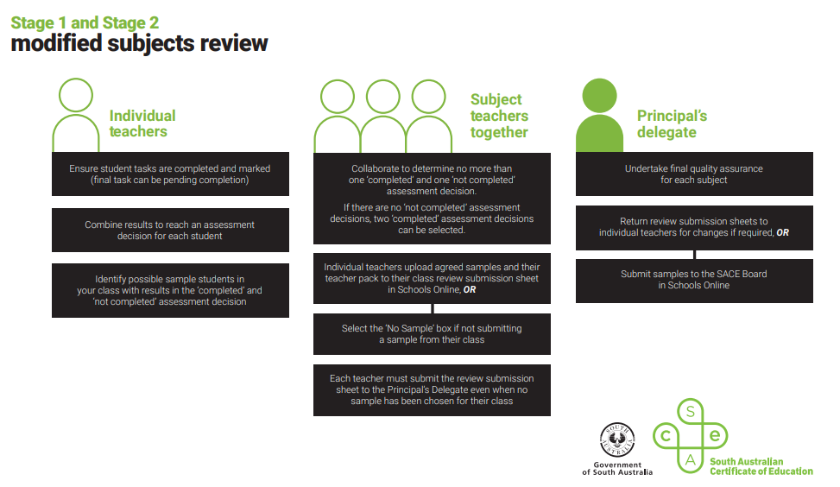
Notes:
if your site is due for Modified Subject Review this is an outline of the process
After individual teachers ensure student tasks are completed, these decisions are then reviewed by the principal’s delegate for final quality assurance. Teachers upload samples to the submission sheet in Schools Online. If no sample is chosen, they select the ‘No Sample’ box. Finally, the samples are submitted to the SACE Board for review.

Slide 41



Activating Identities and Futures: Modified
5
AIF: Modified is available for teaching in 2025
One subject, two pathways. There may be a pivot point for some students
Schools are responsible for determining students’ eligibility for modified subjects following the eligibility criteria outlined in the Modified Subjects policy
QUICK FACTS
YOU
Student achievement should be considered holistically, across Part A and Part B
need to
At least one Key Area is selected for Part A and Key Area 5 is the focus area for Part B
KNOW
BONUS!
The forms and resources section on the website will be continually updated with support materials
Notes:
Before you leave today, we would like to leave you with 5 quick facts you need to know.
AIF Modified is available for teaching in 2025, Research Project Modified will still be available in 2025 but will no longer be available in 2026.
Due to the flexibilities of the course, we have learned throughout the pilot that AIF is one subject, with two pathways. Meaning there may be a pivot point for some students to move from AIF to AIF: Modified, or vice versa.
Schools are responsible for determining students’ eligibility for modified subjects following the eligibility criteria outlined in the Modified Subjects policy. Teachers are to work with their SACE Coordinators to support students in accessing Modified subjects and the SACE Board are available to assist with queries.
Student achievement should be considered holistically, across Part A and Part B. The assessment design criteria will naturally lend itself to each part of the subject, as well as the ways in which learners engage with the subject.
At least one key area is selected for Part A and Key Area 5 is the focus area of Part B. Throughout both parts of the subject, the role of the teacher is integral to support the students’ learning.
Bonus! The forms and resources section on the website will be continually updated with support materials, ready for teaching in 2025. Please feel free to take all of the materials provided to you today back with you to your site, and contact askSACE via phone or email should you have any queries.

