Slide 1

Notes:
Acknowledgment of Country – Elizabeth close triptych entitled Shared Journey; One Path. The panels respectively represent agency, belonging and growth.

Slide 2
Welcome to the
AIF Teacher Implementation
Workshop

Slide 3



Workshop purpose
Develop understanding of the intent of AIF
Develop understanding of the pedagogical approaches that underpin AIF
Develop understanding of the assessment requirements and what student work can look like.

Slide 4
Why is now the time for Activating Identities and Futures?

Slide 5

Stage 2 Review:
to investigate what secondary education should look like for current and future generation of students
Passport to Thrive
AIF Pilot 1:
>1000 students
19 schools
2018
2020
2022
2023
2024
2025
SACE strategic plan:
Thrive
Elements of Thrive
Capabilities
Pilot Projects established
AIF Pilot 2:
>4000 students
63 schools
SA/NT
All SEQs
All Sectors
Modified option
AIF available to all schools
(last year to teach RP)
Notes:
In 2018 there was a review from the SA government who gave us some strong direction to look at what secondary education should look like, and more importantly, how the compulsory aspects of the SACE (PLP and RP) prepared students for the life ahead of them.
In 2020, we launched a strategic plan that built on research that showed creating space to deliberately support students to develop transferrable capabilities for a world beyond school is what would best enable them to thrive..
We established EIF, AIF, and the Learner Profile and Capabilities as pilot projects, and AIF went through its first pilot in 2022.
In 2023, we’ve seen a broad cross-section of more than 6000 students enrolled in AIF who have helped us test what would best allow this subject to deliver on its promise of enabling greater student agency as a vehicle to learn about learning.
That brings us to the SACE Board’s recently unveiled strategic plan, which seeks to deliver a passport to thrive – that is, students who complete the SACE possessing the ability to know what to do when they don’t know what to do.
And then the reason we’re all here: 2025 is the year in which all students will have the opportunity to engage with the vehicle that is AIF.

Slide 6
Say hello!
Take the time to introduce yourselves to the people at your table.
Discuss what you think the intent of Activating Identities and Futures is.

Slide 7
Overview
Activating Identities and Futures

Slide 8
Activating Identities and Futures (AIF)
AT3 Appraisal 30%
AT1 Portfolio 35%
AT2 Progress Checks 35%
Stage 2
If students have already done RP, they don’t have to do AIF as well
credits
Key Operational Information:
Teachers do not need to write a LAP
Is a Tertiary Admission Subject (SATAC approved as providing appropriate preparation for tertiary studies)
Available to all schools in SA from Semester 1, 2025
3 ASSESSMENT TYPES
Notes:
Similar to the RP, AIF is a 10 Credit, one semester subject. This subject is equivalent with 1 semester of work. The way you implement this in your school is up to you – the important thing to note is it should ONLY be 1 semester, and this is something we want to continue to hold tight to. Something else highlighted by the 2018 review of SA secondary schooling was the manageability of workload for students, and keeping AIF to one semester is ensuring students can manage their SACE workload
They will likely start with developing a portfolio, where they will identify a learning goal and create their natural evidence of learning as they progress. As they work towards their learning goal, they’ll check in with you - where they will show you their decision making and metacognitive skills through the AT2 Progress Checks. This is also an opportunity for you to guide, mentor and support their development as they progress. Towards the end, students will appraise their learning and how they went in relation to developing the learning output in the AT3 Appraisal. Note – its great to include the learning output for context, and students should draw connections to it, but this output of learning does not need to be ‘complete’, and is incredibly flexible.
You’ll no doubt have noticed that the three assessment types have a fairly equal distribution. Pilot teachers felt that the learning of each assessment type should be equally considered; there is also strong connection and interplay between the three different assessment types.
You’ll also notice that this is available from Semester 1 – this means your site can start in semester 1, semester 2, or even 2026! What’s important to remember is that Research Project will not be available after 2025. It is probably also worth thinking about the length of each semester at your school in relation to SACE timelines, and how this might impact when you timetable students to undertake the subject.

Slide 9

The Relationship Between EIF and AIF
Stage 1 (EIF)
from 2024
Emerging Agency
I can choose
Emerging Self-Regulation
I am in control
Stage 2 (AIF)
from 2025
Activating Agency
I can choose and pursue
an individual path
Refining Self-Regulation
I can work out how to do it
Developing Self-Efficacy
I believe I can do it
Developing communication and reflection
I can think about my learning
and tell others what I have learnt
Exploring Metacognition
I can use how I think
to achieve my goals
Practicing Reflective Practice and Evaluative Judgement
I know and can justify my why
Notes:
It’s also worth considering how you present AIF in relation to EIF, as the intention is for students to build on what they learned in EIF when they undertake AIF.
Where in EIF they learn more about how capable they are individually, and begin to experiment with greater agency, in AIF they put their self-belief into action, and apply what they’ve learned about working with agency in more complex ways.
This is reflected in the progression you can see on screen – those elements on the right are the learning content for AIF, and as such they are reflected in the performance standards. You won’t see all those words in the performance standards, but when you interpret and apply them, those elements will naturally inform assessment decisions.
This relationship between the subjects does mean that some projects or ideas explored in EIF can be extended into AIF, as for some students, continuing or extending on the same focus area can lead to better engagement. But it also means the learning should be new and more complex, building into the stage 2 subject.

Slide 10




Learning requirements
develop agency by setting a learning goal, exploring a topic of their choice and showcasing their Output of Learning
demonstrate self-regulation in time management, decision making, and the consideration of strategies, perspectives, and feedback to achieve their learning goal
develop and apply metacognitive skills by showing awareness of their own thinking in relation to the learning process and engaging in continuous reflection about their learning
Develop their reflective practices and evaluative judgment through relevant feedback about the learning process in relation to their progression to the learning goal
Notes:
The Stage 2 subject has the following learning requirements, which are all about learning how to learn, and knowing what to do when you don’t know what to do.
These learning requirements are the content of AIF. That is, when people ask “what do people learn in AIF”, these are your answers.

Slide 11




Key Drivers
Developing capacity to initiate and progress learning
Making decision in partnership with teachers
Teacher as co-agent in learning
Feedback on task
Feedback on process
Feedback on self-regulation
Feedback
Agency
Authentic and varied
Supporting student strength and choice
Curated for self
Natural Evidence of Learning
Developing capability to think about own thinking and learning
Evaluating own processes for learning
Meta- cognition
Notes:
Of course whilst we are rightly focused on what students are learning, as teachers we know the next step is how we’re going to best enable that learning.
That’s why the subject outline is underpinned by these key drivers - Feedback, Student Agency, Natural Evidence of Learning and Metacognition.
We’ll be exploring some of these in more detail later, however what’s important to know is that through the co-design process of 2 pilots of EIF and AIF and working with real students, these four elements emerged as the most impactful strategies for supporting students to foster independent learning skills and mindsets.
Those findings are also supported by global research undertaken by The Education Endowment Foundation, who found that focusing on metacognition and self-regulation, and feedback, were low effort, high-impact strategies with a positive effect on teaching and learning.

Slide 12
Assessment Design Criteria
E1 Exploring ideas related to an area of interest
E2 Selecting and applying strategies
PA1 Seeking and responding to feedback
PA2 Managing time and resources
EXPLORING
Developing agency
PLANNING AND ACTING
Developing self-regulation and metacognition
PA3 Making judgements and decisions
E3 Selecting and using perspectives
APPRAISING
Developing reflective practice and evaluative judgment
A1 Appraising the personal value of the learning experiences
A2 Appraising the impact of strategies, perspectives and/or feedback to progress the learning towards the learning goal
A3 Appraising learning development as represented in the output of learning
Notes:
You can see the pedagogical approaches are reflected in the Assessment Design Criteria.
When looking at Assessment Design Criteria, it is important to note that the banners across the top reflect the overall intent and provide context for the individual descriptors, so you can see at the highest level we’re focused on exploring, planning and acting, and appraising, and that sitting beneath those are agency, self-regulation and metacognition, and reflective and evaluative practice.
At a more elemental level, in ‘Exploring’, students explore not only their ideas and interests, but how they use strategies and perspectives too.
In Planning and Acting, you’ll see that students need to consider the feedback they seek and respond to, how they manage their time and available resources, and how they make decisions in light of all this.
In ‘Appraising’, students consider the value of the experiences they live through as they learn, the impacts (positive and negative) of the strategies, perspectives and feedback they’ve gotten along the way, as well as thinking deeply about the way their output of learning actually reflects the learning they’ve done. It’s important to note that it’s learning experiences we’re focused on here – that is, the many different experiences they have along their journey – not the ‘learning experience’ as a whole. Moreover, we’re focused on the learning development – that is, how much have students learned, and why does that matter – not so much on what the students have produced.

Slide 13
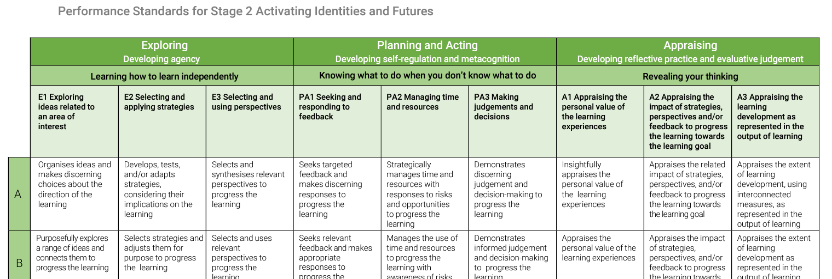
Performance Standards
Learning Requirements reflected in Assessment Design Criteria;
written in student friendly language.
Notes:
You’ll notice in our performance standards that the connection to the learning requirements, and the connection to the four pedagogical approaches continues.
There is a new layer in the top-down section as an added descriptor.
Looking at Exploring, you’ll still see learning how to learn independently is now explicit; in Planning and Acting knowing what to do when you don’t know what to do is explicit; and in Appraising revealing your thinking is explicit.
This is designed to be student friendly language so that teachers are able to have productive conversations with students.
We’re rewarding students for the crucial skills in AIF, regardless of their learning goal – things like considering aspects of how they learn in a related way, making informed decisions or responses to perspectives and feedback, and being deliberate and thoughtful in their strategies and organisation.
What we’re looking for is for students to have the opportunity to grapple and resolve, rather than following a template or a draft – as students will need to be able to independently grapple and resolve beyond school.

Slide 14

One subject, two pathways.
Modified version – completed pathway
Completion of AIF– graded pathway
Students are eligible to enrol in modified subjects on the grounds of documented or imputed disabilities that result in significant impairment in intellectual functioning and/or adaptive behaviours.
Students can use either pathway to result and complete AIF.
Students can also move back and forth through the pathways as needed.
AIF
Activating Identities and Futures
Notes:
It’s important that we provide that opportunity to independently grapple and resolve for all students, so as we journeyed through co-designing AIF, we also ensured we considered what this looks like for students who are eligible and want to use the SACE Modified pathway to succeed. We were very happy to see that due to the flexibility of the subject and focus of the student, we were able to do something slightly different from what other SACE modified subjects are able to offer, which we call ‘one subject, two pathways’.
We’ll touch more on AIF Modified at the end of the session, but we want you to keep in mind that many students who typically only accessed modified options for PLP modified or RP modified were able to achieve a C grade in the AIF standard subject.

Slide 15
AT1: Portfolio
Natural Evidence
Notes:
Grappling and resolving might not be something students are used to presenting for assessment. That is, they are likely used to presenting polished pieces of work that – all being well and good – are the product of grappling and resolving. If we want to develop student ability to learn how to learn, it is important we get to see that in action. That’s why in assessment type one, students are required to present portfolios of natural evidence of learning. But before we speak too much about that, we want to provide an outline of the assessment type itself.

Slide 16
AT1: Portfolio
ASSESSMENT
TYPE
Contains a collection of natural evidence of learning which demonstrates the student’s journey towards their learning goal. It should provide an authentic collection of evidence, demonstrating:
Evidence, including the volume of work and hours spent, should be commensurate with a 10 credit, Stage 2 subject.
1
exploration of ideas related to a learning goal of personal interest
consideration of the value and purpose of their topic to self and/or others and/or community
active seeking of perspectives to build their understanding and ideas
seeking of feedback from responsive co-agents about their learning processes
Assessment Design Criteria:
E1 Exploring ideas related to an area of interest
E2 Selecting and applying strategies
E3 Selecting and using perspectives
PA1 Seeking and responding to feedback
35% weighting
FRONT-LOADED MODERATED*
Notes:
So, AT1 is a portfolio of evidence that shows progress towards their learning goal and is assessed on e1, e2, e3 and pa1
Alongside evidence of the learning they are doing, as well as evidence of the decisions they make about their learning, what has informed those decisions, the feedback or perspectives they collect along the way and how they respond to that.
*Tested FLM in 4 semesters, and is subject to board approval.

Slide 17

Key Drivers
Feedback on task
Feedback on process
Feedback on self-regulation
Developing capacity to initiate and progress learning
Making decision in partnership with teachers
Teacher as co-agent in learning
Feedback
Agency
Natural Evidence of Learning
Authentic and varied
Supporting student strength and choice
Curated for self
Meta- cognition
Developing capability to think about own thinking and learning
Evaluating own processes for learning
Notes:
Something crucial for AIF is that students have the opportunity to take greater ownership and agency over their learning. Students must have the opportunity to develop greater awareness and understanding of their own thought processes, decision making, and organisation in relation to the learning process. If they are to have this opportunity, we cannot prescribe or dictate the way that students must show their learning, or their evidence.
It should be relevant for the learning, authentic for the students way of learning, and should be ‘curated for the self’, rather than ‘created for the SACE Board’. Let’s take a slightly closer look at what this means for teaching, and what this means for AIF

Slide 18

Learning Goal: to prepare and serve a hazelnut latte
What kind of evidence could the student collect or create that shows progress towards their learning goal?
Notes:
Scenario: You have a student who’s learning goal is to prepare and serve an amazing hazelnut latte.
(3 minutes) Take a moment and think to yourself – what evidence could you view, or could they show, that demonstrates the students’ learning of preparing and serving hazelnut lattes?
For the facilitator: ask participants to offer their suggestions. Some ideas could be:
20 lattes, some good, some bad
Photographs of them making it
A self-written ‘procedure for using an espresso machine’ that they used and refined as they continued
Feedback recorded (voice notes or scores out of 5) from ‘customers.
One of our favourite suggestions so far has been a tasting paddle for the teacher, or perhaps the AIF team at the school! Though of course that might be a different learning goal, because that might be about different coffee beans, or milks, or temperatures.
But that leads us into an important point:
The output does not indicate learning progress. The student may already have been able to make a latte. The learning portfolio is the student showing their learning progress, not about them making an exceptional cup of coffee.

Slide 19


Natural Evidence of Learning
Natural – considers, supports and expands on the disposition of the learner.
A combination of intention and forethought as well as allowing room for the spontaneous.
Curation for self
Evidence for progression of knowledge and skills
Authentic, contextual, varied
Curation for others
Evidence for demonstration of knowledge and skills
Polished, nominalized, formalized
Notes:
Given not all students will be learning how to make a coffee, and even if they were, they’d be doing so in varied ways for varied ends, natural evidence will be broad, varied, unique and contextual. It is natural ‘to’ the learner, as well as naturally occurring.
Procedural learning goals like making a coffee can be straight-forward in terms of gathering evidence. Many learning goals will involve students taking their own path to progress toward their goal, challenging us to think about the variety of evidence students produce. Where evidence can look different is where students select strategies or perspectives that are valuable to them.

Slide 20
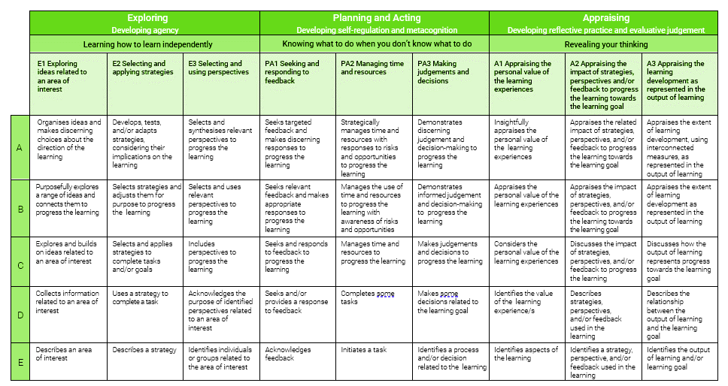
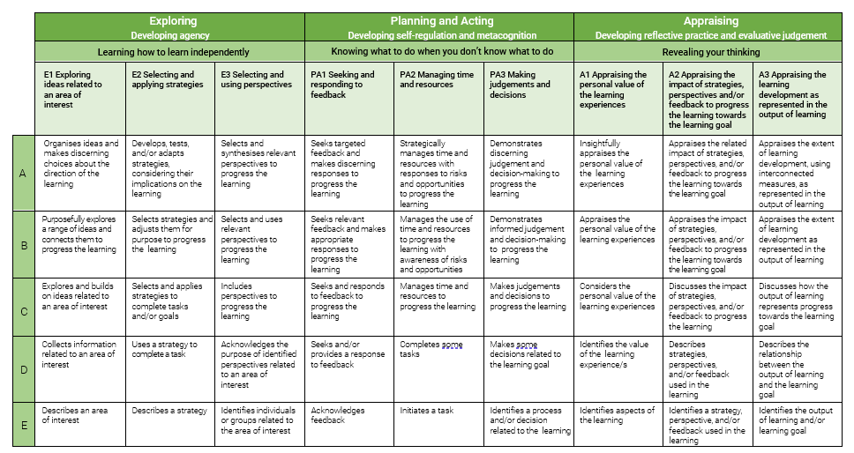
Assessment Type 1: Portfolio
Notes:
E1 first: Exploring ideas related to an area of interest.
Effectively, it is about what a student is learning. They choose an area of interest, making choices about the scope – both breadth and depth – and the direction and goals of their learning. That scope and direction, as well as their goals, may change as they purposefully explore a range of ideas. The more the student explores in this purposeful way, the more they’ll end up needing to organise their ideas as they become more nuanced and complex. As a result of ideas becoming more nuanced and complex, students will need to make choices about what pathways they do and do not pursue.

Slide 21
Guest Speaker

Slide 22
Tell us about your experience with AIF, and what it was like implementing it in your classroom.
What did the focus on agency mean for you and your students?
How did this impact the way that you planned, taught, and thought about AIF?
What did you find was the biggest difference to RP/other Stage 2 subjects?
What would be your advice to other teachers who are about to teach AIF for the first time?
Guest
Speaker
Notes:
20 minutes total
Questions available on the slide, however feel free to encourage questions from the audience, and facilitate the room during the conversation. It’s important to keep to time, so perhaps give a five minute warning.
“what questions do you have for our guest speaker today? We will address some subject or assessment related questions in more depth later, but what we may not be able to speak to as well is the classroom experience of the subject”.
Additional Guiding questions here:
What was the most challenging thing for you at the beginning?
What did you try or do in response to this challenge?
What changed and how did you know?
What did you see in the students?
What did you learn from this experience?

Slide 23

Break

Slide 24
AT1: Portfolio
Perspectives (E3) and Feedback (PA1)
Notes:
There are other key drivers underpinning the assessment type, so let’s look at AT1: Folio again, this time specifically for Perspectives and Feedback.
We mentioned previously that feedback is one of the core pedagogical approaches underpinning AIF, with the focus on perspectives allowing students to develop metacognition and gain connection to the real world or authentic contexts. You may have noticed that assessment design criteria E3 specifically assesses ‘selecting and using perspectives’, with PA1 assessing ‘seeking and responding to feedback’. Let’s clarify a little on what we mean by perspectives and feedback, and how those may look in the AT1 Portfolio.

Slide 25
Assessment Type 1: Portfolio
Notes:
Lets take E3 first – selecting and using perspectives. This descriptor reflects the fact that part of learning about an area of interest is considering who your student is learning from. This includes both their primary and secondary sources. They have some knowledge about who can share opinions, expertise or experiences, and what sources of information they can consult. Students may also need support to navigate and choose between a range of perspectives rather than just selecting the first perspective they come across, or believing they need the most qualified, most credible perspective on the subject, which is not required. There will almost certainly be students who require support to synthesise multiple perspectives so that they build their own understanding or position, rather than just relying on the understanding or position of others.
PA1 meanwhile recognises that when learning something new, there will come a time when it is necessary for students to share their progress and approaches with others. That, essentially, is gaining feedback. But it is important to note that feedback can be on the task itself, or the artefacts they create; it can have more impact at the process level, on what strategies they are using to progress their learning; and it can be at the self-regulation level, regarding how they are managing themselves as learners through the process. Regardless of the type of feedback, it is best if it is about something specific, and if the learner makes informed decisions about what to do in response to the views they have elicited.

Slide 26
What do we mean by Perspectives?
A perspective is an (informative) way of viewing things that may be held by individuals or (representative) groups
Purpose for the student: ​
Increase depth and complexity of understanding about an issue​
Approach skill development from a different angle to enhance performance​
For example​:
An individual nurse vs health industry perspective​
News article outlining individual and/or group opinions on different sides of an argument​​
Focus group interview with a stakeholder group/s (e.g. customer/ company /industry/ government)​​
Experienced surfers' views on what people should do when learning to surf
Notes:
Additional elaborations:
Purpose for the student:
Support divergent thinking in solving a problem​
Example:
Documentary exploring the impact of something on one or more cultural/ social/ linguistic/ religious​/ interest groups​

Slide 27
What do we mean by Feedback?
Feedback is an evaluative response from a teacher, mentor or knowledgeable ‘other’ regarding the process, product and direction of learning
Purpose​ for student:
Build purposeful connection with a ‘knowledgeable other’​
Gain insight from a target audience about a prototype/ product/ performance of knowledge or skill
Stimulate self-evaluation based on feedback others have provided on student’s learning processes and/or product​
Inform decision making about what to do next ​
Could include:​
Mentor’s evaluation of student’s product/ prototype ​
Evaluative discussion with teacher, conferencing student’s draft​
Survey responses from a target audience about student performance/ product/ prototype​
Does not include:​
Personal reflection/self-evaluation​
Data from smart watch/other inanimate device- this is a strategy ​
Didactic conversation aiming to share content/ information- this is a perspective​

Slide 28
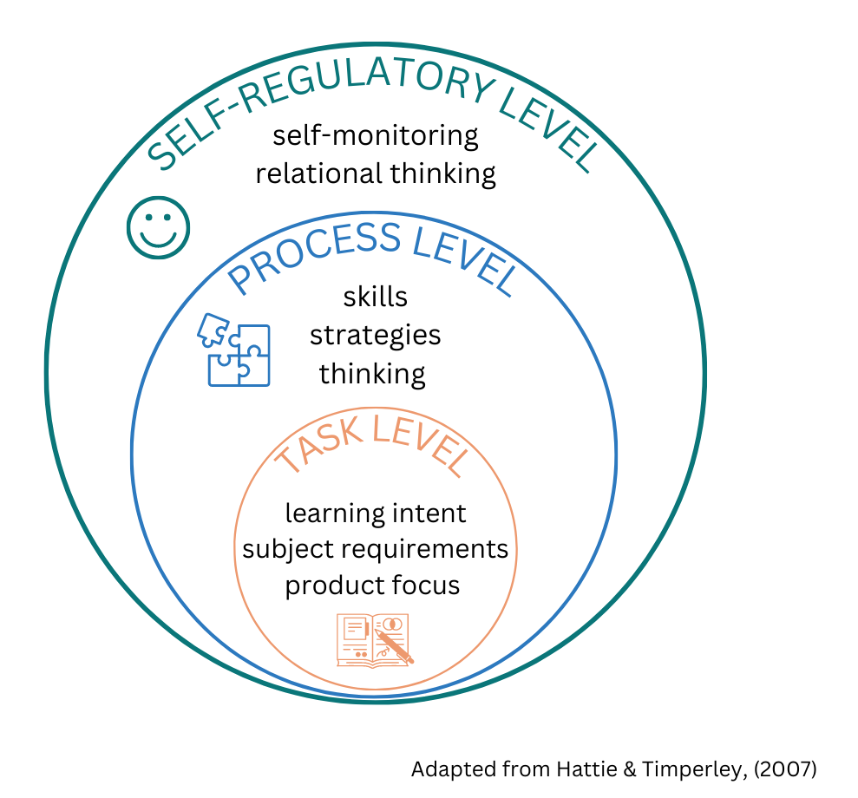

Feedback in AIF
Notes:
​We can also categorize this type of feedback based on the level it is operating on.
Task level feedback is traditionally what teachers have given. It focuses on product, and is useful for that specific task.
AIF seeks to elevate understanding of process and self-regulation, and you may not have expertise in the area their task falls into – say, learning how to do a stunt on a motorbike.
Process level feedback is feedback that is aimed at the processes the student is using and is almost always about feeding forward – that is, what the next steps are in a way that not only helps them with this task, but future endeavors too. It may therefore be about skills and strategies, but is also about their metacognitive processes.
Self-regulatory feedback is dependent on the regulation of the learner, knowing when or if the strategy works for them. This allows the learner to manage their own learning, to decide whether the strategy works for them or if now is the best time to try it.

Slide 29
Metacognition
Notes:
Given how the portfolio is presented, it made sense to begin with a focus on natural evidence of learning. Now that we’ve had a look at how students interact with perspectives and feedback, we’d also like to cover another of the key drivers significant to the subject, Metacognition.

Slide 30
Key Drivers
Feedback on task
Feedback on process
Feedback on self-regulation
Developing capacity to initiate and progress learning
Making decision in partnership with teachers
Teacher as co-agent in learning
Feedback
Agency
Natural Evidence of Learning
Authentic and varied
Supporting student strength and choice
Curated for self
Meta- cognition
Developing capability to think about own thinking and learning
Evaluating own processes for learning
Notes:
Metacognition is one of the key drivers that underpin AIF, as well as the others you see here.
There’s a range of ways to understand ‘Metacognition’ – you’ll commonly hear it described as “thinking about thinking”. It can be defined as “awareness or analysis of one’s own thinking”. When it comes to our students, and the learning they engage in, it is about them understanding the way they think, knowing how they think, and applying that to either enhance the way they think, or to achieve a goal.
There are two aspects of metacognition that we will look at: developing the capability to think about your own thinking and learning, and evaluating your own learning processes.
One thing that we know, is that successful students tend to learn and use metacognitive skills implicitly, as many of us here would have at school and university. So our aim in AIF is to develop these skill for all students so they can work to identify and evaluate what works for their learning, and then apply this to a range of subjects.

Slide 31
Metacognition
Metacognition relates to students purposefully monitoring and directing their own learning, whilst engaging in regular reflection and feedback with their teachers, peers, mentors, and any relevant individual in the planning, acting, and evaluation stages about the relative success and relevance of learning experiences.
AIF Subject Outline, 2024
Notes:
This is how we define metacognition in the subject outline for Aif.
Metacognition is the capacity to understand your own thinking during the learning process, to evaluate this process to understand what is effective for learning, and also how you might manage your motivation to support the completion of a task.
It’s a developing capability for students to think about their own thinking during the learning process, but also to evaluate and decide what is effective, and build their skills in how they judge what is an effective learning process.
In a nutshell, metacognition and its assessment is not about how well the kids know something, it’s about them understanding and evaluating the process of getting to something for each of them individually.

Slide 32
Benefits of developing metacognitive thinking
Post-school, our students are required “to be largely independent, self-regulated learners, an assumed capability many students are ill-prepared for” (Nugent et al, 2019)
Students can evaluate their processes to identify how to be more effective, not just evaluate the output of what they are doing.
Students can draw on their knowledge and awareness of thinking processes and modify these while they are engaged in a task.
Students can shift their way of working to motivate themselves to progress a task
Students can develop a range of help-seeking behaviours that will support them in their learning in AIF, and across all their SACE subjects, and forward into their lives.
Notes:
There is significant research highlighting the importance of self-regulatory behaviours in determining student success. According to research from The Education Endowment Foundation (EEF), the impact measure of using metacognition and self-regulation strategies in the classroom had a low cost for teachers, but high impact on progress made by students
What the research generally says, that once they leave school, and frankly, while they are at school, we require students to be “largely independent, self-regulated learners” which is “an assumed capability that many of our students are ill-prepared for, particularly in further education contexts.
Metacognition is a very strong predictor of learning success, and forms part of the toolkit students take with them from high school out into the world.
In order to be equipped with the lifelong skills students need to flourish in the world beyond, we need students to move beyond asking “What have I learned?” and asking “How did I learn it?”

Slide 33



Thinking about skills and strategies
To effectively teach thinking skills and strategies, it is important for teachers to have a comprehensive understanding of these skills both on a cognitive and metacognitive level.
This means teachers should not only possess the ability to use these skills themselves, but also be able to articulate and model them to their students in a way that highlights the reasoning behind their use.
Let’s learn by doing!

Slide 34
You’re a contestant on MasterChef, and you’ve just got the prompt for your patisserie week signature: 12 croissants
You’ve purchased a new house which requires a complete kitchen and bathroom renovation.
You’ve been asked to organise the handing out of awards on presentation day, which you’ve not done before.
List the steps you would do to achieve this goal, roughly in order.
Choose one of the following scenarios…
Notes:
Activity: We’ll give you 2-3 minutes to make a list of… [read slide]
Allow 5 minutes for listing and the discussion that will naturally arise.
Take a look at your list. Of these steps, which of these were actions you need to do to complete the task? Which of these steps were about helping you manage your time, or your resources? Which of these steps were more about enjoying the task? Are any of these steps inefficient? Are these steps the most effective way for you to complete your goal?
These are the kinds of things we want students thinking about when engaging in their learning or working towards their learning goal.

Slide 35
Metacognition and Self-Regulation
Self-Regulation
Cognition:
Task performance strategies, attention, rehearsal and elaboration
Metacognition:
Strategies to control and regulate cognition
Motivation:
Task related beliefs, interest and emotional reaction/ behaviours
(Dinsmore et.al., 2008)
Notes:
When we start unpacking the details and nuances about metacognition, we can understand it as being key components of Self Regulation, which supports students in setting goals, managing time, staying motivated and adjusting strategies as needed. In this way,
Cognition is what is required to complete the task. The actual doing of the things – it is likely your list is mostly these things, as that’s what you were asked to list
Metacognition forms the strategies that control and regulate your cognition; the things that regulate your performance of the task. It is sometimes the reason why you would do an action.
Motivation also sits in here, and is made up of the interest, beliefs and emotional response to a task. Sometimes you need to do these steps to enjoy the task, like playing music while cooking, so you can maintain momentum through the task.
Motivation is a tricky space with students – our strategies only go so far against apathy, however hopefully the opportunity to engage in a learning goal of their choice and in the way they want to learn, it supports this engagement.

Slide 36

What is metacognition
Evaluating and refining how to judge what is an effective learning process.
How have you come to that decision?
Is this really the case, or do you just enjoy it more?
Evaluating your thinking during task performance
“I learn best when I talk about the topic with my friends…”
I learn best by watching YouTube videos on the topic…”
Task performance
Doing the task
Notes:
To support our students in their metacognitive development, we want to support our students in moving up the metacognitive scale
[run through the scale]
A great place to start with students is building awareness of what they do in their task performance – much like how you wrote on what steps or actions you’d take to achieve that goal.
Students then want to develop being able to evaluate that cognition, evaluate the steps during their task performance. We want to support them moving beyond simply being aware of what they do, but why they do it. Your conversation with a student might be something like “what are you doing this lesson? Why are you doing that this lesson? (I learn best by watching youtube videos)
We then want to support students in being able to evaluate and develop how to judge if what they’re doing is effective. “Okay, so you’re watching youtube videos this lesson as that’s how you learn best. But do you really learn best that way, or is it because you enjoy it more (motivational?)
Essentially, we want students to be able to understand what they do, why they do it, and whether it is effective.

Slide 37
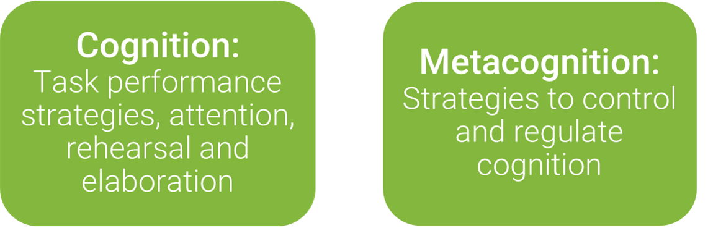
Using your list from earlier…
What are the metacognitive steps associated with the task performance (cognitive) steps that you have written down?
Notes:
It is likely a lot of your steps are cognitive, and about the steps required to complete the task. But what are the associated metacognitive steps? As adults, we may do this inherently, or not write them down, so they remain invisible. How can we make these more visible for our students? How can we understand the distinction? We can do this by teaching, support, scaffolding and modelling, which I will do for you now, using the ‘renovation’ learning goal.
In cognition, the actions I would do to renovate my house would be begin with making a pinterest board of ideas, then talking to a builder to get some quotes, before I feel overwhelmed by the fact I’ve already gone way over my budget.
My metacognition steps associated with the cognition, is that I would usually start with making a pinterest board, partly because it’s motivational – it’s enjoyable, and I really like the creative process involved in gathering ideas and generating a collection of inspiration. However, it’s not just motivational – when I go to speak to a builder, I have created a tangible representation of what I want the final outcome to be, essentially I’ve made an ‘anchor point’ for all future conversations. When I realise I’ve gone over my budget, I may take a step back, tell myself to make a cup of tea to regulate, and then think about how I could review some of my initial actions or decisions. I can think about how effective my choices were, and whether I would do these actions in the same order in the future, maybe I should get some rough quotes first to save myself some frustration.
This the kind of understanding we want our students to have about themselves, So that they are able to judge if how they’re learning is effective, and be able to decide for themselves, how they can navigate and improve.
Activity – take 5-10 minutes to note down or discuss what the metacognition steps associated with your cognition steps are. What is your ‘why’? Why did you do those strategies?

Slide 38

Supporting, Scaffolding and Modelling
How can we balance providing opportunities for students to develop their own agency while supporting their metacognitive development?
Supports the students in developing their thinking, taking risks and experimenting
May differ between learners, between tasks, and across time
Notes:
So what can we do to support our students in the development of metacognition? AIF provides a vehicle for exploring, developing and using metacognitive strategies. These are going to be unique to each and every person, and students need to explore how their own metacognition feels.
This is where the importance of you, the teacher, lies. You are likely to know your students and when they may each need support. What we saw in the pilot was knowing where you can step back and let the students step in, which is the conversation we usually have around agency. Students should have the authentic opportunity to experience and make decisions themselves and support them in building awareness and recognising their own decision-making and motivations behind this.
So, when we come to support students through teaching strategies and resources, we need to think carefully about what resources we are providing, and the purpose of our actions and resources.
Here is where it is important to establish the extent of scaffolding, and it’s differences from ‘templating’. We often use these terms interchangeably, but we encourage you not to moving forward. Scaffolding is different from templating. A template is something like a form, that shows the outline of what is required, and the user must ‘fill it in’.
This can be restrictive to promoting student agency and creating natural evidence of learning. A template may dictate what evidence looks like, depriving the student of the opportunity to present authentically. A template may decide what a student should do before they get a chance to think about it, depriving the student of the opportunity to think and grapple with their own metacognition and decision making.
A scaffold may look or function like a template, but it is different in that the goal is scaffolding is reduced or altered over time, and different depending on the learner. Scaffolding will also likely be different to each learner between their tasks, but also depending on what they may need at one point in time. Additionally, the intention of scaffolding is that it may be there at the start when its needed, but its goal is to always be removed by the end. To repeat the point made earlier, this is where the importance of you, the teacher, lies. You are likely to know your students best and when they may each need support. When they may need a scaffold, or when they may need to figure it out for themselves.

Slide 39
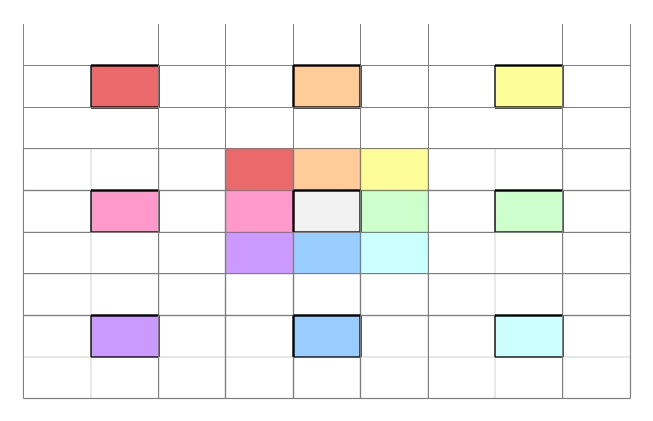
Supporting, Scaffolding and Modelling
What can we do to support and scaffold students in the collection of their evidence?
Consider the purpose behind your resources. What can be provided as options?
The assessment is to show evidence of planning – what is the risk of providing a requirement, or a template to all students?
Notes:
What then can be done to support and scaffold students in the collection of their evidence? There is a balance between supporting students so they feel supported, and giving them just enough they have opportunity to experience their own metacognition.
You likely have a great collection of resources already. Consider the purpose behind them, and the risk of asking your students to participate in the activity/use the resource as a one-fits-all.
For example, lotus diagrams and mindmaps are both tools used to generate ideas. A student could fill out a mindmap or a lotus diagram with great detail, but generate absolutely no new ideas at all, rendering the resource and activity pointless for their learning journey, and experience of metacognition.
Templates can help some students to complete tasks, but it may not be helping with their learning. What is the purpose and benefit of every student showing the same type of evidence as part of their learning journey? Is this evidence of something they learned, or just something they did?
Additionally, some students gravitate to mindmaps,and others prefer lotus. By providing options of tools that support idea generation,students experience choice, thereby have the opportunity to consider their personal preferences, and the way in which they learn (their metacognition).
If you think back to the earlier activities about metacognition, you may remember we want to ensure our students have the opportunity to select the right strategies not just for them, but also for the learning and the purpose of the learning. The goal of something like a mindmap or a lotus diagram is to help generate ideas – teachers may need to support students in choosing the right activity and how to show what they did to generate ideas rather than requiring all students to use the same template. We have seen that students typically need more support or scaffolding at the beginning, however sometimes if you give them the template, you may end up assessing them on how well they fill out the template, rather than assisting them to select the right strategy.
Modelling is also important, as this is a cognitive process, which is inherently, invisible. Consider explaining your own thought process or decision making during lessons or learning activities.

Slide 40
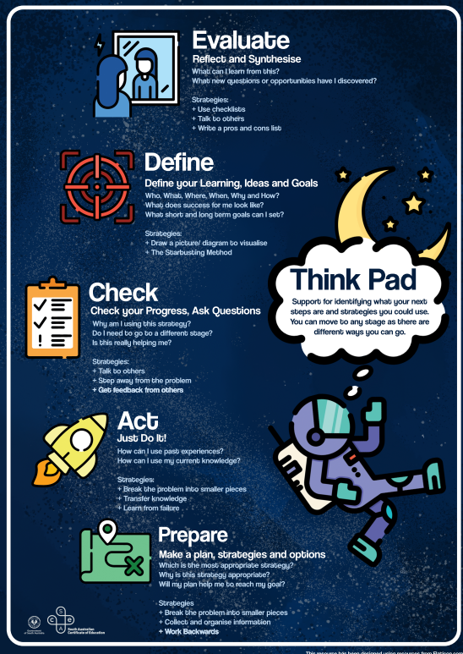
Supporting, Scaffolding and Modelling
The Think Pad showcases a few different strategies or prompts students can use.
Using your list from earlier, consider and chat about the following:
Which strategy did you start with on your own list?
Are you favouring a particular step or strategy? Are you ‘happy’ about that?
Is your pattern of thinking the same as anyone else on the table?
Notes:
We have some resources that can support you as you scaffold, model and support your students in their AIF journey and in their development of metacognition. The ‘Think Pad’ posters outline the different types of strategies and actions a student can do, and some prompts for teachers to use to guide them. What is important here is to support students in identifying steps, and the sequence of steps that are meaningful to them and their progress, rather than relying on strategies that are ‘expected’ or ‘default’.
Model: If I think back to my own list, I started with… [prepare] I know that I favour… [preparing as I gain a clear idea of where I’m going and what this next steps are] this is effective/ineffective because… [it keeps me accountable]
You could do this activity with your own students to introduce them to metacognition, perhaps with more tailored prompts.
We recognise that there are a range of different starting steps, or different processes students will likely use – the poster you see today is outlining some ideas broadly, but there is a poster for each ‘action’. The Full set is digital and is available on the website.
Consider from your list from earlier. Which strategy did you start with? Are you favouring a particular step or strategy? Are you ‘happy’ about that? Is your pattern of thinking the same as anyone else on the table?
---------------
Maybe your croissants don’t rise, or your awards schedule isn’t fitting to time, or your renovation has gone over budget. What do you do next?
5 minutes - Develop some prompts and identify where you might ‘model’ these stages in your teaching.

Slide 41
Break

Slide 42
AT2: Progress Checks
Metacognition
Notes:
In AT2 there is still evidence of metacognition, which means we haven’t moved away from the key drivers, but we are moving on from portfolios to progress checks. Progress checks may be something people are familiar with because of their role in RP, but today we want to take a look at how they function in AIF.

Slide 43
Progress Checks
ASSESSMENT
TYPE
Require retrospective and prospective reflection about the learning process
Occur strategically throughout the development of portfolio
Students
  discuss the progress of their learning in relation to their intended learning goal
  use evidence from their Portfolio as reference points to evaluate the relative impact of strategies, perspectives and/or feedback
  explain and appraise their judgments and decisions at the time of each Progress Check
Submit evidence of two or more
1500 words if written
OR
10 minutes if oral
OR
Equivalent in multimodal
2
Assessment Design Criteria:
PA2 Managing time and resources
PA3 Making judgments and decisions
A2 Appraising the impact of strategies, perspectives and /or feedback to progress the learning
35% weighting
END-POINT MODERATED

Slide 44
Assessment Type 2: Progress Checks
Notes:
There are three criteria to assess in AT2.
For PA2, students demonstrate evidence of managing their time and resources. They will show aspects of their portfolio which will support this. It may start with the student completing some tasks, to show success and progressing their learning. They may also demonstrate awareness and consideration of the risks and opportunities associated with their resources, tasks and actions, and even develop responses, either during or after key learning experiences.
PA3 is related to PA2, in that it focuses on the judgements and decisions students make about the direction, scope and sequence of their learning, both looking back and looking forward.
While PA2 allows for students to consider time and resource management, and PA3 focusing on their judgments and decisions, A2 focuses on the student appraising the impact of one or more strategy, perspective or feedback – something may take time, but have enormous pay-off. Similarly, there may be a commitment to a resource that has limited impact for the investment in it.
This creates a cyclical nature to progress checks and the criteria being assessed.

Slide 45
AT3: Appraisal

Slide 46
Appraisal
ASSESSMENT
TYPE
Students:
Evidence their Output of Learning that showcases the progress to or attainment of their learning goal
Appraise the value and purpose of the learning for themselves
Evaluate the impact of strategies, perspectives and feedback, identifying the most significant contributing factor/s that supported the learning progress
Showcase their output of Learning and appraise it based on their learning development and own goals
1000 words if written
OR
6 minutes if oral
OR
Equivalent in multimodal
3
Assessment Design Criteria:
A1 Appraising the personal value of learning experiences
A2 Appraising the impact of strategies, perspectives and/or feedback to progress learning
A3 Appraising the learning development
30% weighting
External Assessment
MARKED
Notes:
We want students as much as possible to do this for themselves, rather than for the SACE Board.

Slide 47
Assessment Type 3: Appraisal
Notes:
The Appraisal is the student’s opportunity to look back at what they have achieved, what worked well (or not) and what their learning meant to them.
Let’s start with A2, since we have already covered this in progress checks. The focus is on not substantiating or justifying why the student chose the S/P/F, but to appraise its impact on progressing their learning towards their learning goal.
A1, allows for a more personal appraisal of the value of the learning experiences – one or more experience that occurred along the way. These could be planned or incidental activities where the student can express their preferences and their personal perspective. Something may have had low impact, but have great value to the student. Similarly acknowledging and appraising the low personal value is equally as valid.
For A3, where the student showcases their output of learning, they need to appraise their learning development – they can acknowledge and discuss how the output shows what they have learned and how much they have learned. To appraise learning at the highest level, you really need to have some idea of how successful you’ve been in your learning journey – that’s what the phrase “interconnected measures” represents. Measures are also unlikely to be established before commencing a learning journey, as measures may be things that emerge during or after the process. Moreover, complex learning means one measure of your learning is going to be related to another measure of your learning.

Slide 48
A Summary:
The AIF Experience

Slide 49

Relationship between Learning Goal and Output of Learning
The Output of Learning ● showcases the progress to or attainment of the student’s Learning Goal ★
Notes:
There are two aspects to the course that are not directly assessed, but are integral to the framing and focus: the Learning Goal and the Output of Learning
The student sets a learning goal as represented by (CLICK TO ANIMATE) this star
And their journey (CLICK TO ANIMATE) may look something like this: some ups, some downs, some backtracking, but ultimately developing learning
Or maybe it is more direct like this (CLICK TO ANIMATE)
Or perhaps their journey goes in a different direction (CLICK TO ANIMATE), which might indicate they have gone off track a little OR
(CLICK TO ANIMATE) Their learning has developed in such a way that their learning goal is adjusted.
And at some point they will stop developing their learning and develop an output of learning (CLICK TO ANIMATE), an artefact that demonstrates the peak of their learning progress towards their learning goal (CLICK TO ANIMATE)

Slide 50
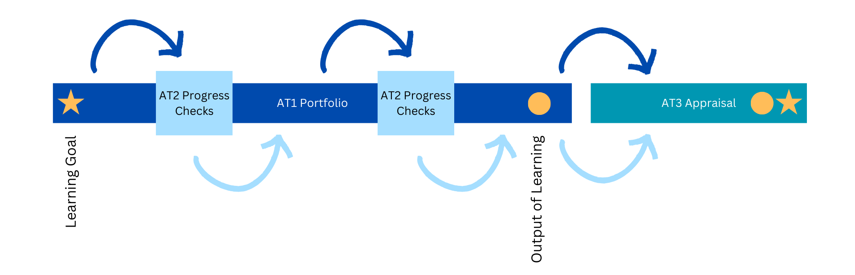
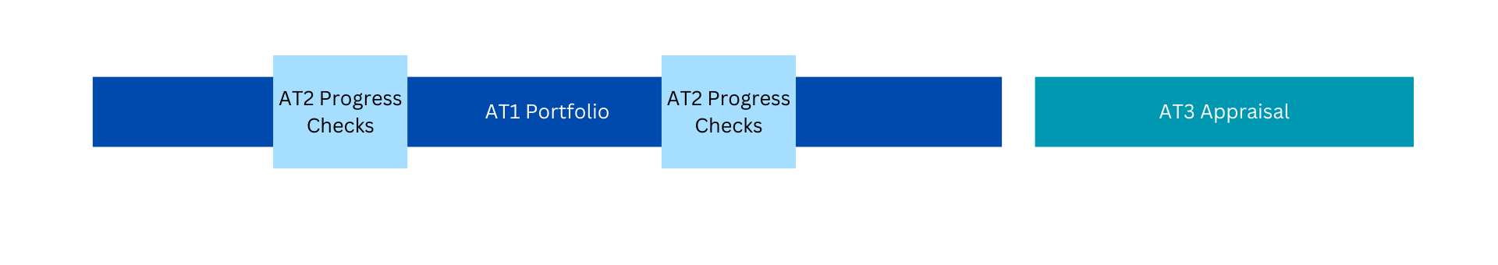
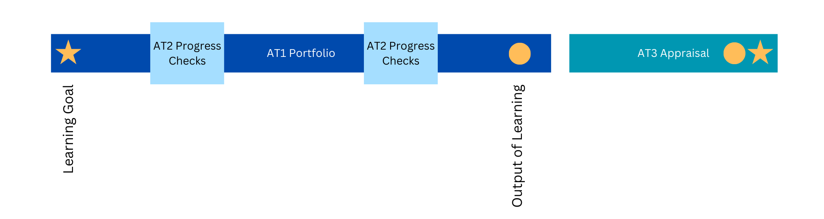
Relationship between Assessment Types
Notes:
Here we have developed a rather simple visual of the assessment types. Now just for our purposes, we have included two progress checks and spread out them evenly, of course there is flexibility here, particularly to consider how the progress checks could be both formal, informal, planned, or naturally occurring.​
(CLICK TO ANIMATE)
​
Students start with a learning goal. And that’s usually connected to something tangible – the output of learning – something they may have decided early on, or is naturally decided on during their learning. It’s not necessarily something finished, which is why we call it an ‘output’, rather than an ‘outcome’. ​At some point the portfolio stops, an output of learning emerges, and the student moves onto their appraisal – which includes the student’s learning goal and their output of learning.
(CLICK TO ANIMATE)
So as the student starts developing their portfolio, evidence from this is used in their progress check. Something may emerge from this and inform learning scope or focus in the portfolio, which again is used for the progress checks, and the portfolio. And when this eventually stops, any learning developed throughout the student’s learning journey can be used in the appraisal.

Slide 51
Stage 2 Activating Identities and Futures:
Modified
Notes:
Before we end, some additional information around AIF: Modified

Slide 52
Stage 2 AIF
Refining self-regulation
I can work out how to do it
Stage 2 AIF Modified
Further developing agency
My choices are important
Exploring Metacognition
I can use how I think to achieve my goals
Practicing Reflective Practice and Evaluative Judgement
I know and can justify my why
Exploring future capabilities
I can build skills and connections to the world
Developing communication
I can communicate to show my learning the way I prefer
Practicing co-regulation and developing independence
I can access help and help myself
Activating agency
I can choose and pursue an individual path
AIF and AIF Modified
links
Notes:
There is a clear connection between AIF and AIF Modified, as shown through the links here. This framing was also co-developed with teachers from a range of modified settings, to ensure that there is inclusivity for all students.
[read slide]
For those who have had experience with a SACE modified subject previously, there is innovation in the way that AIF Modified can be implemented. We learnt from our pilot teachers that those who only access modified options for compulsory subjects, such as RP Modified, these students were able to achieve a C- or higher in AIF. However there was still a need identified for a separate AIF Modified Option.
As such , innovation for AIF required a pivot away from the typical model of valuing goal setting and task completion in modified subjects, to focusing on achieving learning for a purpose, and utilising natural evidence of learning for assessment.
This means students can start in AIF, and move from AIF or AIF modified depending on what support they need to succeed.

Slide 53
AIF Modified Part A: Portfolio
AIF MODIFIED
PART
In Part A: Portfolio, students:
Explore ideas related to a learning goal of personal interest
Collect evidence of learning that takes place in a student learning portfolio
Explore their agency, future capabilities and/or connections with others based on at least one of the Key Areas.
A
Learning goals may be based on:
- purposeful development of a skill​
- interest exploration or enrichment​
- independence or agency enabling activity​
- transition to future connections beyond school.
Key Area 1:
Exploring and Developing Agency
Key Area 2:
Exploring Futures and Connections
Key Area 3:
Developing Capabilities
Key Area 4:
Planning and Implementing Action
With assistance, students choose a learning goal, within their proximal achievement, designed to further increase their agency and/or future capabilities and/or connections with others.
Assessed holistically with Part B
NEoL With
Annotations
Notes:
As such, AIF Modified has been designed with two key parts, in which students show learning to address both parts. Students develop a learning goal, which may be based on but not limited to [read brackets and box on slide].
In Part A: Portfolio, students show their evidence of learning as they work towards their learning goal.
There are still ‘Key Areas’ available, as per the AIF Modified Subject Outline, that can be used in conjunction with their Learning Goal.

Slide 54
AIF Modified Part B: Showcasing Learning
AIF MODIFIED
PART
For assessment, students present 3-5 samples of natural evidence of learning, collectively demonstrating achievement of the three assessment design criteria
B
In Part B, students select and showcase natural evidence of learning that best demonstrate their progress towards their learning goal.
With assistance, students engage in activities to reflect on and communicate the value and purpose of their learning, based on Key Learning Area 5:
Exploring Agency and/or futures and/or connections
AIF1 Student further explores agency and/or futures and/or connections with others
Planning and Implementing Action
AIF2 Student further engages with learning activities for a purpose
Communicating Evidence of Learning
AIF3 Student communicates evidence of learning in an authentic and personally relevant manner
Key Learning Area 5
reflect on and communicate the value and purpose of the learning for themselves and/or others
showcase how their evidence represents purposeful development or progress in their learning.
Assessed holistically with Part A
NEoL With
Annotations
Notes:
In Part B,[read slide ]
Key area 5:
Reflecting on learning experiences
Identifying growth and/or progress in learning
Recounting and/or demonstrating learning to an audience
For assessment, [read brackets].
Brief annotations, explaining how each piece of evidence represents the achievement of learning for a purpose, should accompany student samples of natural evidence of learning.
Your school will only be required to submit materials for Modified Review if your site is due for Modified Subject Review. If so, you supply the Stage 2 AIF: modified – Natural Evidence of Learning Assessment Record

Slide 55



Activating Identities and Futures Overview
5
AIF does not require a Learning and Assessment Plan
AT1 does not prescribe assessment conditions (volume of student work should be commensurate with a 10 credit, Stage 2 subject)
Templating for all students is not scaffolding for student agency
QUICK FACTS
YOU
The output of learning does not need to be completed;
it showcases progress toward the Learning Goal
need to
The output of learning is appraised based on the student’s learning development
KNOW
BONUS!
The forms and resources section on the website will be continually updated with support materials
Notes:
AIF does not require a Learning and Assessment Plan. The assessment types weighing, design criteria and assessment conditions (except for AT1) have been pre-determined by the SACE Board.
AT1 does not prescribe assessment conditions (volume of student work should be equivalent with a 10 credit, Stage 2 subject) quality of evidence over quantity is key
Templating for all students is not scaffolding for student agency
The output of learning does not need to be completed; it showcases progress toward the Learning Goal
The output of learning is appraised based on the student’s learning development
Bonus – the forms and resources section on the website will be continually updated with support materials

