Slide 1
Teaching and Learning Leaders conference
March 2025
Summary feedback data

Slide 2
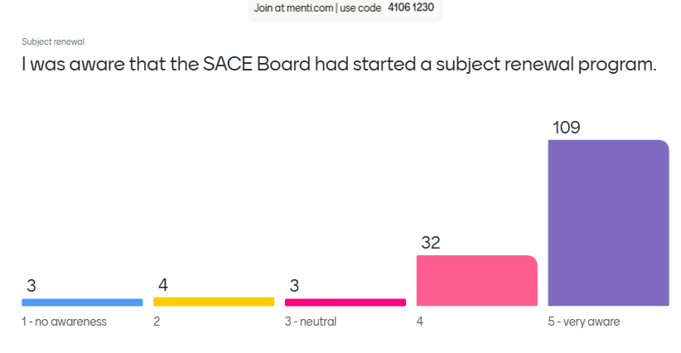
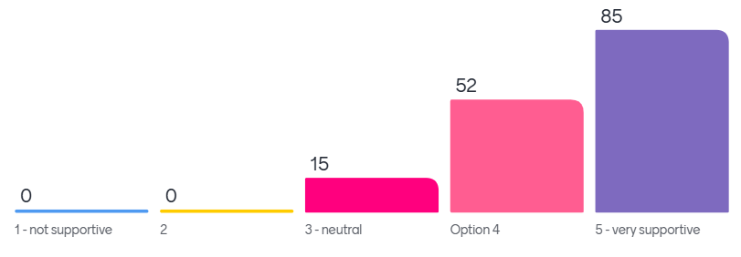
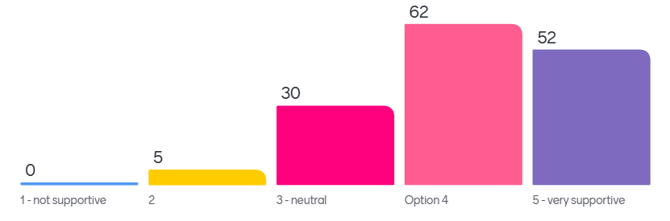
Subject Renewal
I was aware that the SACE Board had started a Subject Renewal program
I am supportive of the drivers for Subject Renewal: Agency, Deep authentic learning, Natural evidence of learning, Metacognition and Capabilities
I am supportive of the direction for Subject Renewal.
What information do you need right now to support your teachers?
Feedback opportunities
Progress updates
Capabilities information
Timelines
Presentation slides

Slide 3
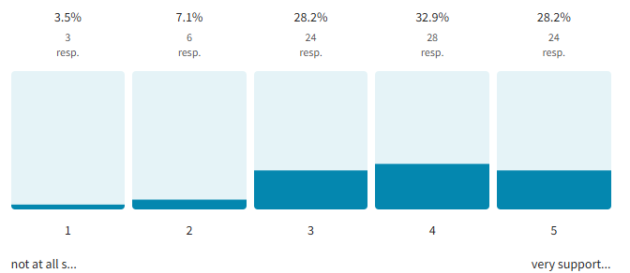
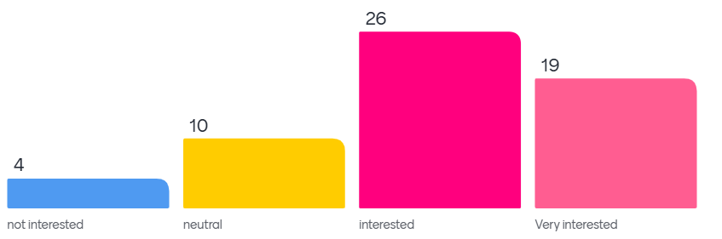
Capabilities and Learner Profile
How supportive are you of the SACE Board's strategic vision and direction for Capabilities and Learner Profile?
What opportunities do you see?
Replacing ATAR – if universities/employers buy in, LP could revolutionize credentialing
Supporting diverse learners – esp. those underserved by traditional exams.
Real-world skill recognition – helping students articulate strengths beyond grades.
Teacher & system growth – shifting pedagogy toward student-centered, capability-focused learning.
3.8 average rating
What do you need?
Concrete examples – rubrics, sample assessments, and case studies.
Tertiary & employer recognition – SATAC/uni engagement is crucial.
Digital tools – e-portfolios for easy evidence collection.
Teacher support – PD, workload considerations, and clear guidelines.
Flexible but standardised framework – balance consistency and school autonomy.
Clarity on future use – will this replace ATAR? how will it benefit students?
Where are you on the interest curve?

Slide 4
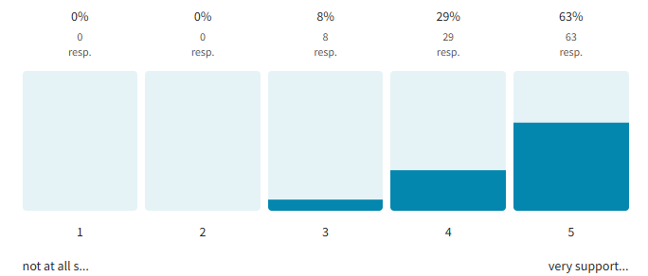
Recognition of Aboriginal Cultural Knowledge and Learning
How supportive are you of the SACE Board's strategic vision and direction for Recognition of Aboriginal Cultural Knowledge and Learning?
What resonates?
Cultural Justice – valuing Indigenous knowledge in formal education.
Student Pride & Belonging – students see their culture as an asset.
Alternative Pathways – credits for real-world, community-based learning.
Potential Expansion – could this model work for other marginalized groups?
Challenges
Scalability – small schools, disconnected students
Tertiary/Employment Recognition – how will universities treat these credits?
Resources & Training – how can schools without strong community ties implement this?
4.5 average rating

Slide 5
Stage 2 Activating Identities and Futures (AIF)
What resonates?
Key challenges
Engagement & authentic learning.
Students excited by choice and deep interest in topics.
Student agency. Self-directed learning. Fosters independence.
Positive shift from traditional teacher-directed models.
Teachers struggling to move away from scaffolding and templates
Students used to being "spoon-fed" may resist.
Fear of AIF becoming over-structured, formulaic.
Ensuring fairness and consistency in grading
Positive experiences in pilot schools.
Confirmation that AIF is working
Success stories of disengaged students
Metacognition & lifelong learning.
Preparing students for learning beyond school.
Teacher workload & resourcing.
Teacher capacity for new pedagogy.
Student readiness
Need for earlier development of metacognition, agency (eg. in middle years)
Natural evidence & capabilities
Valuing real-world learning.
Support for capabilities-based assessment.
Teacher mindset & pedagogy shift.
Moving from a directive role to a facilitator role.
Passionate teachers are key.
Equity & accessibility
Avoiding disadvantaging vulnerable learners in open-ended tasks.
Parents/universities may not value AIF like traditional subjects.
Balancing AIF with ATAR & other SACE requirements

Slide 6
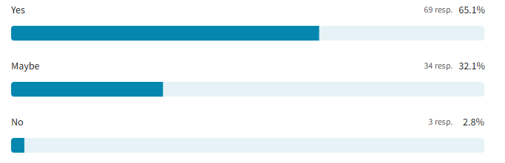
Communication and engagement
What type of discussion or resource would you value?
sharing ideas, experiences, recommendations and success stories of
pilot programs
implementing capabilities
natural evidence of learning etc.
moderation processes
trends in global education informing learning design and subject renewal
SACE updates suitable for sharing in staff bulletin
aligning SA curriculum with SACE directions
timetabling, making room for new initiatives
innovative ways schools support students to achieve their SACE
sharing videos or student work demonstrating agency
addressing concerns widely held by other leaders
innovative practices to offer individualised SACE experiences
networking and communication with others in similar roles
how leaders are driving SACE improvement
special provisions processes
Would a PLATO Connect site exclusively for Teaching and Learning Leaders to share leadership and advice and resources be useful?

