Slide 1
SACE Subject Renewal update
Communication slides prepared by the SACE Board for use by Teaching and Learning Leaders to raise awareness of the subject renewal program with the Leaders within their school, including activities for them to run with Teachers.
Notes:
We encourage you to adapt and tailor this content to your own school context.
The slides are designed for you to add your own school branding and images of your students.
If your school has an SRG member, they may like to speak to their experience.

Slide 2
SACE Subject Renewal
What this means for our school
A starting point for conversation and planning
Notes:
This presentation is designed to support us to:
understand SACE Board’s subject renewal
begin thinking about what it means in our context and how we can support our teachers to engage with this change
This is a starting point for discussion and exploration

Slide 3

Challenges students face today
Rise of Artificial Intelligence
Focus on mental health
& wellbeing
Dissatisfaction with using grades and ranks to define success
Today, the processing power and speed of artificial intelligence is changing the way we access and use knowledge.
Today, more than 25% of young people meet the criteria for experiencing psychological distress and over 50% identify mental health as a top barrier to achieving their study or work goals.¹
Many young people reject the idea that the breadth and depth of what they know and can do is represented in grades and ranks. ²
Sources
¹ 2021, Mission Australia’s Youth Survey 2021
² 2020, Learning Creates Australia - Recognition of learning success for all
Notes:
Young people are facing big challenges in today’s ever-changing world
They need to be prepared for a future they will define and lead.
To be equipped to tackle these challenges, every young person will need to build life-long skills, capabilities, knowledge and understanding.
Subject renewal is one of the key initiatives of the SACE Board’s Passport to Thrive Strategic Plan, designed to ensure the SACE remains a modern and responsive qualification for a changing world
For students, the renewed SACE will incorporate a fuller appreciation of what students know and can do—not just their performance in tests or exams
For teachers, subject renewal will recognise the vital role of teachers in understanding where each student is at in their development, knowing when to provide support, and when to step back and allow them to flourish
The process is collaborative and co-designed, drawing on the expertise of teachers, leaders, and students across sectors

Slide 4


  SACE subject renewal overview
The aim of subject renewal is to:
through enabling the key drivers:
Sharpen content & assessment
Agency
Acting independently in life towards a purpose
Metacognition
Going beyond “What have I learned” and asking “How did I learn it?” and "How can I learn more?"
Drivers
Deep Authentic Learning
Rich, relevant, meaningful transferred to real experiences
Intentionally develop capabilities
Natural Evidence of Learning
Naturally occurring, captured in the moment, genuine and not artificially polished
Thrive.
Notes:
Subject renewal is a process to co-design subjects with the community; that will sharpen content and assessment and intentionally develop capabilities.
This will be achieved through enabling the key drivers of:
Agency
Metacognition
Deep Authentic Learning
Natural evidence of Learning
These key drivers are lenses, not checklists
We already see these in parts of our practice
The shift is about making them more intentional and visible

Slide 5
  What is changing?
From
Task-focused
End-point assessment
Teacher-directed
One way to show learning
To
Learning-focused
Ongoing evidence
More student agency
Multiple forms of evidence
Thrive.
Notes:
This is not about replacing everything
It’s about shifting emphasis
Many of these things are already present — but may become more intentional

Slide 6
  Follow the journey
Following the journey
The SACE and Subject Renewal Groups (SRGs) are designing the following artefacts
Vision
Statement
Subject
Blueprint
Subject
Prototype
Subject
Design Map
Subject
Outline
  Defines the
  big picture
  A clear and inspiring description of what the subject aims to achieve in the future
  Maps the plan
  A conceptual plan
  that shows how the key drivers will come to life
  Tests the ideas
  A practical trial of key concepts, learning design, and assessment approaches
  Brings it all together
  A structured document that consolidates insights from the vision, blueprint and prototypes
  Sets the policy
  The accredited policy document for the subject
Thrive.
Notes:
These are the artefacts that subject renewal groups will be developing throughout the subject renewal journey
Vision statement: A clear and inspiring description of what the subject aims to achieve in the future
Subject Blueprint: A conceptual plan that shows how the key drivers will come to life
Subject Prototypes: A practical trial of key concepts, learning design, and assessment approaches
Subject Design Map: A structured guide that consolidates insights from the vision, blueprint, and prototypes
Subject Outline: The official policy document for the subject
As the subject renewal groups progress through the process, they will be sharing these artefacts on the subject mini-site. This is a great way to stay up to date on the progress of each subject and understand the vision for the future.
Before a subject outline is accredited, there will be an opportunity for community consultation, where you can review and provide feedback.

Slide 7
  What will SACE provide before implementation?
SACE will provide:
Implementation timelines
Professional learning (for Teachers and Leaders)
PLATO
Other resources: example LAP, samples etc
Thrive.
Notes:
The SACE Board have confirmed they will provide support before implementation, this includes
Clear timelines
Professional learning for Teachers and school leaders
PLATO courses and/or community of practices
Other key resources

Slide 8
  Preparing for change
Questions to explore with your team:
What does good learning already look like here?
Where could we increase student agency?
What evidence of learning do we value?
What could we try next term in Stage 1?
SCHOOL BRANDING HERE
SCHOOL BRANDING HERE
Notes:
We can start supporting our teachers now for the change
We can start having conversations with our team now, to help deepen their understanding of the key drivers and consider where these already appear in the current state
We can try different forms of evidence, introduce metacognition and agency within existing subjects. Stage 1 is a good place to give things a go.

Slide 9
  Preparing for change
Create conditions for teachers to try something different
How we might prepare our staff
Create space for collaboration
Start small
Share practice and reflect
Provide reassurance
SCHOOL BRANDING HERE
SCHOOL BRANDING HERE
Notes:
This isn't a one-off conversation, continue creating space for conversations, experimentation and reflection

Slide 10
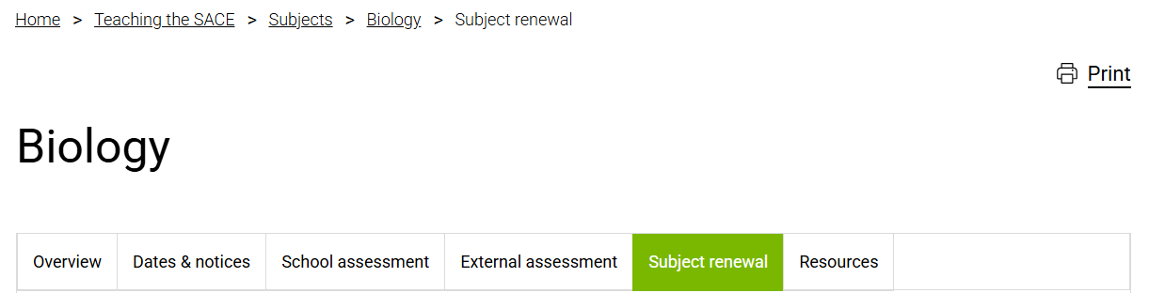
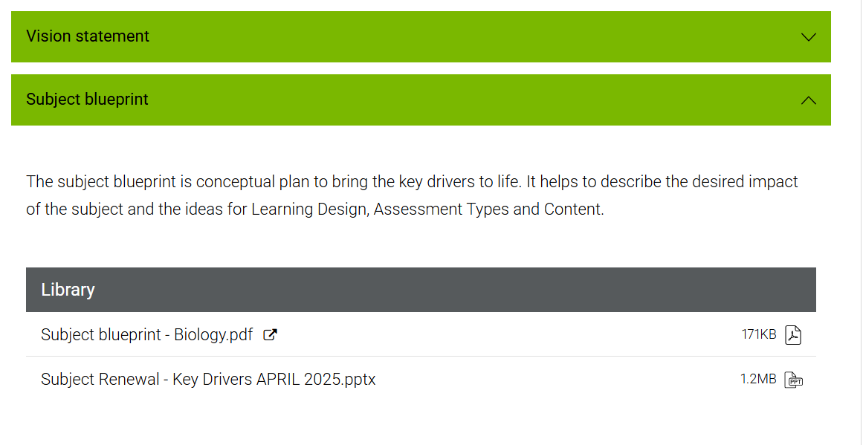
  Try something different
Trying something different
Activity:
Visit the subjects on the SACE website
Look at artefacts such as:
  Vision statements
  Subject blueprints
Consider:
  What is being valued more?
  What looks different?
SCHOOL BRANDING HERE
SCHOOL BRANDING HERE
Notes:
Key messages:
The SACE Board website publishes quarterly updates on the progress of the subject renewal program.
For group 1 and some group 2 subjects this includes a new Subject Renewal section within the subject sections, containing copies of the key artefacts including:
vision statement
subject blueprint
… with more artefacts to be added as the subject progresses
These minisites give us a window into the future
They are not final — they show thinking in progress
This is one of the most practical ways to start building understanding with our Teachers

Slide 11
  Key messages for our school
Subject renewal is about deepening learning, not adding more
Many of these practices already exist, we are making them more intentional
Support and time will be provided before implementation
We can start small now
SCHOOL BRANDING HERE
SCHOOL BRANDING HERE

Slide 12
  What happens next?
The first subjects will be implemented for teaching in 2028
SACE will provide implementation support in 2027
Public consultation on the first subject outlines will occur before implementation
Thrive.

