Slide 1
The Research Project
Thinking about a research outcome

Slide 2
The research outcome
The research outcome is the answer to your research question that is substantiated by evidence and examples from your research.
You may present this in any format you choose and the purpose of this power point is to highlight some examples of less conventional formats.
It will also provide guidance on possible methods to substantiate and evidence your research.

Slide 3
Substantiation
Substantiation is backing up your findings. There are two ways to approach this:
  1 You need to provide evidence of where your ideas came from
  OR
  2 You need to explain how you carried out your research and give reasons for your chosen methodology.

Slide 4
The research outcome
Hopefully the research outcomes featured here will inspire you to think of novel and unique ways to produce your research outcome.
The slides which follow are selected examples of research outcomes.

Slide 5
The research outcome
  The research outcomes shown in this power point are organised as follows:
  key findings and substantiation, which together form a product
  key findings and substantiation, with parts of, or reference to, a separate product
  key findings which are annotations on a product, with substantiation from evidence and examples of the research

Slide 6
Key findings and substantiation, which together form a product

Slide 7
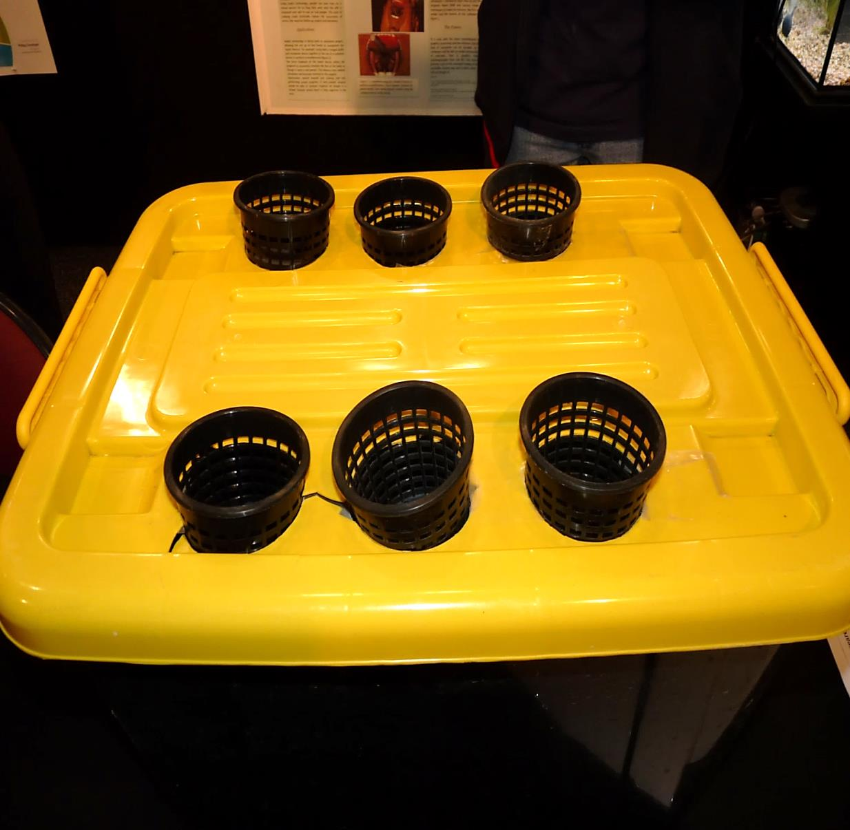
A documented science experiment, detailing methodology.
How do environmental factors affect the growth of vegetation in an aeroponics system?

Slide 8
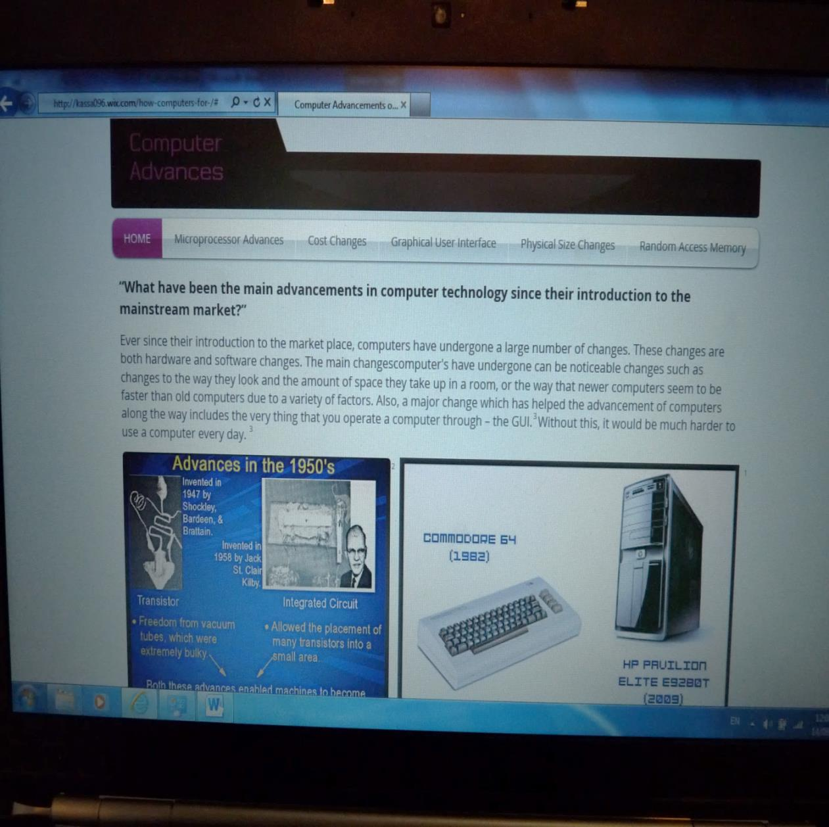
A web page with in-text referencing.
What are the main advancements in computer technologies since their introduction?

Slide 9
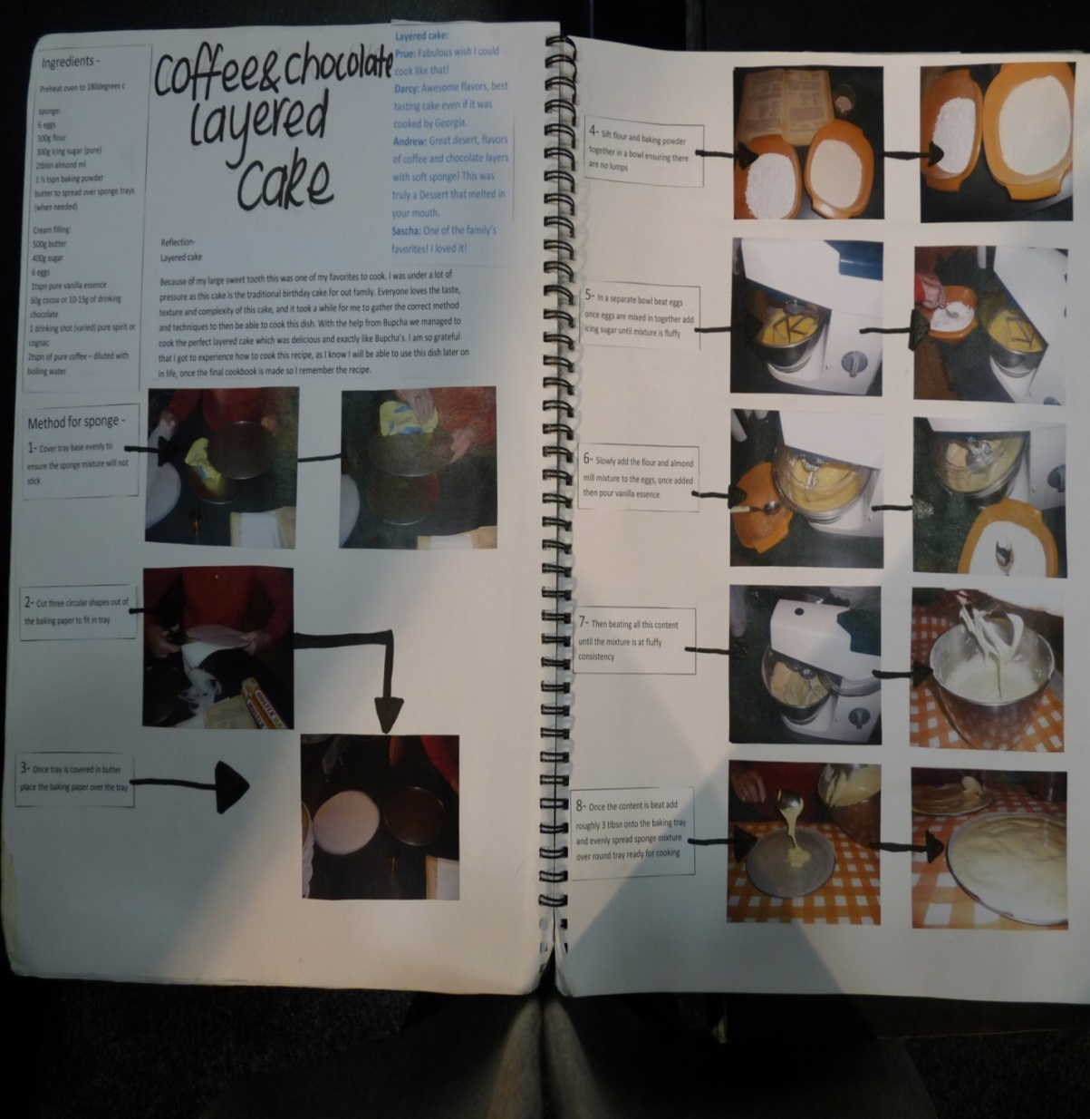
A recipe book with
explanation of the
methodology throughout.
What are the secret recipes to my grandma’s Polish cooking?

Slide 10
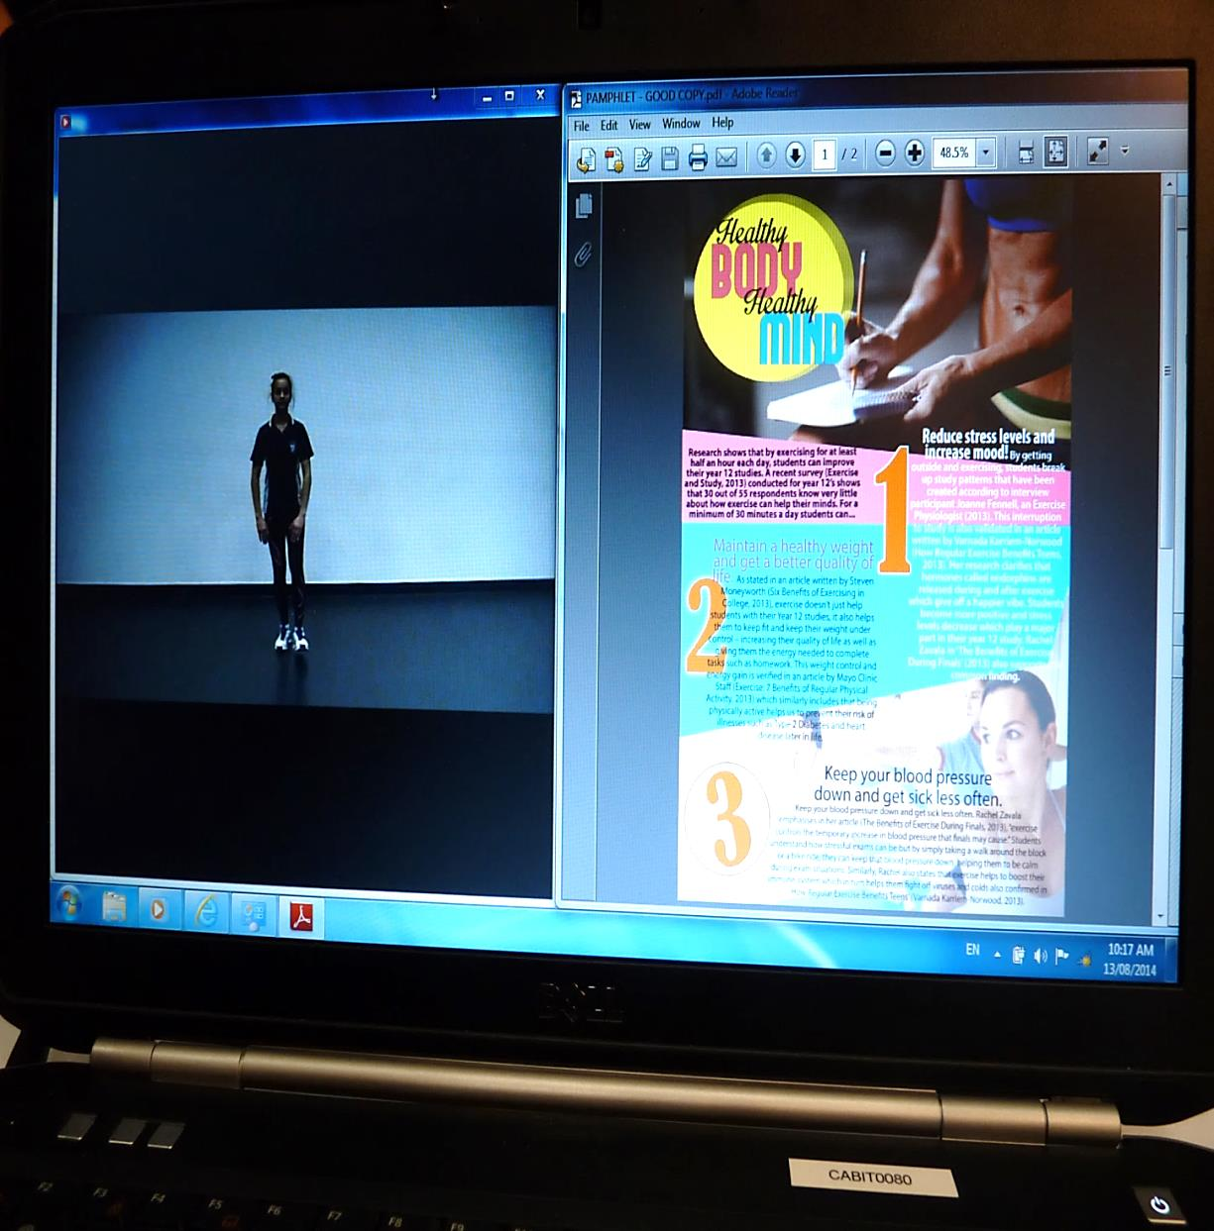
A pamphlet and a
referenced oral history
explaining where the ideas
originated from.
What are the mental and physical health benefits of exercise during Year 12 study?

Slide 11
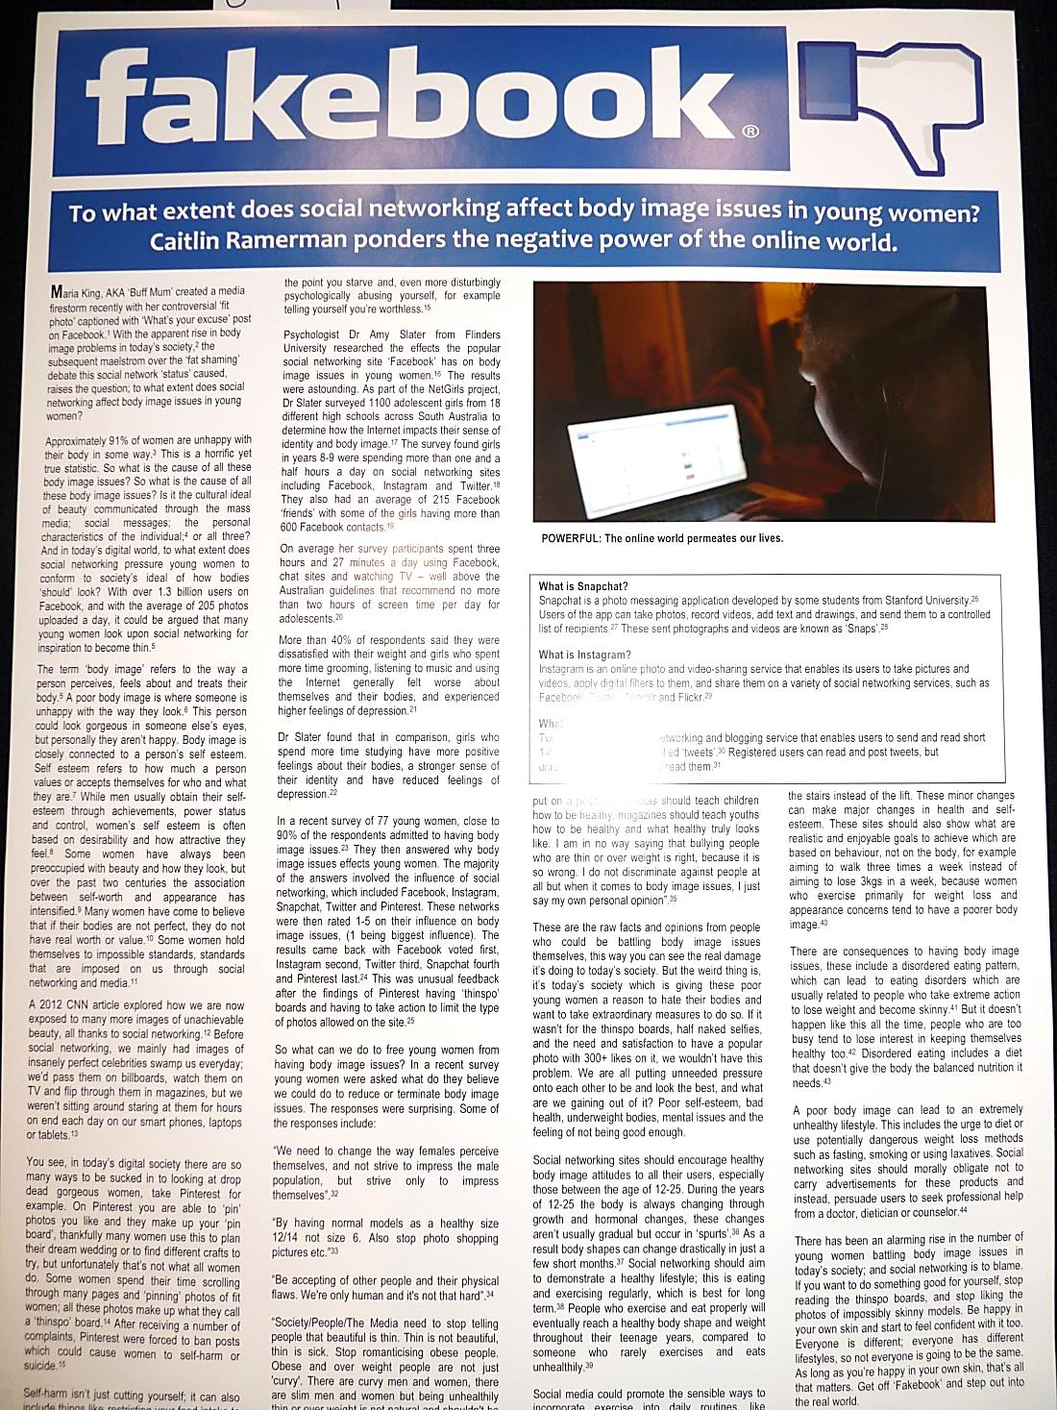
A poster with footnotes and a
bibliography.
To what extent does social networking affect body issues in young women?

Slide 12
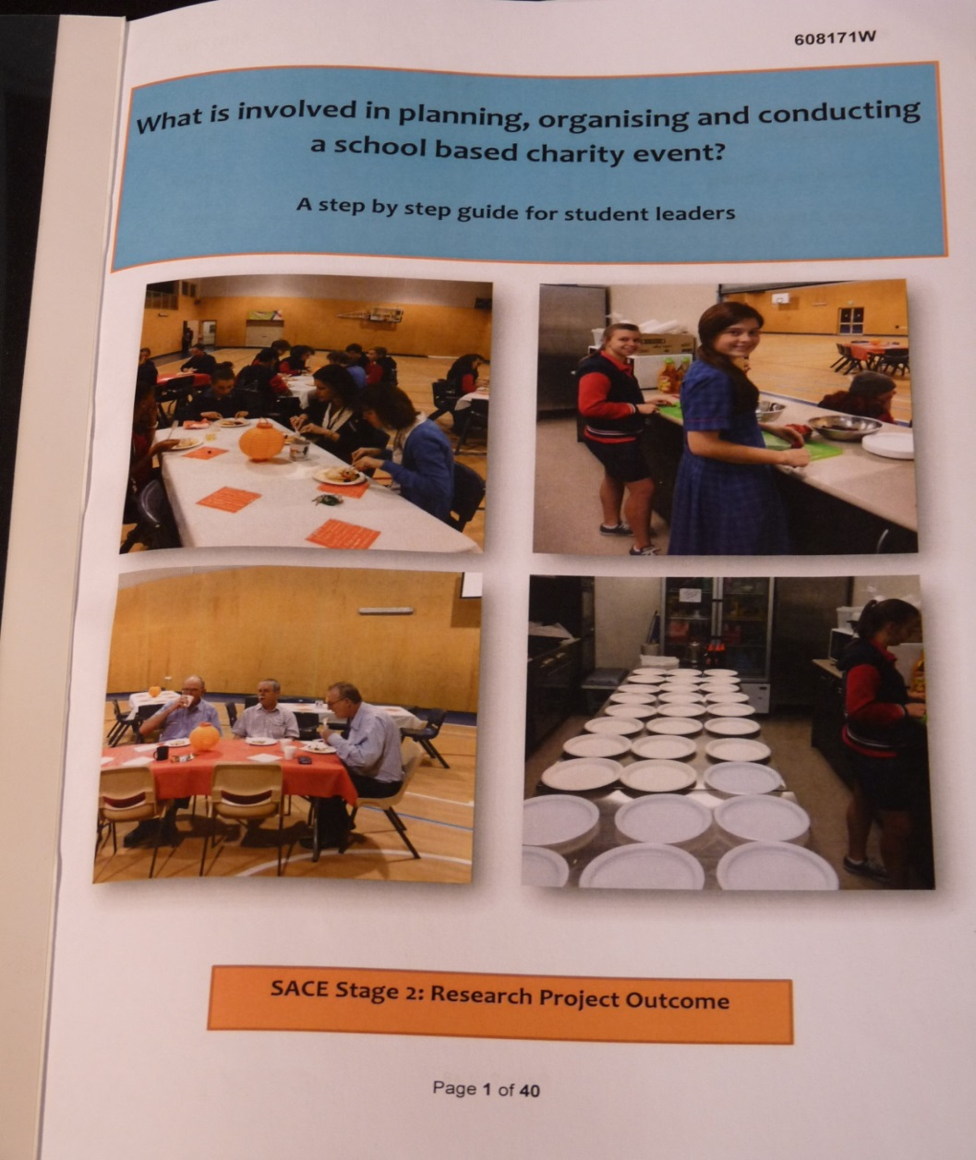
A guidebook with explanation
of the research steps
throughout.
What is involved in planning, organising and conducting a school based charity event?

Slide 13
Key findings and substantiation, with parts of, or reference to, a separate product

Slide 14
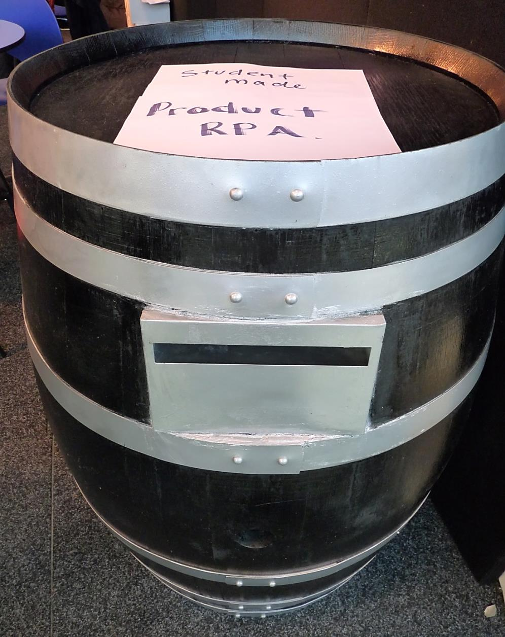
A mailbox with annotated photos of it being constructed.
How do I design and construct a mailbox as a housewarming gift?

Slide 15
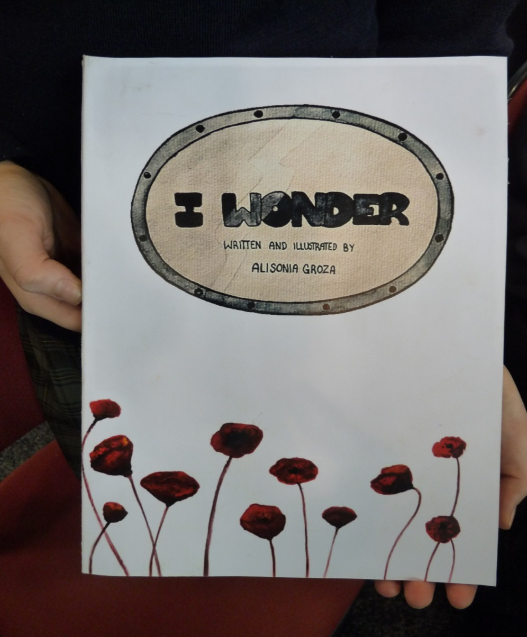
A children’s book with a written record of background research.
How can I explain the significance of
World War One to children aged 5 to 7
through a book?

Slide 16
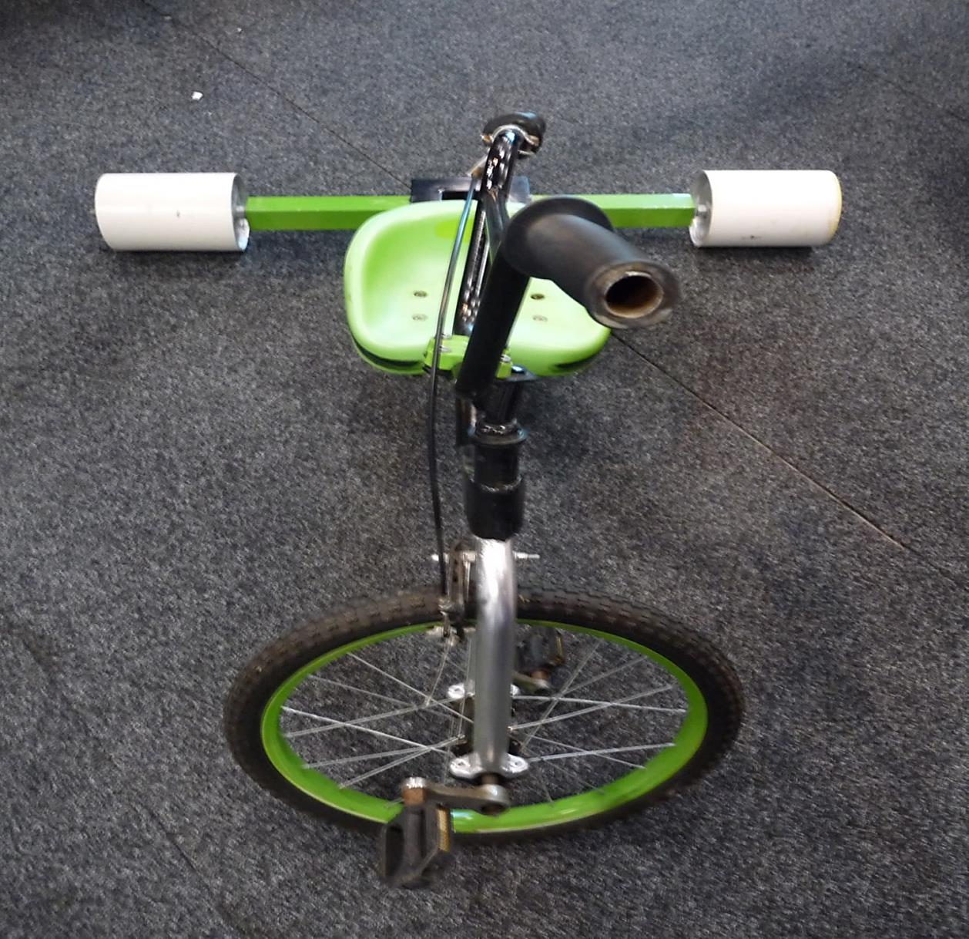
A motorised drift bike with a guide detailing the steps in its construction.
How do I build a drift trike?

Slide 17
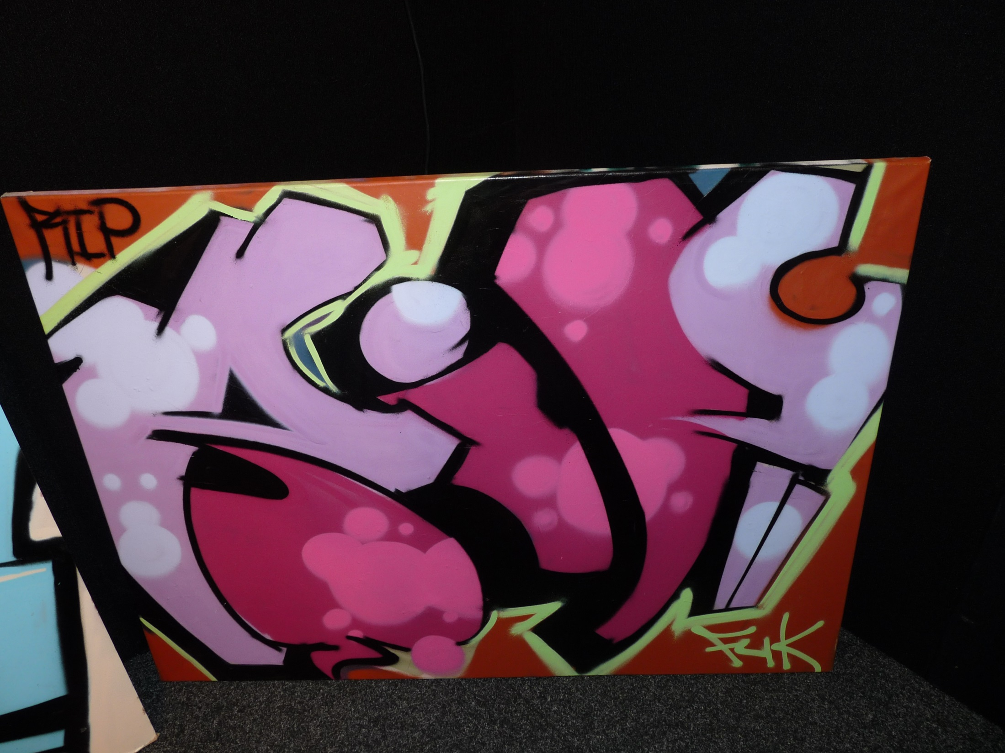
Urban artwork with
annotated sketches of the
work in progress and
reviewed photographs of
similar art works.
How can I develop urban art designs that reflect a high level of technique?

Slide 18
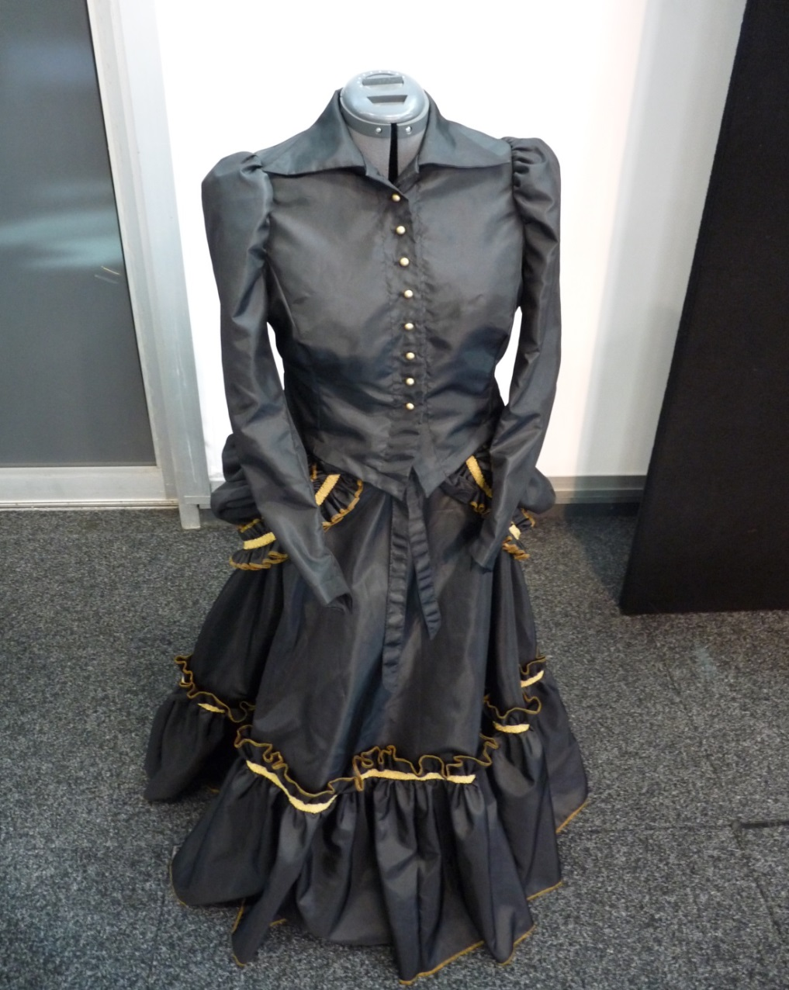
A Victorian style dress with
a scrapbook referencing ideas
and explaining methodology.
What are the challenges to producing a Victorian style dress?

Slide 19
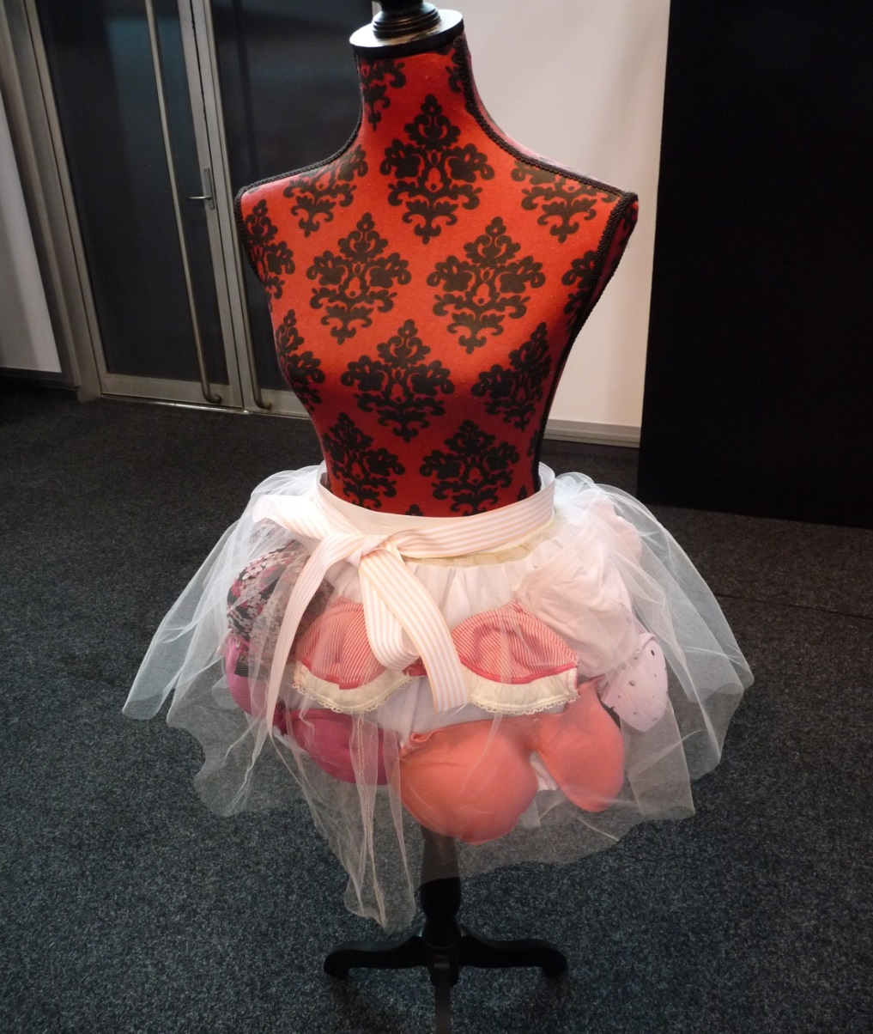
A skirt made from bras and a poster with a written explanation of methodology illustrated through photos, sketches, material swatches and sewing techniques.
How can I incorporate my love of fashion with my desire to raise awareness for the Breast Cancer Foundation?

Slide 20
Key findings annotated on a product, with substantiation from evidence and examples of the research

Slide 21
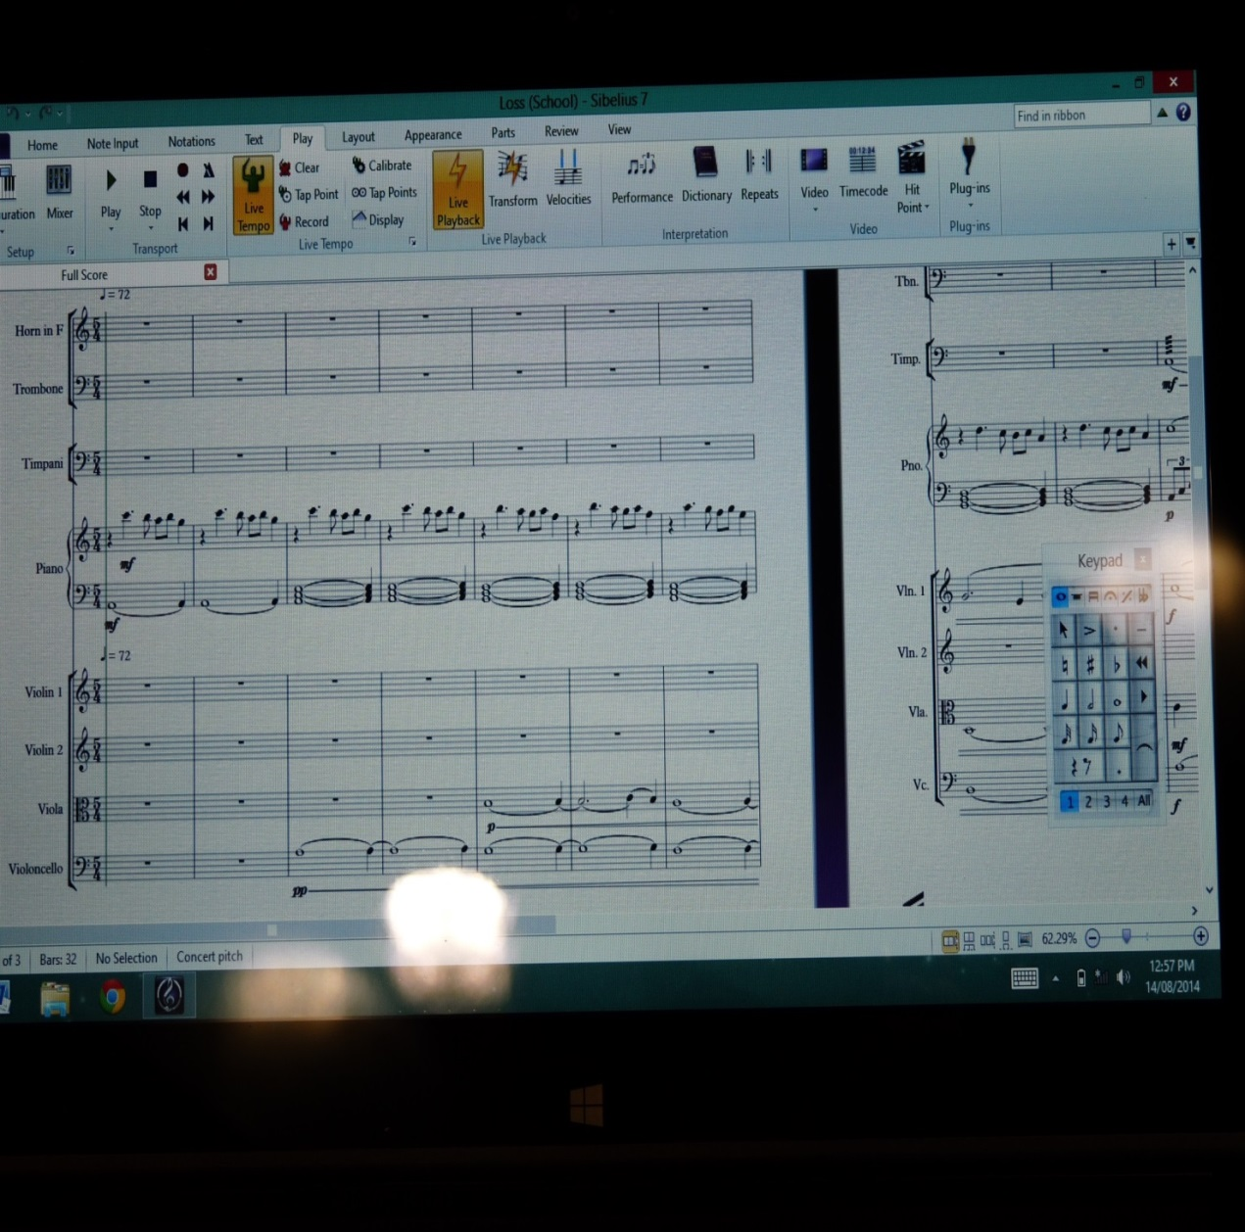
A recording of the film
soundtrack with notes,
and a written journal
with evidence of the
research.
What is the process of scoring a soundtrack for a film?

Slide 22
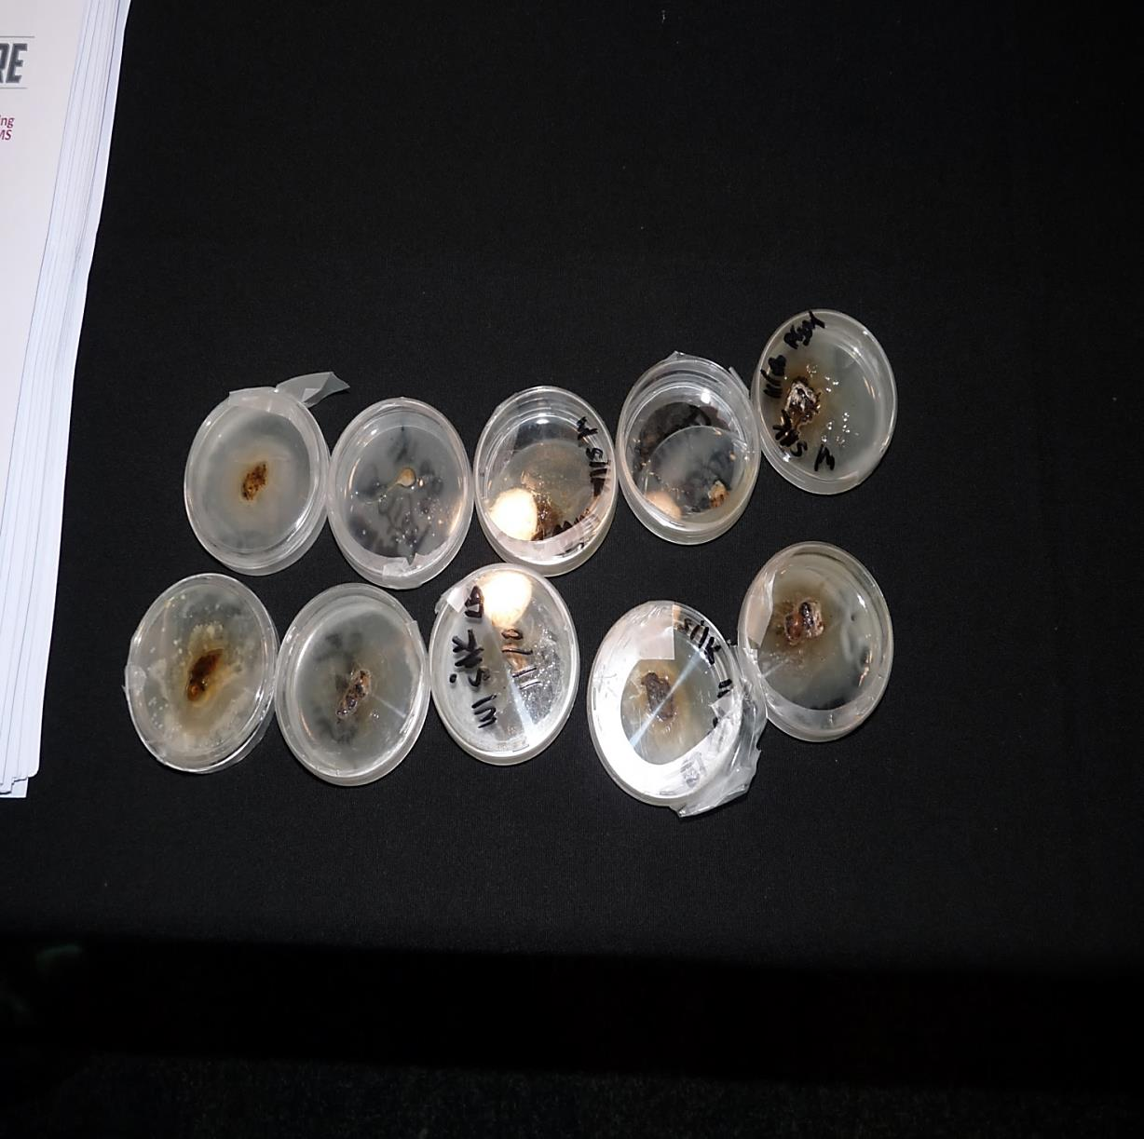
A video of the experiment
With notes and an
annotated log book.
How can spider silk assist in the repairing of damaged human tissue?

Slide 23
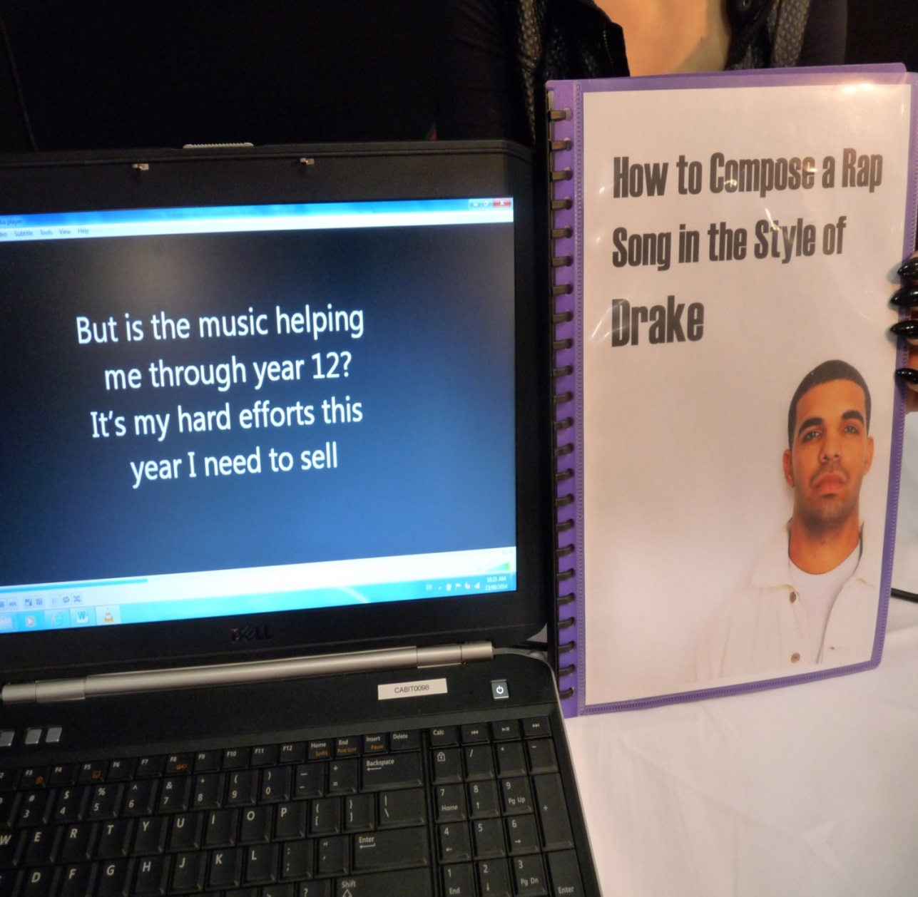
A recording of the song
being performed with
notes and a guidebook
explaining the
methodology.
How do I compose a rap song in the style of Drake?

Slide 24
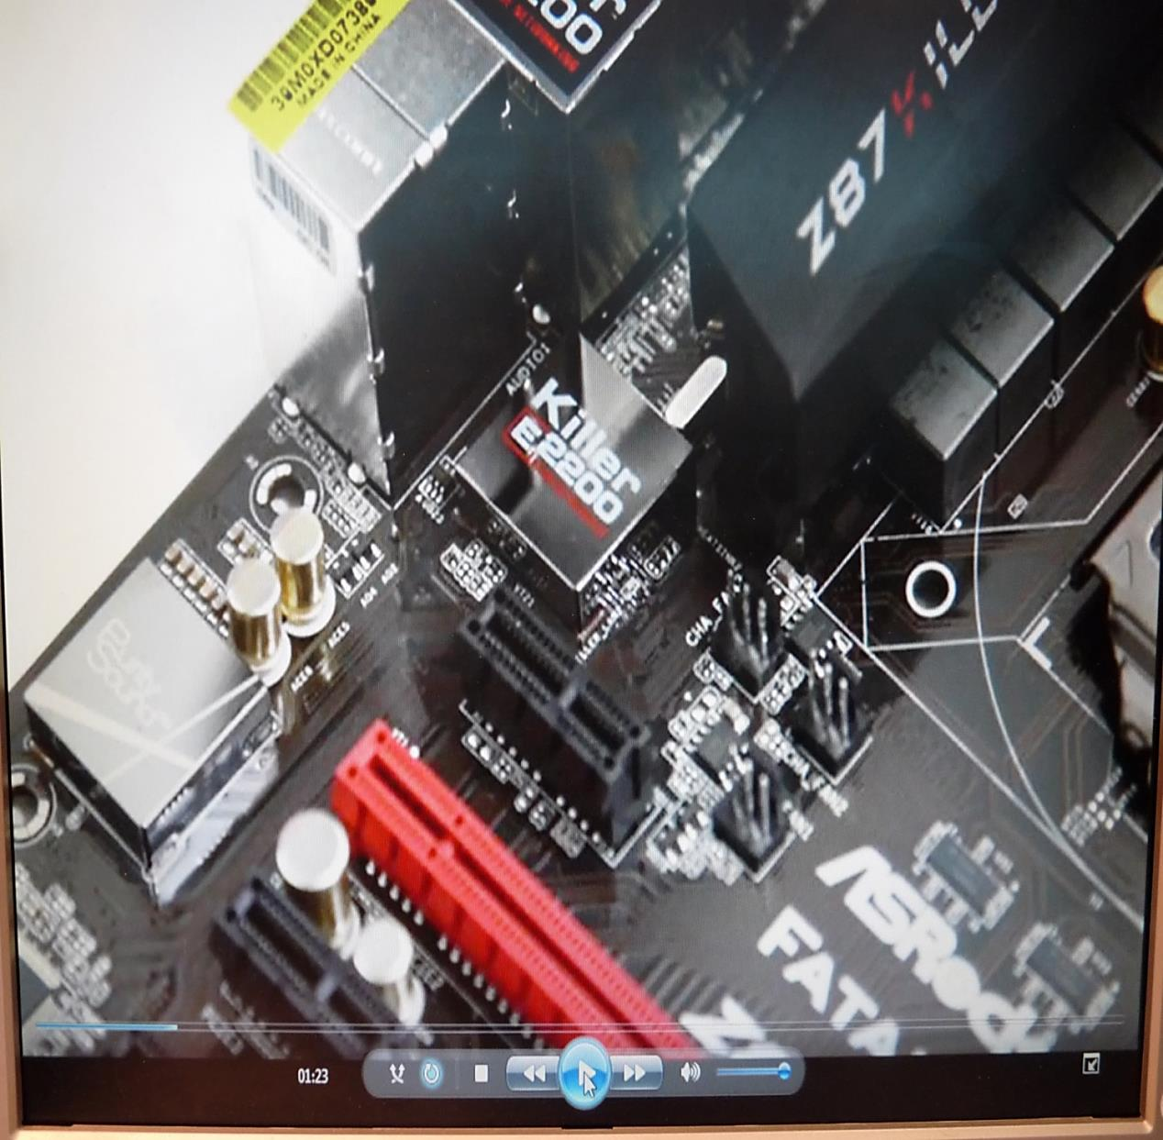
A video of the
construction of a
computer circuit board
with notes and a referenced written report.
How do go about building a computer?

Slide 25
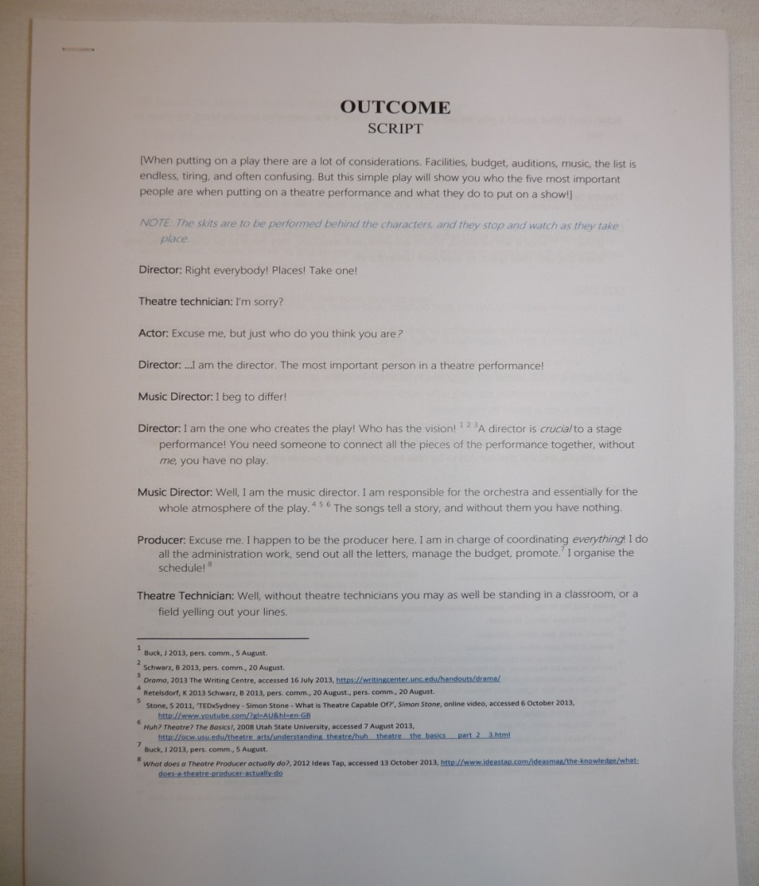
A recorded performance of the
play and a script with in-text
referencing and a reference list.
What are the most significant processes that are completed by the Director, Music Director, Actors, Producer and Theatre Technicians to put on a theatre
production? (student produced a script).

Slide 26
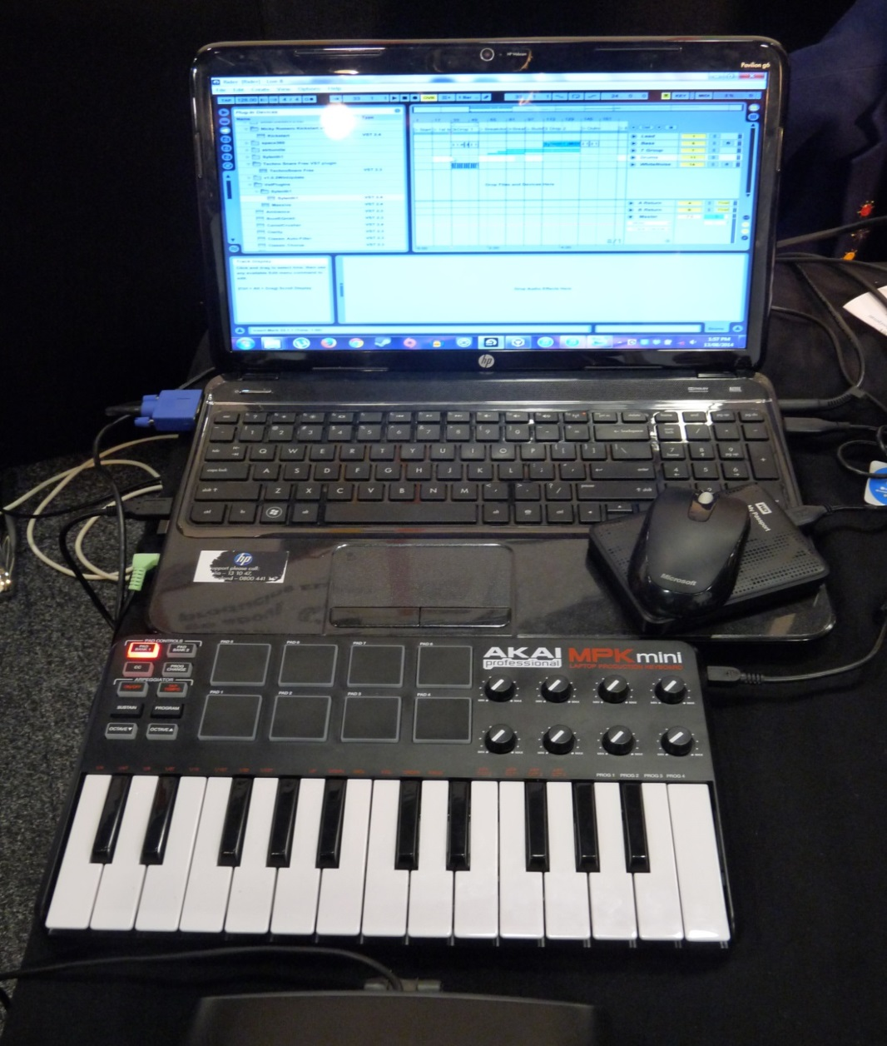
A recording of the music with
notes and research evidence on
the computer screen.
How does one go about producing
Electronic Dance Music?

Slide 27
Research outcome
Hopefully the previous slides will have given you some insight into how creative you can be with the format of your outcome.
You can discuss your ideas with your teacher and negotiate a suitable format for your outcome.
GOOD LUCK!!

