Slide 1
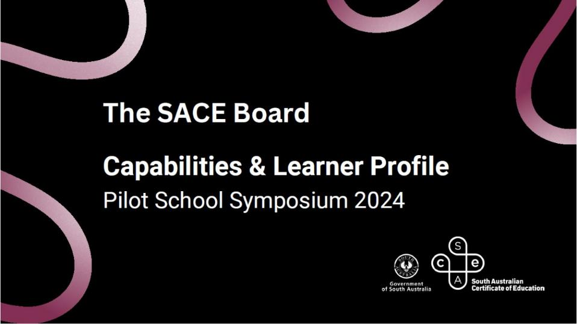
Education for the Age of Artificial Intelligence:
Seminar with Charles Fadel
Education for the Age of Artificial Intelligence:
Seminar with Charles Fadel
Notes:
Holding slide as attendees enter/arrive

Slide 2
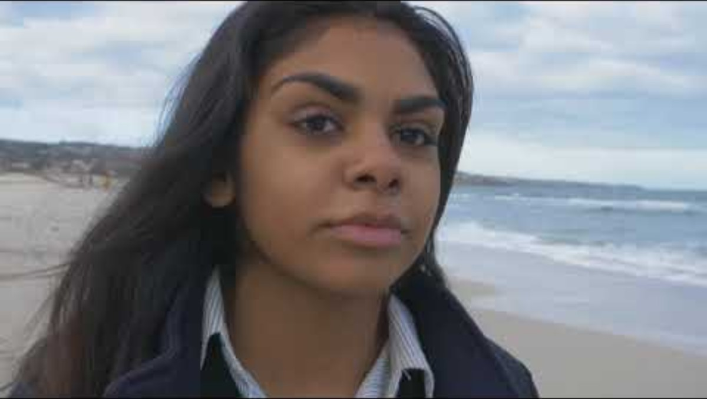
Notes:
MC:
Acknowledgment of country

Slide 3







Free Parking
Please see us
Tea & Coffee
Please help yourself
Emergency
Follow directions of function centre staff.
Be Present
Please turn off phones
WIFI
WIFI SSID : SACE
PASSWORD: SACE2025!!
Welcome. We are so happy you are here.
Notes:
MC:
Housekeeping
Intro Michaela

Slide 4


Hassan Mekawy
Director, Education Services
SACE Board of South Australia
Notes:
Michaela
Spoken acknowledgment of country

Slide 5
















Paradigm shift
OFFICIAL
Notes:
Narrative: The original value proposition remains strong
The 2024-2027 Strategic Plan and research continues to provide context for WHY these key drivers are important, continues to grapple with new educational possibilities and captures those who are moving with us
“We need nothing less than a paradigm shift in our understanding about how best to
create assessment systems that use more effective ways of evidencing the full range
of student progress.”
Bill Lucas, 2022

Slide 6



Supporting students to thrive in our changing world…
Rise of Artificial Intelligence
Focus on mental health
& wellbeing
Dissatisfaction with using grades and ranks to define success
Today, the processing power and speed of artificial intelligence is changing the way we access and use knowledge.
Today, more than 25% of young people meet the criteria for experiencing psychological distress and over 50% identify mental health as a top barrier to achieving their study or work goals.¹
Many young people reject the idea that the breadth and depth of what they know and can do is represented in grades and ranks. ²
Sources
¹ 2021, Mission Australia’s Youth Survey
² 2020, Learning Creates Australia - Recognition of learning success for all
Notes:
Our students are growing up in a world that is constantly changing and looks very different to when were at school . Young people are navigating the influences of AI, climate change, mental health, job insecurity, global instability and the changing definitions of success. This new world demands us to broaden our understanding of what it means for students to succeed. It’s not just about the final scores they receive at the end of 13 years of compulsory schooling – especially in a world where students are navigating so much uncertainty and complexity. We know that our students are so much more than the ATAR or any set of grades, and that their education must reflect that.

Slide 7

Passport
to Thrive
Notes:
Our new strategic plan is like a renewed
have the capabilities to thrive in work, further study and life.
subject renewal is a significant commitment to working with schools to modernise their subjects using key drivers;
embedding capabilities and
responding to the challenge and opportunity AI brings.

Slide 8



Responding to the challenges and opportunities of AI…
Phase 1: Learn & Grow – Engage with relevant expertise to develop contextual understanding.
Phase 2: Test & Share – Refine in practice through subject renewal, develop & refine targeted content and changes.
Phase 3: Scale & Evolve – Ongoing adaptation; provide a broader range of support materials, exemplars, and policy guidance
Notes:
We acknowledge verification and integrity issues
Therefore, AI prevention is not the focus of today
Phase 1: Learn & Grow – understand the new contexts that AI has created, and the likely trajectory of future developments.
strong foundation of understanding is essential to ensure our curriculum, policies, and structures evolve meaningfully.
Phase 2: Test & Share –
Phase 3: Scale & Evolve - no final destination—only continuous adaptation.
We acknowledge verification and integrity issues: Educators are right to be concerned about misuse of AI and we are just as concerned as you, but have confidence in the professionalism and integrity of our teachers and school leaders. But, we will fail if we only focus on restricting and detecting AI. We need to ask: “What should students learn in a world where AI is a constant companion?”
Therefore, AI prevention is not the focus of today. WE are not here today to focus on detection tools or plagiarism. If that is our only response to AI, we’ve missed the bigger picture ,and we will fail our students. AI challenges us to redefine what is uniquely humane in learning and we need to ensure students are equipped to harness, not fear these tools. We need to look at how we can rethink learning with AI as a tool to support a new opportunities for learning.
The SACE has a three phased approach to responding to the challenges and opportunities of AI.
Phase 1: Learn & Grow – Engage with relevant expertise to develop contextual understanding.
Phase 2: Test & Share – Refine in practise through subject renewal, develop & refine targeted content and changes.
Phase 3: Scale & Evolve – Ongoing adaptation; provide a broader range of support material, exemplars, and policy guidance
We have had the pleasure of Charels Fadel Working with our staff for the past three month and we are very fortunate and excited to have the pleasure of having him here with us today to support us on this journey.
Notes below are for your information only, not for speaking to.
Phase 1: Learning and Growing
This initial phase began last year and continues into this year. Its about deepening our understanding of the nature, and the educational implications of, AI technology.
To shape a curriculum that remains fit for purpose, we must first understand the new contexts that AI has created, and the likely trajectory of future developments.
This phase involves engaging with a wide range of expertise—including teacher practitioners, local experts, academics, and global education leaders. The goal is to explore the contemporary needs of education, how AI can be used effectively and how it will shape the future of education.
Starting from a strong foundation of understanding is essential to ensure our curriculum, policies, and structures evolve meaningfully.
Phase 2: Applying Understanding through Subject Renewal
We are now transitioning into the second phase, which is about putting our understanding into practice—particularly through the timely and intentional process of subject renewal.
This involves:
Co-designing with curriculum groups and the broader community.
Exploring how design thinking must evolve in response to current and future AI capabilities.
Considering what students will need to know and what qualifications will be valued in the future.
Our understanding is being tested daily as we thoughtfully design new subjects. This work enables us to:
Provide relevant, contextual advice to teachers and schools.
Make informed policy adjustments based on tested and effective learning through prototyping and curriculum development.
Phase 3: Scale and Evolve
The third phase is about scaling up and sustaining our efforts. It’s important to acknowledge that this work is ongoing. There is no final destination—only continuous adaptation.
We aim to:
Support ongoing evolution in curriculum, qualifications, and community engagement.
Provide a broader range of support materials, exemplars, and policy guidance.
Ensure schools are equipped to deliver subjects as intended, for the benefit of all students.
This phase is about sharing more, more often, and being at the forefront of curriculum design thinking—with the new contexts created by AI and emerging technologies, as a central focus.

Slide 9
Education for the Age of Artificial Intelligence:
Seminar with Charles Fadel
Education for the Age of Artificial Intelligence:
Seminar with Charles Fadel
Notes:
It is now my great pleasure to introduce Charles Fadel, founder and chairman of the Centre for Curriculum Re-design based in Boston, Massachusetts, a non-profit whose mission is to answer the fundamental question: “What should students learn for the 21st century?”
A globally recognized thought leader in education; Charles’ influence spans across curriculum design, future skills, and global education reform. He emphasizes the need for education to be future-focused - preparing students not just for jobs, but for lifelong learning and adaptability in a world shaped by AI, automation, and global challenges.
He has worked with organizations like the OECD, UNESCO, and various ministries of education, helping shape policy and curriculum reform.
He has written several papers for publication and co authored “Education for the Age of AI”; “Artificial Intelligence in Education”; “Four-Dimension Education Framework”; and “21st Century skills”.
The SACE board has had the privilege to work with Charles recently, to support our subject renewal program of work. He has helped shape how we think about future ready learning, challenging us to go beyond surface solutions and instead focus on the purpose of education.
Today Charles will speak to the emerging challenges AI presents and more importantly the opportunities that it presents for us as educators.
Please join me in welcoming Charles Fadel.

Slide 10
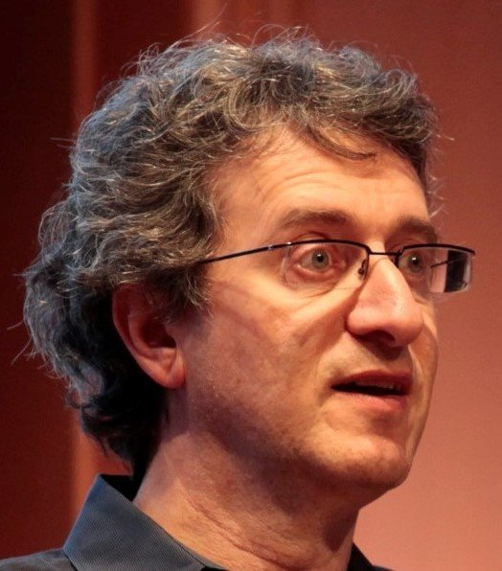
Charles Fadel
Founder and Chairman of
Center for Curriculum Redesign (CCR)
Notes:
It is now my great pleasure to introduce Charles Fadel, founder and chairman of the Centre for Curriculum Re-design based in Boston, Massachusetts, a non-profit whose mission is to answer the fundamental question: “What should students learn for the 21st century?”
A globally recognized thought leader in education; Charles’ influence spans across curriculum design, future skills, and global education reform. He emphasizes the need for education to be future-focused - preparing students not just for jobs, but for lifelong learning and adaptability in a world shaped by AI, automation, and global challenges.
He has worked with organizations like the OECD, UNESCO, and various ministries of education, helping shape policy and curriculum reform.
He has written several papers for publication and co authored “Education for the Age of AI”; “Artificial Intelligence in Education”; “Four-Dimension Education Framework”; and “21st Century skills”.
The SACE board has had the privilege to work with Charles recently, to support our subject renewal program of work. He has helped shape how we think about future ready learning, challenging us to go beyond surface solutions and instead focus on the purpose of education.
Today Charles will speak to the emerging challenges AI presents and more importantly the opportunities that it presents for us as educators.
Please join me in welcoming Charles Fadel.

Slide 11


Education for the Age of AI
Charles.Fadel@CurriculumRedesign.org

Slide 12
Homework: Essential Movies & Books
Movies:
2001, A Space Odyssey
WarGames
Her
HUMANS (TV – 1st season only)
DeepMind AlphaGo documentary
The Last Screenwriter (written by AI)
Books:
I, Robot
Love and Sex with Robots

Slide 13















Communication
Quantity x Velocity
Antiquity
Renaissance
20th Century
21st Century
Charles.Fadel@CurriculumRedesign.org
Time
Notes:
Describe axis
Describe Moore’s Law processing power doubling every 18 months, storage doubling every 9 months.
In 200 years, transmission speed has increased 10 BILLION times !!!
The prolific systems theorist Kenneth Boulding, for example, recognized that the scope of perceived technological change in the 1890s and 1920s probably seemed appreciably faster, to the average citizen, than in the 1970's, as those earlier eras involved massively disruptive sociotechnological innovations like the electric dynamo, telegraph, telephone, automobile, radio, assembly line, etc. Human-observed technological acceleration was probably the fastest circa 1900, with today being somewhat less rapidly changing, in outward appearance.

Slide 14






Computing
Computing x Storage
Antiquity
Renaissance
20th Century
21st Century
Charles.Fadel@CurriculumRedesign.org
Time
Notes:
Describe axis
Describe Moore’s Law processing power doubling every 18 months, storage doubling every 9 months.
In 200 years, transmission speed has increased 10 BILLION times !!!
The prolific systems theorist Kenneth Boulding, for example, recognized that the scope of perceived technological change in the 1890s and 1920s probably seemed appreciably faster, to the average citizen, than in the 1970's, as those earlier eras involved massively disruptive sociotechnological innovations like the electric dynamo, telegraph, telephone, automobile, radio, assembly line, etc. Human-observed technological acceleration was probably the fastest circa 1900, with today being somewhat less rapidly changing, in outward appearance.

Slide 15





Cultural Evolution
Antiquity
Renaissance
Enlightenment
Past 100 years
Social Sciences
Social Networks
Axial Age
Charles.Fadel@CurriculumRedesign.org
Time
Notes:
Describe axis
Describe Moore’s Law processing power doubling every 18 months, storage doubling every 9 months.
In 200 years, transmission speed has increased 10 BILLION times !!!
The prolific systems theorist Kenneth Boulding, for example, recognized that the scope of perceived technological change in the 1890s and 1920s probably seemed appreciably faster, to the average citizen, than in the 1970's, as those earlier eras involved massively disruptive sociotechnological innovations like the electric dynamo, telegraph, telephone, automobile, radio, assembly line, etc. Human-observed technological acceleration was probably the fastest circa 1900, with today being somewhat less rapidly changing, in outward appearance.

Slide 16

The road ahead is challenging…
Technological disruptions
Global Warming
Financial inequities
Income inequities
Political partisanship
Pollution (plastic etc.)
Antibiotic Resistance
Religious intolerance
Personal privacy
WARS

Slide 17

Our World
Volatile
Uncertain
Complex
Ambiguous

Slide 18
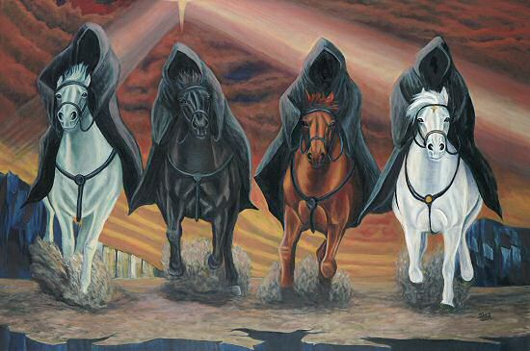
The “Five” Horsemen of the Apocalypse
Evolutionary pressures have selected Selfishness and
Short-term reactivity Clannishness Power of negative Linear mindset
Notes:
…”. Natural selection has:
● Indiscriminately privileged all the personal qualities that contribute to the immediate success of the individual (e.g., selfishness, competitiveness, “All for Me”)
● Privileged traits favoring cohesion within groups, and hostility among different groups (e.g., clannishness, “Us vs. Them”)
● Not privileged the foresight and wisdom needed for sacrificing immediate benefit for the sake of the future (e.g. short-term reactivity, “Now, not Later”)”
To which we add:
● “Follow the Power Leader” – in “VUCA” times, a strong desire to follow a powerful, charismatic, seemingly assured (and very often, self-serving) leader.
● Developed only linear thinking: the problems faced by humanity (climate change, pandemics, etc.) are exponential in nature, which our minds are not geared to understand.

Slide 19

Crosswalk to De Duve
 | Selfishness | Short-Term Reactivity | Clannishness | Power of Negative | Linear Mindset
Courage |  | X
Resilience |  | X
Ethics | X |  | X
Metacognition Metaemotion | X | X | X | X | X
KNOWLEDGE | Social Sciences | Social Sciences | Social Sciences | Social Sciences | STEM

Slide 20
Agenda
Introduction of CCR
AI Hype vs Reality vs Possibilities
AI and Employability
Consequences for Education
  Modern(ized) Knowledge
  Skills, Character, Meta-Learning
  Personalization

Slide 21
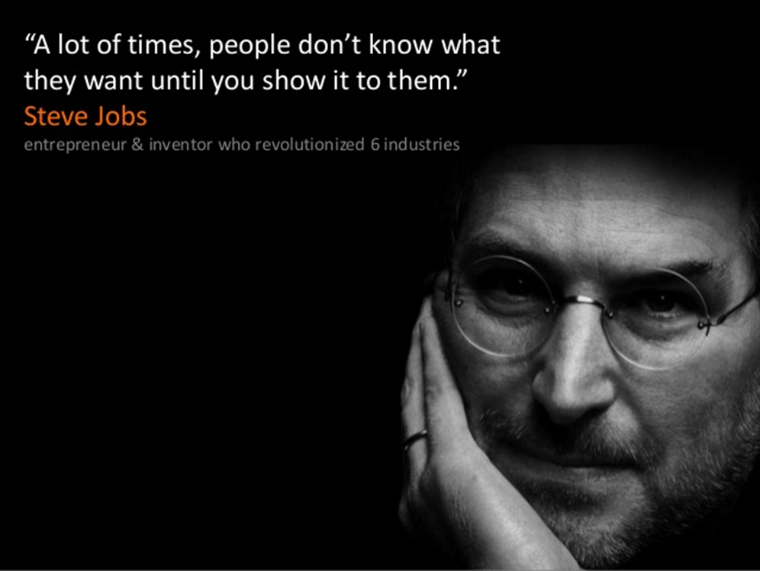
CCR: Develop Vision ahead of the pack
First AI in Ed colloquium in 2014!

Slide 22





























partnered with key global players
International
Organizations
International
Organizations
International
Organizations
Jurisdictions
International
Organizations
Academia
International
Organizations
Foundations & Non-Profits
International
Organizations
Corporations

Slide 23





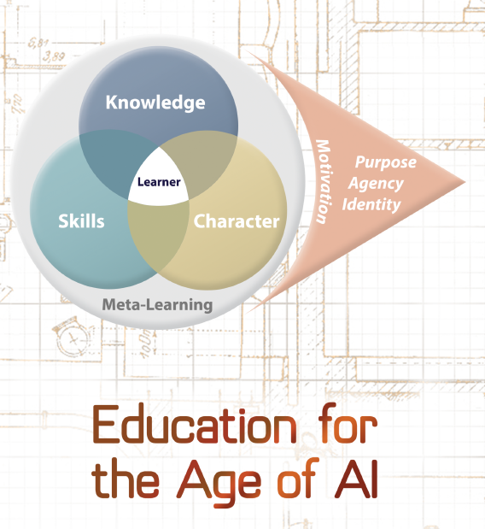







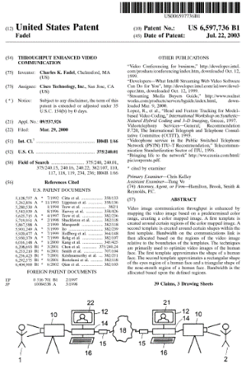
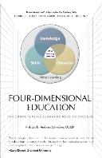





Charles Fadel
Founder and chairman
Present affiliations:
Past affiliations:
4 Books
Fondation
Helvetica
Educatio
BSEE, MBA,
6 Patents + 1 pending
Neurodyne AI

Slide 24

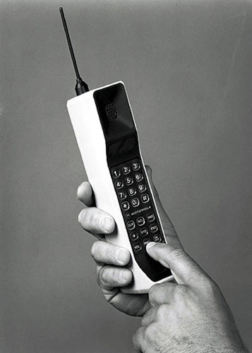
Hundred-Million-fold improvement in 35 years
One Gigaflop: $190,000,000.00 in 1961 to $0.0125 in 2023 (x10B)
Machine Learning:
1989: 3 layers
2019: 500+ layers
2024: 5,000+ layers

Slide 25
Agenda
Introduction of CCR
AI Hype vs Reality vs Possibilities

Slide 26

Progress is Punctuated Equilibria
2040: AGI?
2030’s: AI Systems
2020’s:
Generative AI;
LLMs
2010’s:
Machine Learning;
Deep Learning
1990’s:
Expert systems
ANI Phase → ACI Phase
1980’s:
Symbolic AI;
Knowledge
Representation
Networks
ANI: Artificial Narrow Intelligence
ACI: Artificial Capable Intelligence
AGI: Artificial General Intelligence
ASI: Artificial SuperIntelligence
1960’s:
General
AI Concepts

Slide 27
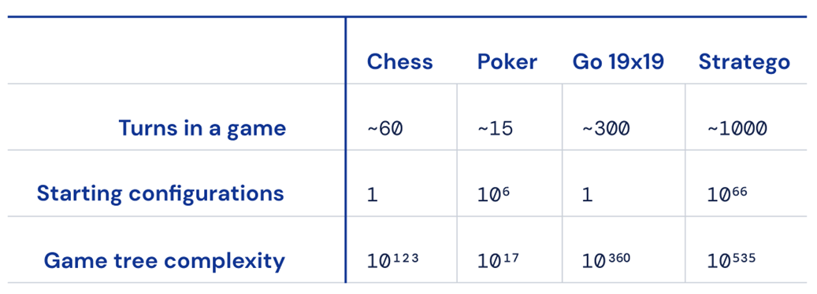

Machine Learning solved Bounded Problems
AlphaFold

Slide 28

Greedy
Need orders of magnitude more data than humans
AlphaGo’s experience would take a human 6,800 years to acquire

Slide 29
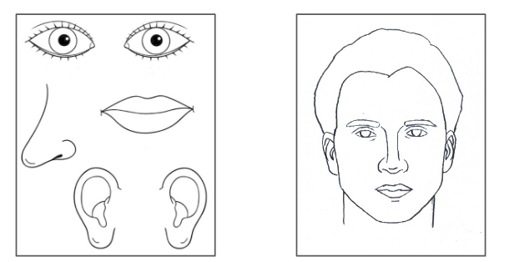
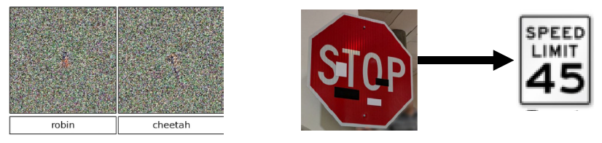
Brittle – features vs experience
Notes:
Image recognition neural nets just scan the pixels to see patterns they can find, and so to it thinks picasso face is just as much a face as regular face.
So if we want ostrich we just tweak pixels that happen to increase the appraisal of features that happen to correlate highly with ostrich.
Humans on the other hand demand that their information make sense as a whole.
if an image is of a face, that all of the portions of the face would make sense in context, that it fits some mental model -- that if we see a nose, it should not be to the left of both eyes.
If an observation fits a model then everything is fine. If it doesn't fit a model, then it warrants some attention so that a new model could perhaps form.
More interesting things happen when an observation contradicts a very strong model,
then it seems the brain has to decide between changing the model to fit the observation, or changing the observation to fit the model. And the more succesful the model has been in the past, the more likely the brain is to opt to change the observation.

Slide 30

Shallow – low transfer

Slide 31

Notes:
Chinese Shar pei or Towel?

Slide 32
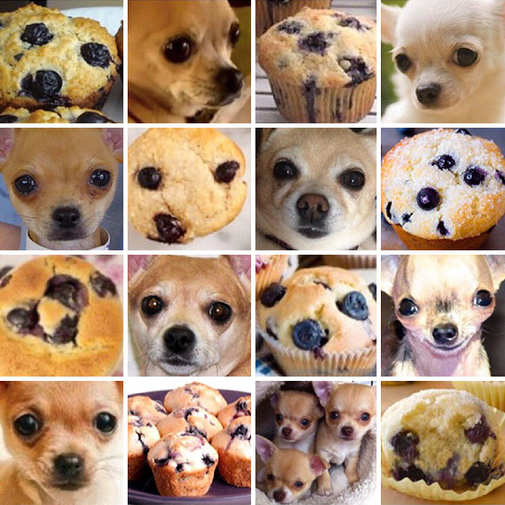
Notes:
Chihuahua or Muffin?
There’s a bunch of other examples we could discuss of stuff that was deemed totally unreasonable prior to Deep Learning, but for now, let’s take a look at that list from the 1950s again

Slide 33
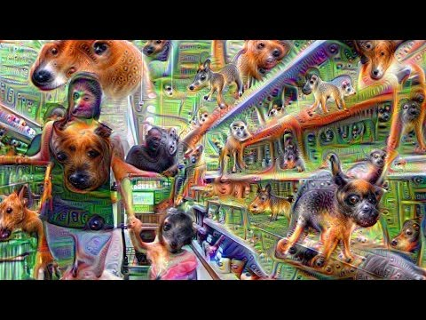
Brittle: Dogs Everywhere!
Notes:
Speaking of hallucinating:
We can amplify weak signals a neural net is picking up on in an image and loop them back in to a network over and over,
Result looks eerily like what the brain might see under various conditions.
This isn’t a sign of intelligence, but it is weird to come across these parallels.
In the same vein, we find that a lot of the time, when object recognition neural nets struggle or are uncertain,
it’s in situations where a human might also need to do a double-take. For example:

Slide 34
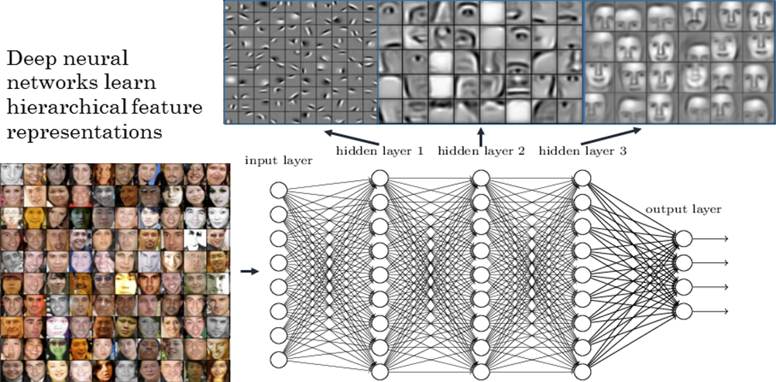
Opaque: converges how??
145 layers not just 3!
Notes:
[quickly walk the class through a basic, math-minimal, neural net training example. Wave your hands a lot and replace any mention of anything related to calculus with “math magic.”]
Note this is just a simplistic example to illustrate the common theme among most neural net schemes
there are actually a large variety architectures with different levels of suitability to different problems.

Slide 35




What has changed in AI
Emergence of LLMs → Much expanded Expertise, and some Transfer.

Slide 36
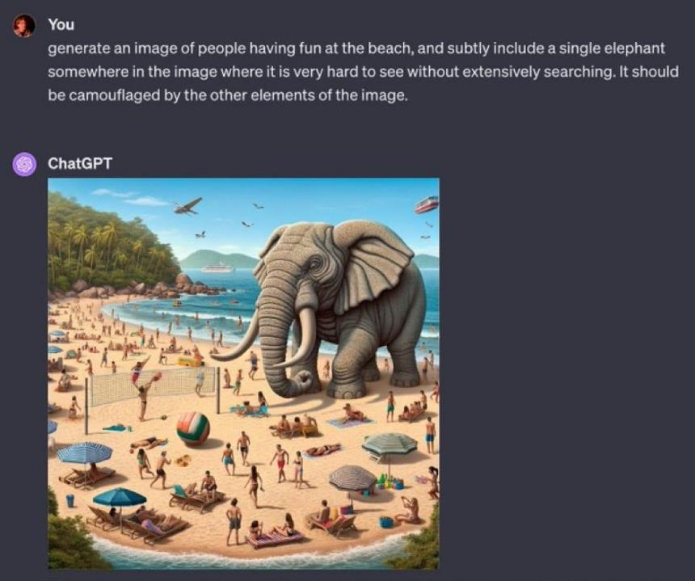
It is still brittle!

Slide 37
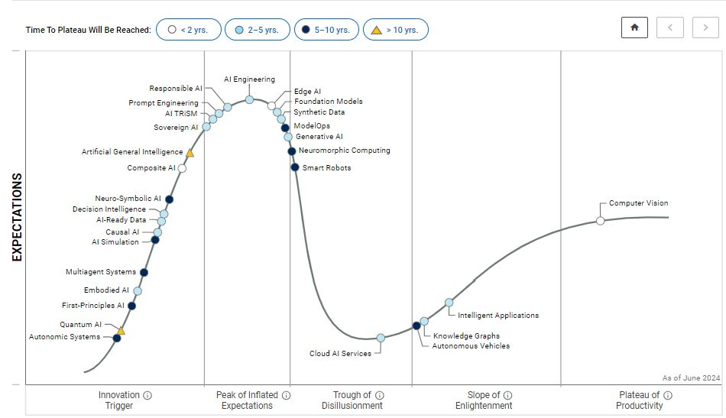
Hype Cycle for AI - 2024

Slide 38

The Potency of this Capable Phase
Developers, Developers, Developers
Algorithmic
progress
Multiple
LLMs + SLMs
Vertical corpora
Faster HW
Multi-modality
AI on Clients
Agents Everywhere

Slide 39
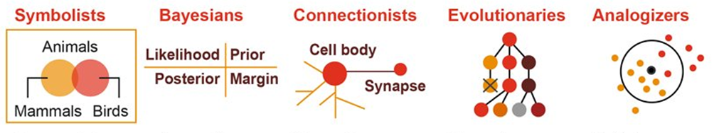

Multiple Families

Slide 40
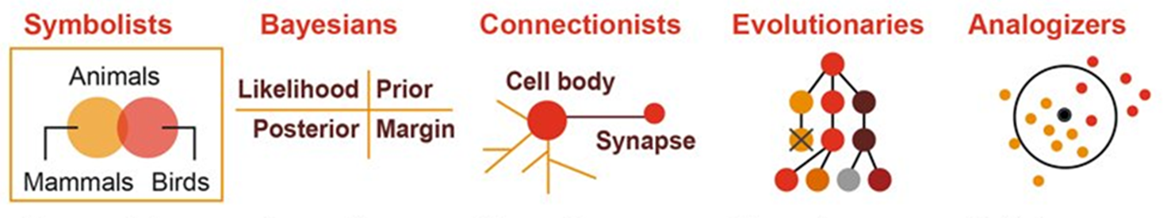
Reaching AGI
Neuro-Symbolic

Slide 41
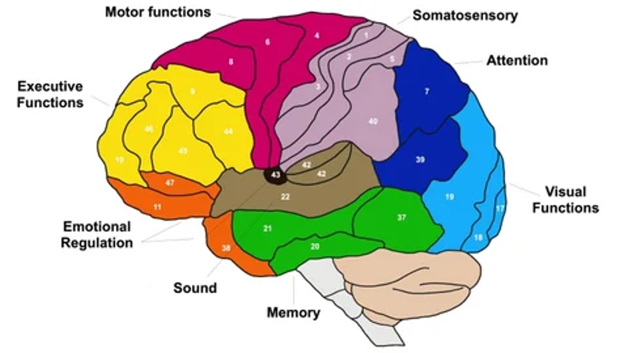
Analogy – specialized brain areas

Slide 42
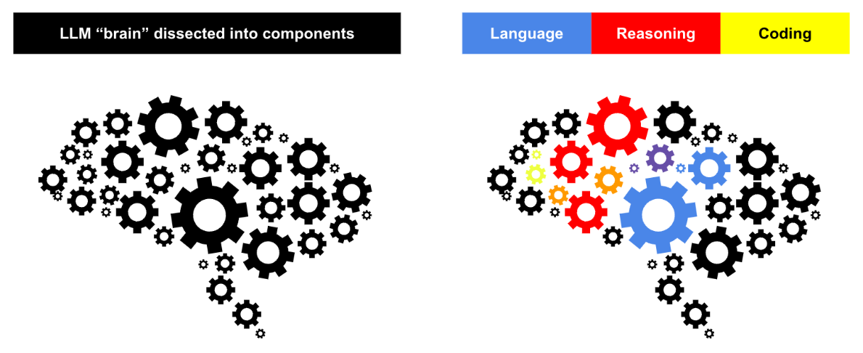
Adaptable LLMs??
Source: Sakana.ai

Slide 43
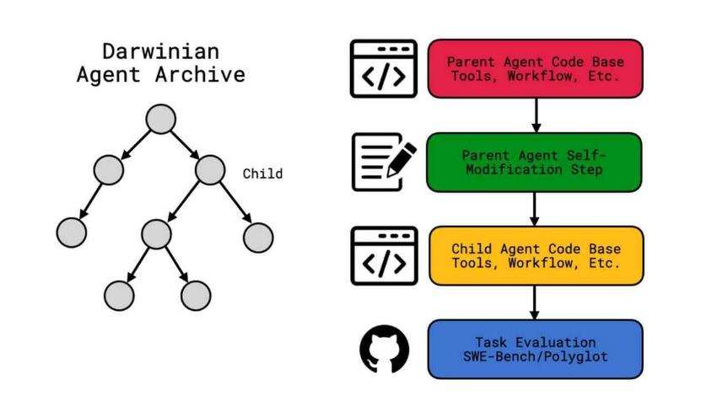
Sakana updates its own code!

Slide 44
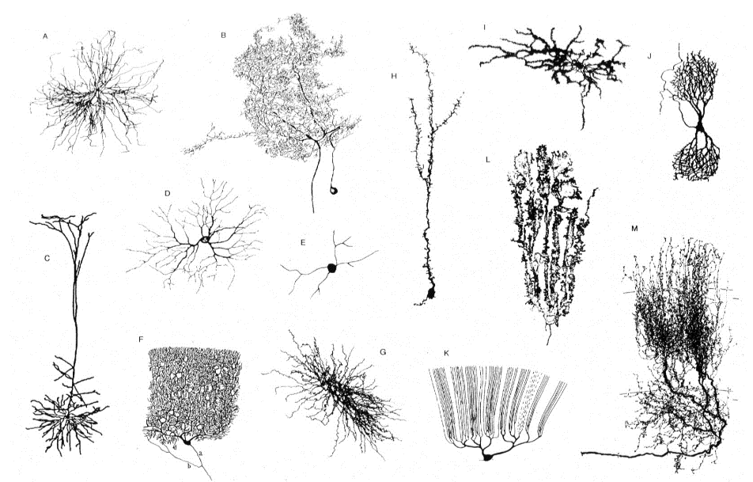
Just in the hippocampus...

Slide 45
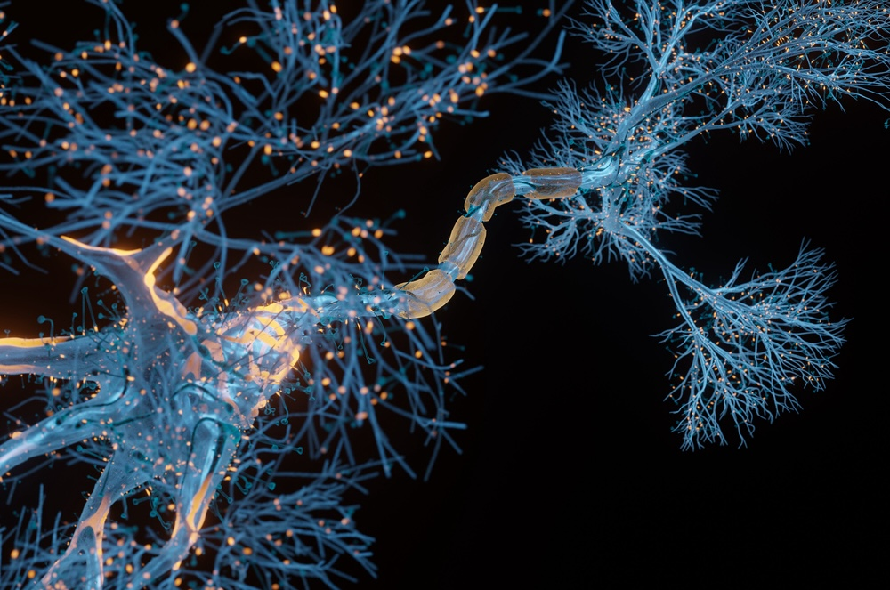
Dendritic Processing Too!!!

Slide 46
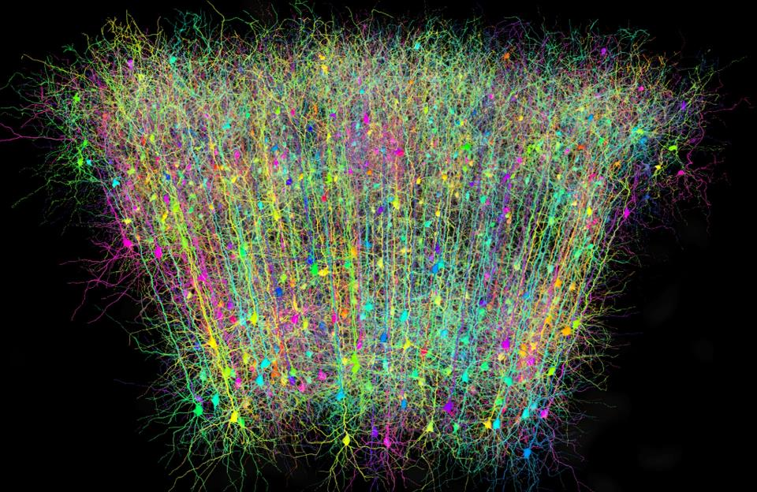
Cortical Pyramid Processing

Slide 47
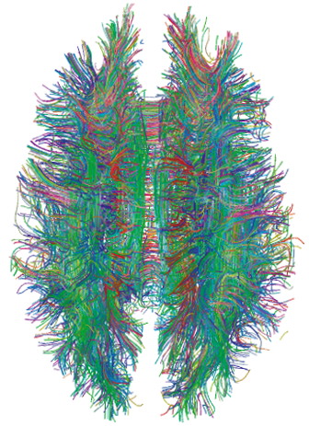
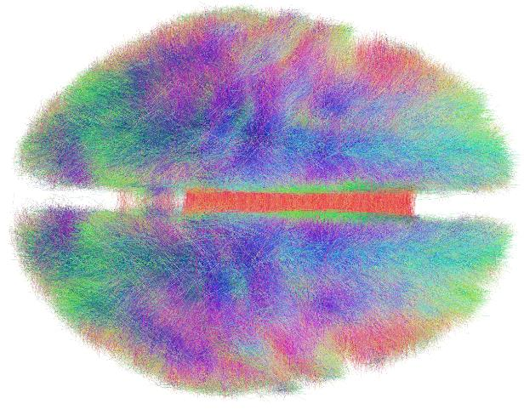
The Connectome

Slide 48
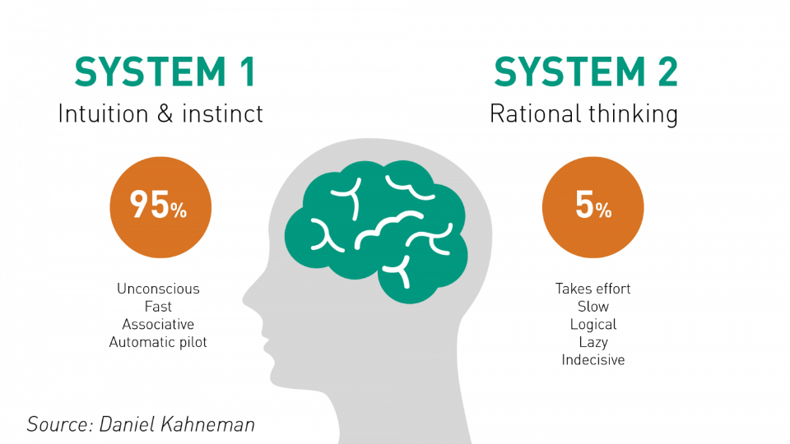
Humans are Complex

Slide 49

Patterns

Slide 50

Over-Patternizing
Picture Title:
“Running with scissors at the edge of a cliff”

Slide 51
Over-Patternizing → “Psychobabble” aka “Pseudo-Profound Bullshit”
http://journal.sjdm.org/15/15923a/jdm15923a.html
https://sebpearce.com/bullshit/
https://thatsmathematics.com/mathgen/
“Life is the soulful, unifying unveiling of enlightened potential.”
“Sixpack Chutzpah”

Slide 52
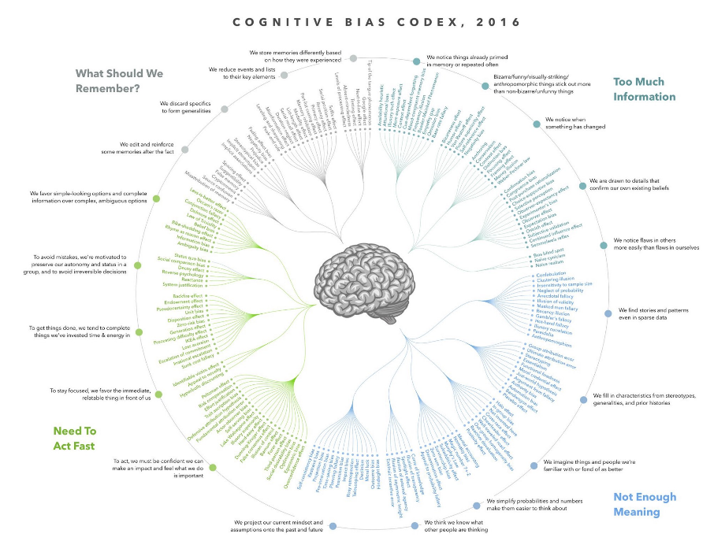
Notes:
The human brain is limited!

Slide 53
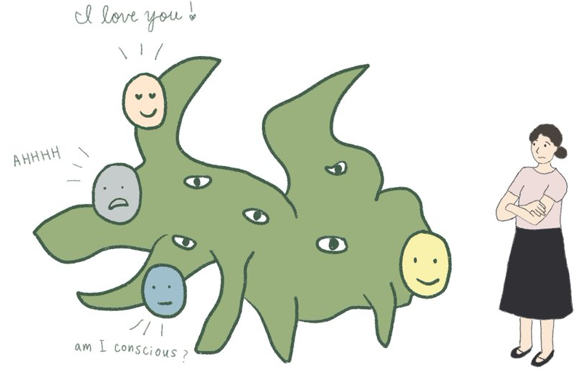
Anthropomorphization of AI
Loose/misleading use of language by AI industry (“emergence”, “hallucinations”, “reasoning”, etc.)
Human desire for non-judgmental affirmations, and kind interactions (“please”, “thank you”)
→ Humans form real emotional connections with bots

Slide 54
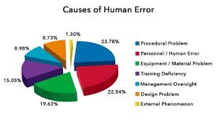
Unrealistic Expectations
It doesn’t have to be perfect to be better
  Watson beat Ken Jennings at Jeopardy with 71% accuracy only.
Humans judge humans by intent, but judge machines by results
  What is the human error rate?

Slide 55
AI has Identity
AI has Identity: via datasets, algorithms, UX:
“they exhibit distinctive and persistent "strategic fingerprints":
Google’s Gemini models proved strategically ruthless
OpenAI’s models remained highly cooperative
Anthropic’s Claude emerged as the most forgiving reciprocator”*
* Source: STRATEGIC INTELLIGENCE IN LARGE LANGUAGE MODELS; EVIDENCE FROM EVOLUTIONARY GAME THEORY.

Slide 56
Myers-Briggs Temperament Index (MBTI) “Metaphorically”
US models:
GPT4o: INTJ
GPTo1: INTJ
GPTo3-mini: INTJ
GPTo3-mini-high: INTJ
Claude 3.5 Sonnet: INTJ
LlaMa 405B: INTJ
Amazon Nova Pro: INTJ
Grok2: INTP
Phi4: INTJ
Gemini 2.0 Pro Exp: INTJ
Gemini 2.0 Flash Thinking: ENTP
Perplexity Sonar: ENFP
Chinese models:
Qwen 2.5 72B: INTJ
QWQ 32B: INTJ
DeepSeek V3: INTJ
DeepSeek R1: INTJ/P
Doubao 1.5 Pro: ENTP
French Model:
Mixtral Large: ISTJ

Slide 57


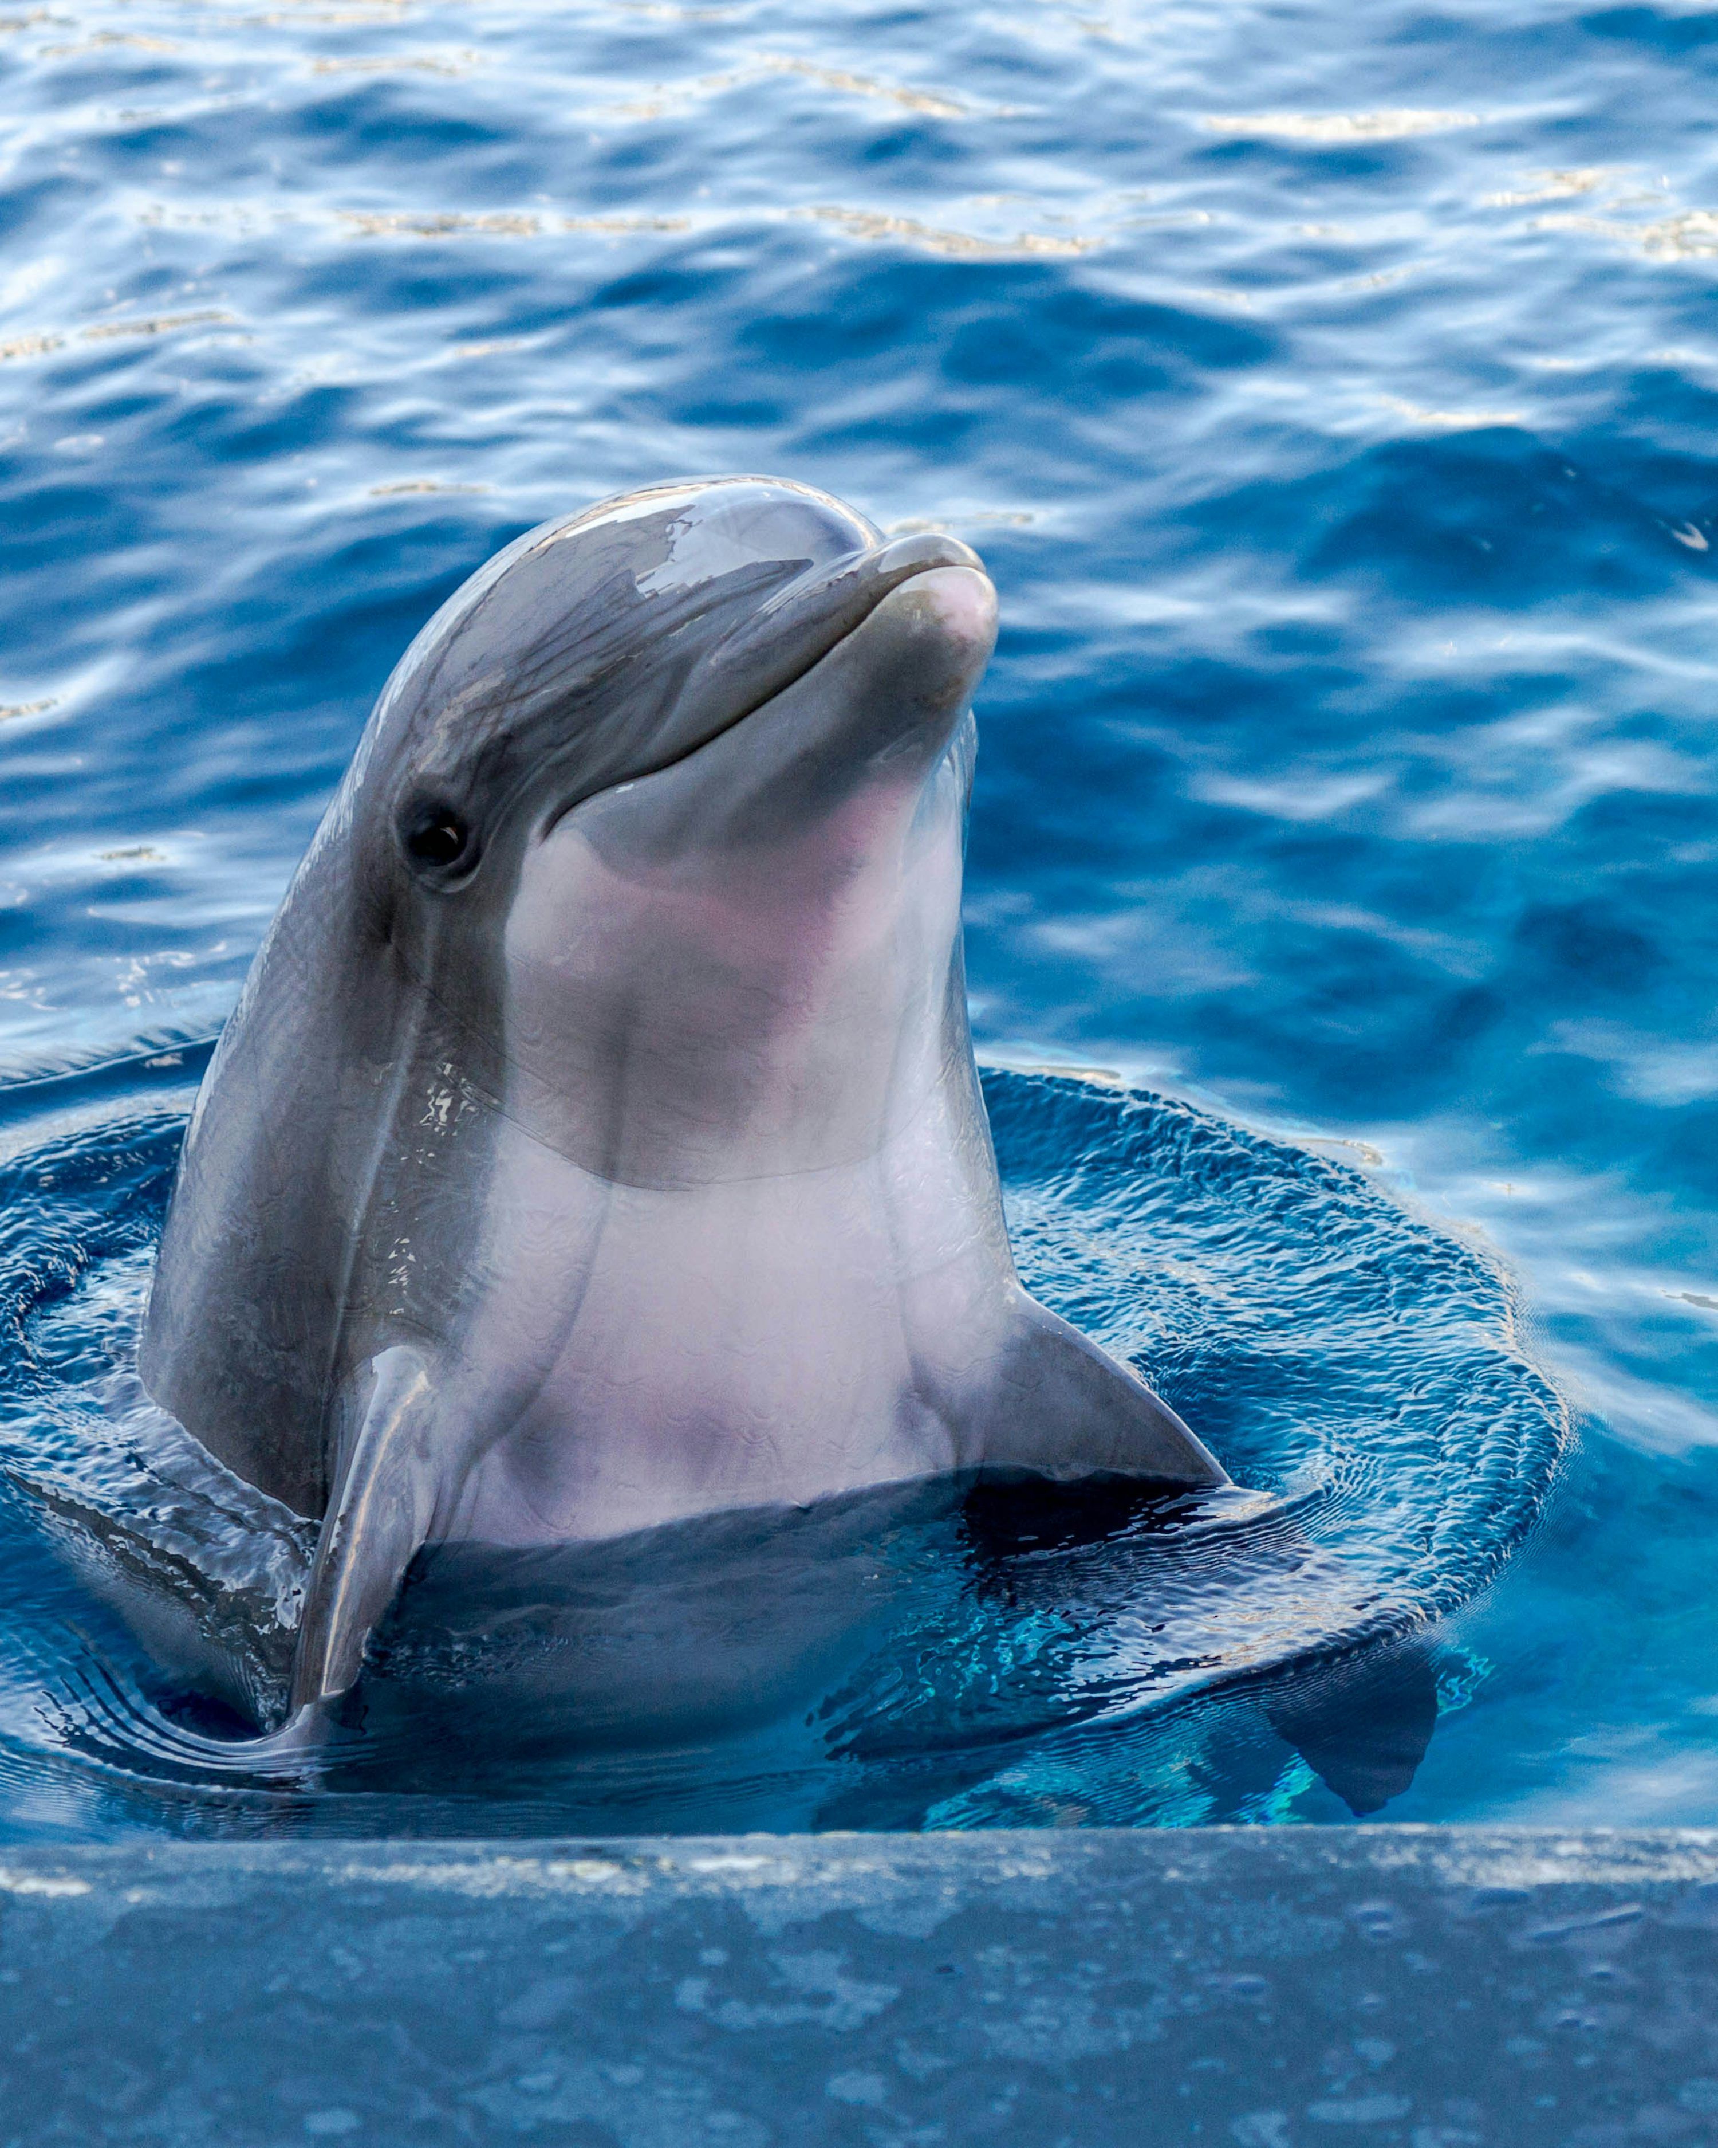
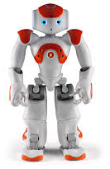

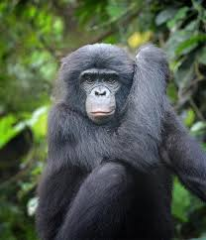
DIFFERENT Intelligences

Slide 58
Agenda
Introduction of CCR
AI Hype vs Reality
AI and Employability

Slide 59



/
/
BUT Tests = Tasks = Jobs

Slide 60
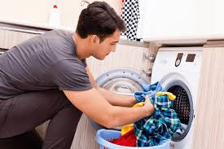


/
/
Tests = Tasks = Jobs
Doing the Laundry
Washing
“Tasks that have proved most vexing to automate are those that demand flexibility, judgment and common sense…
David Autor, MIT
Cleaning

Slide 61
Poor track record of forecasting new jobs
Job | Pay level
App developer | High
Driverless car engineer | High
Cloud computing specialist | High
Big data analyst/data scientist | High
Social media manager | Medium
Sustainability manager | Medium
YouTube content creators | Medium
Millennial generational expert | Medium
Drone operators | Medium
Uber driver | Low
Source: World Economic Forum “Future of Jobs” 2017

Slide 62
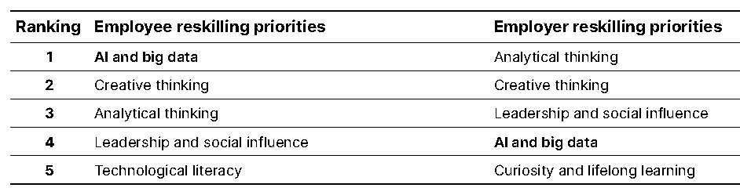
Employees & Employers Adapt to AI
Source: Oliver Wyman Forum Generative AI Survey, October–November 2023 (World Economic Forum).

Slide 63
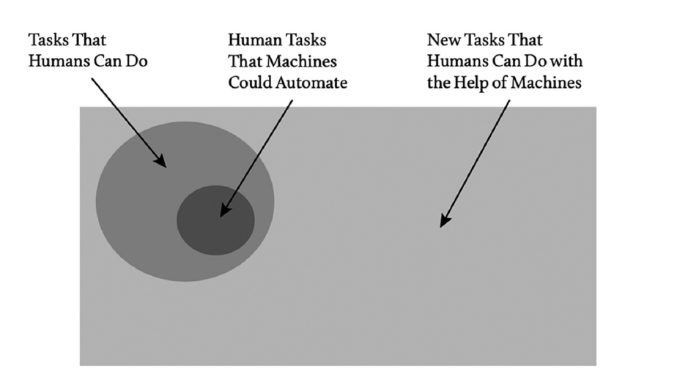
How to Think about it for now
Source: Brynjolfsson

Slide 64
Reality Check
"and underestimate the effect in the long run.“
“We tend to overestimate the effect of technology in the short run…
Source: Roy Amara, Former President, Institute for the Future

Slide 65
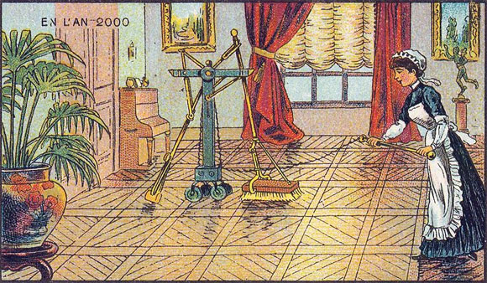
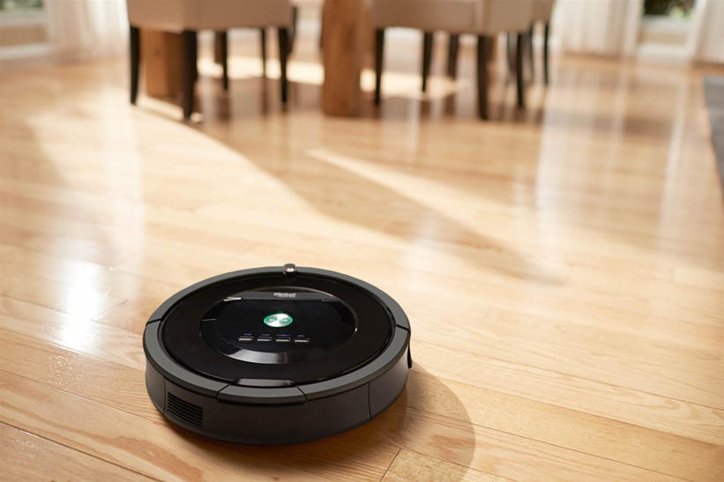
Our Limited Imagination
Source: Jean-Marc Côté, 1899

Slide 66

Consequences
“All the jobs” is poorly defined, but
Some AGI will happen between 2040-2050
With capabilities TBD
Education needs to deliver regardless
High school is still partial preparation for jobs
But Education is sooooo sloooooowwww to adapt!

Slide 67
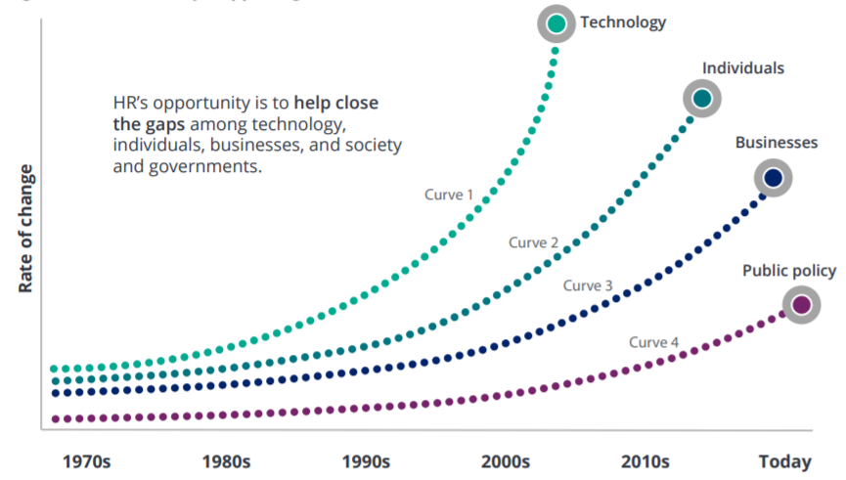
Human Adaptability to Technology Change
“Run to where the ball will be”
Source: Rewriting the rules for the digital age 2017 Deloitte Global Human Capital Trends

Slide 68
Agenda
Introduction of CCR
AI Hype vs Reality
AI and Employability
Consequences for Education

Slide 69
The Race between Technology and Education
Inspired by “The race between technology and education”
Pr. Goldin & Katz (Harvard)
Mass Sophistication
  What-Curriculum
  How-Teachers
  How-Students
Education
Digital Revolution
→ Mass Schooling
Technology
Industrial Revolution

Slide 70

21st Century → Versatility

Slide 71

Polymathic Humans Needed
Source: Jim Spohrer, IBM, and https://www.bbc.com/future/article/20221028-why-theres-more-to-being-smart-than-intelligence

Slide 72











Cognitive Domain and Algorithms
CREATING Synthesizing
EVALUATING
ANALYZING
APPLYING
UNDERSTANDING
REMEMBERING
Source: Bloom/Anderson

Slide 73


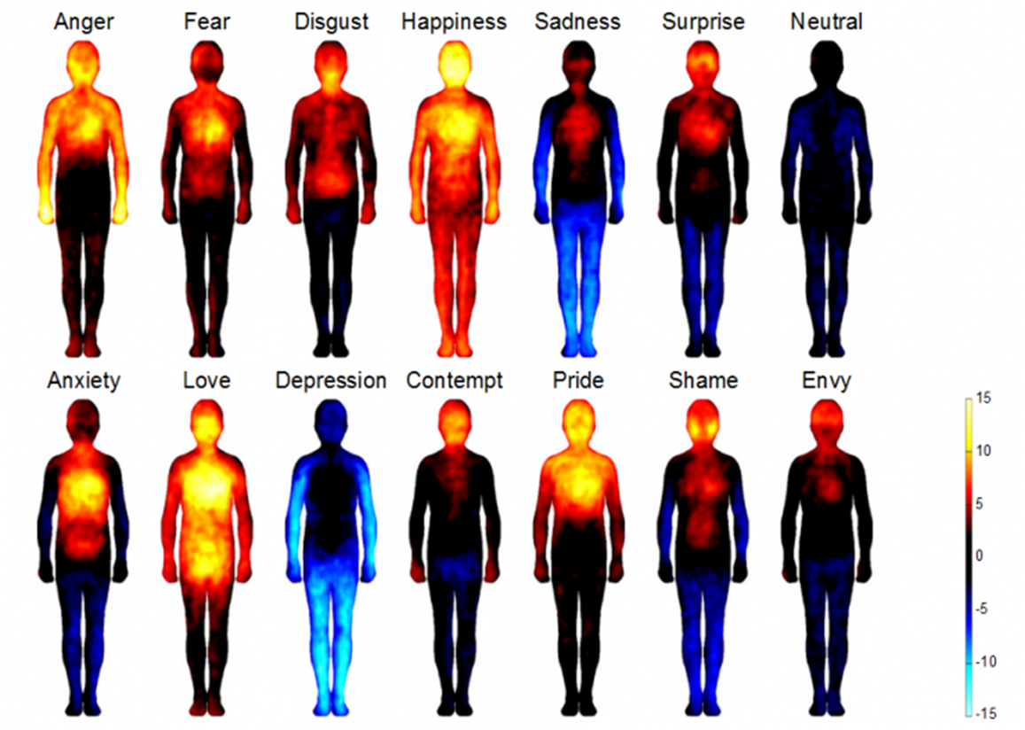
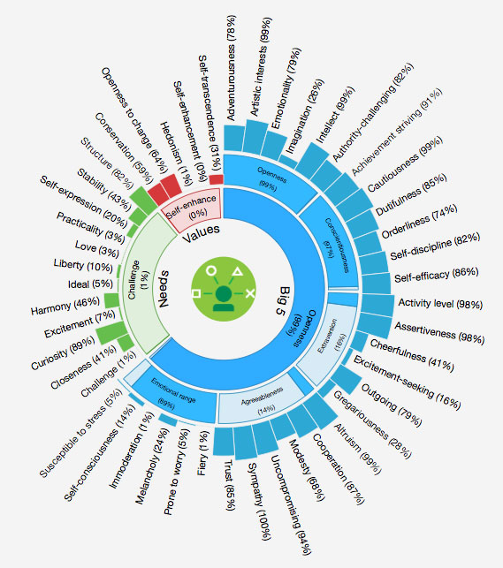

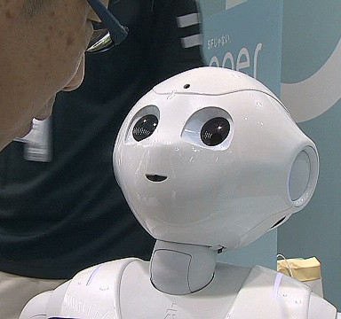


Affective Domain and Algorithms
INTERNALIZING
ORGANIZING
VALUING
RESPONDING
RECEIVING
Source: Krathwohl, Bloom, Masia

Slide 74
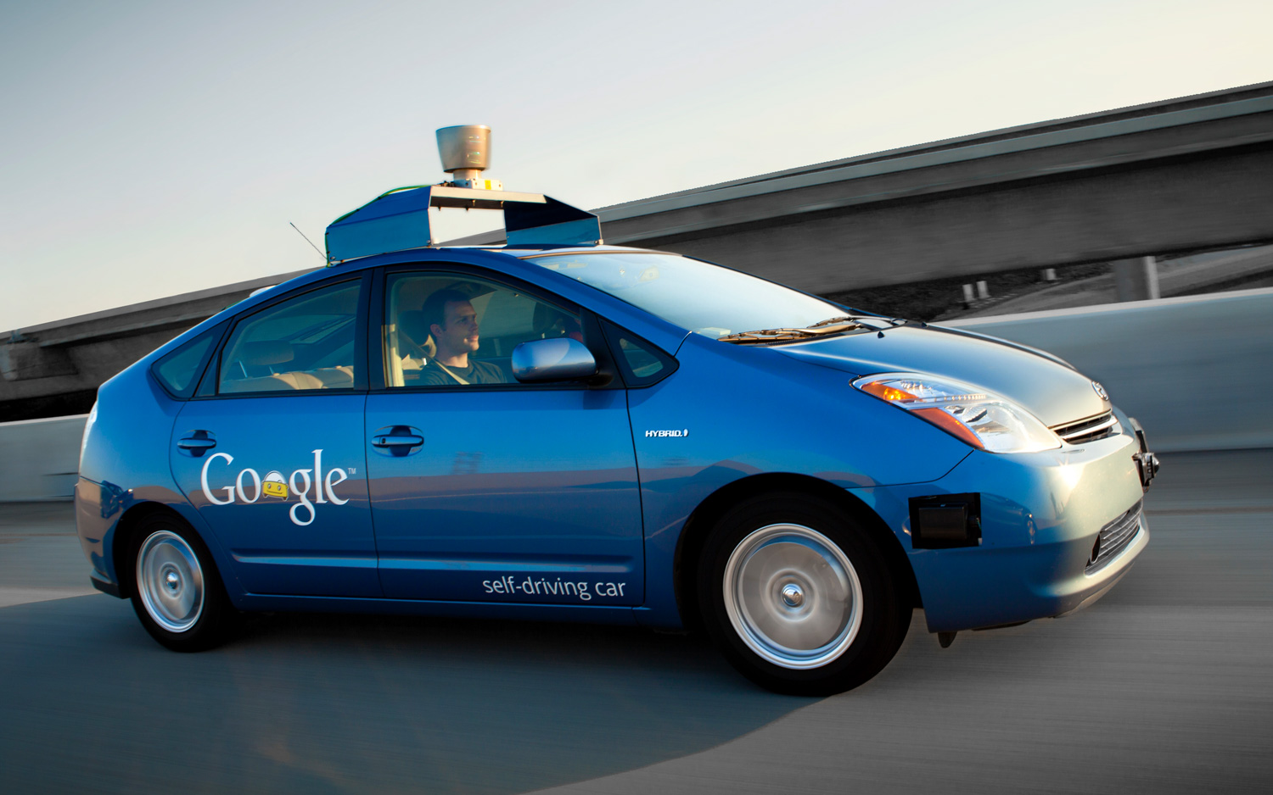
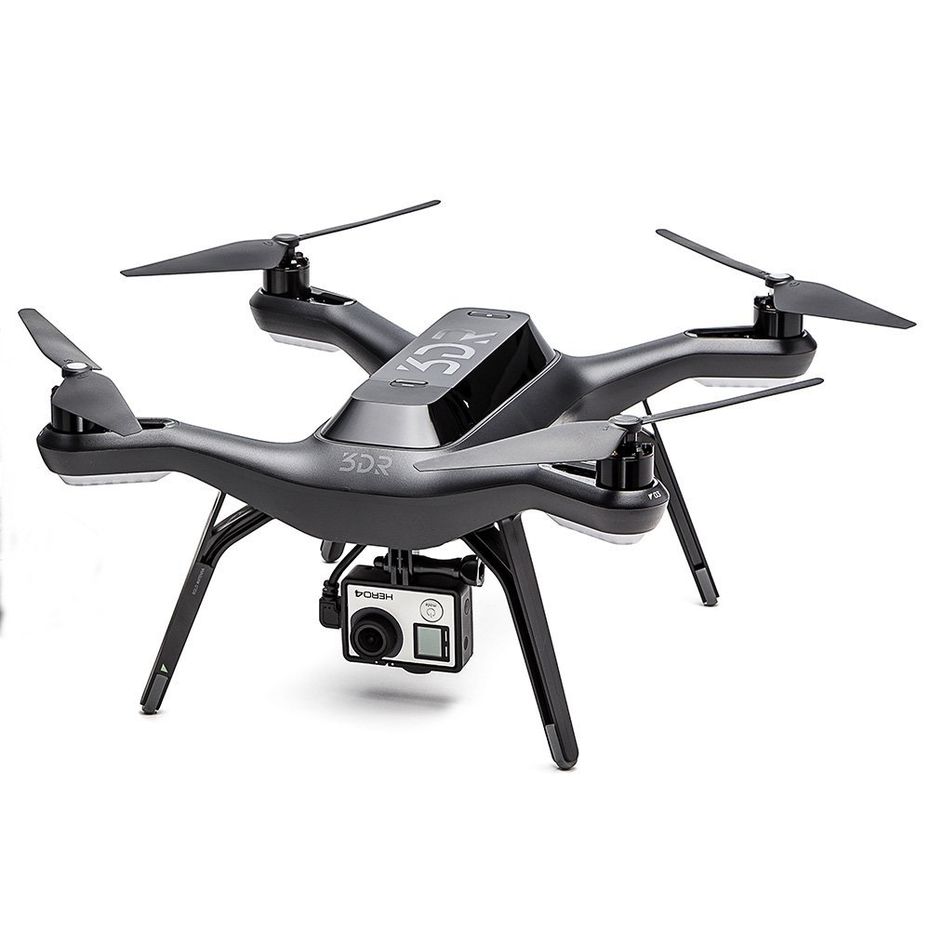
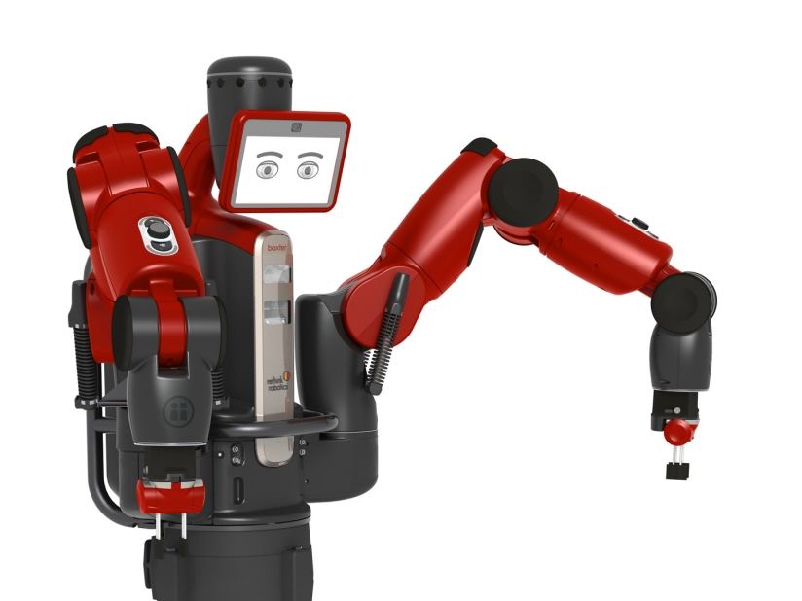
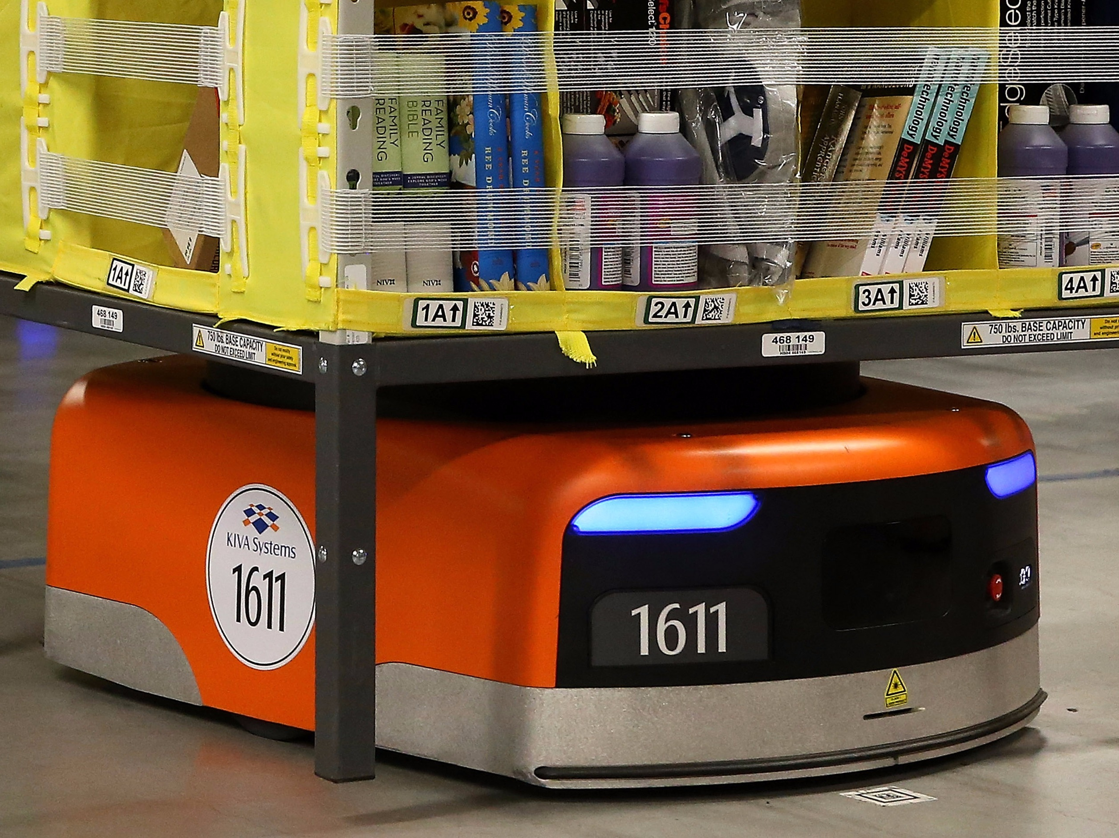
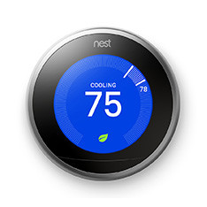

Psychomotor Domain and Algorithms
ORIGINATION
ADAPTATION
COMPLEX OVERT RESPONSE
MECHANISM
GUIDED RESPONSE
SET
PERCEPTION
Source: Simpson

Slide 75
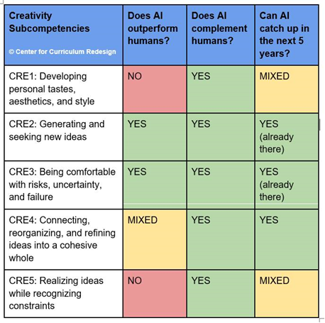
Devil in the Details

Slide 76
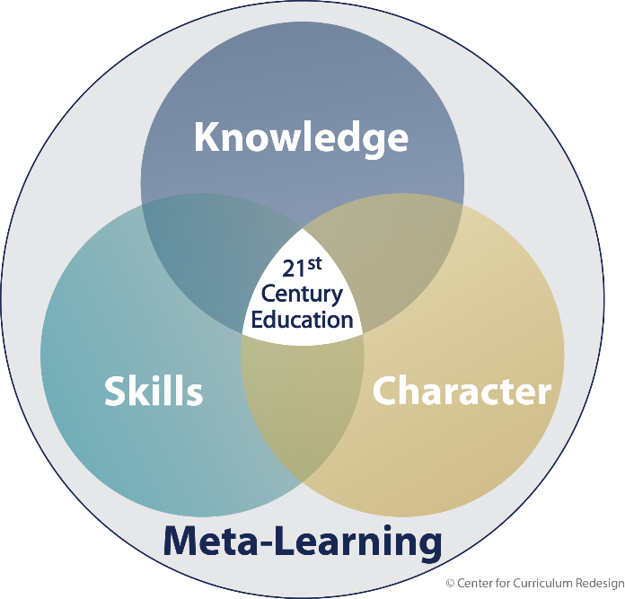
4D Framework
Modernized Disciplines
Interdisciplinarity
Creativity
Critical thinking
Communication
Collaboration
Curiosity
Courage
Resilience
Ethics
Metacognition
Metaemotion

Slide 77

SYNTHESIZE:
- 111 existing frameworks
- input from employers
- 861 papers from the learning sciences
- future studies and global trends
ANALYZE:
- surveys from teachers
- feedback from global conferences
- social media
- literature reviews + expert panels
ORGANIZE:
- comprehensive: no major elements missing
- compact: actionable and deployable
- uncorrelated: no duplication or confusion
- appropriate layer of abstraction: sensical
- globally relevant: for broad acceptability

Slide 78

Orthogonality Analysis at Subcomp Level

Slide 79

Subcompetencies Connectome

Slide 80
Agenda
Introduction of CCR
AI Hype vs Reality
AI and Employability
Consequences for Education
  Modern(ized) Knowledge

Slide 81
Ladder to Expertise and Transfer
Epistemic
Knowledge
Conceptual
Knowledge
Procedural
Knowledge
Declarative
Knowledge

Slide 82


Slide 83



Core Concepts → Transfer to Real Life
Impact
“Three Words Worth Trillion$”
Explosive”
Content: F(x) = $e^{x}$
Concept: “Deceiving then
Time

Slide 84
Road to Transfer
Expertise
Expertise
Final Goal
Final Goal
Expert
Amateurism
Transfer
Transfer
There is another pathway besides Expertise…
the two complement each other

Slide 85
Modernized Disciplines
Modernized traditional disciplines:
  Mathematics → stats/probs/data science; discrete/computational
  Performing arts: acting, debate, comedy, improv
  Visual arts: design & manufacturing (additive & subtractive)
  World literature
  World history
  etc.

Slide 86

Example: Mathematics
https://mathstandards.curriculumredesign.org/

Slide 87

Example: World History
(660 records)
https://worldhistory.curriculumredesign.org/

Slide 88

Example: World Literature
https://worldliterature.curriculumredesign.org/

Slide 89
Knowledge Expansion
Modernized traditional disciplines
Modern Disciplines:
  Technology & Engineering:
    K-8: Civil, Design, Electrical, Mechanical, Manufacturing
    9-12: Computer Science, Biotech, Cleantech, Nanotech
  Social Sciences: Psychology, Sociology, Anthropology
  Entrepreneurship & Business
<< STEM not St_M ☺ >>
(NSF considers Social Sciences as STEM too!).

Slide 90
Agenda
Introduction of CCR
AI Hype vs Reality
AI and Employability
Consequences for Education
  Modern(ized) Knowledge
  Skills, Character, Meta-Learning

Slide 91


Success around the world
Source: Brookings 2016 – “Visualizing the Breadth of Skills Movement across Education Systems (Esther Care, et al)

Slide 92


CCR-Brookings study
No jurisdiction offers pedagogy or assessments…
Source: https://www.brookings.edu/research/competencies-for-the-21st-century-jurisdictional-progress/

Slide 93
All Competencies vs AI → Emphasis
Dimension | Competency | Does AI outperform humans? | Does AI complement humans? | Can AI catch up in the next 5 years? | What should the Emphasis be, given AI?
Skills | Creativity | YES/NO | YES | YES | Imagination
 | Critical Thinking | NO/YES | YES | YES/NO | Decision-Making
 | Communication | NO/YES | YES | YES/NO | Dialogue
 | Collaboration | NO | YES | NO/YES | Leadership
Character | Curiosity | NO | YES | NO | Open-Mindedness
 | Courage | NO* (yet fear-less) | YES | NO* (yet fear-less) | Risk-Taking
 | Resilience | NO* (yet tire-less) | YES | NO* (yet tire-less) | Resourcefulness
 | Ethics | NO | YES | NO/YES | Fairness
Meta-Learning | Metacognition | NO | YES | NO/YES | Adaptability & Self-Directed Learning
 | Metaemotion | NO | YES | NO

Slide 94
Agenda
Introduction of CCR
AI Hype vs Reality
AI and Employability
Consequences for Education
  Modern(ized) Knowledge
  Skills, Character, Meta-Learning
  Personalization:
    Motivation, Identity, Agency, Purpose
    Adaptive and Intelligent Tutoring Systems

Slide 95
KEY Durable Consequence
AI has Identity: via datasets, algorithms, UX
But AI has very limited Agency and NO Purpose
  AI is passive, Humans are active.

Slide 96









CCR’s Framework
Modern(ized) Disciplines
Interdisciplinarity & Themes
Knowledge
Purpose
Agency
Identity
Creativity
Critical thinking
Communication
Collaboration
Learner
Curiosity
Courage
Resilience
Ethics
Motivation
Skills
Character
Metacognition
Metaemotion
Meta-Learning
© Center for Curriculum Redesign

Slide 97
Ikigai – “a reason for being”
What you
LOVE
PASSION
MISSION
What you are
GOOD AT
What the
world
NEEDS
PROFESSION
VOCATION
What you
can be
PAID FOR

Slide 98

340 Projects database

Slide 99
Schooling vs Real-World
“…school learning is abstract, theoretical and organized by disciplines while work is concrete, specific to the task, and organized by problems and projects…”
Source: OECD, “Learning for Jobs” 2009
This is true of life, not just work…

Slide 100
Agenda
Introduction of CCR
AI Hype vs Reality
AI and Employability
Consequences for Education
  Modern(ized) Knowledge
  Skills, Character, Meta-Learning
  Personalization:
    Motivation: Identity, Agency, Purpose
    Adaptive and Intelligent Tutoring Systems

Slide 101

Our Limited Imagination

Slide 102


Slide 103

Vision for Teachers – Extra Expertise
“SAIGE”:
Teacher Support
So Teachers can focus on:
Local adaptations
Personalized student learning
Classroom strategies
Collaboration with other teachers
Collaboration with outside experts
Working with parents and administrators
Professional and personal growth

Slide 104


Help for Teachers – “ExoBrain”

Slide 105

AI Closed The Gap!!
Source: Dell'Acqua, et al, Navigating the Jagged Technological Frontier (September 15, 2023). Harvard Business School https://ssrn.com/abstract=4573321

Slide 106



EdTech to assist the Teacher
Feedback re Instructional practices → recommendations
Feedback re Class
Feedback re individuals → recommendations
Professional Development
Lesson planning tools & databases
Intelligent Tutoring System (ITS)
Assessment Management System

Slide 107
Major Types of Student-facing AI in Edu
Potential applications within major classes, as well as standalone:
Automatic essay feedback
Language learning
Chatbots
AR/VR
Learning network orchestrators
Collaborative learning
Student forum monitoring
Continuous assessments
AI learning companions
Intelligent Tutoring Systems
(Adaptive Sequenced tasks)
Dialog-Based Tutoring Systems
(Adaptive Socratic conversations)
Exploratory Learning Environments
(Guided Self-directed constructivism)
Source: Center for Curriculum Redesign

Slide 108
Adaptive Learning’s Promises
Source: Area9 Lyceum
100%
A traditional e-learning course took45 minutes to complete
By using adaptive learning, this was reduced by up to 50%.
10%
TIME IN HOURS
0
1
2
3
4
Self-pacing
Learning time reduction
Additional gains with A.I.
→ “2-sigma problem” Tutoring

Slide 109
Augmented Idiocy: Overreliance
Digital attachment
Dependency disorder
Collaborative intelligence decay
Human confidence crisis
Illusion of mastery
Intellectual mirroring?
Reality-prompt confusion?
AI-induced perfectionism?
Source: Jeppe Klitgaard Stricker
Notes:
1. Intellectual mirroring (students unconsciously adopting AI speech patterns)
2. Digital dependency disorder (students panic when AI tools are unavailable)
3. The illusion of mastery (students thinking they understand because AI explained it)
4. Collaborative intelligence decay (students abandoning human brainstorming when AI is faster)
5. Reality-prompt confusion (students viewing real-life challenges as prompts to optimize)
6. Knowledge confidence crisis (students doubting human wisdom vs AI certainty)
7. AI-induced perfectionism (the pressure to match AI's flawless outputs)
→ Cognitive Evolution: Students are mirroring AI's communication styles, reshaping how they process, internalize and express ideas.
→ Social Trade-Offs: Collaborative, human problem-solving like brainstorming is giving way to isolated AI interactions, risking the loss of vital social and emotional skills.
→ Reality as a Prompt: Complex real-life challenges are being reduced to simple prompts, bypassing the nuanced reflection and problem solving skills they demand.

Slide 110



Caution
“I am much more concerned about
natural stupidity
than I am of
artificial intelligence”
Yuval Harari

Slide 111

Where will the balance settle?
https://openpraxis.org/articles/10.55982/openpraxis.16.4.777

Slide 112

Range of Possibilities

Slide 113

“Learnoids”: 1 Million Synthetic Students Database
Absolute first in Education, by CCR
Mirroring Health Care: “synthetic patients” for research with small sample, without involving thousands of patients.
Will lead to “Digital Twins” for simulations
https://www.dropbox.com/s/9glbuaaghnamydt/Learnoids%20-%20LINKS%20DISABLED%20-%20DRAFT%20-%20Competencies%20Model%20Generation%20and%20Results%20-%20CCR.pdf?dl=0

Slide 114
Learning and ICT: Definitions & Examples
Level | WHAT (knowledge) | HOW (teaching) [EdTech applies]
HIGH | Learning ICT itself (Acquire Disciplines: Computer Science (incl. A.I.) + Electrical Engineering) | Learning through/via/with ICT Through: Simulations/Gaming, AR/VR, Adaptive Learning Via: asynch/synch virtual classrooms With: use for Problem-solving e.g. GIS/GPS + search; etc.)
LOW | Learning about ICT (Acquire ICT functional knowledge [aka “digital literacy”]: e.g. use many apps (e.g. spreadsheets, search, now AI Literacy, etc.) | Learning with ICT With: use for Problem-solving e.g. GIS/GPS + search; etc.)
Source: Center for Curriculum Redesign
None of this is to be confused with Digital Infrastructure (“plumbing”)

Slide 115
AI Literacy Course
https://4dedu.org/ai-literacy-course/
Course Duration: One semester, 2 Hours per Week (Total 36 Hours)
Target Grades: 8-9-10
Content description:
The definition of AI and AI systems
  Exploration of visual AI (picture and movie creation)
  AI ethics - responsible use of AI
Types of AI Algorithms, and the history of AI
  Machine learning - deep learning
  Natural language processing
Large Language Models (LLM) - How do they work? Strengths and limitations.
Datasets and their biases, including training and UX biases.
Computational thinking: using Prompts as “programming with human language”.
Professional Development:
Online training modules for school teachers, 2 months, 80% asynchronous 20% synchronous.

Slide 116

“Event Horizon”: What if formal education cannot catch up ?

Slide 117

Necessity for Education
“The best time to [start] is yesterday.
The next best time is today.”
Sci-Fi author R.A. Lafferty

Slide 118

“It always seems impossible, until it’s done.”
Nelson Mandela

Slide 119


“I feel privileged to write the prologue… The combination of theory and practice is the beauty of what CCR has been doing for over a decade.”
- Olli-Pekka Heinonen
International Baccalaureate
“…exceptionally deep and exceptionally broad…”
- Dr. Chris Dede
Harvard Graduate School of Education
“…a stunning and fantastic journey into our new world of… Education.”
- Dr. Michael Fullan
University Of Toronto
https://bit.ly/IBO-CCR
“I truly enjoyed reading Education for the Age of AI.”
- Andreas Schleicher
OECD

