Slide 1

Teaching and Learning Leaders Conference
Semester 2 2025

Slide 2
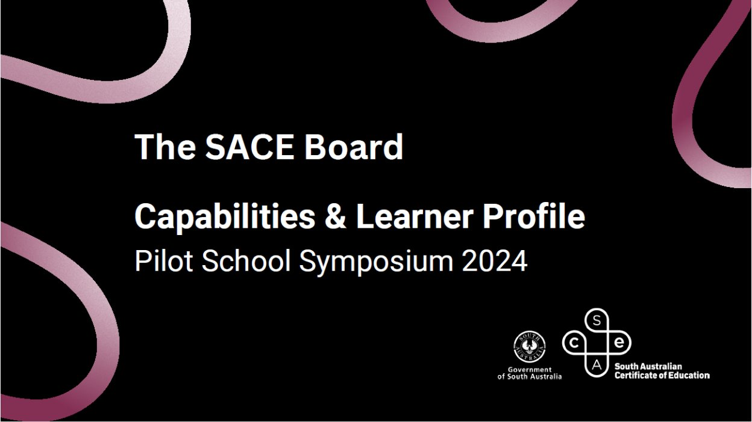
SACE Board acknowledgment of Country

Slide 3







Housekeeping
Continuous tea and coffee, morning tea and lunch provided
Free parking
Emergency exits
Toilets
QR codes
Wi-Fi SSID: SACE
Password: SACETHEATRE2025!!!
First Aid

Slide 4


Agenda
8:30 | Welcome
8:45 | Our direction of travel
9:00 | Subject renewal
10:10 | Morning tea
10:30 | Capabilities and learner profile
12:00 | Stretch
12:25 | Narrative activity
12:50 | Lunch
1:20 | Close

Slide 5
Speed Connections
  Pair up with someone from a neighboring table.
  You each have 2 minutes:
    What’s one thing that surprised you in the last week?
    What’s one thing you’re curious to learn today?

Slide 6
Our direction of travel
Hassan Mekawy
Director, Education Services
SACE Board of South Australia

Slide 7



Supporting students to thrive in our changing world…
Rise of Artificial Intelligence
Focus on mental health
& wellbeing
Dissatisfaction with using grades and ranks to define success
Today, the processing power and speed of artificial intelligence is changing the way we access and use knowledge.
Today, more than 25% of young people meet the criteria for experiencing psychological distress and over 50% identify mental health as a top barrier to achieving their study or work goals.¹
Many young people reject the idea that the breadth and depth of what they know and can do is represented in grades and ranks. ²
Sources
¹ 2021, Mission Australia’s Youth Survey
² 2020, Learning Creates Australia - Recognition of learning success for all

Slide 8
Rise of AI– urgency and impact
Watch Do you trust this Computer? doyoutrustthiscomputer.org

Slide 9

The kind of things that are easy to teach are now easy to automate, digitize or outsource

Slide 10


Education won the race with technology throughout history, but there is no automaticity it will do so in the future
Prosperity
Digital revolution
Social pain
Prosperity
Industrial revolution
Universal
public schooling
Social pain
Technology
Education
Inspired by “The race between
technology and education”
Pr. Goldin & Katz (Harvard)

Slide 11
Reality Check
"and underestimate the effect in the long run.“
“We tend to overestimate the effect of technology in the short run…
Source: Roy Amara, Former President, Institute for the Future

Slide 12


Rise of AI– urgency and impact
To tackle these challenges, every young person will need to build life-long skills, capabilities, knowledge and understanding.
Integrity of SACE results under pressure from AI-enabled tools.
Advancing faster than systems can adapt.
Concerns about becoming irrelevant, yet opportunities to evolve.
Students fear their qualifications may lose relevance.

Slide 13



Adapting to the challenges and opportunities of AI
Phase 1: Learn & Grow – Engage with relevant expertise to develop contextual understanding.
Phase 2: Test & Share – Refine in practice through subject renewal, develop & refine targeted content and changes.
Phase 3: Scale & Evolve – Ongoing adaptation; provide a broader range of support materials, exemplars, and policy guidance

Slide 14
Empowering learners and educators
Subject Renewal
  AI as a catalyst for innovation, not a threat.
  Learning and assessment design that are resilient
  Developing “human” capabilities
Capabilities and Learner Profile
  Recognises and captures these “human” capabilities
  Raises student’s awareness of their strengths alongside disciplinary understanding and skills
To tackle these challenges, every young person will need to build life-long skills, capabilities, knowledge and understanding.

Slide 16
Key Drivers
Student Agency
Students are proactive in the co-creation of their learning pathway and influence how they undertake, demonstrate and action their learning.
Metacognition
Students are empowered to understand the way they think using feedback and self-evaluation to purposefully consider and enhance their own learning
Deep Authentic Learning
Students discuss and apply learning from familiar and unfamiliar situations across a range of meaningful and relevant real-world situations
Natural Evidence of Learning
NEoL captures the diverse authentic forms of students’ demonstration of learning and achievement, better reflecting what students know and can do.
Capabilities
Personal Enterprise
Open doors: find opportunities
Quality Thinking
Stretch minds: through global curiosity
Self-Motivated Learning
Strengthen ownership: grasp responsibilities
Principled Action
Embrace perspectives: honour difference
Collective Engagement
Share success: with communities
By designing for agency, metacognition, deep authentic learning & NEOL we are indirectly designing for Capabilities

Slide 17
Subject | Prototype | Agency | Deep authentic learning | Natural Evidence of learning | Metacognition
Essential English | Spoken language in real world contexts |  |  |  ✓
Ancient Studies | Concept-driven learning |  ✓ |  ✓
Biology | Unpacking the D&D |  |  ✓ |  |  ✓
Biology | SIS Journal |  |  ✓ |  ✓
General Mathematics | Scenario Based Modelling |  ✓ |  ✓ |  ✓ |  ✓
General Mathematics | Scenario Based Modelling (Phase 2) |  ✓ |  ✓ |  ✓
General Mathematics | Scenario Based Modelling (Phase 3: Reflection) |  |  |  |  ✓
General Mathematics | Connection Task and Dialogue |  ✓ |  ✓ |  ✓ |  ✓
Health and Wellbeing | Reflective and Reflexive Practice |  |  ✓ |  |  ✓
Language Continuers | Creative Expression prototype |  ✓ |  ✓ |  ✓ |  ✓
Language Continuers | Exchanging Meaning |  ✓ |  |  |  ✓
Modern History |  |  ✓ |  ✓ |  ✓ |  ✓
Music Explorations | Prototype 1 |  |  ✓ |  ✓ |  ✓
Music Performance | Engaging with the music community |  ✓ |  ✓
Music Performance | Music Practise and Practice |  |  |  |  ✓
Music Studies | Musical Literacy Applied Musicianship |  ✓ |  ✓ |  ✓

Slide 18
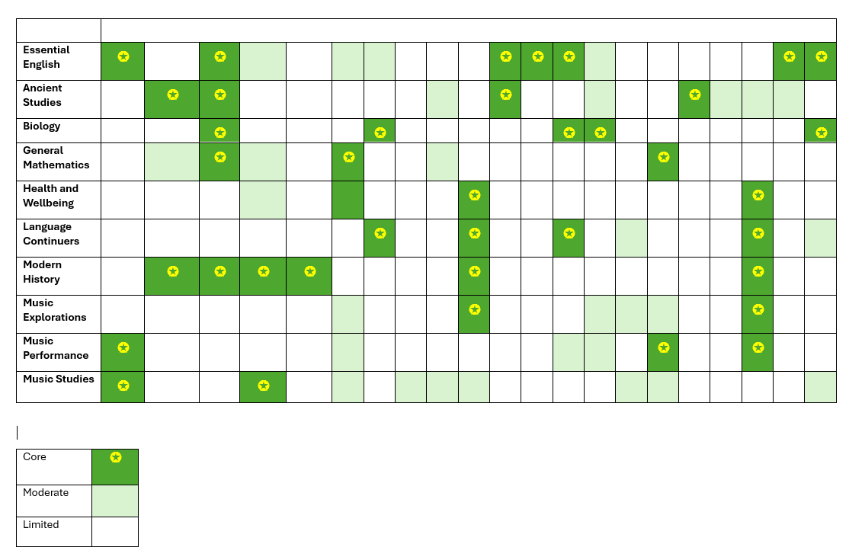
For illustration only

Slide 19
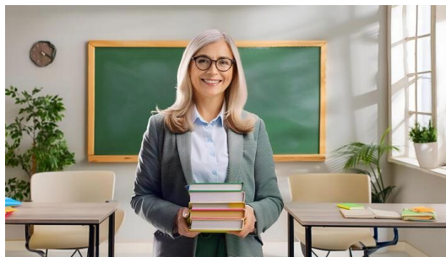
How do we create conditions for teachers to try something different?
"Exactly how are you asking me to behave differently in the classroom?“
Guy Claxton’s Teaching for Life, A culture change for schools, May 2025

Slide 20
“The role of the leader is to create a context where others feel stronger and more capable.”
- David McClelland

Slide 21
Subject renewal
Jane Marshall
Faculty Manager (Arts & Pathways)

Slide 22
Our narrative
Subject renewal is a process
to co-design subjects with the community;
that will sharpen content and assessment
and intentionally develop capabilities.
Renewed subjects will have space for student agency (agency)
So that students can engage in real-life learning (deep, authentic learning)
And recognise a broader range of evidence of learning (Natural Evidence of Learning)
Where students evaluate their thinking to regulate the way they learn. (metacognition)

Slide 23
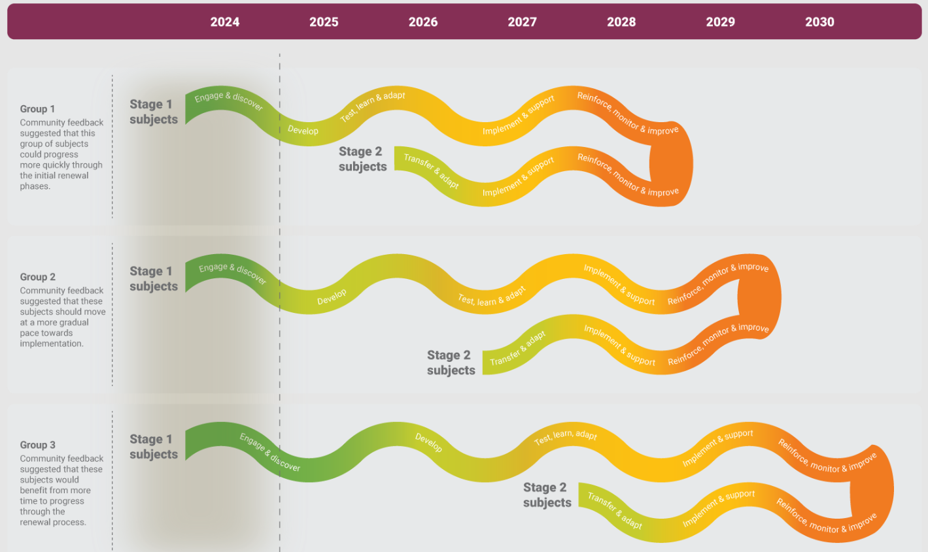
Subject renewal roadmap

Slide 24
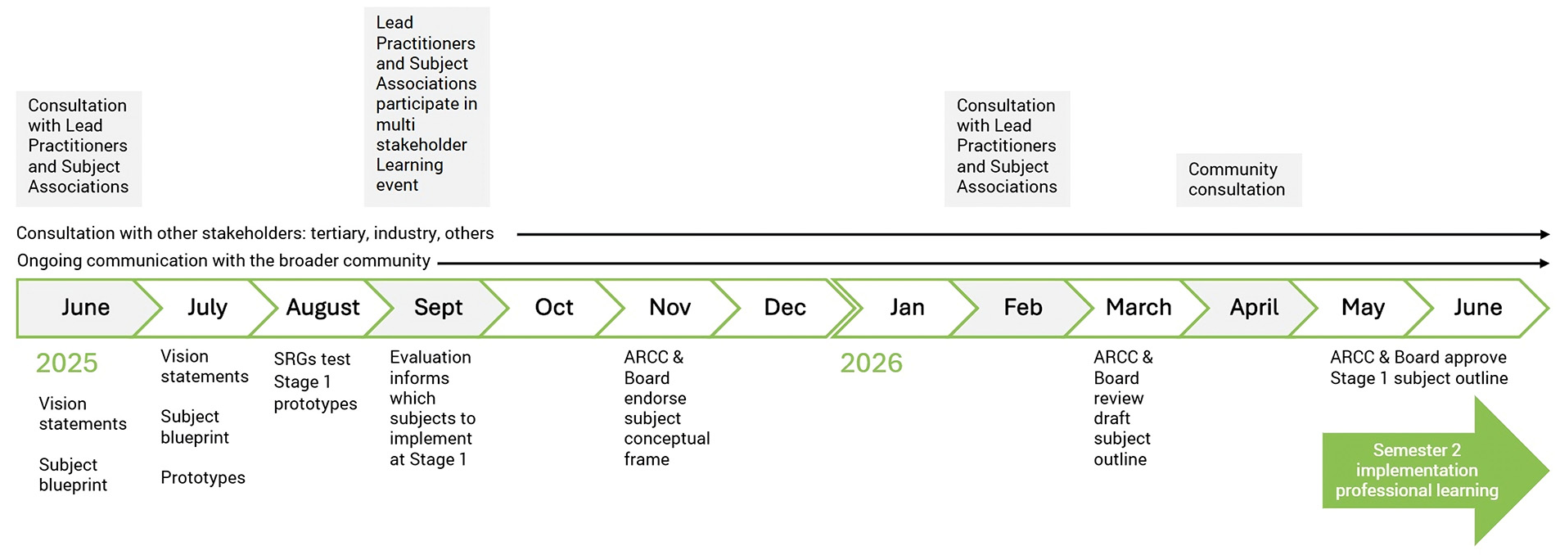
2025 Subject Renewal Roadmap– Group 1 SRGs

Slide 25
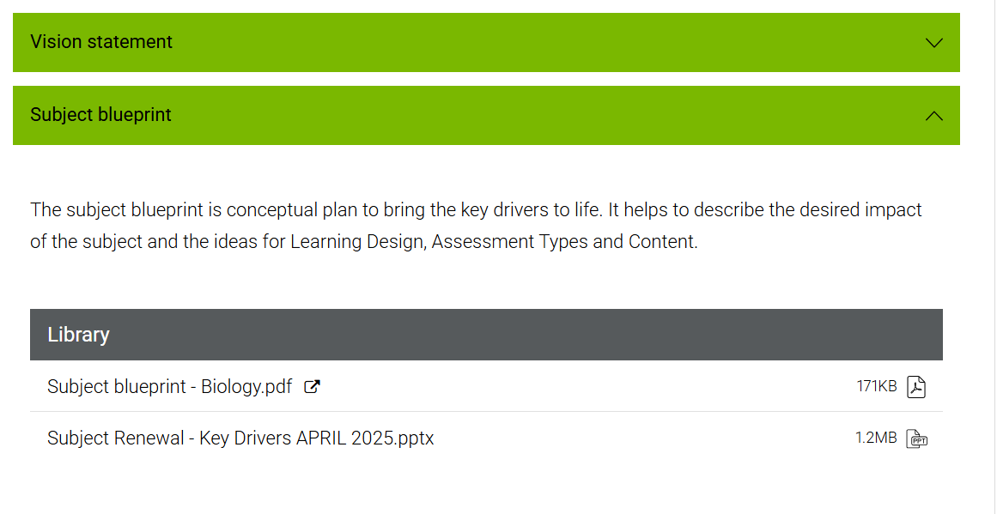

Slide 26
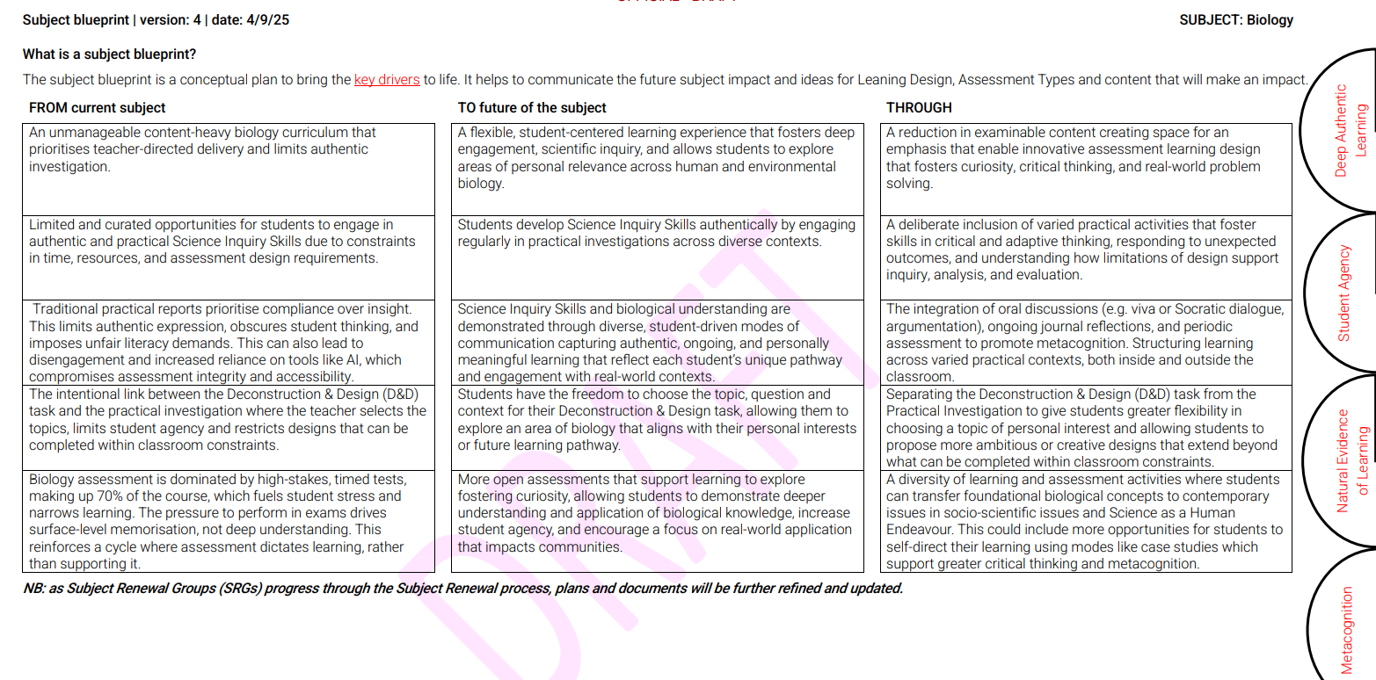
FROM
TO
THROUGH
EXPECT UPDATES

Slide 27
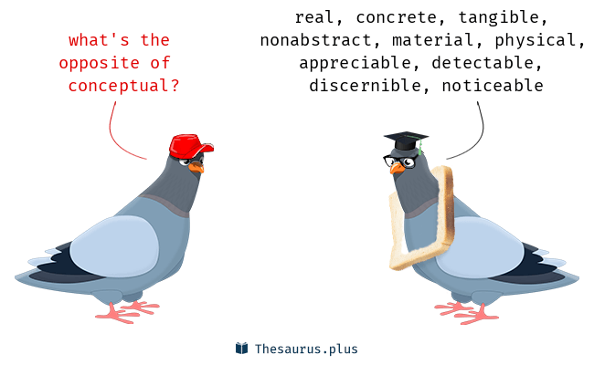

Slide 28

Notes from the classroom
Tyson Munday & Aabhigya Khadka
Kings Baptist Grammar School
April Bunton
Glenunga International High School
Will Morphett
Wirreanda Secondary School

Slide 29


Prototyping: General Mathematics
Tyson Munday and Aabhigya Khadka
^{King’s Baptist Grammar School}

Slide 30
Introduction
The Spark
The Experiment
The Impact
The Future

Slide 31
‘The Spark’ – Why?
Vision statement
General Mathematics engages students with personally meaningful and practical mathematics that equips them with the skills to make real mathematical decisions with confidence and clarity. The subject empowers learners to think critically, embrace technology, and apply mathematics to solve challenging, real-life problems in contexts that matter to them.
The purpose of the prototype is to give students the opportunity to:
1. Solve open-ended problems they are likely to encounter in their lives.
2. Present in a way that is unique to them.
3. Critically reflect and be able to explain the purposes behind their mathematical thinking.

Slide 32
Challenges
Freedom is a double-edged sword
How do we empower teachers with the tools to do this effectively?
Students expect tests
How do we assess consistently?

Slide 33
Opportunities
Old models limit students to a strict layout
Students are equipped to explore unique solutions
Knowledge is gained in a more practical context
Students demonstrate their ability to verbally explain their mathematical thinking and problem solving

Slide 34

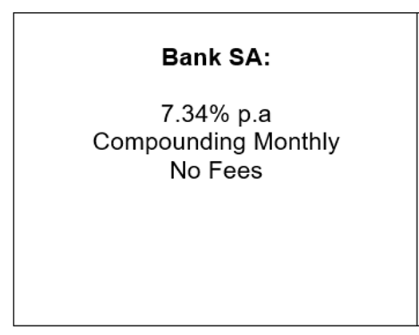
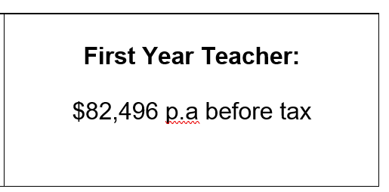
‘The Experiment’ – What?
Topic: Stage 1 General Mathematics (Finance)
Students simulate beginning their first full-time job and must take out a loan. They are posed a few scenario options, for example:

Slide 35
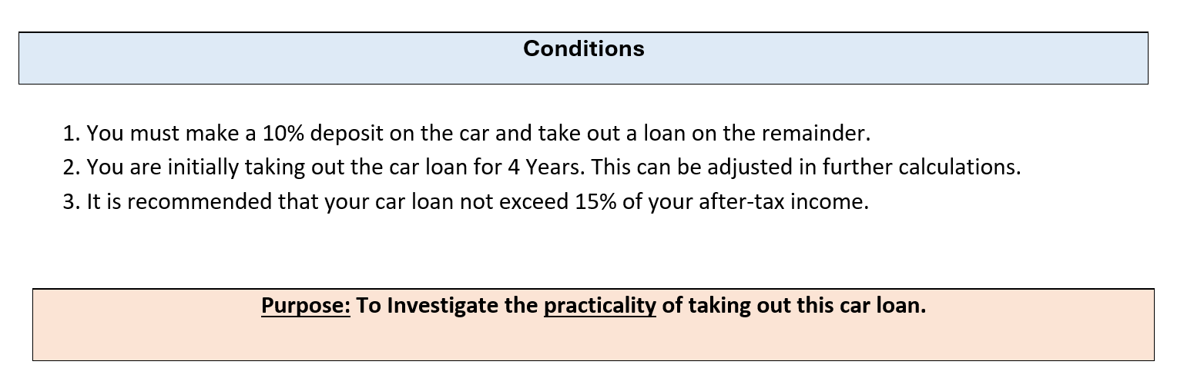
‘The Experiment’ – Conditions
We constructed a few conditions to frame the structure of the task.
Purpose: To be open-ended, allowing student agency and creativity, while still allowing all students to engage meaningfully.

Slide 36
‘The Experiment’ – Summative Conditions
100 minutes
No laptops
Calculators allowed
Written notes allowed
Handwritten (range of paper provided with creativity encouraged)
After the summative assessment, students are interviewed one-on-one with reflection questions that allow them to provide evidence and elaboration of their learning in their own words.

Slide 37
Intentional Formative Assessment
One complete week of lesson time for students and teacher to discuss the task and offer guidance.
Practice assessment in test conditions (similar structure, different scenario)
One-on-one feedback interviews with students (5 minutes each) to provide intentional guidance before the final assessment.

Slide 38
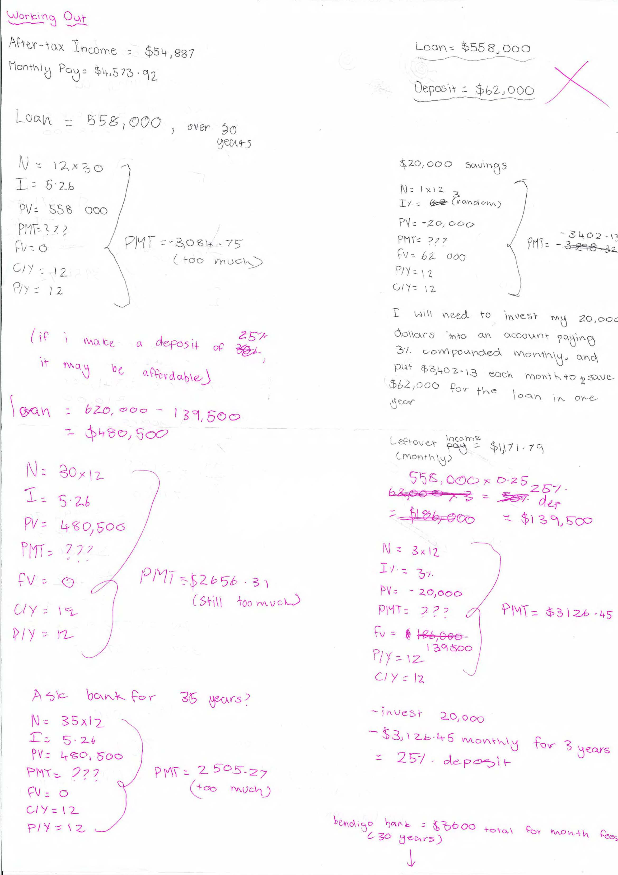
^{‘Messy Maths’}
^{Celebrate every step!}

Slide 39
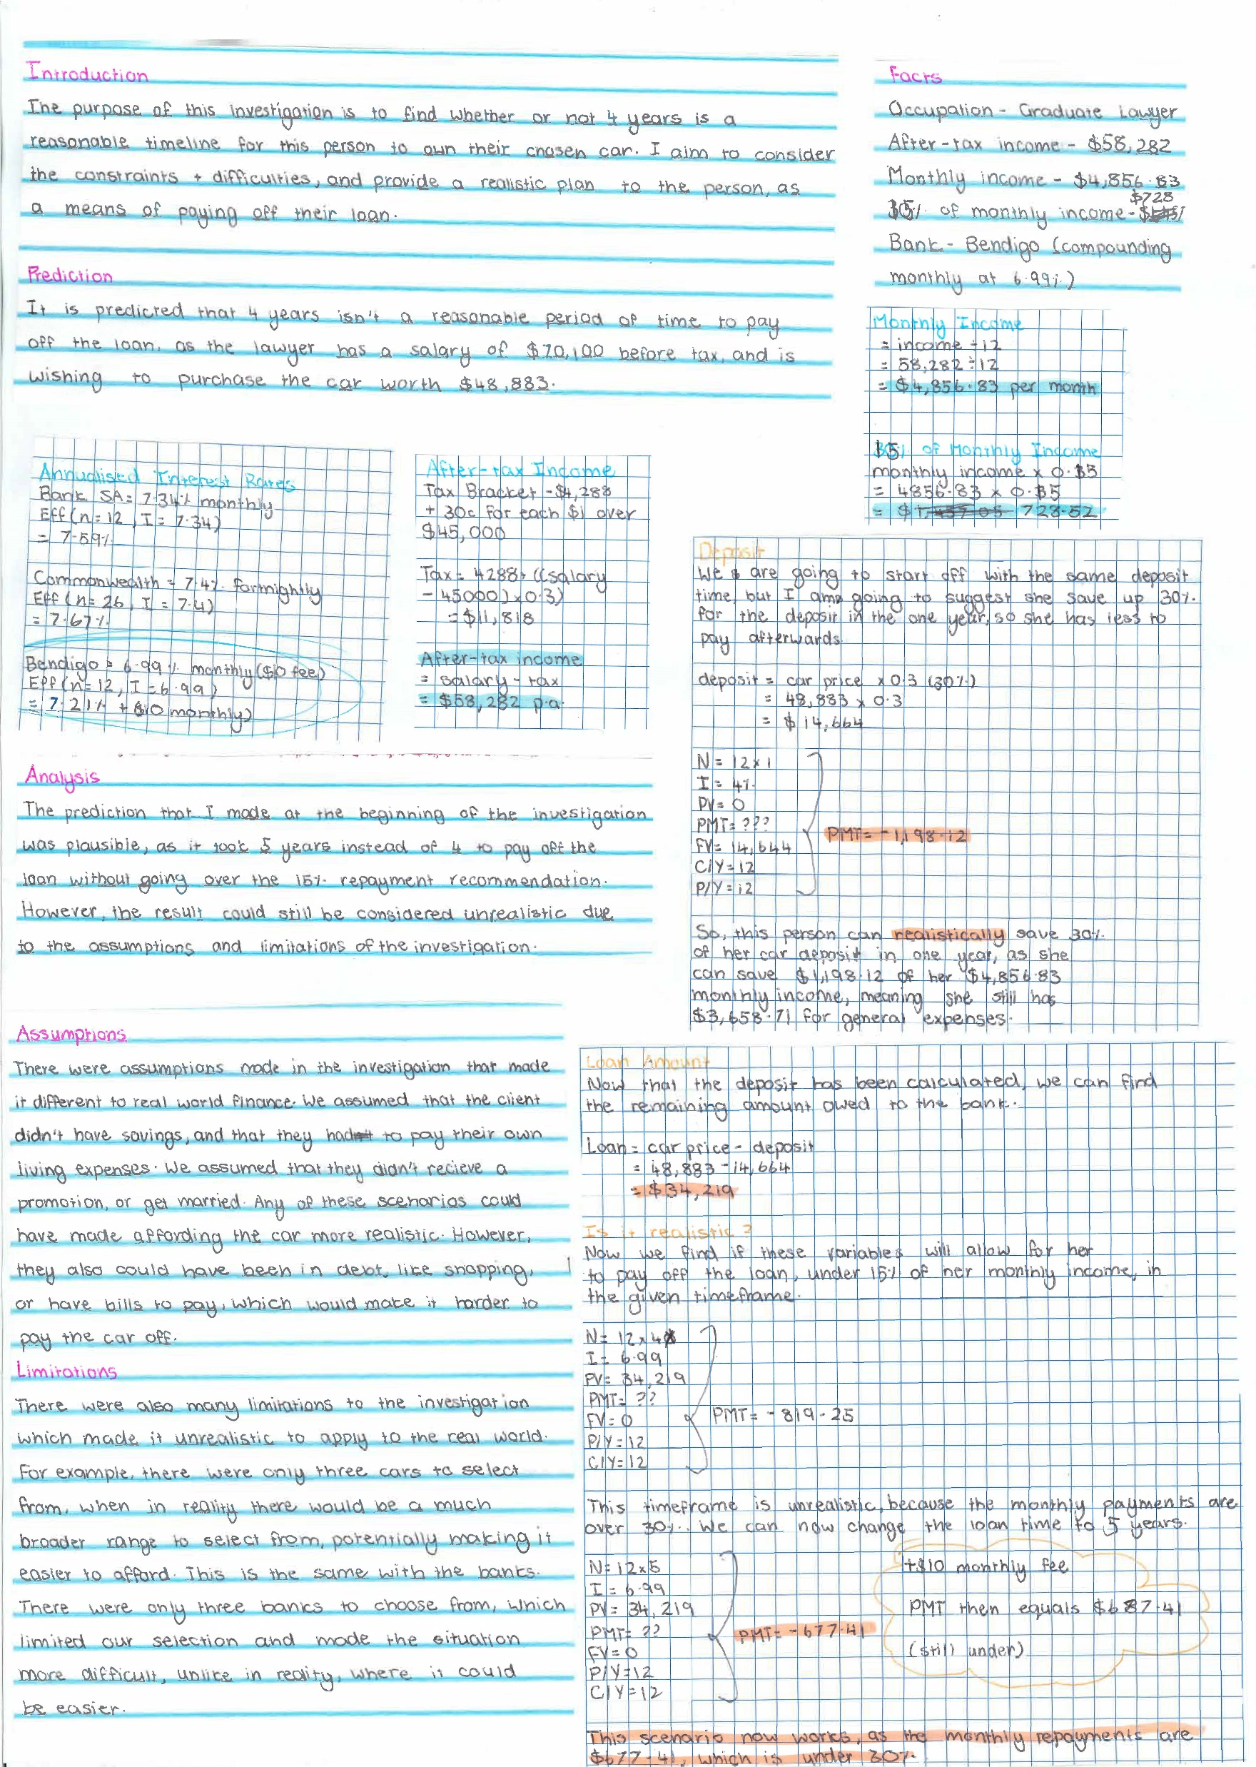
^{Transformation}
^{Student-led – Teacher-directed}

Slide 40
The Experience
I was intrigued by the assessment format since it was different from traditional tasks
This assessment was heavily applicational
I was able to realise the gap in my ability to connect mathematical concepts into real world contexts

Slide 41
Pros | Cons
Practical
Helped students think beyond standard test-based learning
Refreshing change from traditional methods
Time restrictions
Strict time pressure can hinder students from producing their best work
Longer time durations can provide students with more time to think.

Slide 42
The Impact
The assessment helped me view maths with a broader perspective
I learned how to apply maths into the real world
I was encouraged to explain and critique my results
Instead of formulas, my cheat sheet focused on reminders to expand my mathematical discussion and reasoning.

Slide 43
Reflections
Students were apprehensive about change – anticipate it
The uniqueness of student work was surprising
Design of questions to allow for further exploration is crucial
Student engagement is key. Differentiate and structure as normal.

Slide 44
‘The Future’ – Follow-up questions
How do we provide structured resources for teachers to implement this effectively in the classroom?
How do we adapt the current Performance Standards to reflect the learning that students are demonstrating?
What does this replace?

Slide 45
Tyson Munday and Aabhigya Khadka (King’s Baptist Grammar School)

Slide 46


SACE Subject Renewal at GIHS
Language Continuers
September 2025

Slide 47
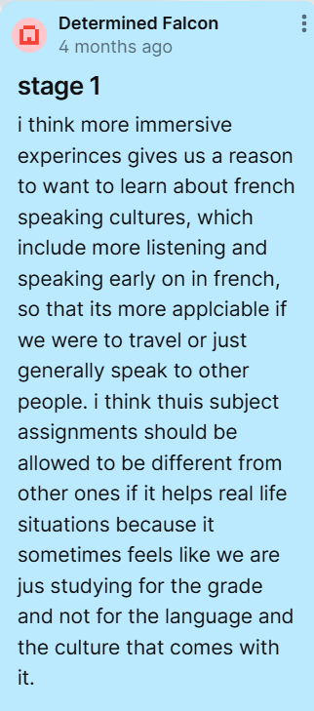
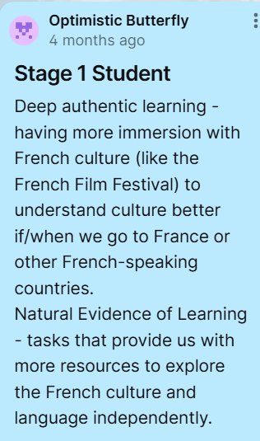
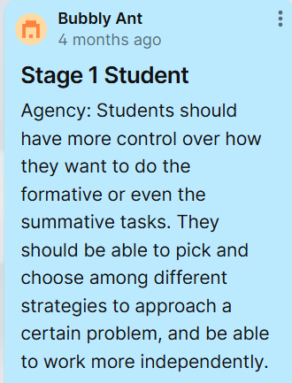
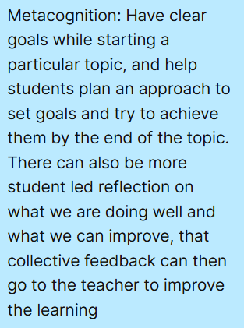
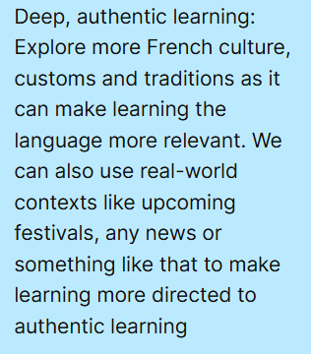
The Spark
Moving from: high expectations of linguistic and grammatical accuracy as success.
Moving to: valuing adaptable communication with authentic and reflective language use.
Student feedback on current course from the Padlet

Slide 48
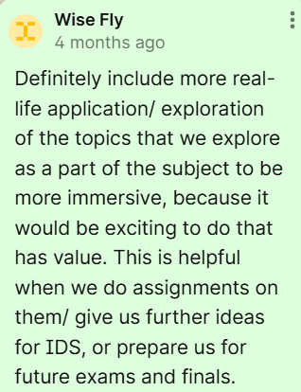
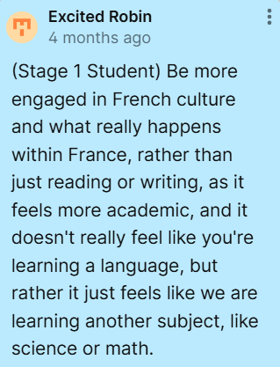
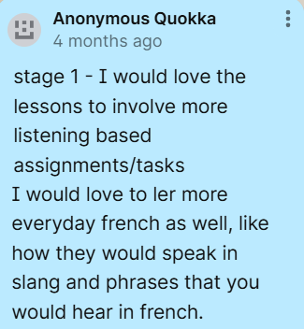
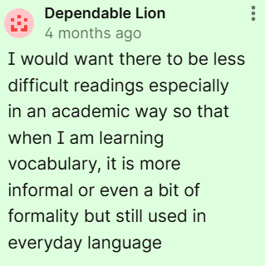
The Spark
What did we hope to improve or explore?
Based on student feedback:
  Deeper understanding of cultural differences and similarities.
  Authentic application of language, less academic style.
  More space for immersion in the language, rather than English analysis.
  Encourage risk-taking and creativity in communication.
Based on the current course:
  Big ideas and creative expression.
  Valuing the learning process, not just the outcome.
  Relevant and diverse perspectives, ideas, and expression.

Slide 49

The Experiment
The Experiment
The students chose the topic of travel - based on the current topic.
  This topic was devised through discussion of things that made them nervous/excited about travelling to a French-speaking country.
Class discussion indicated which elements of travel were of interest to them.
Focus on Francophone countries - less Eurocentric.
  Exploration of new cultures not previously considered as much.

Slide 50
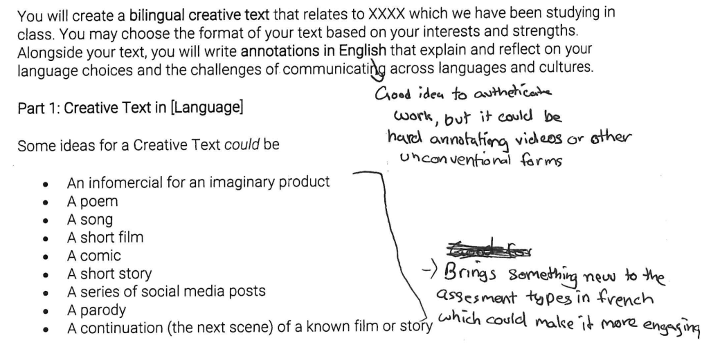
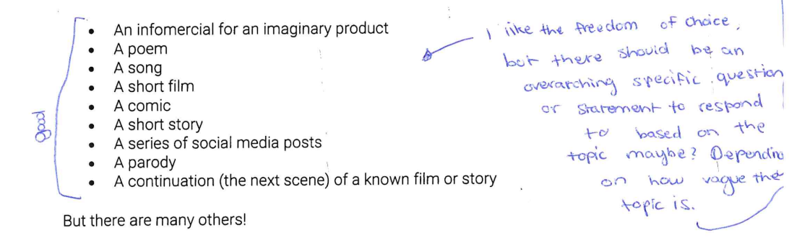
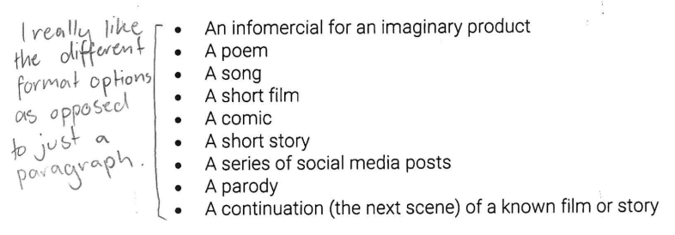
The Experience
Pre-task annotations
How did we design and implement the changes?
  The prototypes were designed by the SRG group leader based on student feedback from the Padlets.
  Then given to students for further feedback on the design.
    Annotations of further questions, and opinions.

Slide 51
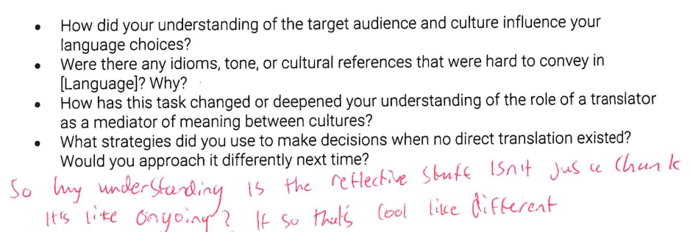
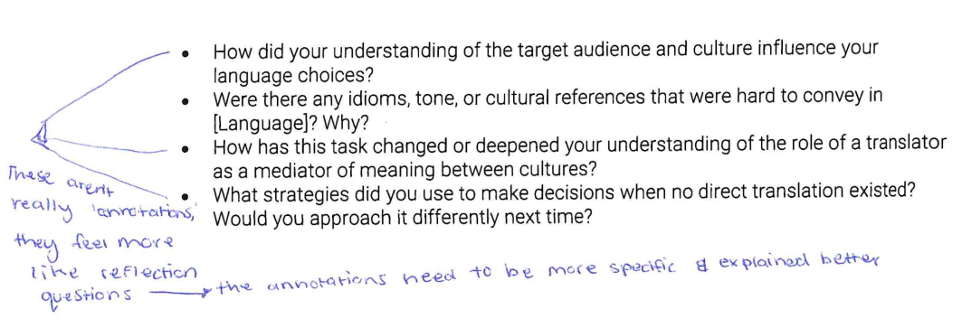
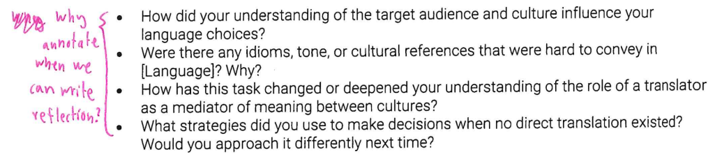
The Experience
Pre-task annotations

Slide 52
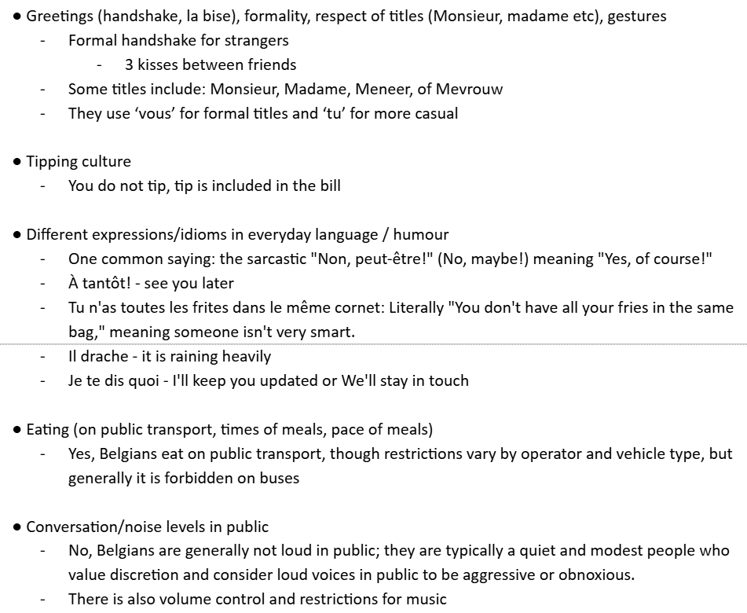
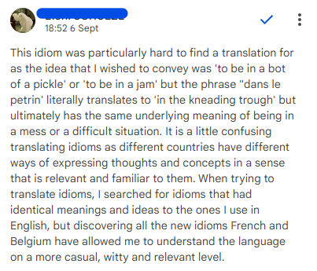
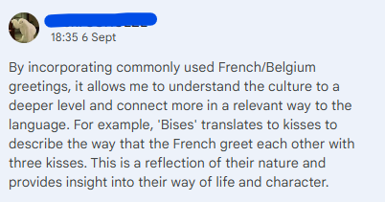
The Experience
Task progress
The planning process was consistent, as usual.
Some annotations, but more so planning for the output.
NEoL and Metacognition need more concentration.

Slide 53
The Experience
What worked well and what didn’t?
  Students found the lack of structure confronting - refinement required to maintain the level of creativity and student agency, while making them feel comfortable in an exploratory space.
  In Language Continuers, students are used to a post-outcome reflection, so annotations and NEoL require some additional strategising.
How did students respond and engage?
  Ownership - something they chose, rather than something they were obliged to do.
  Curiosity & authentic learning - they learned about a place that they intended to travel one day.

Slide 54
The Impact
What shifts did we notice in learning, engagement, or assessment?
  The students seemed much more self-directed in this space: their student agency was well explored.
How did this change our thinking or practice?
  NEoL is something that needs more intentional focus in class.
  The metacognitive questions about language choices needed to be broken down further in class.
    Students are used to application, not necessarily considering their language choices beyond a shallow level.
What did the students feedback?
  Overall a positive experience, but with some challenges regarding the different levels of agency and creativity.

Slide 55
The Future
What do you suggest we keep, adapt, or let go?
  Reflective annotations were an interesting addition, prompting thinking about idiomatic expressions (natural and informal language) and how this impacts meaning-making.
What further questions does it raise?
  Can the Performance Standards be adapted to include the Key Drivers?
  Incorporation of THRIVE capabilities - these will be incorporated well.
  How can we guide students out of their comfort zones between Year 10 and Stage 1 and 2?
  How can this level of metacognition and NEoL be implemented in oral and aural tasks?
  Deeper questions to guide metacognitive thinking about language use will need to be provided, otherwise it is recount.

Slide 56
Stage 1 Biology
Will Morphett
Teacher: SACE Biology, Science and Maths, Industry Connections

Slide 57
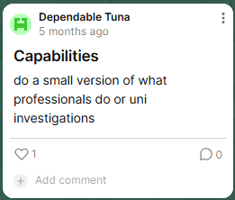
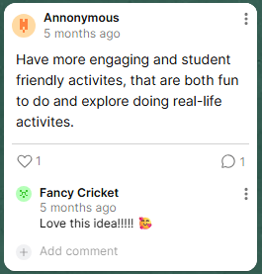
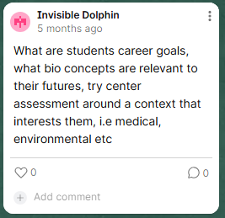
The Spark
Stage 1 class of 2024
School contexts
No Stage 2 Biology class 2025 due to numbers
Low reading levels
Low attendance rates
Interest in health pathways

Slide 58
The Spark
Deep Authentic Learning
How can provide opportunities for exploration when significant supports are required for engagement in content?
Natural Evidence of Learning
How might we expand the way we look at evidence and diversify how students can show evidence of learning?
Metacognition
How might we provide opportunities for reflection and introspection in assessment tasks?
Agency
how might we ensure that teaching, learning, and assessment cater to the needs, interests, and pathways of all students?

Slide 59
The Experiment
Science Inquiry Skills Journal
Journal entries focusing on 4 areas of SIS: Scientific background, data presentation and analysis, evaluation, and recommendations/further questions.
5 practical focused activities throughout the assessment period.
Journal entry for at least 2 activities.
Flexibility to complete different sections for different experiments.
Multimodal evidence encouraged
teacher questioning and discussion occurred throughout.

Slide 60
The Experience
Science Inquiry Skills Journal
High levels of engagement (0 non submissions)
Flexibility to explore concepts further
Varied forms of evidence some of which were unexpected
Engagement and achievement from unexpected students
Difficult to capture all evidence observed in the classroom
Time limitations impacted content delivery

Slide 61
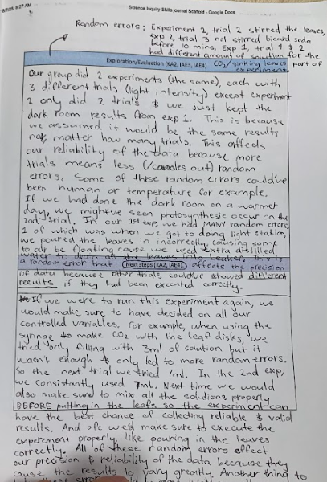
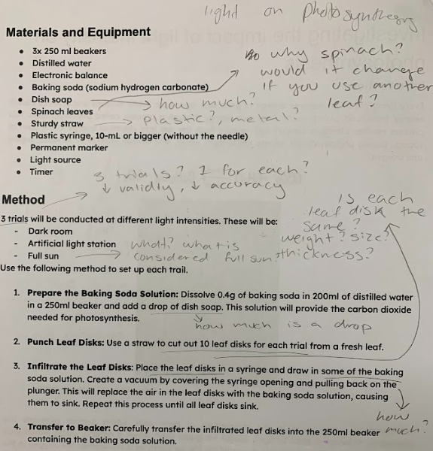
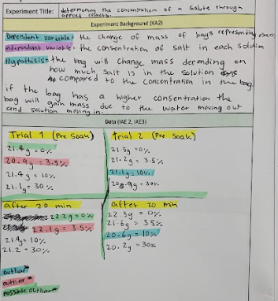
The Experience:
Science Inquiry Skills Journal
Observation of note:
Richest examples of natural evidence were reactive conversations and comments during practical.

Slide 62
The Impact: SIS Journal – Student Perspectives
Deep Authentic Learning | Natural Evidence of Learning | Metacognition | Agency
“The experiment on osmosis allowed me to see how biology plays a big roll in nursing, the career I would like to pursue after high school.”
“Allowed me to show my learning by having to write down everything I observed and learned and what those observations meant and how it effected the data and stuff.”
“Doing repeated experiments and journaling allowed me to reflect on what I wrote and did last time and see if I can change anything, improve anything, stop something or start doing something.”
“The journaling was particularly helpful because it was an individual task and meant I had full control of how and what I learned by what I wrote down and asked questions about. “
“too many practicals, not enough writing time.”
“it was good because you were able to see how other people learnt and wrote stuff down which helped me see different perspectives.”
“doing lots of prac’s was good but I felt like not everyone got enough time to put their full thinking in the journal.”
“we got to choose some of the experiments we did, and it was mostly self directed in groups.”
“I feel like we should have had more book stuff to set up our knowledge for the practicals, but it was good to explore”
“maybe a little bit too open ended so I think some people were a little confused about what to write”
“I feel like, when doing the experiments when something didn’t happen in the way I thought it would I was able to break that down in my own mind and explore what caused it”
“I feel like it’s a positive impact on my learning because it makes it much easier to understand because it’s a lot of mini things that are slowly combined”
“I felt like I didn’t have enough time to fully complete journal entries and explore further”
“I feel like I could produce a better-quality evidence in a single prac report as I would have more time.”

Slide 63
The Impact: SIS Journal – Teacher perspectives
Deep Authentic Learning
          Significant development of SIS skills and evaluation of experiment limitations
          Lack of time for explicit teaching and deep exploration of real world applications
Natural Evidence of Learning
Included annotations on methods, dot pointing, colour coding and full paragraphs.
in-class observations and conversations elicited high levels of understanding not captured in the journals.
Metacognition
Many opportunities for reflection and exploration.
Discussion supported capacity to provide timely, targeted feedback.
Agency
Limited to some further exploration of specific practical tasks and the choice between two practicals for one task.

Slide 64
The Future
Major advantages
Significant increase in engagement in tasks
Increases accessibility for diverse learners.
Capacity to develop scientifically minded, expert learners.
Key questions
How might we provide time to support opportunities for deep, authentic exploration of concepts and maintain a rich and varied curriculum?
How might we maintain equity in exposure to deep, authentic learning opportunities?

Slide 65
The Experiment: D&D– (alternative approach)
Students deconstructed the question:
“how might the risk of the spread of infectious disease be reduced in a school environment?”
Students formed groups based on selected factor to test and design a method.
Method presented to teacher in the form of research proposal defence.
Groups carried out practicals and presented the results to the class.
Students evaluated other groups presentations exploring the impact of methods on data.
Students completed an individual reflection focused on performance standards.

Slide 66
The Experience
Deconstruct and Design – (alternative approach)
Students engaged well with the freedom to choose their investigation method.
Format expanded forms of evidence that could be collected.
Group format facilitated further discussion and peer learning opportunities.
Opportunities for soft skill development (communication)
Availably of resources resulted in low validity of data.
Group format made it difficult to gather evidence of individual achievement.

Slide 67
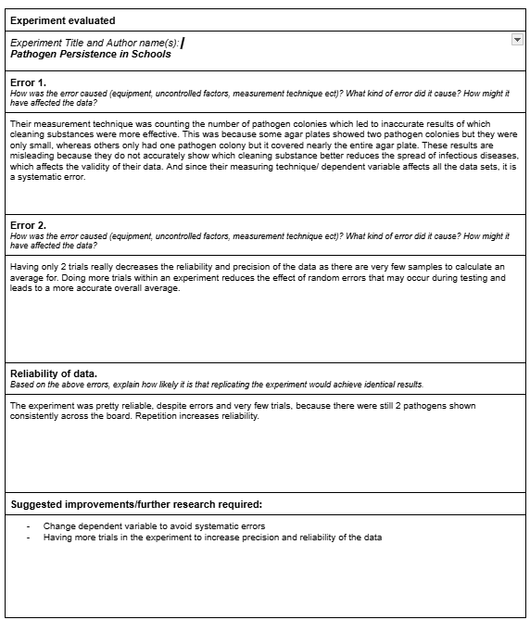
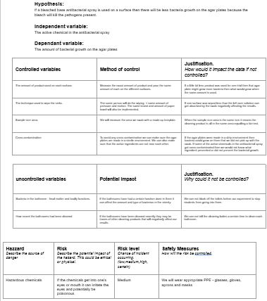
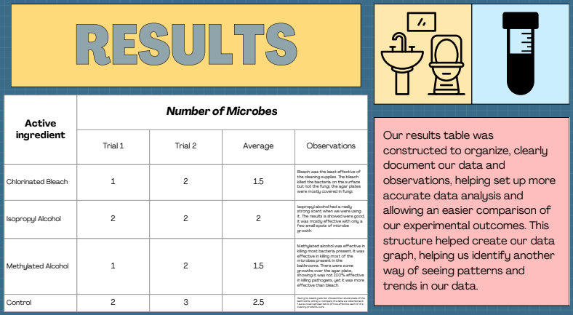
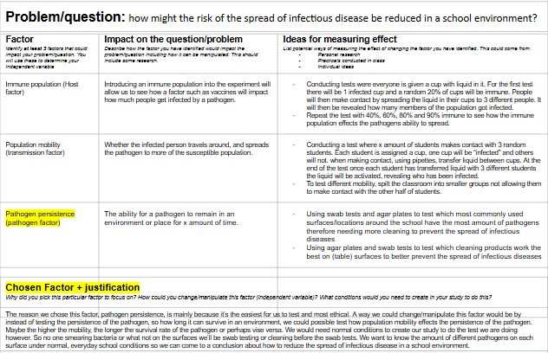
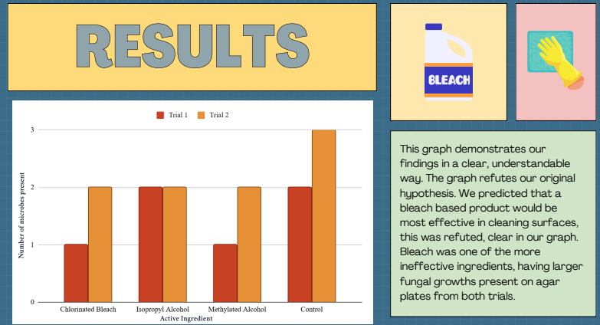
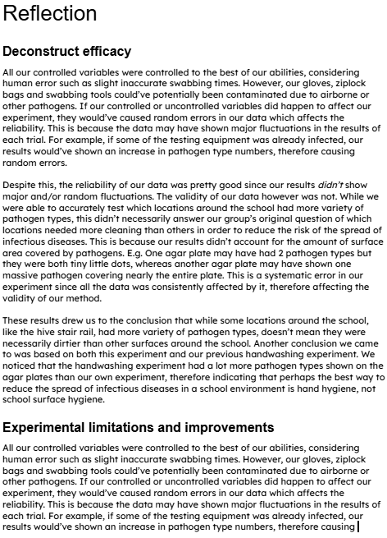
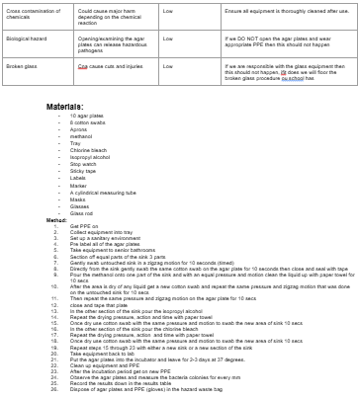
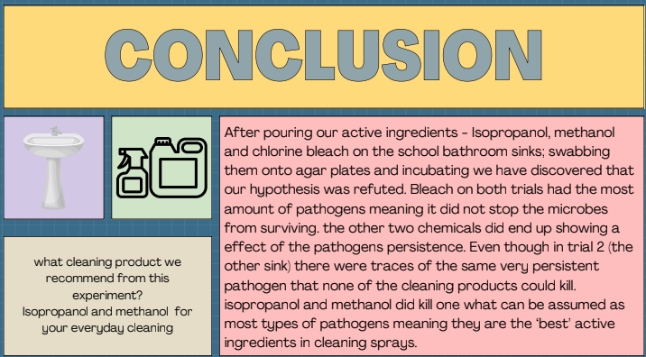
The Experience:
Deconstruct Exploration
Feedback and reflection (individual)
IAE 1, IAE4, KA1, KA4
Design and completion (Group)
IAE 1, IAE2, IAE3, KA4
Deconstruct (individual)
IAE 1 KA1, KA4

Slide 68
The Impact: D&D (alternative approach) – Teacher perspectives
Deep Authentic Learning
          Students thinking in action in a real-world context
          Some barriers included research skills and self-directed learning.
Natural Evidence of Learning
Continuous nature of task provided multiple opportunities to collect evidence of student progress.
Some resistance to verbal assessment.
Metacognition
Limited materials/resources provided genuine opportunity to explore experimental limitations
Agency
Choice of focus/freedom of design increased engagement in the assessment task
Group task provided opportunities for peer-to-peer learning.

Slide 69
The Future
Major advantages
Key checkpoints throughout ➔ increased opportunities for reflection and collection of natural evidence
Restricted equipment and materials allowed genuine exploration of limitations
Key questions
How do we create genuine student agency if the capacity to complete a designed experiment is removed?
Does only conducting completion practicals provide enough scope for exploring experimental limitations?

Slide 70
“The role of the leader is to create a context where others feel stronger and more capable.”
- David McClelland
Table discussion
What resonated with you?
Assuming SACE implementation workshops, support materials on SACE website…….. How do we as leaders create conditions for teachers to try something different?

Slide 71
Morning Tea

Slide 72
SACE Capabilities and Learner Profile
Virginia Steele
Program Manager, Capabilities and Learner Profile

Slide 73
Alex's Story
Alex started their SACE journey in EIF and enjoyed learning about the capabilities. Their subject teachers in Stage 1 introduced the elements most relevant to their discipline area. By the end of Semester 1 they had their first learner profile.
In Semester 2, Alex had data input from their subject teachers, plus extra-curricular sport from their basketball coach, as sport was an important part of Alex’s life. At the end of the year, they had a learner profile that showcased not only their subject achievement, but also their capability strengths.
The following January, Alex used their Year 11 profile to apply for a job in the local café. They were able to use the language of the capabilities to talk about how they worked well with others, responded effectively to feedback, and demonstrated a high level of organisation. In Year 12, Alex had data entered by all their subject teachers plus from the teacher who ran the school Peer Mentoring Program they worked in. They also asked their employer to submit data. At end-of-year SACE Results Release, Alex received their Record of Achievement, SACE Certificate, and final Learner Profile. Their Learner Profile supported an enhanced admission process into the university course they wanted.

Slide 74















Alex’s story
Capability development
Assessment data visualised in a Learner Profile
Students develop capabilities in a range of contexts both inside and outside of school
Separate capability assessment
Employment
Subject learning – classroom teacher
Extra curricular activities – relevant teacher
Outside of school – relevant adult
Data shared with pathway providers

Slide 75
Alex's Story
Capabilities assessed within SACE subjects
Capabilities assessed via extra-curricular activities
Capabilities assessed through outside of school activities
All assessment data visualised in a learner profile
Capabilities data shared with post-school providers

Slide 76
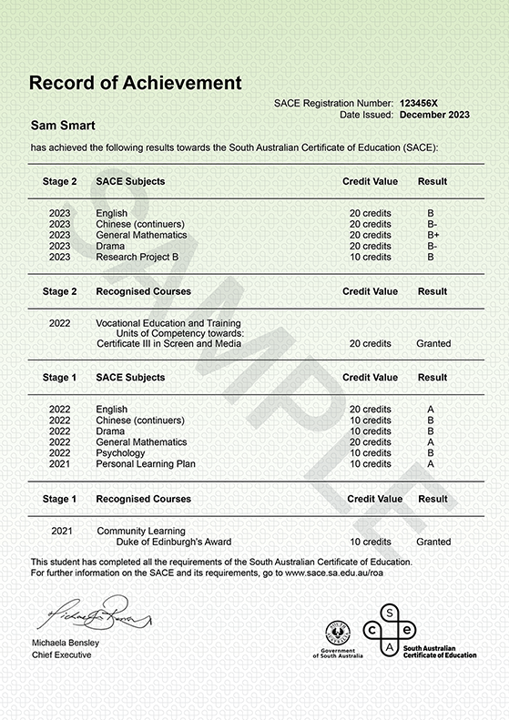

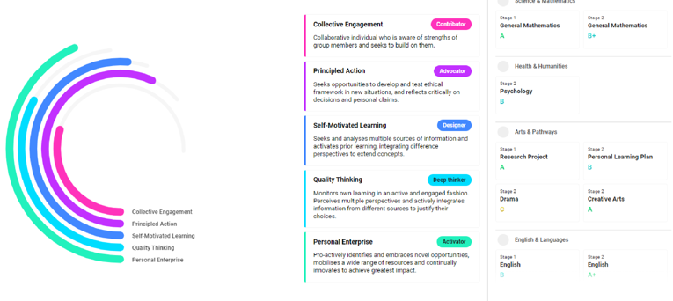
Alex’s Documentation
Alex’s passport to thrive
Students Online > Learner Profile (2022 version)

Slide 77
The elements in pilot
Adapting
Being considerate and caring
Being creative
Being organised
Being reflective
Demonstrating initiative
Demonstrating perseverance
Demonstrating respect
Developing informed opinions
Embracing diversity
Forming relationships
Inquiring
Making contributions
Taking opportunities
Being curious
Being responsible
Comprehending
Engaging in dialogue
Engaging with feedback
Reasoning
Using tools

Slide 78
Self-motivated learning
 | Does the learner typically…
Adapting | Not applicable for this student | Not yet achieved |  | Try different methods when faced with a challenge. | Change their approach based on feedback or new circumstances. |  | Continuously monitor and adjust strategies as necessary to ensure success.
Being organised | Not applicable for this student | Not yet achieved | Ask for guidance in getting organised. | Use strategies to stay organised. |  | Tailor strategies and plans to navigate competing priorities.
Being reflective | Not applicable for this student | Not yet achieved | Recount what they did during a learning experience. | Identify what they did well and what they could improve. | Take intentional moments of reflection to evaluate their learning progress. |  | Integrate continuous and purposeful reflection into their learning process.
Being responsible | Not applicable for this student | Not yet achieved | Participate in activities and complete assigned tasks. |  |  | Actively engage in the learning process and take ownership of progress.
Demonstrating initiative | Not applicable for this student | Not yet achieved | Select from options to action their learning. | Pursue learning in areas of interest. |  | Seek opportunities to learn and broaden understanding. | Establish their learning goals and make discerning decisions about the path to get there.
Demonstrating perseverance | Not applicable for this student | Not yet achieved | Continue working on a task or activity despite difficulties. |  | Actively seek additional resources and guidance. |  | Know their limits and when it’s appropriate to step back and reassess their goals.
Engaging with feedback | Not applicable for this student | Not yet achieved | Use feedback as directed. | Apply feedback when required |  | Seek out feedback proactively to improve
Taking opportunities | Not applicable for this student | Not yet achieved | Try new experiences with prompting. |  | Explore new opportunities for learning. |  | Maximise opportunities for learning through a wide range of experiences.
Using resources | Not applicable for this student | Not yet achieved | Use basic resources that are provided to them. | Find and use additional resources to support their learning. |  | Integrate multiple tools and resources to enhance their learning. | Effectively transfer skills and resources across contexts.

Slide 79
SACE Capabilities in pilot
Collective Engagement
I can be inclusive of ideas, people, and perspectives to generate purposeful outcomes
Personal Enterprise
I can demonstrate initiative, pursue opportunities, produce outcomes of value, and ‘get things done’
Principled Action
I can be responsible for my actions and consider the impact I have and the experiences of others, and ‘do the right thing’
Quality Thinking
*Plus, testing: Communication
I am curious about the world around me and use a range of thinking strategies to shape my understanding
I can embrace challenges as opportunities and persevere and be active in my own learning
I can communicate to enhance relationships, shape understanding, and build connections
Self-motivated Learning
Saturn is the only planet with rings in the entire Solar System

Slide 80

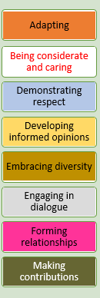
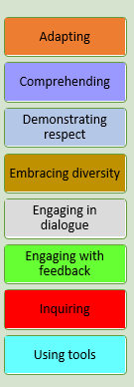
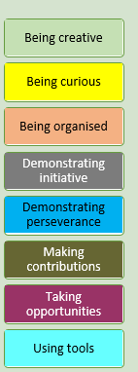



The Elements in the Capabilities
Communication
Personal Enterprise
Principled Action
Quality Thinking
Self-motivated Learning

Slide 81
Activity A – Engaging with the Capability frameworks
Conceptual and technical understanding
Self-assessment

Slide 82
Activity B – Engaging with the Capability frameworks
Is level 2 realistic and attainable for SACE students?

Slide 83
ders Conference
Notes from the pilots
Tracey Wallace & Amy
Scotch College Adelaide
Emily Rodgers & Ava Laan
Eastern Fleurieu R-12 School
Theo Papazoglov
Adelaide Botanic High School
2 2025

Slide 84
Capability Development in Action:
Teachers Creating Conditions, Students Owning Growth
Tracey Wallace, Service-Learning Coordinator
Amy, Year 12 student and College Captain

Slide 85

The Spark – Context & Motivation
Service Learning – Student volunteering (toolkit)
Making good humans
Supplementary/alternative metrics to the ATAR
‘ATAR+’, ‘Beyond the ATAR’, ‘We are More’ – SS students
Parent hat on – Dux but…
Capability development is at the core of what we do!
Scotch College: SACE LP, New Metrics with UoM & Matching for Success
(language used interchangeably)

Slide 86


The Experience – What We Did
Within curriculum
9@Scotch/EIF
Integrated Learning
Co-curricular
Service Learning - Borneo
Future Problem Solving
Leadership
Helping Hands Program

Slide 87






Within curriculum - 9@Scotch/Exploring Identities & Futures
s
What Elements
am I strong at?

Slide 88




How will you use your
Elemental strengths
to contribute to your Group Culture and Norms?
What Elements
are required for leadership?

Slide 89








Within curriculum – Integrated Learning (Stage 1)

Slide 90




Slide 91


Co-curriculum – Service Learning Borneo
Unique opportunities for students to develop Capabilities
Explicit focus through activities

Slide 92













Setting TEAM Learning Objectives

Slide 93







Individual Learning Objectives
Unpack the Capabilities – choose your focus
What observable behaviours (elements) will others see in you?
Which expedition activities are an opportunity to exercise the chosen elements?
How will you know if you have achieved your learning objectives?

Slide 94










Camp Mail
Writing ‘element’
notes…

Slide 95


Slide 96



Co-curriculum – Future Problem Solving
Community Problem Solving component of the FPS Program. Students select a real-world problem, identify a solution, and then actively implement their action plan to address the problem.

Slide 97


Slide 98


Slide 99


Leadership – Helping Hands Program

Slide 100


Slide 101
The Impact – What We Learned
The time in now – keep the momentum to shift the system
Key stakeholders engaged
Shared ambition to measure what is valued, and value what is measured.
Students want to believe that their SACE certificate and Learner Profile will be a holistic representation of their secondary schooling

Slide 102




The Future – What’s Next?
Active Citizenship
Safeguarding Democracy
Students in the driver's seat of their education journey
Language mix
Expect to adapt elements – e.g. navigating AI

Slide 103

Emily Rodgers
Teacher
Ava Laan
Student
Eastern Fleurieu School

Slide 104


The Spark

Slide 105


The Experiment – WHAT WE DID

Slide 106


Slide 107


Slide 108
The Future – What’s Next

Slide 109


Capabilities and Learner Profile
Theo Papazoglov
Assistant Principal Innovation in Data, Learning Technology and Communication
Adelaide Botanic High School
The next iteration.

Slide 110



Contents Our Purpose Our DNA Our Aspirations Coherence Framework The Iceberg The Journey
Community
Excellence
Curiosity
Our DNA
Community
Excellence
Curiosity
Investing in our people and relationships is a powerful catalyst for change
Everyone is capable of growth and can be extraordinary
By building on students’ natural curiosities, innovation is inevitable

Slide 111


Slide 112

Contents Our Purpose Our DNA Our Aspirations Coherence Framework The Iceberg The Journey
Futures-Focused Capabilities
Connect Learning
Sustainable Relationships
Innovative Curriculum
Quality Feedback
Enjoyable Learning
Highly Skilled Staff
Futures-Focused
Capabilities at the forefront
of learning
We aspire for our people to be future-ready.
We aspire for our people to be future-ready
We equip our people with the skills, dispositions, and capabilities needed to adapt to future challenges while staying grounded in core human values. Our teaching and learning approaches focus on building student capacity to fully understand themselves as learners and develop their capabilities in preparation to leap into tomorrow’s world with confidence, curiosity, compassion, and social responsibility.

Slide 113

We equip our people with the skills, dispositions, and capabilities needed to adapt to future challenges while staying grounded in core human values.
Futures-Focused Capabilities at the forefront of learning

Slide 114


At Adelaide Botanic High School these things matter.
Learning Design for Enduring Purpose

Slide 115

Timeline
2021 | 2022 | 2023 | 2024 | 2025
Year 10 STEM Year 10 English | Biology English Earth and Environmental | Biology English Earth and Environmental | Connect (sample) Biology English Chemistry Philosophy | Connect (All Students) Philosophy Chemistry Art Design Drama Business Innovation Musical Photography Chemistry Film

Slide 116
Insights
  Scale can break things
  Quality Assurance
  Student Self Assessment is crucial
  Everyone involved makes it easier
  Single source of truth

Slide 117

Student Experience- Mentoring

Slide 118


Slide 119
Where to now?
Futures-Focused Capabilities at the forefront of learning

Slide 120

Common Language
Futures-Focused Capabilities at the forefront of learning

Slide 121



Slide 122


SA Curriculum - Mathematics Capabilities
Problem Solving
Developing Understanding
Being creative
Being organised
Demonstrating perseverance
Being curious
Making contributions
Comprehending
Reasoning
Engaging in dialogue
Using tools
Inquiring
Taking opportunities
Fluency and flexibility
Reasoning
Being organised
Adapting
Comprehending
Being organised
Developing informed opinions
Making contributions
Inquiring
Using tools
Reasoning
Futures-Focused Capabilities at the forefront of learning

Slide 123


Slide 124

Draft ABHS Frameworks

Slide 125

Draft ABHS Frameworks

Slide 126

Draft ABHS Frameworks

Slide 127



Thank You

Slide 128
?
Table discussion:
What resonated with you?
What does it mean for us to lead this in our schools?
"Exactly how are you asking me to behave differently in the classroom?“
Guy Claxton’s Teaching for Life, A culture change for schools, May 2025

Slide 129
Stretch

Slide 130

Communication role
SACE to school to teacher
Teacher to school to SACE
Teacher to system to SACE
Engagements
Emails
Social Media
Conferences
SACE website

Slide 131

PechaKucha planning
Goal: Create a presentation that captures the essence of your learning today and outlines how you’ll lead change or spark conversations back at your school.
Together or individually
Reflect on key insights
Brainstorm and storyboard
Use 20x20 sketch visuals, key messages and metaphors

Slide 132
Thank you

