Slide 1
ASSESSMENT TYPE 3: SKILLS DEVELOPMENT PORTFOLIO
SACE ID:
A950468

Slide 2
FOUNDATIONS & DEVELOPMENT OF LYRICAL
What is the history of your chosen dance genre? When/where/why did it begin?
Contemporary dance originated around the 1880’s and was movement for dancers who wished to not follow a strict ballet or lyrical form of dance. It specifically formed in the US and then expanded over the years. Contemporary dance was instead about exploring the area of revolutionary unconventional movements. These movements were gathered from all different styles all over the world. Contemporary dance did not use similar moves in the styles it developed a totally new form of movement and dynamics. These included quick oppositional movements, shifting alignments, expression of raw and real emotions and found the absolute limits of the human body form.
The origins of contemporary dance movements have been influenced by dance masters such as Isadora Duncan, Martha Graham and Merce Cunningham. These three dancers wanted to express to the world that contemporary dancers should embrace freedom within dance and explore movement to the body’s full potential.
The dancer who had greatly popularised and introduced contemporary movement was Martha Graham. She showed the style of contemporary dance world-wide. Continuing Merce Cunningham refined the work that Martha Graham established, and he expanded with his own choreographies, improvements and dance techniques. During Merce Cunningham’s long career he was fortunately regarded as one of the ‘greatest creative forces in American Dance.’
Jennifer Archibald, founder and director of Arch Dance in New York City mentioned that contemporary dance is a form of dance that has gathered different aspects from a range of different styles. She also mentions that it has a major part of technique in it and is also one of the most common styles to use a great range and amount of emotion and expressive movement.
Contemporary dance has a great amount of history to it and over the years has had many adaptations to it as well. In contemporary dance there is not set movements or syllabus that you have to follow unlike ballet and jazz. Contemporary has its own interpretation for each human and can have a great range of free movement.
What are the defining technical and stylistic features of your chosen dance genre?
In contemporary there is quite a range of movements and technical features of the style. Common dance movements found in contemporary dances and classes are movements such as floorwork, contractions, high releases and swings. Floorwork includes movements such as rolls,
Contemporary is a very expressive dance style and is a style that contains a lot of freedom. So, movements that are well known for contemporary dance is the use of a lot of floorwork. Floorwork is very common and can include movement such as knee rolls, back rolls, crawling. etc. Contemporary dance also includes movement such as contractions and high release, swings and flow. These movements are seen in most contemporary dances and can be very expressive to the audience. Compared to ballet most contemporary movements are done in parallel.
Compared to ballet contemporary has not set work and the movements are free for each individual. There are certainly specific movements that you can identify that someone is dancing contemporary but unlike ballet it completely free. Ballet has a very controlled movements and are very light on their feet whereas contemporary dancers are free to do what they want and move how they feel without any needed movements like ballet movements.

Slide 3
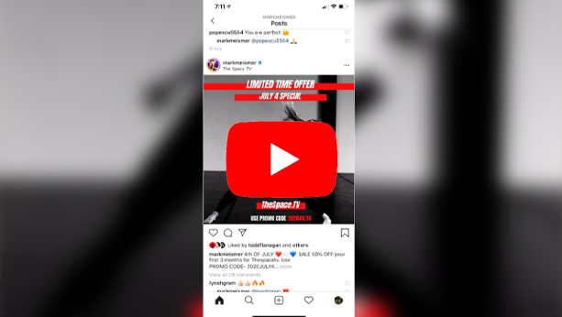
ANALYSIS OF A PROFESSIONAL DANCER
Strengths
-Extends all her movements
-Great amount of control
-Stretched legs
-Stretched feet
-Arched back in jump
-Great split
-Controlled arms in turns and pulled up on her leg
-Use of contraction and high release
-Light and shade used
Weaknesses
-Could’ve opened up her chest a bit more in the first big lunge.
-Not much expression seen
-Very controlled like ballet. Could loosen up a bit
How successful does the dance demonstrate the features of the genre?
Autumn Miller is a very strong lyrical/contemporary dancer. She is able to express herself through her dancing and apply the foundations and the elements of technique she has. Within this short piece she has used many features to demonstrate that this is a contemporary style piece. She uses a great amount of contraction and high release and has the ability to extend every movement. Autumn clearly has a great understanding of all the different features that make up contemporary and the choreographer Mark Meismer has a broad understanding as well. This is because he is able to add them all in his choreography.

Slide 4
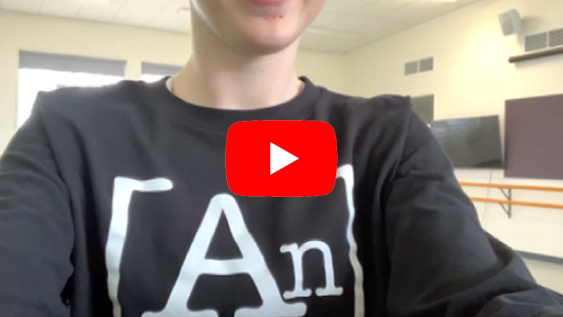
INITIAL ANALYSIS
Performance
Weaknesses
- Bent knee in lunge at the start (Not aesthetically pleasing)
- Slightly rushed at the beginning bit with all the show movements
- Bend in both legs when swinging round to the front from the back corner
- No arch in back when performing a split jump
- Didn’t straighten my legs in the split jump (due to lack of flexibility)
- No control in floor roll after jump especially when lowering into the ground
- Leg not pulled up in the turn
- Loss of control after the toe roll up (due to getting tired during the dance)
- No control in last turn to the ground
- Work on emotion coming across and using my upper body more
Strengths
- Deep lunge at the start (Ability to use up all the space)
- Great use of turnout
- Able to dance and use all the space but can still take up more space
- Ability to keep in time with the music and keep most of my movements flowing
After watch the video multiple times and analysing it I have found many areas of improvements that can be made. One of the major improvements is my overall technique. I found in the video my legs were quite bent and didn’t really point my feet. This made the alignment of my legs not look as good as it should’ve been. To improve this, I will need work on my flexibility, so I am able to et my leg at the height and the legs straighten as well. Especially in the two jumps I do I need to work on improving my flexibility, so I am able to create a nice line with my legs and split them even more. Additionally, with the jump I need to work on my back flexibility so that I can extend back and make the jump look overall better. Another improvement that needs to be made is my endurance. You can see that throughout the dance I become tired and puffed out. This is due to not hot having a good stamina to get me through the dance. At the end of the dance after the toe roll, I gave up and fell out of it because I didn’t have enough energy to push through and control the toe roll. This can be improved by going on walks, runs, bike rides and doing a bit of swimming. Lastly another improvement that needs to be made is slow down, connecting with the movement and finishing off every movement. I feel by working with my breath will help me to slow down as throughout the dance I tend to hold my breath and rush through it. By working with my breath and slowing down I will have more control over the movement and also be able to have the extra time to think about the step I am doing and not rush off into the next one.

Slide 5
PLANS FOR IMPROVEMENT - TECHNIQUE
 | Monday | Tuesday | Wednesday | Thursday | Friday | Saturday | Sunday
Week 1 | 5 min jump rope in the morning Yr 11 Dance lesson (Core, Cardio) At Home HIIT Workout | Rest Day (Dance at Studio from 6:15 – 8:45 with and 30 minute break for a stretch and roll) | 5 min jump rope in the morning Core and Legs when I get home | Rest Day | 5 min jump rope Core and simple stretch when I get home | Rest Day (Dance at studio from 9:30 – 4:30 with a 1 hour break where I stretch and roll) | 5 min jump rope Simple stretch and roll when I get home
Week 2 | 5 min jump rope in the morning Yr 11 Dance lesson (Core, Cardio) At Home HIIT Workout | Rest Day (Dance at Studio from 6:15 – 8:45 with and 30 minute break for a stretch and roll) | 5 min jump rope in the morning Core and Legs when I get home | Rest Day | 5 min jump rope Core and simple stretch when I get home | Rest Day (Dance at studio from 9:30 – 4:30 with a 1 hour break where I stretch and roll) | 5 min jump rope Simple stretch and roll when I get home
Week 3 | 5 min jump rope in the morning Yr 11 Dance lesson (Core, Cardio) At Home HIIT Workout | Rest Day (Dance at Studio from 6:15 – 8:45 with and 30 minute break for a stretch and roll) | 5 min jump rope in the morning Core and Legs when I get home | Rest Day | 5 min jump rope Core and simple stretch when I get home | Rest Day (Dance at studio from 9:30 – 4:30 with a 1 hour break where I stretch and roll) | 5 min jump rope Simple stretch and roll when I get home
Week 4 | 5 min jump rope in the morning Yr 11 Dance lesson (Core, Cardio) At Home HIIT Workout | Rest Day (Dance at Studio from 6:15 – 8:45 with and 30 minute break for a stretch and roll) | 5 min jump rope in the morning Core and Legs when I get home | Rest Day | 5 min jump rope Core and simple stretch when I get home | Rest Day (Dance at studio from 9:30 – 4:30 with a 1 hour break where I stretch and roll) | 5 min jump rope Simple stretch and roll when I get home
Week 5 | 5 min jump rope in the morning Yr 11 Dance lesson (Core, Cardio) At Home HIIT Workout | Rest Day (Dance at Studio from 6:15 – 8:45 with and 30 minute break for a stretch and roll) | 5 min jump rope in the morning Core and Legs when I get home | Rest Day | 5 min jump rope Core and simple stretch when I get home | Rest Day (Dance at studio from 9:30 – 4:30 with a 1 hour break where I stretch and roll) | 5 min jump rope Simple stretch and roll when I get home
Week 6 | 5 min jump rope in the morning Yr 11 Dance lesson (Core, Cardio) At Home HIIT Workout | Rest Day (Dance at Studio from 6:15 – 8:45 with and 30 minute break for a stretch and roll) | 5 min jump rope in the morning Core and Legs when I get home | Rest Day | 5 min jump rope Core and simple stretch when I get home | Rest Day (Dance at studio from 9:30 – 4:30 with a 1 hour break where I stretch and roll) | 5 min jump rope Simple stretch and roll when I get home

Slide 6
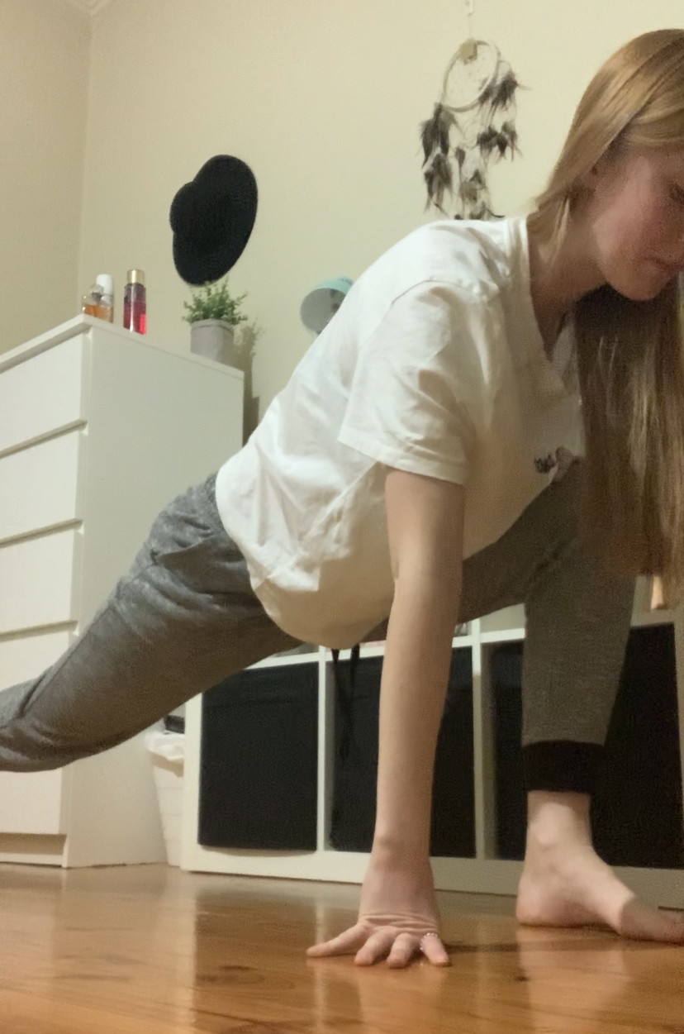
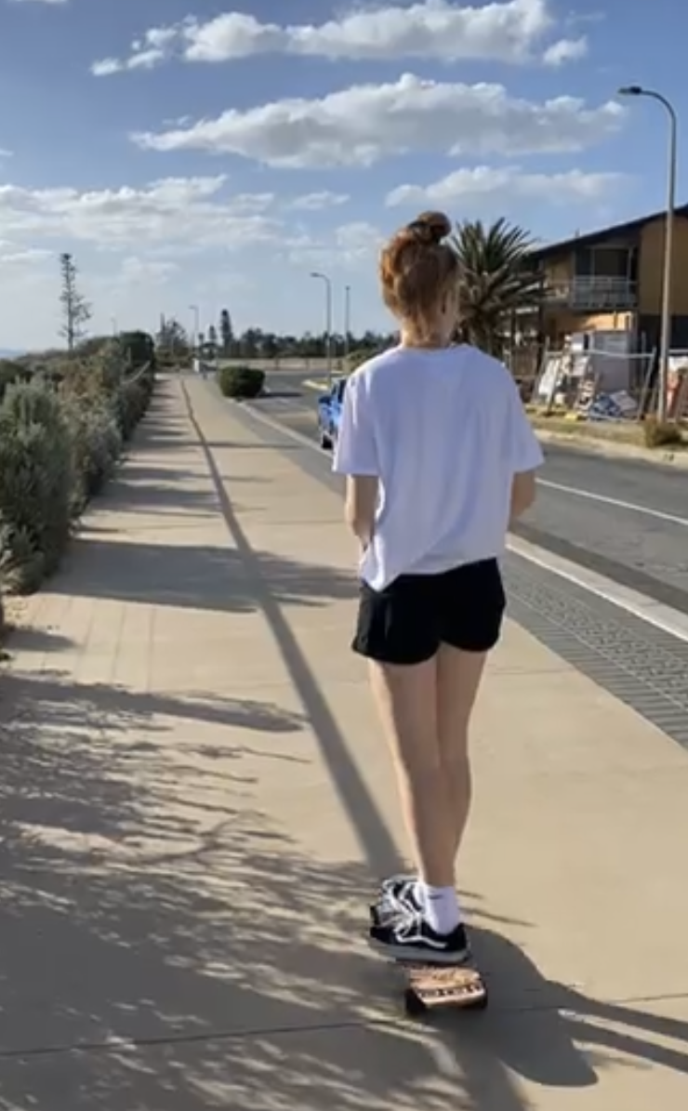
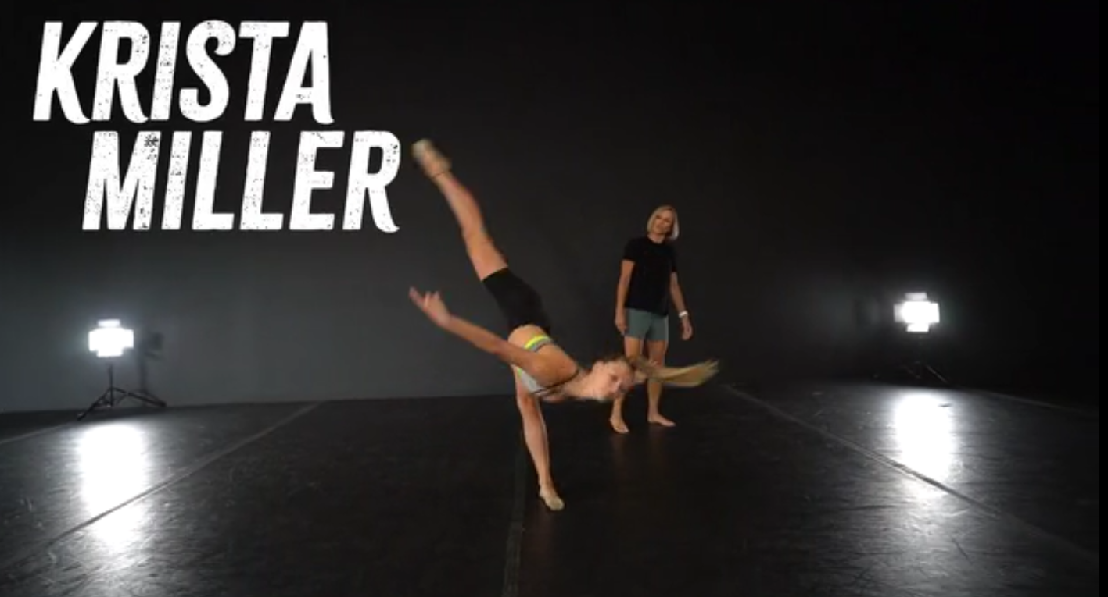
EVIDENCE OF TECHNICAL IMPROVEMENT PROGRAM
Going for walks
Going for skates
Stretching
Workouts
Classes with Krista and Autumn Miller weekly with the space Tv subscription

Slide 7
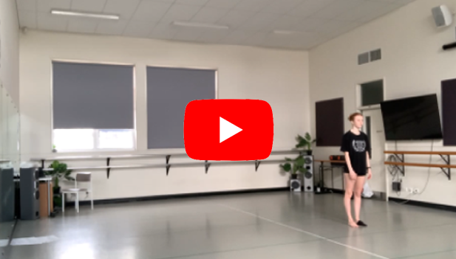
FOLLOW UP ANALYSIS
Performance
Analysis
After completion of the six week program it is evident that there has been a slight improvement. Although it was only six weeks I feel if I am able to keep following the program I will be able to improve even more over time. In the first video there were many weaknesses around my technique and flexibility. This included bent knees, no use of high release, no control when rolling onto the floor, and not control in turns. After completion of the program and refilming myself I feel that I have been able to turn most of these weaknesses into strengths. At the beginning of the routine, I was able to straighten my knee even more which made the movement look more aesthetically pleasing. Additionally I was able to control myself when turning from the back to the front and in this video my supporting leg was pulled up and my right leg was straightened as I spun to the front. After analysing the video above I have found that I didn’t get as tired as I did in the first video I filmed. In this one I worked with my breath more and this allowed me to gain more control in this piece and not get tired by the end of the piece.
With all the improvements that I have made from the first video there are still weaknesses in this piece that I need to work on. A major weakness in this video is both of my turns. My knees are bent, I'm not pulled up through my body and I have no control in my arms. By improving this I will be able to turn better and turn quicker therefore ill be able to add in more turns.
There are many areas in this dance were injuries could happen and by knowing the choreography well and controlling my movements I was able avoid getting an injury. Also by taking my weight with me in every movement helped to control the dance and also maintaining a good balance helped me to not fall over and control the dance as well.

Slide 8
EVALUATION OF ACTIONS TAKEN & IMPACT ON DEVELOPMENT AS A DANCER
To begin this task, I learnt a small phrase at home choreographed by Mark Meismer to the song Stone Cold which was a contemporary styled piece. This original piece was used to look at the strengths and weaknesses I had in the video and then build 6-week program on how I can improve them. The areas that were looked at mainly were strength, muscular endurance, cardiovascular endurance and my flexibility within the dance.
In order for me to complete this task I had to analyse and re-watch my first video multiple times to identify all the weaknesses I had and how I could improve on them. I then had to build a 6-week program for myself to improve as a dancer and complete it. You can see in previous slide the evidence of completion of the program. After the 6 weeks were up, I then refilmed the same dance and analysed that video as well. I was able to see an improvement on the original weaknesses I had and also areas I still need improvement on.
In order to film this dance I had to wait to wait until I was at school because during COVID-19 I was unable to go to my private dance studio and due to the fact that I didn’t have the opportunity to attend my private dance studio I took up another opportunity and took part in online classes from a studio over in America. A problem I had was that being at home I didn’t have enough room to dance to my full potential so therefore I had to wait until I got to school to film it.
The environment I was in for both the videos was a dance studio at school which was big enough for me to dance and perform at my full potential.
Actions that I took throughout the folio was taking part in the 6 week program I set myself. I could’ve just set myself a program I was going to do but didn’t, but instead I kept focus and only skipped over 3 days out of the 6 weeks. As a result of this action I found that I the second video I was able to dance a lot better then what I did the first-time round. If I didn’t take part in this 6 week program and just had it presented on my folio I would not have improved as a dancer.
Overall, I feel the experience of the 6 week program was beneficial for me as I was able to row as a dancer and improve slightly over this time. In the future I feel that I will continue to follow this program as I will need to add in my own training and not just rely on what I do at the studio to improve.
A skill that came out of completing this task was that I had to ability to challenge myself to see if I can complete tasks, I set myself like this six week program. On average most of the tasks I set myself are small and don’t last as long as this did but this one did. A task like this can be applied elsewhere, could be with school, at home, at work, or with training again. By doing a task like this I have been able to work on my own growth and personal development as well as improving on my

Slide 9
REFERENCE LIST
References
Bubnis, D. (2020, 11 5). Healthline. Retrieved from 10 Aerobic Exercise Examples: How to, Benefits, and More: https://www.healthline.com/health/fitness-exercise/aerobic-exercise-examples
Dance Facts. (n.d.). Retrieved from Contemporary Dance: • http://www.dancefacts.net/dance-types/contemporary-dance/#:~:text=Around%201980s%2C%20the%20world%20%22contemporary,dance%20styles%20of%20the%20world.
Magazine, D. (2012, 8 13). Dance Magazine . Retrieved from Modern Vs Contemporary: https://www.dancemagazine.com/modern_vs_contemporary-2306900829.html
ONENOTE (PDF, First Steps towards a New Form)
ONENOTE (PDF, Concepts in Modern Dance)

