Slide 1
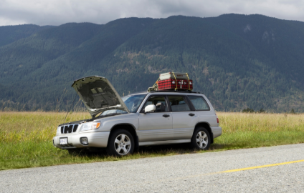
COLLABORATIVE TASK evaluation
This recorded presentation has a maximum limit of 5 minutes. With changes made Subject Outline for 2023, this task should feature:
a description of what the inquiry was about
an evaluation of the effectiveness of collaboration and its impact on results/outcomes
This task has been adapted from a 2021 submission so this sample is indicative of the evidence we would expect to see featured in 2023.
Click on the speaker icon to play the audio file

Slide 2
TASK
You and a small group of people have broken down in the middle of the outback. With no service, it is unknown how long you will be there until another car passes through. Using the supplies in your car as well as in the environment around you, find a way to successfully create clean drinking water from a muddy puddle you found on the side of the road.

Slide 3
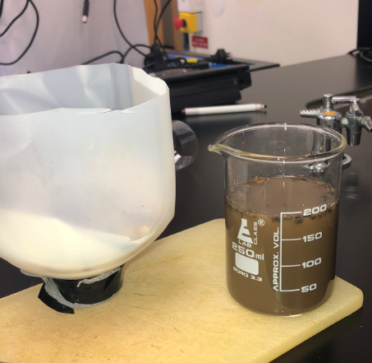
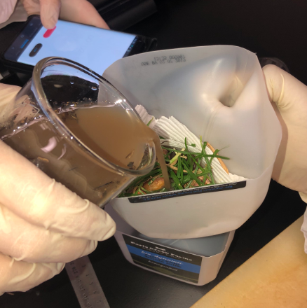
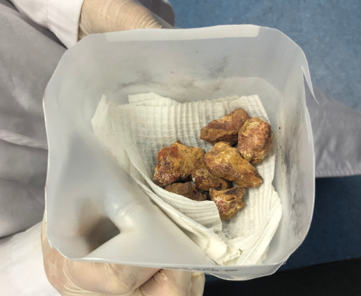
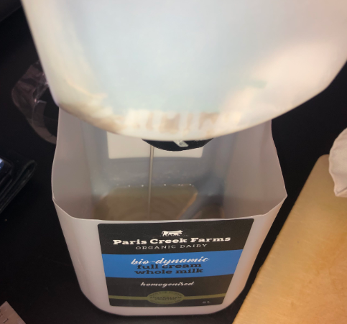
PROCESS

Slide 4
COLLABORATIVE REFLECTION
Throughout the many days of experimenting, the collaboration side was not always so helpful. There were days where everyone was working together and communicating efficiently. However, on other days there was either unsuccessful or no communication, as well as some group members not participating. On these ‘weak’ days, the collaborative aspect to this task as well as the group results was in jeopardy.
Lack of collaboration in a collaborative task can create a few challenges:
One of those challenges being the distribution of the group’s evidence photos. This was an issue as without the photo evidence, the findings have no meaning without evidence to support it. This challenge was resolved by including the teacher. Informing the teacher of the problem and then they provided the solution and got the other members to send out the photos.
Another challenged face was when the group wasn’t fully working together. This lead to data being contained with those who were collaborating, leaving the other(s) in the dark. This was resolved by overcompensating on the said ‘good days’ when everyone was collaborating. This way everyone would be on the same page and further experimenting could be done successfully.
IAE5: Discussion about how well the group members worked together, the distribution of tasks, and allocated due dates to keep people accountable.
Some additional, but limited evidence of evaluating collaboration appears in the journal which can also contribute. It would be good to see it featured specifically in this section where the student could discuss in greater depth how collaboration impacted/ influence decisions and progress.

Slide 5
STU_AT2_Evaluation water recorded presentation
In the recorded presentation, students are required to:
outline the problem faced
evaluate the effectiveness of collaboration and its impact on results/outcomes
This student has:
outlined the problem faced
shown a visual representation of the steps followed in the first part of the attempt to solve the problem
repeated the text from their journal reflecting on the collaboration of the group and this is also read by the student
IAE5: Refers to some of the challenges faced as a result of collaboration and what was done to overcome this. Minimal additional evidence of collaboration appears in the journal. Overall, the effectiveness collaboration has been considered and is at a C grade level.
It would be good to see a greater depth of evaluation about how well group members:
led and allocated tasks,
worked to deadlines,
ensured accountability
impacted/influenced decisions and progress.
ensured reliable, accurate and precise results/outcomes when collaborating on data collection.

