Slide 1
Teaching and Learning Leaders Conference
March 2025

Slide 2
Why Are We Here? Purpose and Principles
Nick Brice
Deputy Chief Executive
SACE Board of South Australia

Slide 3
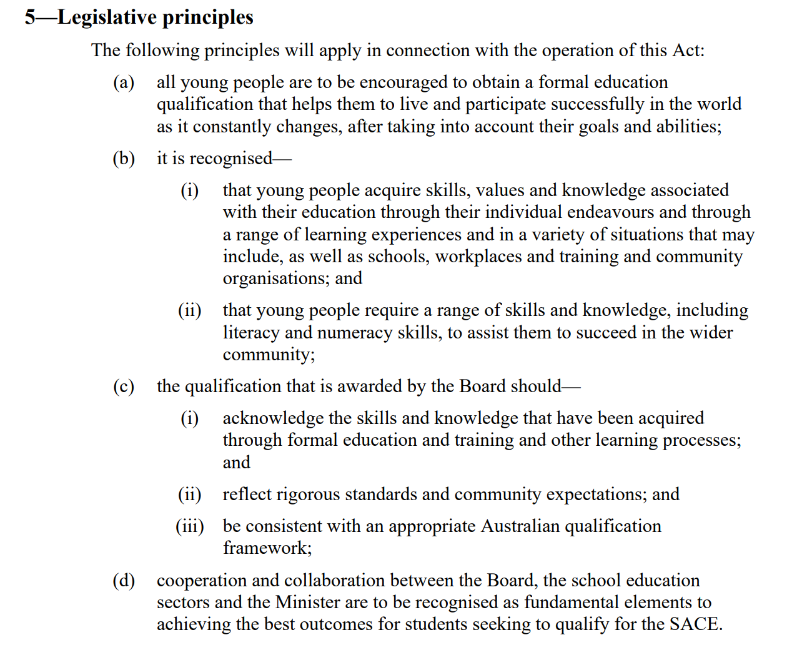

Slide 4
The change narrative
Hassan Mekawy
Director of Education Services

Slide 5
Learnings from SACE pilots have informed the following considerations
FROM
THROUGH
TO
Broad content coverage
Strategic evaluation of curriculum requirements
Deeper and more authentic learning experiences
Less is more curriculum
A focus on the finished output
All evidence of learning in all course work informs teacher's subject and capabilities judgements
learning contributes to student assessment evidence
Assessment is for learning
Notes:
When we reflected on the 3 pilots of the last strategic plan, we came up with 6 high-level ‘From – to- Throughs’…theyare a great tool for program logic and to test your prototypes.
Less is more curriculum
We have heard that there is an overcrowded curriculum that doesn’t allow you to deep dive into topics and concepts that resonate with your students; instead you have to rush through all superficially. We also heard you want to make room for the development of capabilities. So our aim is to undertake curriculum transformation across all subjects to look at reducing/refining content, number of units, prescribed topics – we will also consider greater affordances for capabilities where they naturally fit
Assessment is for Learning
Through our pilots we heard that most students are doing assessments for SACE – for the authority, to get through the qualification – not for their own learning and development. For teachers it means their T&L program is focussed on working through one assessment task to the next. We also hear students ask ‘if this work counts?’ and either they are reluctant to engage or have great evidence of learning that doesn’t contribute to their final assessment grade. We have learned some things about NEoL and considering incorporating all relevant coursework into teachers’ professional judgement

Slide 6
Learnings from SACE pilots have informed the following considerations
FROM
THROUGH
TO
Teacher-led with student input
Professional learning for teachers to focus on co-agency, self-regulation and metacognition
Students and teachers as learning partners with more student self-regulation and metacognition
Teacher Practice
Valuing subject-related discipline learning
Formal recognition of capabilities developed and evidenced within and beyond the classroom
Formal and informal, subject, extra curricula and outside of school learning equally valued
Recognition
of more
Notes:
Teacher Practice
We have heard that much of the SACE curriculum lends it self to a ‘tell and apply’ pedagogy that is largely teacher led, with some student input, Students are passive agents in the learning and required to absorb and apply what they have learnt. Our pilots have shown evidence of the value in students playing a greater role driving their learning and working in partnership with teachers as co-agents. Teachers are just as important as ever, but in a more coaching and mentor role, they will need to be adaptive practitioners that are responsive to students’ needs (ZPD).
Recognition
We have heard that, although subject discipline knowledge is still important, there seems to be an over emphasis placed on student achievement and success in this domain at the expense of other learning that is comparable and should be equally valued. The SACE has always recognised learning that happens out side of the classroom, but we have heard it is not valued, celebrated or recognised, at the same level. (e.g. Aboriginal cultural knowledge and student capabilities). We will be working to explore ways to formally recognise this learning.

Slide 7
Learnings from SACE pilots have informed the following considerations
FROM
THROUGH
TO
Trusting teachers’ judgements and end point quality control
New front-loaded processes that provide useful feedback, extended verification, trust and confidence
System that builds teacher capability and extends trust to include judgements of a skilled adult outside the classroom
Fit for purpose quality assurance
Focus on subject achievement
A certificate for the new world
Recognising the broader capabilities of students
Teachers providing deeper and more authentic learning experiences and recognising a more holistic view of student capabilities and subject achievement
Notes:
Fit for purpose QA
We have heard that SA teachers and leaders are proud of our high-trust in teacher professionalism and assessment design and decisions. However, our current QA system doesn’t support capability of teachers, doesn’t provide professional learning opportunities and in turn, confidence in the system. There have also been concerns about the level of feedback received that is effective and actionable. Emerging learning from our pilots suggests we need to consider a new QA model that is fit-for-purpose and is able to accommodate the new types of evidence that is emerging (NEoL, hierarchy of evidence, capabilities and Aboriginal Cultural learning). Proposing a new front-loaded, social moderation approach that is timely, effective and build capability.
A certificate for the new world
We have heard, that for many students, SACE completion is a significant milestone and rite-of-passage that they are proud of. However, the certificate and ROA do not reflect a holistic representation of the skills and capabilities they have developed through 13 years of schooling. The certificate, ROA and, by extension, educational success is seen through meritorious achievement in subject grades. This meets the needs of a small portion of students, but not all students are able to demonstrate evidence of the excellence and strength through the current methods (essays/tests/exams) of assessment and representations of success (A+, merits, high ATAR). More importantly, this representation does not support students to make decisions about their future pathways. A broader recognition of the types of student evidence, a focus on student capability development and a way to recognise and warrant this is the proposal moving forward. It is assumed this will support students and stakeholders to make better decisions about employment and further education pathways.

Slide 8
Subject renewal
Emma Wegner
Faculty Manager (Health and Humanities)

Slide 9
Subject renewal is a process
to co-design subjects with the community;
that will sharpen content and assessment
and intentionally develop capabilities.
The renewed subjects will have space for student agency (agency)
So that students can engage in real-life learning (deep, authentic learning)
And recognise a broader range of evidence of learning (natural evidence of learning)
Where students evaluate their thinking to regulate the way they learn. (metacognition)
Our narrative

Slide 10
Students are proactive in the co-creation of their learning pathway and influence how they undertake, demonstrate and action their learning.
Student Agency
Students are empowered to understand the way they think using feedback and self-evaluation to purposefully consider and enhance their own learning
Metacognition
Students discuss and apply learning from familiar and unfamiliar situations across a range of meaningful and relevant real-world situations
Deep Authentic Learning
Natural Evidence of Learning
NEoL captures the diverse authentic forms of students’ demonstration of learning and achievement, better reflecting what students know and can do.
The SACE Board’s capabilities aim to create a more inclusive, flexible, and student-centred approach to education, fostering deep, authentic learning and the development of essential capabilities.
Capabilities

Slide 11
Our Journey
Curriculum forums
Short-term improvements and long-term ambitions
SRGs – EOI, formation
SRG Launch
Complexity matrix
Roadmap for subject renewal
Subject adjustments
New subject sites
Group 1 March 7 meeting
In progress – Groups 2 and 3

Slide 12
Subject Renewal Roadmap
We are here: Engaging and discovering with SRG
Co-design phases
Engage and discover
Develop
Test, learn adapt
Transfer and adapt
Scalability phases
Implement and support
Reinforce monitor, improve

Slide 13
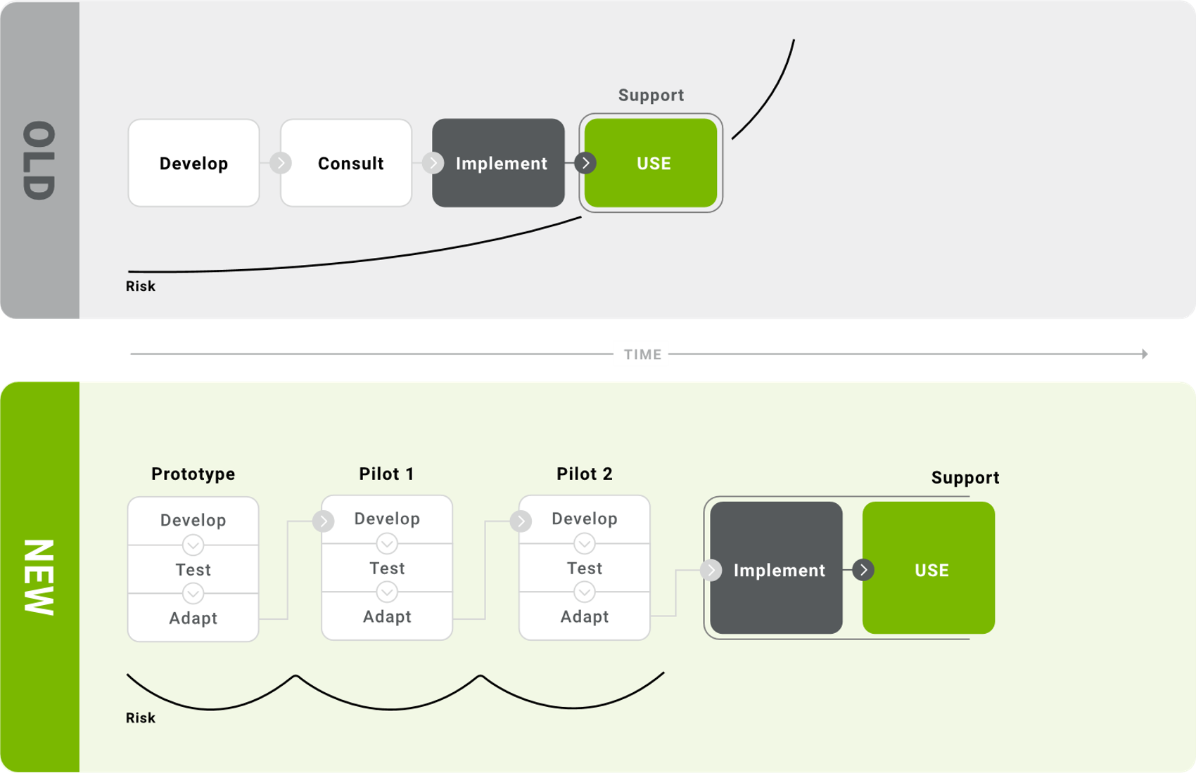
Our responsive approach

Slide 14
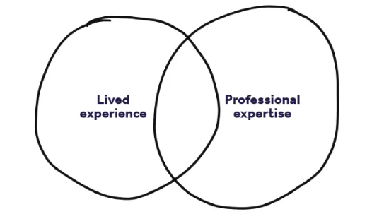
Subject Renewal Groups (SRGs)
Diverse subject teachers from all schools with up to 12 teachers per SACE subject.
3 subject groups
Why diversity?
Using teacher expertise and lived experience to find solutions and breakthrough assessment types and learning design

Slide 15
Update
Form Subject Renewal Groups (SRGs)
Group 1 SRGs develop the subject vision statement that match the SACE Board’s drivers for thriving learners (Passport to Thrive).
Gather student insights
SRGs considering content and concepts students must learn
Ideate future learning design and assessment types
SACE research future learning design and assessment types

Slide 16
Version 1 - First thinking
“For every complex problem there is an answer that is clear, simple, and wrong”
H. L. Mencken, 1920
Multiple versions
Notes:
Education is complex, the change and ambition we aspire to is complex, it has not been done before, so we don’t really know the answer yet.

Slide 17
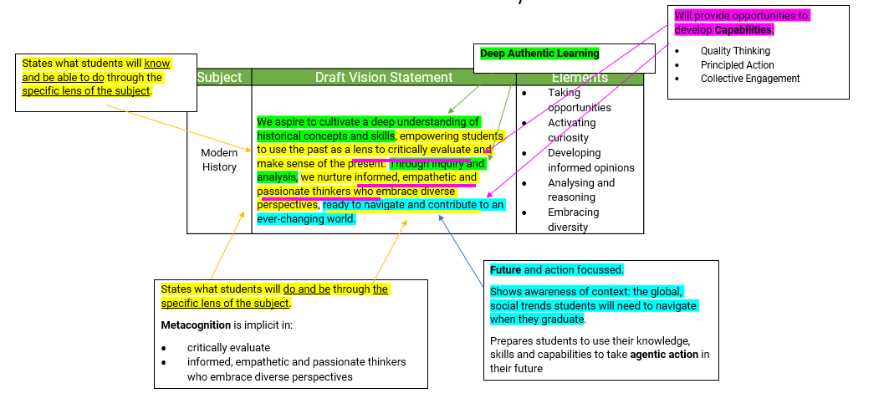
Version 1 – Vision Statement
Developing a vision and purpose of the future subject to guide thinking through the next phases.

Slide 18
Version 1 – Subject plan
Subject:
Showing how the learning design, assessment types, subject content together create a future subject.
Drivers: Agency, NEOL, Deep Authentic Learning, Metacognition and Capabilities
From
Through
To
Current subject
Contemporary Content:
The disciplinary Topics, Content, Concepts
Future of the subject
Future Learning Design: learning experiences and teacher practices that create conditions for learning
Future Assessment Types:
The conditions for formally capturing and assessing achievement

Slide 19
Next phase
Develop learning design and assessment type ideas and prototypes

Slide 20
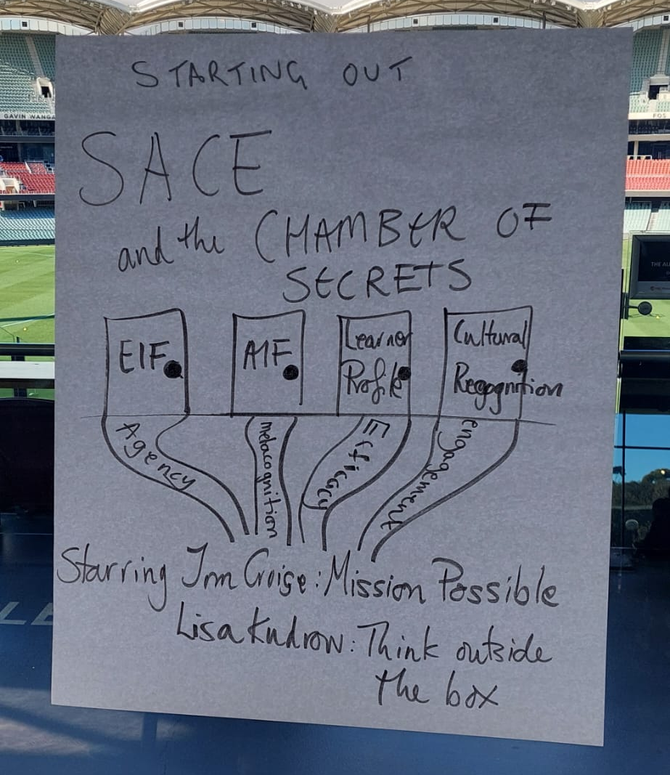
The need to communicate beyond SRG

Slide 21
Take away messages
Subject design is with a diversity of teachers
Aim to develop learning designs and assessments that work
Renewal has just started
There will be many versions over time
It’s not exclusive
All teachers will receive updates
If you have any questions, then please get in contact

Slide 22
Stage 2 Activating Identities and Futures
Laura O’Shea
Education Consultant

Slide 23
Stage 2 Review:
to investigate what secondary education should look like for current and future generation of students
Passport to Thrive
AIF Pilot 1:
>1000 students
19 schools
2018
2020
2022
2023
2024
2025
SACE strategic plan:
Thrive
Elements of Thrive
Capabilities
Pilot Projects established
AIF Pilot 2:
>4000 students
63 schools
SA/NT
All SEQs
All Sectors
Modified option
AIF available to all schools
(last year to teach RP)
Notes:
In 2018 there was a review from the South Australian government, which provided some strong direction for the SACE Board, to focus on what secondary education should look like, and more importantly, how the compulsory aspects of the SACE (including PLP and RP) prepared students for the life ahead of them.
In 2020, we launched a strategic plan which was built upon the foundations of research. The research showed how creating space to support students in developing transferrable capabilities for a world beyond school, is what would best enable them to thrive.
AIF went through its first pilot in 2022.
In 2023, we saw a broad cross-section of more than 6000 students enrolled in AIF, which helped us test what would best allow this subject to deliver on its promise of enabling greater student agency.
That brings us to the SACE Board’s recently unveiled strategic plan, which seeks to deliver a passport to thrive.
And then, where we are now, 2025, is the year in which all students will have the opportunity to engage with AIF.

Slide 24
The Vision of Activating Identities and Futures (AIF)
Activating Identities and Futures aims to foster independent learning and the skills of lifelong learning in students. The belief that students have the ability and the will to positively influence their own lives and the world around them.
AIF supports students to be more proactive and reflective in their learning and to develop and use a broad set of transferable learning strategies.
Students take greater ownership and agency over their learning. They develop greater awareness and understanding of their own thought processes, decision-making, and organisation.
Notes:
Activating Identities and Futures aims to foster independent learning and the skills of lifelong learning in students. The belief that students have the ability and the will to positively influence their own lives and the world around them is integral to the course.
This subject supports students to be more proactive and reflective in their learning, and to develop and use a broad set of transferable learning strategies.
AIF requires students to take greater ownership and agency over their learning, in the pursuit of a Learning Goal of their choice.
Each student will have a different learning journey that they tailor to their Learning Goal. Approaches, contexts, and strategies will vary to suit the individual student.
Students will develop greater awareness and understanding of their own thought processes, decision-making, and organisation in relation to learning.

Slide 25
Activating Identities and Futures (AIF)
AT3 Appraisal 30%
AT1 Portfolio 35%
AT2 Progress Checks 35%
Stage 2
If students have already done RP, they don’t have to do AIF as well
credits
Key Operational Information:
Teachers do not need to write a LAP
Is a Tertiary Admission Subject (SATAC approved as providing appropriate preparation for tertiary studies)
Available to all schools in SA from Semester 1, 2025
3 ASSESSMENT TYPES
Notes:
Here is a visual overview of the requirements of the subject.
AIF is a Stage 2, 10 Credit, one semester subject.
Students will likely start with developing a portfolio, for Assessment Type 1, where they will identify a learning goal and create evidence of learning as they progress. As they work towards their learning goal, they’ll check in with their teacher - where they will share their decision making and metacognitive skills through the AT2 Progress Checks. Towards the end, students will appraise their learning and how they went in relation to developing the learning output in the AT3 Appraisal.

Slide 26
Underpinning Pedagogical Approaches
Developing capacity to initiate and progress learning
Making decision in partnership with teachers
Teacher as co-agent in learning
Feedback on task
Feedback on process
Feedback on self-regulation
Feedback
Agency
Authentic and varied
Supporting student strength and choice
Curated for self
Natural Evidence of Learning
Developing capability to think about own thinking and learning
Evaluating own processes for learning
Meta- cognition
Notes:
The subject outline is underpinned by these four pedagogical approaches: Feedback, Student Agency, Natural Evidence of Learning and Metacognition.
Through the co-design process of 2 pilots of EIF and AIF, and working with real students, these four elements emerged as the most impactful strategies for supporting students to foster independent learning skills and mindsets.
Those findings are also supported by global research undertaken by The Education Endowment Foundation, who found that focusing on metacognition, self-regulation, and feedback, were low effort, high-impact strategies with a positive effect on teaching and learning.

Slide 27
One subject, two pathways.
Modified version – completed pathway
Completion of AIF– graded pathway
Students are eligible to enrol in modified subjects on the grounds of documented or imputed disabilities that result in significant impairment in intellectual functioning and/or adaptive behaviours.
Students can use either pathway to result and complete AIF.
Students can also move back and forth through the pathways as needed.
AIF
Activating Identities and Futures
Notes:
As we journeyed through co-designing AIF, we also ensured we considered what this looks like for students who are eligible and want to use the SACE Modified pathway to succeed.
We were very happy to see that due to the flexibility of the subject and focus on the student, we were able to do something slightly different from what other SACE modified subjects are able to offer, which we call ‘one subject, two pathways’.

Slide 28
Experience from the field
Pat Klimatsakis
AIF Teacher
&
Anna Fusco
Senior Years Learning Leader
Immanuel College

Slide 29
Implementing Activating Identities and Futures (AIF)
Pat Klimatsakis and Anna Fusco

Slide 30
The Journey
Early adopters
Started with two teachers
Why?
Notes:
Early adopters - part of SACE pilot 2023. At our school we immerse ourselves in innovation. We take risks and not afraid of change because we have the support and trust of leadership. Immanuel is at the forefront of providing new opportunities for our students and for our staff to drive new ideas and professional learning.
Started with two teachers – Senior Years Learning Leader and AIF Coordinator (both experienced RP teachers)
Why - To understand the subject; The purpose; How to deliver it successfully in our context. We also wanted to be part of the change process and provide feedback to SACE on what worked and what didn’t.

Slide 31
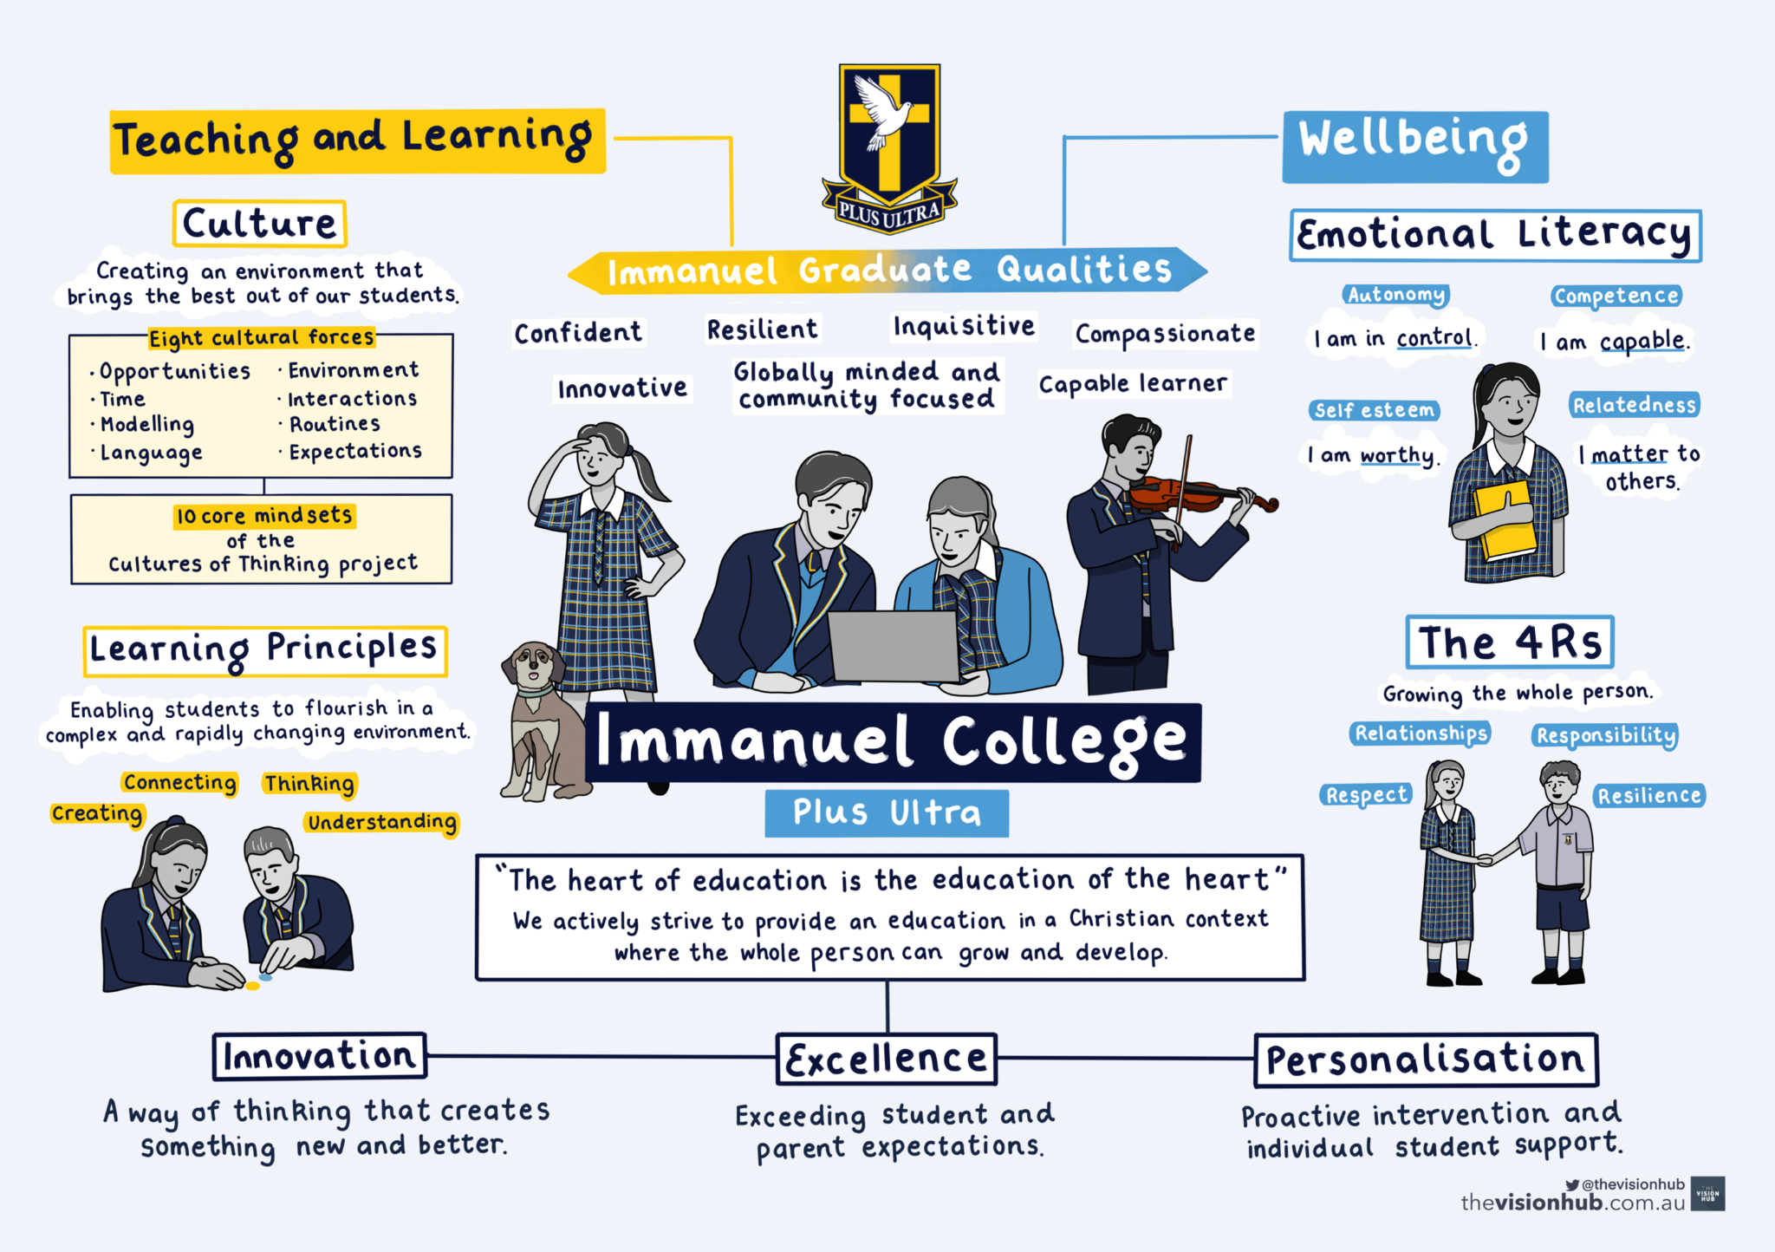

Slide 32
How did we do it?
2023 – Semester 1
2 classes
Year 12
Approx 40 students
2023 – Semester 2
8 classes
Year 11
Approx 120 students

Slide 33
What did we learn?
Subject requirements were significantly different
Early involvement was helpful
Ability to identify issues early
Managing change
Notes:
What we found significantly different was the focus on process over product – we had to change our headset from synthesis of information to evidence of the learning journey to produce an output that did not necessarily need to be fully completed (as it wasn’t assessed)
Early Involvement - We wanted to experience what worked, what needed improving and what we couldn’t deliver first before rolling out to all classes and training staff. We did this by visiting another school that was already in the pilot in 2022.
Issues:
Problem to Solve: Could teachers transition to the flexibility and agency offered in AIF? Could teacher’s ‘let go’ and trust students to take charge?
Could we deliver and result the subject in a semester because we weren’t able to do this with RP. How do we adopt/adjust the new language of AIF – strategies, perspectives, feedback and the emphasis not being on synthesis and product.
Outcome: We found that teachers' interpretation of student agency varied. Teachers struggled initially with 'letting go’. The move away from product to process was difficult for some teachers and students.
To manage change to reduce transition anxiety we:
Talked the talk – we had to talk positively to staff about subject to reduce change anxiety and reassure them that this change was for the better for both teachers and students and that subject was now achievable in a semester by all students.
Showed examples – of students who had completed AIF previous semester
Went through the three assessment tasks – important for teachers to be aware that there was no longer a curated Folio or a 2000 word (equivalent) Outcome
To ease anxiety, we invited students to speak of their experience with AIF to teachers before delivering subject across all classes (strengths and weaknesses from their perspective)
Managing Change:
Internal workshops
Encouraged attending SACE workshops/SACE Teams group
Regular check-ins by us with new staff to subject. That was either face-to-face or email. We provided teachers with a weekly programme and resources to ease the load.

Slide 34
Challenges
Time to upskill staff
Buy-in and trust
Student agency and ‘letting go’
Consistency in delivering the subject
School interruptions
Balancing time between semesters
Notes:
Time is a huge factor in any school – finding time was a challenge as we were on borrowed time, and we had to move and train staff fast.
Attitude, enthusiasm and positive language was very important to get staff to embrace the change and the integrity of the subject.
Getting teachers to let go was one of the biggest challenges as many were RP teachers who were comfortable with the subject the way it was.
Consistency – We created a detailed semester programme to guide all teachers and assessment due dates were flexible to some extent. We realised during our own trial that due dates had to be flexible. Moved away from a specific date to a specific week.
Balancing semesters – semester 2 is more challenging as it’s shorter but we were confident we could still deliver the subject and result it in that semester.

Slide 35
Successes
Equitable for all student abilities
Variety of topics broadened
ALL students can succeed
Achievement of capabilities
Positive parent and student engagement
Notes:
Equitable: Equitable for all students – many chose multi modal presentations increased. Most popular: podcasts, websites, videos, pamphlets, info graphics, music tutorials etc.
Topics were varied and achievable - eg embraced personal topics such as ADHD, dyslexia, trauma in young people, scoliosis etc. Learning skills such as knitting and we still had students pursuing academic topics as well as career pathway topics.
All students can succeed - focus is on process rather than product. Student agency – take charge of their own learning and how much they want to learn.
Capabilities – all students achieved the capabilities- most without realising – the skills developed can be used well into the future (vocation or study).
Engagement and support from within and outside our school community was very positive and provided perspectives and feedback which enhanced the students learning journey.

Slide 36
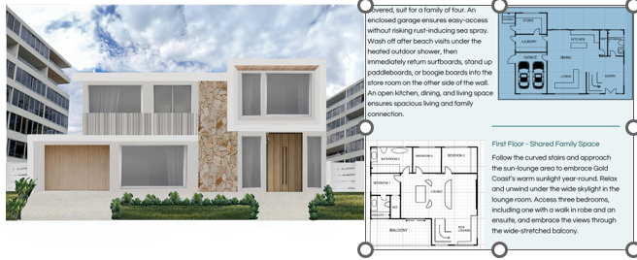
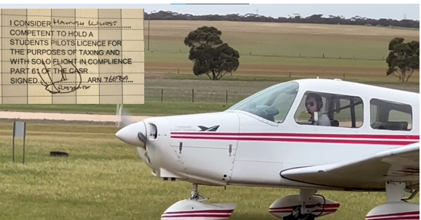
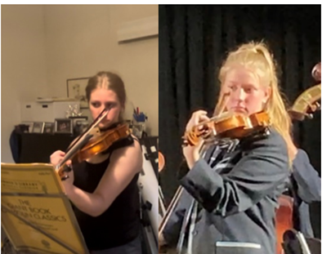
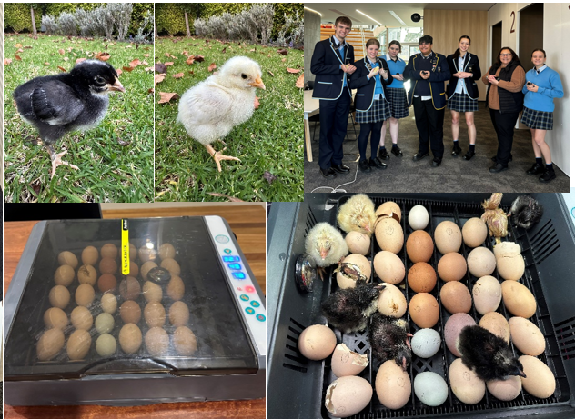
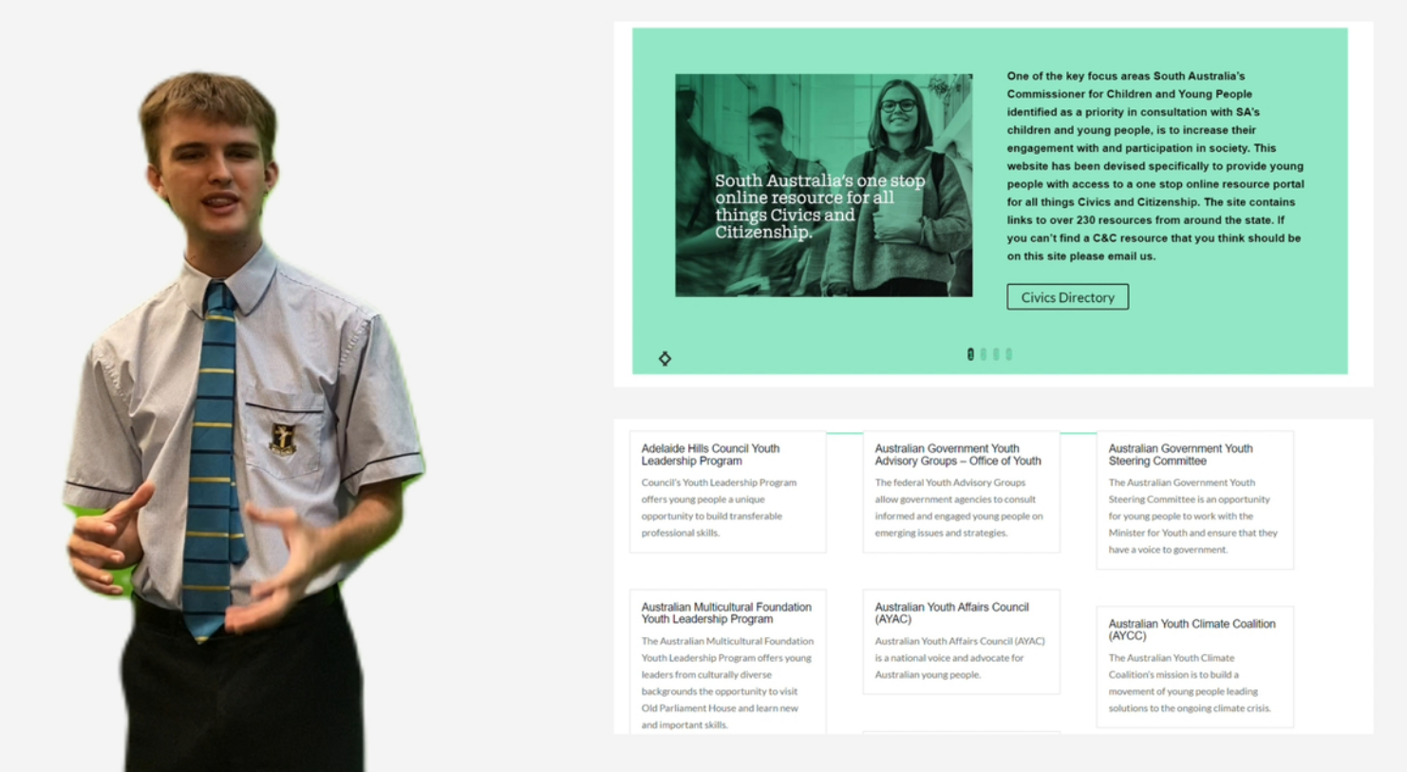
Examples of Topics
Notes:
Jamie was invited to speak to the Federal Senate on bridging the gap between young people and politics.
Jannik – Swiss Alliance University

Slide 37
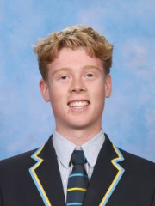
A Student Perspective - Patrick
Notes:
We have a few student examples for you so you can hear directly from the students about why they chose the topics they did.
Click play on the speaker icon to hear from Patrick

Slide 38
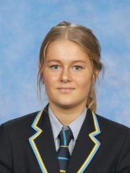
A Student Perspective - Marley
Notes:
Click play on the speaker icon to hear from Marley

Slide 39
Key Takeaways
Learn the terminology of AIF early
Allow teachers time to upskill – it’s a big shift for teachers
Attend SACE workshops early
Contact/visit schools that have taught the AIF
Let go and embrace student agency
Familiarise yourself with the criteria and the performance standards
Progress Check – encourage face to face for at least one to understand student topic and direction
Encourage multi-modal (authentic)
Determine and discuss due dates early – consider interruptions
NO TEMPLATES/SCAFFOLD – let it be natural and personal learning style
Encourage students to think for themselves - confidence

Slide 40
Thank you
Contact Us
Pat Klimatsakis - pklimatsakis@immanuel.sa.edu.au
Anna Fusco – afusco@immanuel.sa.edu.au

Slide 41
Experience from the field
Ros Mattner
11-12 Leader, SACE Coordinator, Teacher
St Francis De Sales

Slide 43
Implementation
Teachers who will work with an open mind and willingness to learn new skills
Engaging with professional learning and past experiences to engage with (continuing) the Pilot to full implementation and review of practices to support the development of AIF, including moderation practices and sharing of ideas (collegial and SACE)
Transparent and informative communication with students, parents and carers to ensure they are aware of the previous Pilot phase and review of this working towards implementation
AIF has presented significant opportunities for students who are completing Vocational Education either as School Based apprentices or in full apprenticeship mode as they are able to access learning offline and connect to their own specific focus

Slide 44
Implementation
As teachers we model ‘knowing what to do when you don’t know what to do’ as this builds a community of learners who collaborate and respond to learning opportunities
The capabilities are intertwined naturally within the student’s growth as we provide opportunities for them to realise what they can understand, showcase and what they are capable of – they are activating their identity and future
We inducted students by exploring and reflecting on the key drivers – student agency, self-regulation, metacognition, deep authentic learning and the concept of natural evidence of learning.
We ask students what they need and challenge them with what they are capable of – if a question does not make sense, ask another question…

Slide 45
The journey
We joined the second Pilot of AIF as we believed that it was time for change and were confident in what we could offer
Our team has worked collaboratively to ensure that we have maintained the key drivers of AIF and focused on using consistent language to promote the integrity of AIF
We work with the mindset of challenging students to identify their progress by asking open questions to them instead of directing them
Building transference of skills from EIF and sharing consistent understandings of language and learnings

Slide 46
The journey
Challenges - overcoming the view that this was a ‘Research Project’ rename
Challenges – helping students understand what ‘natural evidence of learning’ is (and some other stakeholders!)
Challenges – helping students to understand that they are not going to be ‘told’ what to do
Opportunities – genuine teaching experiences for everyone – as teachers we listen, question and at times suggest but most of all we continually question the students
Opportunities – minimal worksheets – we made 3 task sheets
Opportunities – student agency is actioned – students are responsible for their learning – when they learn how they learn and use this as their springboard then students gain insights into what is possible

Slide 47
The journey
Successes
Multiple learning pathways are possible
Students can explore and develop personalised learning opportunities
If students find the learning ‘repetitious’ they can change this
Students build their own awareness of why metacognition is a valuable understanding of who they are and what they can do
Teachers gain new learning opportunities to learn with students and in a professional environment

Slide 49
Capabilities and Learner Profile
Kate Leadbeater
Education Consultant
Notes:
Capabilities combine skills, knowledge, attitudes, and behaviours that empower students to navigate a wide range of situations with confidence. These capabilities go beyond academic knowledge, encompassing qualities like problem-solving, communication, adaptability, creativity, relationship-building and perseverance. It enables students to apply their learning in real-world contexts, and provides a foundation for lifelong learning and growth.
These capabilities build upon those outlined in the national Australian Curriculum, which schools use to support students’ development in the early and middle years. They have been identified by schools, industry, employers, and further education providers as essential for young people’s future success in both work and life.

Slide 50
A focus on Capabilities and the Learner Profile
The value for students, schools and the future
The Capabilities and Learner Profile Project aims to recognise and showcase the knowledge, skills and capabilities of the whole student
Working with schools to support students in developing the language and the capabilities to recognise their unique strengths inside and outside of school, alongside the ATAR and grade achievement.
Through partnership with Industry and Tertiary sectors, the SACE Board are looking for ways to open doors to future pathways and possibilities for all students, regardless of their chosen pathway
For students, the capabilities and the Learner Profile…
encourages students to keep learning and growing throughout their lives
helps signal what a student would like to do, where they would like to go, and what goals they might have
allows students to recognise their unique strengths and talk about what they are truly capable of
Notes:
The Capabilities and Learner Profile pilot is committed to recognising and showcasing more of what young people know and can do beyond just subject grades. As a key pillar of the strategic plan, we believe that by placing a focus on the intentional development of capabilities, we will equip students with the language, skills and knowledge they need to open doors to future pathways and possibilities while encouraging curiosity, lifelong learning, being responsible members of society, and being connected to people and communities. If students can recognise their unique strengths and have the language to be able to talk about them, this will help signal what they would like to do, where they would like to go, and what goals they might have. We want to give students the language to talk about what they are truly capable of.
The SACE also wants to personalise the learning program for each individual student’s chosen pathway and allow the SACE certificate to recognize and value the learning that students do both inside and outside of the classroom. We are committed to putting students at the centre of decision making and supporting them to think about their strengths and the capabilities they have both in school and in their everyday lives.

Slide 51
Capabilities project development
2020
Entrepreneurial Learning, Validation 1
2020
2022 Pilot 1 Teacher focus
Future capabilities – discovery
Pilot 1 frameworks
Professional Learning
Stage 2 students
2023 Pilot 2 Student focus
Pilot 2 frameworks
Elemental model
Stage 2 and Stage 1 students
Personal Enterprise
Validation 2
EOI Pilot Schools
Tested utility of 5 capabilities
Prototype Entrepreneurial Learning
Melbourne Assessment
2019
2021
2024
Pilot 3
Refined elemental model
Tested learning design in assessment
Continued development of better matching to pathways
2025
Pilot 4
Reviewing and refining resources
Promoting external value and utility
Direction and guidance on future implementation
Notes:
While we have been piloting since 2022, work really began on this project in 2019. Early work included prototyping an entrepreneurial capability, connecting with the University of Melbourne, and undertaking horizon scans to identify the most valued skills and capabilities for schools, industry stakeholders, and tertiary stakeholders. Over the course of our three pilots, we have worked with schools in the SACE Change Network to test the capability frameworks, we have learnt about how this fits within existing school structures, have connected with students to gather their insights and perspective on the accessibility, usability and value of a Learner Profile, focused on testing learning design and assessment, and considered student agency in the development and recognition of student capabilities.
We have commenced pilot 4 for 2025 where we are looking to review and refine our resources, promote the external value and utility of a Learner Profile for post-school pathways, and connect our learnings into subject renewal.

Slide 52
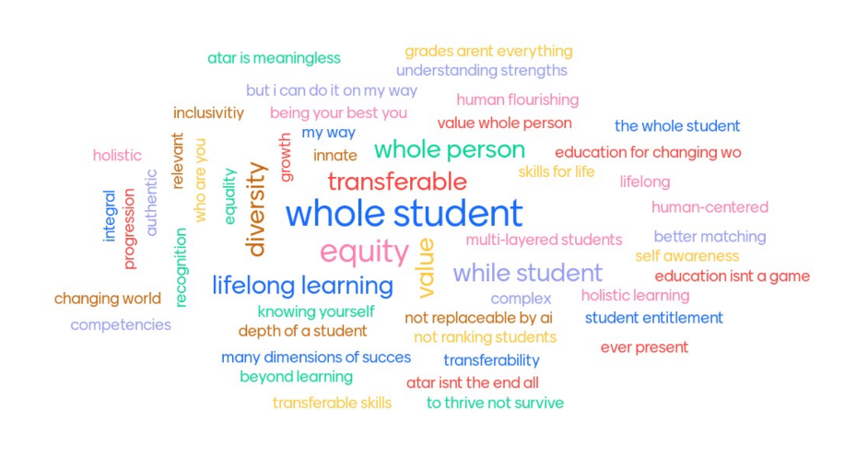
Why capabilities?
Notes:
So, why capabilities?
The development of capabilities is so important for students as they navigate high school, and eventually life outside of school. Developing a diverse skill set helps students discover their passions and potential future pathways. Supporting the development of capabilities in young people can pave the way for their long-term success and fulfillment.

Slide 53
The bigger picture
Notes:
If we look at the bigger picture, this work is gaining traction both nationally and internationally, and the SACE is really leading the way in having capabilities valued and recognized as part of the students’ learning journey. Key connections have been made with the University of Melbourne, Learning Creates, and Big Picture Australia who are also pioneers in this work.
At a local level, we have been piloting for nearly three years, partnering with schools (who are probably in this room today), students, SATAC, the universities, and industry representatives to test and learn how this will work and what it will mean for the future of schooling in South Australia, the Northern Territory, and internationally.

Slide 54
The student’s experience
Develop capabilities
Showcase in a Learner Profile
Areas of the learning journey
Evidence of knowledge, skills, capabilities that will better match students to post-school pathways
Subject learning
Extra curricular activities
Personal experience
School activities
Formally recognise
Teacher
Schools
SACE Board
Supports student understanding and development of capabilities in subjects
Support students in identifying opportunities to develop and show their capabilities in extra curricular, personal experience and school activities
Formally recognises and quality assures
Notes:
This diagram encapsulates the high-level concept of the way capabilities could be embedded, valued and recognised in the SACE. It illustrates how a student might be able to develop their capabilities during their SACE years.
And it is our pilot schools who have been the ones ‘on the ground’ testing and trialing the development and recognition of capabilities within their school structures and processes. I am pleased now to be able to introduce you to our first pilot school who you will be hearing from today. Please welcome Ashley Jenner, Director of Learning Innovation, from Sports College SA who is going to share the Sports College pilot journey and what this has looked like for teachers and students at their site.

Slide 55
Experience From the Field
Ashley Jenner
Director of Learning Innovation
Sports College SA

Slide 57
ABOUT SPORTS COLLEGE SA
Our Journey
Our People
Our Program

Slide 58
RECOGNISING MORE

Slide 59
KEY LEARNINGS
Tiered Implementation
Focus on the Bigger Picture
Create Flexibility
Be Strategic

Slide 60
Experience From the Field
Alana Rologas
Science/Biology Teacher
EIF and Learner Profile Leader
Marryatville High School

Slide 61
The Learner Profile Pilot at Marryatville High School
“Call to Action…”

Slide 62
“The Ordeal”
Pilot 3 expanded to 6 HG teacher/raters (no teacher/advocates) and 1 leader.
10 Yr. 12 Biology students.
Aimed for “supported and reduced workload for pilot teachers” by using processes already established @ MHS for testing capabilities:
Biology practical (over the 3 weeks of planning, testing and drafting)
Using the Mentoring Meetings which take place between HG teachers and students during term 3 to have a ‘Facilitated Conversation’/Capability assessment interview.
Began in Pilot 1 with x2 teachers and 20 year 12 students
Focus was in-class capability assessment (linked to formative or summative tasks).
Pilot 2 included 4 teachers; 2 teacher/raters and 2 teacher/advocates, and 20 yr. 11 students.
Focus expanded to include capability assessment from out of classroom learning activities (coaching, employment, sport, etc.)
What we learnt…

Slide 63
“The New”
In semester 2, 2024 we trialled using the LP Capabilities in EIF…
Student and staff feedback indicated that the Elements (in particular) from the LP were ‘easier’ (to comprehend and apply) than the usual SACE Capabilities of literacy, numeracy, ICT, personal and social, etc.
Opportunity in Pilot 4 - Use the LP capabilities in all EIF classes …
Pilot 4 will involve all year 10 students completing Stage 1 EIF in Sem 2.
It is possible that EIF is a logical ‘beginning’ for the LP once rolled out due to the nature of EIF, being:
Student driven, enquiry type tasks
greater opportunity for learner agency
focus on capabilities
Space for in-class time to explore the Learner Profile itself
Flow on from EIF to AIF (AIF is another subject where the LP could align well).
What we learnt…

Slide 64
FUTURE WONDERINGS/CHALLENGES:
Can we use DayMap to capture/record the development of capabilities?
How do we onboard the school community?
Can this be aligned with the SA Curriculum? Would that be valuable?
How do we ensure we have many, varied, consistent and reliable assessments of capabilities for all students?
How do we ensure all students have the same level of opportunity for capability development?
STARTING POINT?
Look at current processes/opportunities/structures, etc, to identify where there is already space for LP Capability Assessments. And go from there…

Slide 65
Recognition of
Aboriginal Cultural Knowledge and Learning
Lyndon Parry
Faculty Manager
(English and Languages)
Emma Johnston
Education Innovation Project Officer

Slide 66
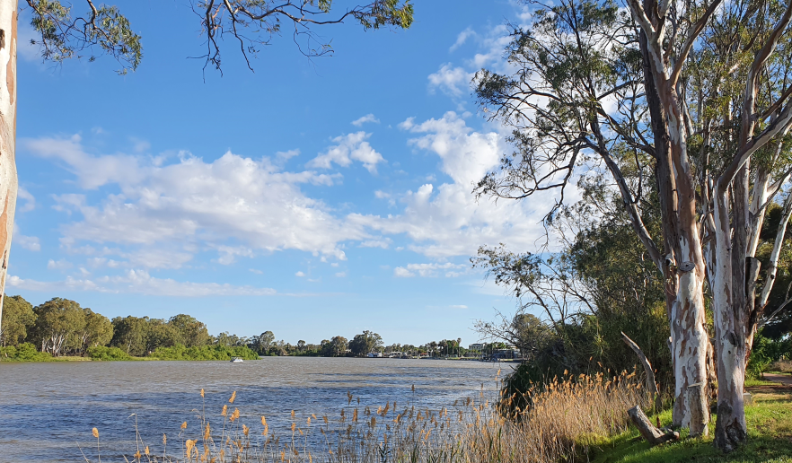
3 Pathways for Recognition of Aboriginal Cultural Knowledge & Learning
Co-delivered
Student-led
Community-led
Renmark, South Australia
Source: SACE Staff
Notes:
We worked with Aboriginal communities and authorities across SA and NT to co-design three pathways for the students to be recognised - these pathways are Co-delivered, Student-led and Community-led

Slide 67
Recognition Pathways
Activities where Community and school develop and deliver programs to help support the students’ cultural knowledge and learning. Learning Plan completed by CA and school
10 credits / Stage 1. One instance only
Co-delivered
Activities where students direct their own learning in an area of personal interest​ ​ Assessment made by a school-based assessor
10 or 20 credits / Stage 1 and Stage 2. One instance at Stage 1 and One Instance at Stage 2
Student-led
Activities where students learn directly from people in their community​ ​ Verification made by community to the school that successful learning has occurred
20 credits / Stage 2. One instance for each standard
Community-led
Notes:
If we have a deeper look at the individual recognitions
Co-delivered
The first pathway (that was actually the last designed) Schools are required to co develop a Cultural Learning Plan with Aboriginal Cultural Authorities and/or Aboriginal Communities describing activities, tasks, and learning that students will participate in. The evidence described in the 3 learning domains should be equivalent to a 60 hour, Stage 1, 10 credit course, and can be met by students participating in multiple tasks and activities.
Students are recognised across 3 learning domains, Knowing, Doing, Being which is sing a framework consistent with the current SACE option of Self-Directed Community Learning.
Student Led
Also using the Knowing, Doing, Being framework, a Performance Criteria checklist has been developed with standards under the following three criteria:
1.Knowing. Knowledge and understanding
2.Doing. Impact and contribution
3.Being. Personal Meaning
Performance Indicators have been developed by SACE in Allyship with school and Aboriginal Community stakeholders and the indicators are informed by the Stronger Smarter consultation paper that articulates nationally defined Aboriginal cultural competencies
Community Led
Through co development and consultation Aboriginal communities have confirmed that ongoing leadership, authority, and responsibility are valued as the highest levels of learning. When students are given ongoing leadership, ongoing responsibility and ongoing authority, they have developed and demonstrated deep understanding of aspects of their culture.
Schools work with cultural authorities to confirm learning, and learning is verified by the cultural authority.

Slide 68
Recognition of Aboriginal Cultural Knowledge and Learning Pilot 1
November / December 2022
x 7 schools
participated
Metro / Regional
SA / NT
Different sectors
x 5
students
x 5 discussions undertaken
x 20 students received credits
X 20 staff assessor trained
STUDENT LED
x 7 School / community partnership agreements signed
COMMUNITY LED
x 7 Cultural Authorities used
x 15
students
Notes:
In 2022, the SACE Board worked closely with SACE Change Network schools to run a small-scale pilot to recognise Aboriginal students’ cultural knowledge and learning, including:
Community led learning
Self-directed cultural learning
In this pilot 20 students received recognition across 7 schools with the majority using the community – led pathway.

Slide 69
Recognition of Aboriginal Cultural Knowledge and Learning Pilot 2
2023/2024
x 15 schools
participated
Metro / Regional
SA / NT
Different sectors
x 23
students
x 28 discussions undertaken
x 52 students received credits
X 32 staff assessor trained
STUDENT LED
x 19 School / community partnership agreements signed
COMMUNITY LED
x 19 Cultural Authorities used
x 29
students
Notes:
Pilot 2 commenced in semester 2 2023 and was extended into 2024, working in partnership with schools across South Australia and the Northern Territory. Through Pilot 2 an amazing 52 students across the 2 years received recognition with a greater number of cultural authorities used and more schools involved. Learning events have taken place in order for us to continue to monitor and improve.
We are proud to report that 71 Aboriginal students have received formal recognition in the pilot.

Slide 70
Experience From the Field
Carlee Stewart
SACE, VET and Senior School Curriculum Coordinator
Unity College

Slide 72
“Walk tall in both worlds”
Help make the dreams of the community a reality

Slide 73
Challenges

Slide 74
Relationships are key
It must be a true partnership.
Invite the elders into the school, visit the community, take time to discuss the program.
Explore the benefits and brainstorm projects, learning events that the students can participate in.
Listen to the elders.

Slide 76
Accessible to everyone
Student teaching Ngarrinderi language to Reception and year 1 students
"They respect my culture and it just makes me happy to know that there are other people who want to learn my language."

Slide 79
Communication and engagement
Jamie Dunnill
Program Manager, Change and Partnerships

Slide 80
Support Principals are seeking:
Diversify communication channels
Email works
Face to face engagement is great
Many ideas: short videos, Q&A sessions over Teams, podcasts
NOTE: to ensure you receive email communications, please add onlinecommunications@saceboard.sa.gov.au to your address book and/or safe senders list.
Clear communication & timelines
Professional development that involves principals and school leaders
Communication and engagement with the broader public to build awareness about educational change and its importance.
Tools and resources to support teachers in implementing changes, specifically on observing and making judgments of capabilities.

Slide 81
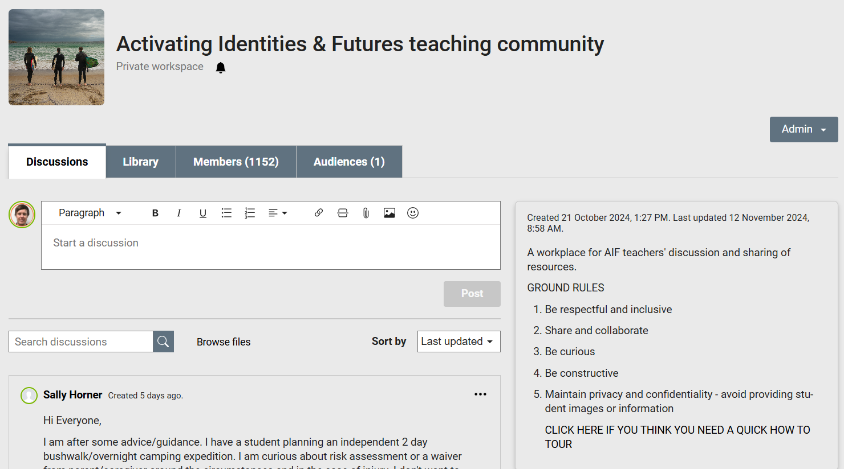
Would a PLATO connect community for Teaching and Learning Leaders be useful?
Notes:
Jason

Slide 82
Close
Nicholas Brice
Deputy Chief Executive

