Slide 1




Teaching and Learning Leaders conference
June 2026
Summary feedback data

Slide 2
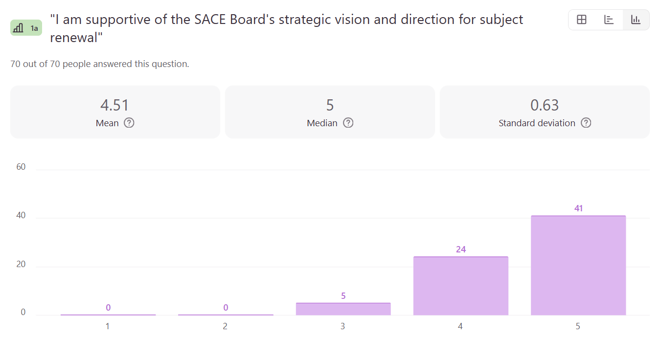


Subject Renewal

Slide 3
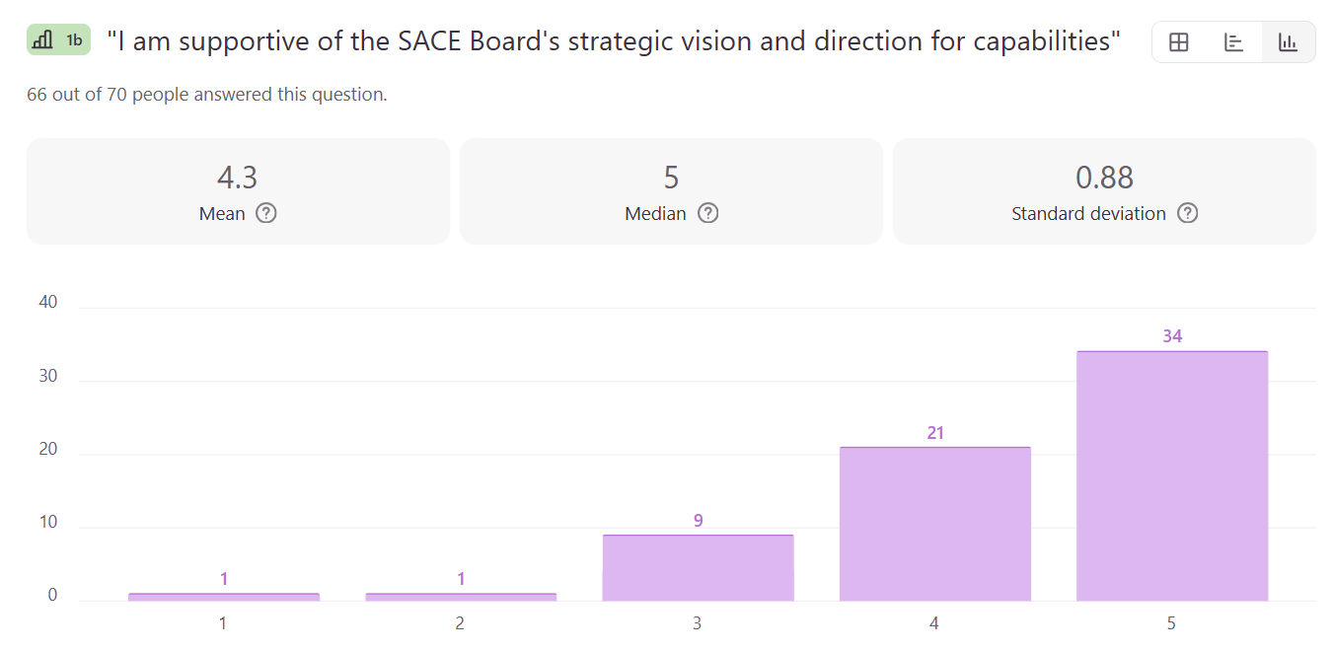
Capabilities and Learner Profile

Slide 4
What is your overall perspective about the SACE Board's current strategic priorities
Very much agree with the vision and mission of the change just wonder what this is going to look like operationally.
Focus on capabilities is a great initiative though I worry about its execution.
Subject renewal would benefit from having a proposed agenda for how this will be rolled out and when… would be nice to know a timeline expectation that SACE is working towards.
Resources and professional learning opportunities should be accessible to all teachers… ensuring equitable access… will help teachers confidently deliver the renewed subjects.
They want to shift from SACE just being about getting into university. They want students who are best prepared for life.
The strategic priorities are aligned with where this needs to go, the issues arise when it comes to implementing the priorities in a way that is actually workable for schools.
Good, but still needing more clarity around what the end goal is so that we can help pave the path ahead within our schools.
I think bringing it to life is challenging for many senior subject teachers without more examples of practice.
It is timely alongside the SA curriculum and the need for the future of education.

Slide 5
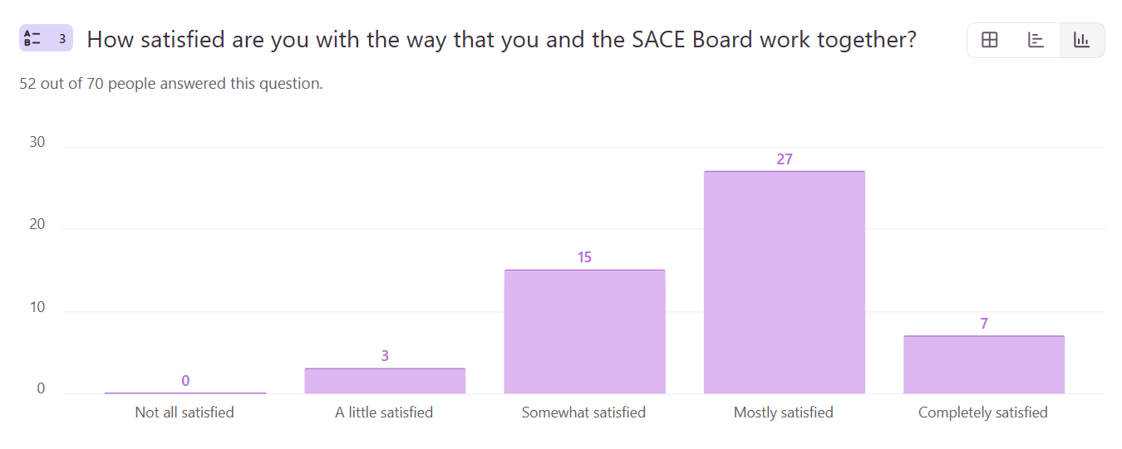
SACE and TLL partnership

Slide 6
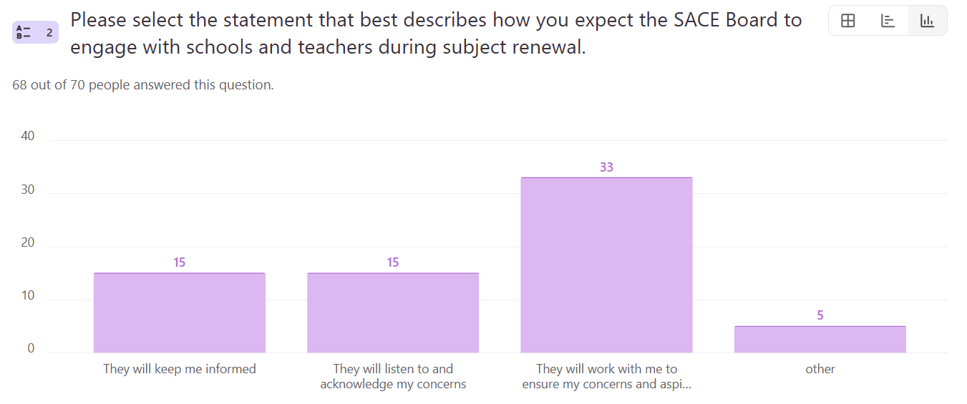
SACE and TLL partnership

Slide 7


What we heard — how schools implement
TWO DISTINCT APPROACHES TO EMBEDDING CHANGE OVER TIME
STRUCTURED
Leadership-led models emphasise clear processes, defined stages, and consistency across staff.
EMERGENT
Teacher-led approaches are more iterative and adaptive, evolving during delivery and responding to context.

Slide 8

What we heard — barriers and enablers
Teaching and Learning Leaders we're invited to map their experience in implementing a new subject and how information flows from the SACE Board into classroom practice. Through this activity a number of key BARRIERS and ENABLERS we're identified

Slide 9



Enablers: what helps implementation?
Schools are most successful when leadership, collaboration and professional learning work together.
Through the workshop, participants consistently identified several factors that support successful implementation:
Strong leadership provides clarity and direction, helping schools make decisions and align implementation across staff.
Intentional professional learning builds confidence and capability, supporting teachers to embed new approaches in practice.
Collaboration strengthens implementation, with ongoing conversations, shared planning and feedback helping to build collective understanding.
Time and flexibility enable quality implementation, allowing schools to plan, refine and adapt approaches to their local context.

Slide 10


Barriers: what gets in the way?
Clarity, capacity and context remain the biggest challenges.
Participants also identified several barriers that make implementation more difficult:
Lack of clarity creates uncertainty, particularly about expectations, standards and design.
Workload pressures limit capacity, making it difficult for staff to engage deeply with change.
Time constraints reduce opportunities for planning, collaboration and reflection.
Confidence and capability gaps persist, particularly when teachers are navigating new approaches.
Structural, access and equity challenges can affect implementation differently across schools, particularly in smaller or regional contexts.

Slide 11

What we're doing in response
Your feedback is shaping the next phase of support.
Participants highlighted a common tension between the desire for local flexibility and the need for clear direction.
Our focus is to make implementation clearer, more practical and better supported for teachers and school leaders:
providing greater clarity and direction
developing practical guidance and tools
sharing tangible examples and resources
supporting professional learning and collaboration
recognising the diverse contexts in which schools operate

Slide 12

What we heard — barriers and enablers
BARRIER
ENABLER
LACK OF CLARITY
Confusion around how to bring new subjects alive in the classroom - how to build learning and assessment, design tasks, what forms of evidence will count, adapting to new pedagogies, how to assess.
CLARITY AND PLANNING
Clear implementation plan: timelines, next steps, actionable resources, examples.
Need for shared understanding and alignment across staff in schools. Supported by well-defined plans that guide consistent and coordinated action.

Slide 13

What we heard — barriers and enablers
BARRIER
ENABLER
WORKLOAD
Multiple demands limiting teachers’ capacity to engage deeply.
Limited time reduces opportunities for collaboration and a tendency toward rushed or surface-level approaches.
TIME & COLLABORATION
Structured release time for collaboration and building understanding. Planning, iteration, and review.
Value of ongoing conversations, active feedback loops across staff and opportunities to unpack, question, and refine practice
.

Slide 14
What we heard — barriers and enablers
BARRIER
ENABLER
CAPABILITY, CONFIDENCE, ACCESS
Understanding the intent, but unsure how to actually do the work.
Without safety and clarity, experimentation stalls and people hesitate to try new things.
Limited access to clear and timely information.
PROFESSIONAL LEARNING & CHAMPIONS
Essential to building capability and embedding change. Ongoing learning supports consistent implementation and maintains momentum.
Individuals who lead locally, build and sustain momentum, help interpret changes, support colleagues, and maintain progress over time.

Slide 15

What we heard — barriers and enablers
BARRIER
ENABLER
STRUCTURAL CONSTRAINTS
Student numbers, subject viability, timetabling and staffing decisions influence practice.
STRONG LEADERSHIP
Strong, aligned leadership, particularly where it establishes clear structure and direction. Drives coherence and shapes decisions for design, staffing, and rollout.

Slide 16

What we heard — barriers and enablers
BARRIER
ENABLER
EQUITY CHALLENGES
Constraints in resourcing and the ability to fund participation limits opportunities for involvement, particularly for small and remote schools.
FLEXIBILITY
To ensure relevance across diverse school contexts. Adapting approaches based on factors such as school size, staffing, and student cohort. Different models in response to local needs.

Slide 17
What’s next
The SACE Board will develop a strategy in response to this feedback, with a focus on addressing key barriers and strengthening identified enablers. This work will prioritise clearer direction, practical supports, and accessible resources to help schools implement subject renewal with confidence.

