Slide 1

Teaching and Learning Leaders Conference
Semester 1 2026

Slide 2


Dr Ankit Agarwal
Senior Manager, Education Services
SACE Board of South Australia

Slide 3
Agenda
9:00am | Welcome
9:35am | Subject renewal
10:10am | Mapping the middle activity
11:00am | Morning tea
11:20am | Panel discussion
11:55am | Gallery walk
12:10pm | Lunch
12:40pm | Capabilities
1:15pm | Design the support activity
2:05pm | Stretch break
2:15pm | Panel discussion
2:50pm | Close

Slide 4







Housekeeping
Continuous tea and coffee, morning tea and lunch provided
Free parking
Emergency exits
Toilets
Wi-Fi SSID: SACE
Password: SACESTARROOM2026!!!
First Aid

Slide 5
Our direction of travel
Hassan Mekawy
Executive Director, Education Services
SACE Board of South Australia

Slide 6


As an authority our enduring function is to…
5—Legislative principles
The following principles will apply in connection with the operation of this Act:
  (a) all young people are to be encouraged to obtain a formal education qualification that helps them to live and participate successfully in the world as it constantly changes, after taking into account their goals and abilities;
    (b) it is recognised—
    that young people acquire skills, values and knowledge associated with their education through their individual endeavours and through a range of learning experiences and in a variety of situations that may include, as well as schools, workplaces and training and community organisations; and

Slide 7







Key Drivers
OFFICIAL

Slide 8
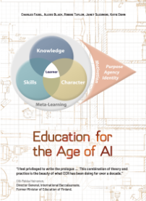
















Key Drivers: The value proposition continues to grow
OFFICIAL

Slide 9
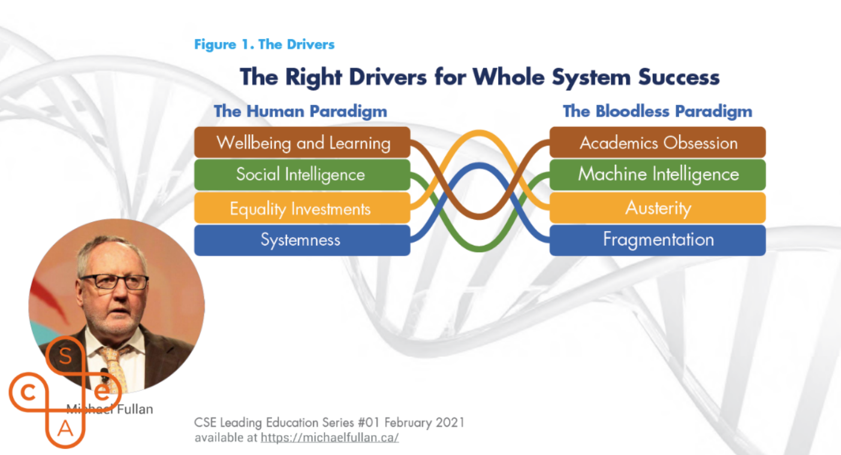

Slide 10
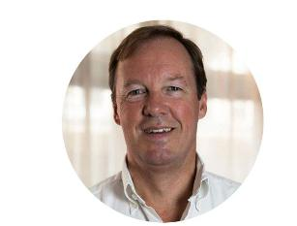

Rethinking assessment in education
Bill Lucas
“Across the world assessment is not
working. We are not evidencing the kinds
of dispositions and capabilities that
society increasingly wants. They
are testing the wrong things in the wrong
ways. “
“We need nothing less than a paradigm shift
in our understanding about how best to
create assessment systems that use more
effective ways of evidencing the full range
of student progress.”

Slide 11
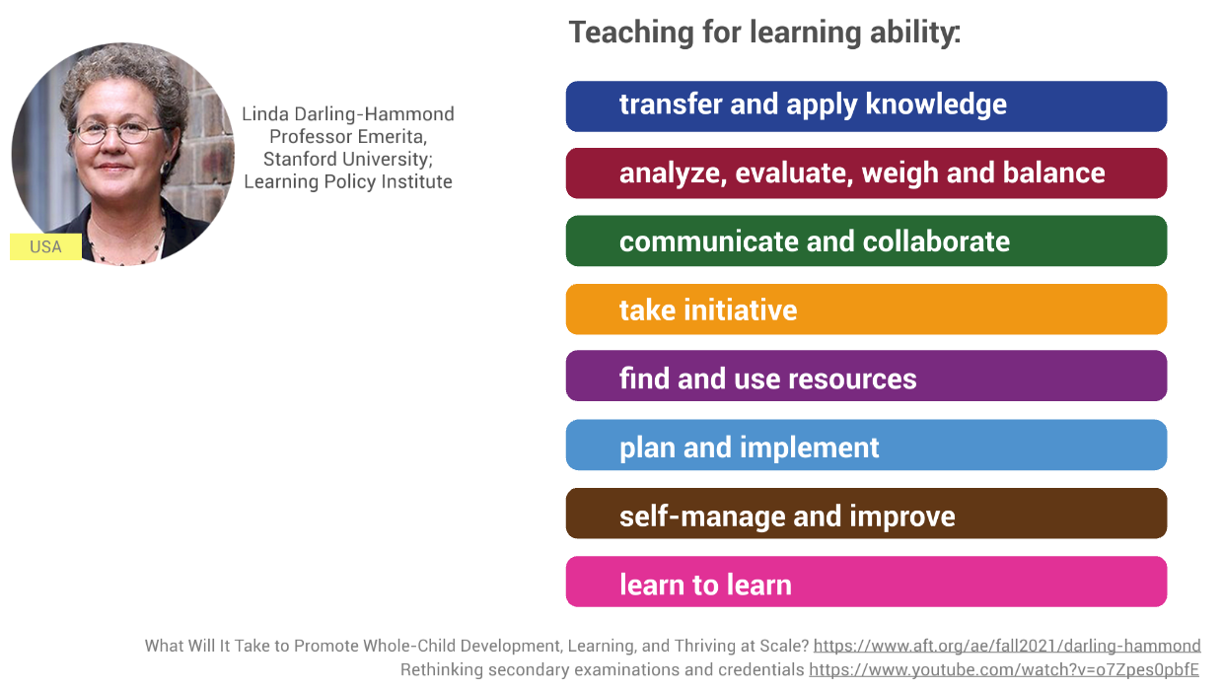

Slide 12



Challenges students face today
Rise of Artificial Intelligence
Focus on mental health
& wellbeing
Dissatisfaction with using grades and ranks to define success
Today, the processing power and speed of artificial intelligence is changing the way we access and use knowledge.
Today, more than 25% of young people meet the criteria for experiencing psychological distress and over 50% identify mental health as a top barrier to achieving their study or work goals.¹
Many young people reject the idea that the breadth and depth of what they know and can do is represented in grades and ranks. ²
Sources
¹ 2021, Mission Australia’s Youth Survey 2021
² 2020, Learning Creates Australia - Recognition of learning success for all

Slide 13

Rise of AI – urgency and impact
To tackle these challenges, every young person will need to build life-long skills, capabilities, knowledge and understanding.
Integrity of SACE results under pressure from AI-enabled tools.
Advancing faster than systems can adapt.
Balancing challenges with opportunities.
Risks eroding the relationship between teachers and students.

Slide 14



Adapting to the challenges and opportunities of AI
Phase 1: Learn & Grow – Engage with relevant expertise to develop contextual understanding.
Phase 2: Test & Share – Refine in practice through subject renewal, develop & refine targeted content and changes.
Phase 3: Scale & Evolve – Ongoing adaptation; provide a broader range of support materials, exemplars, and policy guidance

Slide 15
Empowering learners and educators
Subject Renewal
  AI as a catalyst for innovation, not a threat.
  Learning and assessment design that are resilient
  Developing ‘human’ capabilities
Capabilities within the SACE
  Recognise and capture these ‘human’ capabilities
  Raise student’s awareness of their strengths alongside disciplinary understanding and skills
To tackle these challenges, every young person will need to build life-long skills, capabilities, knowledge and understanding.

Slide 16
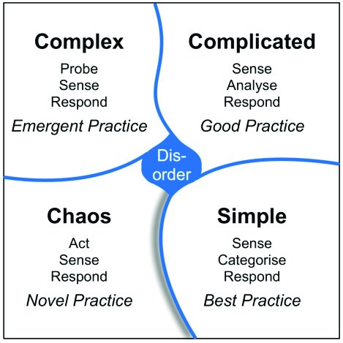
Complexity
To tackle these challenges, every young person will need to build life-long skills, capabilities, knowledge and understanding.

Slide 17

Consolidation
To tackle these challenges, every young person will need to build life-long skills, capabilities, knowledge and understanding.
Damien Newman
‘The Process of Design Squiggle’

Slide 18
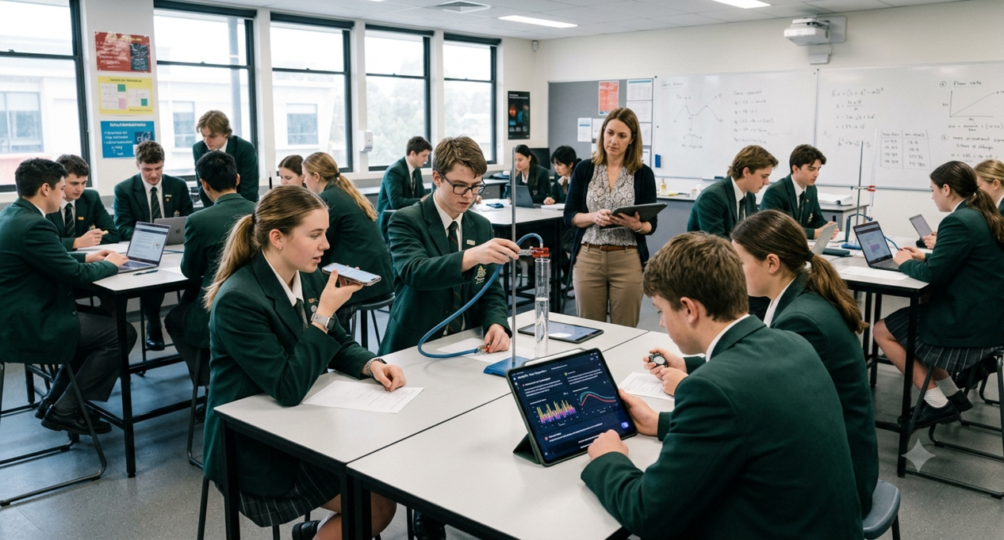

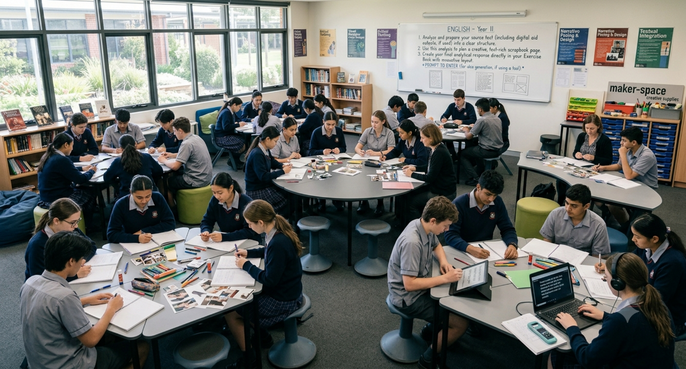
How do we create conditions for teachers to try something different?
"Exactly how are you asking me to behave differently in the classroom?“
Guy Claxton’s Teaching for Life, A culture change for schools, May 2025

Slide 19

Exploring Identities and Futures is a subject that really lets you explore yourself.
I chose to do mine in the form of a photo album.
So, I got some photos of some of the people who I really looked up to….
So, if my person was someone who was a good public speaker, then I would try and put myself in a position that I'm not super comfortable with and do some public speaking myself to show my improvement and how I'm working towards being more like them.

Slide 20
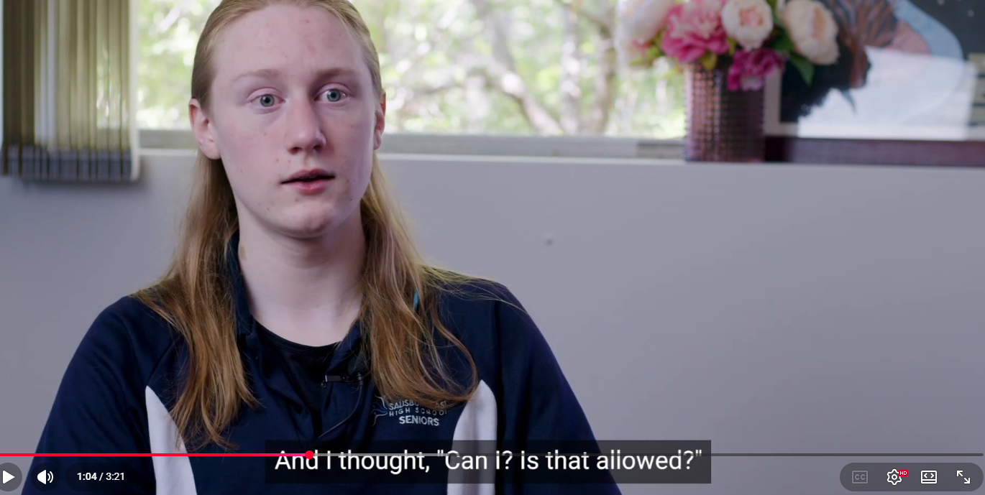

Slide 21

“The role of the leader is to create a context where others feel stronger and more capable.”
- David McClelland
“Give it a go! Start small…start at Stage 1”
- Hassan Mekawy

Slide 22
We want to provide confidence
You are not risking student’s grades:
by being innovative
embedding the key drivers
by having students use AI tools
by having layered assessment
by encouraging students to take risks, or alternatives, to traditional forms of tasks.

Slide 23


Slide 24

Hygiene Factors
Psychological Safety
Motivators
We see the world in binary. We have grown up living this view and its deeply embedded in our evaluation of all that we and others do. However, opposites aren’t so clear when it comes to motivations and dissatisfactions, the lines are blurrier than what we note.

Slide 25
You can’t motivate a motivated person
What this means for TLLs:
Perhaps a radical and liberating claim: satisfaction and dissatisfaction are NOT opposites on the same scale. They are driven by entirely different forces.
Motivators (intrinsic): achievement, recognition, meaningful work, growth, responsibility → these create satisfaction
Dissatisfiers (extrinsic): unclear expectations, poor relationships, lack of support, role ambiguity, feeling unheard → these create dissatisfaction
Removing dissatisfaction doesn't create motivation — but dissatisfaction WILL destroy it.

Slide 26
You can’t motivate a motivated person
What this means for TLLs:
You are intrinsically motivated. You don't need to be inspired to care. But if your dissatisfiers left unaddressed, that motivation erodes. The dissatisfiers for TLLs could include (and we can hear from you during panel sessions):
Isolation: "No one else understands what I do"
System friction: "I can't get the information I need“
Lost in translation: “The information keeps changing. Should I do my own?”
Today's event is designed to reduce dissatisfaction — not manufacture motivation.

Slide 27
You can’t motivate a motivated person
Psychological Safety First
Reduce the Friction
Trust the Motivation
Before you as TLLs can do your best work, you need to feel safe to ask questions, admit confusion, and challenge assumptions without fear of judgment.
Every activity today is designed to surface and address the dissatisfiers — the systemic barriers that drain TLL energy and effectiveness.
We don't need to convince you TLLs to care. As SACE, we need to care about removing what's in your way.

Slide 28


Marshmallow and spaghetti activity
Build the tallest free-standing structure
Use all materials provided (including different sizes/colours)
The marshmallow must be on top
The structure must stand on its own
You have 10 minutes

Slide 29
Subject renewal
Jane Marshall
Faculty Manager (Arts & Pathways)

Slide 30
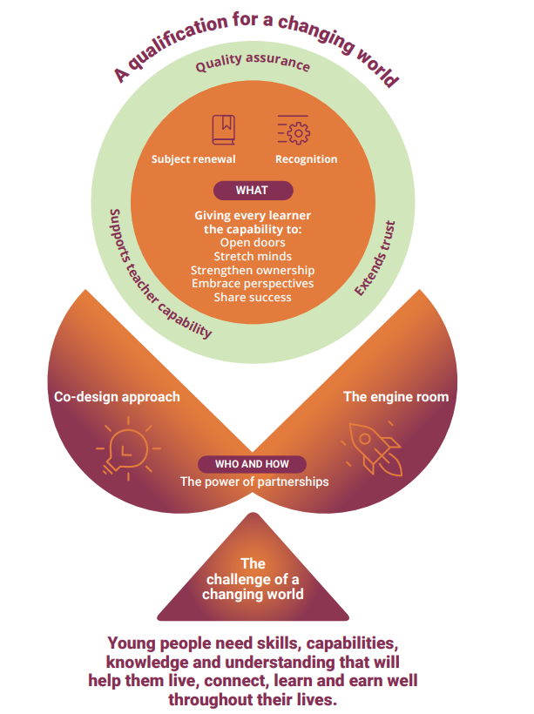

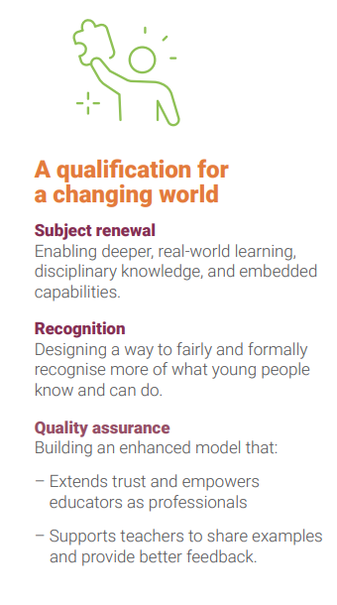

Slide 31





Subject Renewal
Co-designing with Subject Renewal Groups (SRGs)
Sharpen content & assessment
Intentionally develop capabilities
The SACE Board is engaging with the diversity of teacher experience and perspectives on SRGs to design subjects

Slide 32
Developing the Key Drivers
Drivers
Metacognition
Deep authentic learning
Natural evidence of learning
Agency
Capabilities to thrive

Slide 33








Subject Renewal
Lead Practitioners
Subject Associations
Capabilities Leaders
Industry
2026
Tertiary
Students
SRG Teachers
SACE Education Consultants
Community

Slide 34

Using this
new approach
The SACE and Subject Renewal Groups (SRGs) are designing the following artefacts
Vision
Statement
Subject
Blueprint
Subject
Prototype
Subject
Design Map
Subject
Outline
  Defines the
  big picture
  A clear and inspiring description of what the subject aims to achieve in the future
  Maps the plan
  A conceptual plan
  that shows how the key drivers will come to life
  Tests the ideas
  A practical trial of key concepts, learning design, and assessment approaches
  Brings it all together
  A structured document that consolidates insights from the vision, blueprint and prototypes
  Sets the policy
  The accredited policy document for the subject
Thrive.

Slide 35
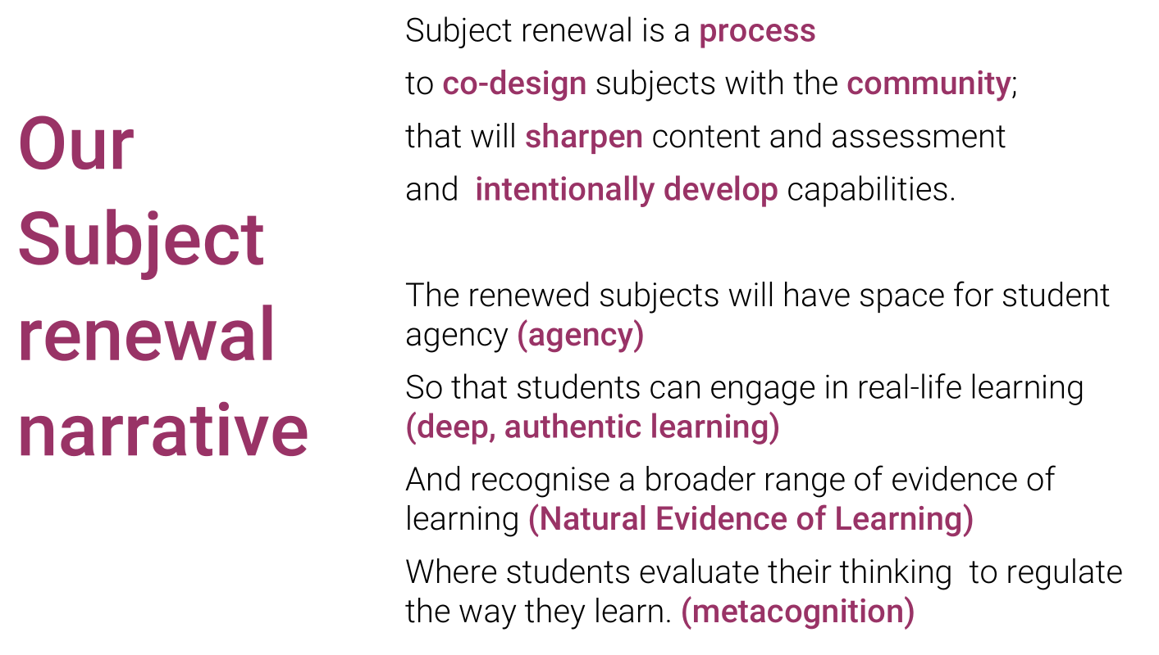

Thrive.

Slide 36




Integrating Capabilities through Subject Renewal
Subject
Renewal
Capabilities
Feasibility
Program

Slide 37
Less is more: focusing on big ideas
Amplifying: Deep Authentic Learning
Prioritising deep conceptual understanding
More flexibility in what is taught
Learning that connects and transfers

Slide 38
Less is more: reduce assessment
Consistency Across the SACE
Reduction in assessment across subjects
depth over breadth
make space for capabilities development
Learning from our prototypes
Consistent approach to structure of performance standards
align to what the SACE board values in learning
are clear, observable and standards referenced
Dimension 2
Consistent approach to assessment types across the SACE
nuanced to each discipline

Slide 39
Learning across the Prototypes leading to exploration of Assessment Types
Assessment Type 1: Knowledge, Understanding and Application | Assessment Type 2: Activating in Authentic Contexts | Stage 2 External: Extend & Transfer
Demonstration of disciplinary learning progress |  | Student led activation through authentic performance |  | Extends learning and performance in school-based assessment, rather than simply repeating it
Collection of evidence across a range of learning activities. |  | Evidence is generated as learners engage in self-managed processes and develop metacognitive awareness. |  | Transferring learning into new and unfamiliar contexts – using conceptual understanding, rather than reproducing memorised material.

Slide 40
Applied
Example
Essential English

Slide 41
Vision Statement
Subject: Essential English
The flexibility within Essential English will empower students with the skills to make meaning and connection to the world. Students will confidently use communication skills to create connections and participate within the diverse communities they are part of.
Through sustained exploration of perspectives and a variety of everyday text types, students apply their learning to develop their own voice and creativity to confidently communicate for different purposes, audiences and contexts.
Vision Statement guiding criteria:
Makes clear what is unique to the subject (compared to what other subjects offer)
Reflects the drivers in context of that subject (links not lists: not just stated explicitly/generically)
Is focussed on the essence of the subject (not trying to be all things to all people)
Future focussed (how will students be different from doing this subject?)

Slide 42
Subject Blueprint
Subject: Essential English
From: Responding to texts
To: Language for connection
From | Through | To
Current structure is academic and rigid, lacking real-world relevance. | Students focus on appropriate communication skills for both real world and creative contexts. | Students will experiment with language use in personally relevant contexts to understand how they are empowered when they can adapt their oral, written and visual literacy beyond the classroom. Where appropriate, experiential learning will be incorporated into learning design.

Slide 43
Subject Prototype
Subject: Essential English
Key driver: Agency, Deep Authentic Learning, Natural Evidence of Learning, Metacognition | Principle/technique/method: Communication skills in everyday situations
Prototype description The prototype was designed to test if moving away from traditional oral presentation modes to authentic communication in everyday situations would enhance the learning and application of oral language skills. Teachers taught the linguistic features of effective oral communication and the students applied their learning in either real or simulated scenarios in different contexts.

Slide 44
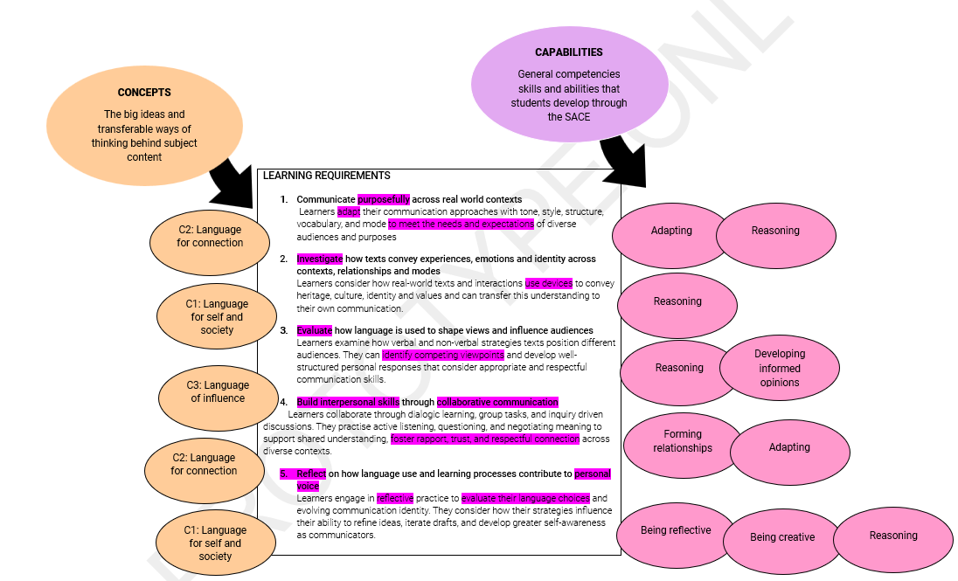
Prototype Subject Outline
Subject: Essential English
From: Responding to texts
To:
Language for connection

Slide 45
Subject Renewal Implementation
What SACE will provide:
Implementation timeline
Professional learning (for Teachers and Leaders)
PLATO
Other resources: example LAP, samples etc

Slide 46
Preparing for Transition
What you can start now:
Start conversations with your teams
Build understanding of the key drivers
Try small changes in practice

Slide 47

Highlights from Schools:
Subject Renewal
Mary Hodson
Northern Adelaide Senior College
Kelly Scott
Walford Anglican School for Girls

Slide 48

Mary Hodson: Deputy- Teaching and Learning and SACE
Schools Vision and Values:
Growth – How can we support this?
Success – What can this look like?
Belonging – What connections can we build on?

Slide 49





Our Site Context
Category 1 Senior School: Serving adult re-entry students across a wide diversity of educational abilities, personal commitments, and cultural backgrounds.
450
177
118
49
TOTAL ENROLMENTS
TAILORED LEARNING
EALD LEARNERS
ABORIGINAL LEARNERS
Students aged between 15 to 69 pursuing Stage 1 and Stage 2 subjects in senior education.
Targeted programs, fee-for-service
Specialised pathways
Dedicated pathways

Slide 50



Learning Design & Intentional Pedagogy
Our challenge for consideration:
Developing learning opportunities that build systematically upon the core elements of the capability descriptors.
Engaging students through collaborative, dialogic teaching, and interactive instruction.
Encouraging school attendance by making learning deeply contextual and rewarding.
Fostering meaningful, real-world learning that resonates with adult lifepaths.
Promoting a strong sense of belonging within a highly diverse learning community.
The world is shifting and those who adapt
and innovate will be the ones to lead the way.

Slide 51

Our "Why"
Our Challenges
Re-imagine a comprehensive, robust education model centered entirely around learner agency.
How do we effectively enact curiosity to produce highly motivated, self-focused, and engaged learners?
Providing a transformative second opportunity for adult students who haven't had previous academic pathways
Ongoing structural ambiguity regarding SACE Renewal groups and curriculum bounds.
Inviting deep curiosity to foster experimentation, creative pedagogical practice, and critical thinking.
Hesitancy and uncertainty around what "natural evidence of learning" metrics look like in practice.
Managing staff pressure regarding SACE moderation guidelines.

Slide 52

My approach

Slide 53

Setting up the conditions
Identify the need for change to spark student curiosity
Acknowledge what learning experiences staff are proud of
Explore what we want our learners to be like as adults?
Explore what learning experience we want to change?

Slide 54
Capabilities Matrix
CAPABILITY | CAPABILITY DESCRIPTOR
Personal enterprise Open doors: find opportunities By pursuing ideas and creating new paths, getting things done and setting the pace. | Developing Attempts to explore and identify opportunities. Shows curiosity and works under guidance and support | Well developed Demonstrates growing confidence, and independence in seeking and acting on opportunities. Is proactive in generating and pursuing ideas | Established Identifies and pursues opportunities with autonomy. Creates and executes innovative ideas to support and motivate others.
Elements of a capability | Managing time, designing and planning, perseverance, contributing, seeking feedback, self-directed, showing initiative
Evidence of growth | Responds to presented opportunities to produce an outcome, using relevant knowledge and available resources under guidance. Manages and fulfills caring responsibilities with support, demonstrating empathy, organisation, and commitment. | Develops plans and seeks support with minimal assistance and accesses opportunities to produce an outcome, using relevant knowledge and available resources Supports in fulfilling caring responsibilities, demonstrating empathy, organisation, and commitment. | Capitalises on presented opportunities to produce an outcome, using relevant knowledge and available resources Consistently and effectively manages and fulfills caring responsibilities, demonstrating empathy, organisation, and commitment e.g. develops and drives a project plan.
  Unpacking what growth looks like within each of the capabilities and elements and what evidence would we see

Slide 55





Exploring What We Notice About Learners: Connections the SA curriculum and SACE
"If learners were living out the capabilities, what would we see?"
"What actions would a teacher need to do to bring this to life?"
"What messages about learning do we send to our teams & students?"
•
Student Agency actively researching
•
Designing engaging, flexible learning tasks
•
Staff feel deeply passionate and connected to subject matter
•
Exploring individualised, personal pathways
•
Providing opportunities to ‘do’ hands-on, authentic activities
•
Value structured teamwork and shared problem solving
•
Attending site immersions & school events
•
Targeted individualised learning activities
•
Provide platforms to showcase student skillsets
•
Connecting learning with life
•
Forging tight connections with employability skills
•
Foster agency & support students to connect learning with pathway goals
•
Work experience placement
Targeted industry learning
•
Empower students to take calculated risks and develop resilience
•
•
Enrolling in courses & qualifications
•
Building long-term employability skills

Slide 56


What We Are Seeing & Learning
What's Working Well
Identified Hesitations
Industry Partnerships: Successfully translating into professional collaborations and authentic curriculum design.
Stage 2 teachers feeling boundary uncertainty regarding SACE criteria.
Creating targeted pathway, capability development, and authentic learning experiences.
Maintaining cross-continuity between Australian Curriculum descriptors, SACE elements, and site-level targets.
Staff willingness to be highly flexible and collaborate.
Navigating general change-management hesitation ("What will this look like in the long term?").
Valuing of the pedagogical shift.

Slide 57







Implications for Consideration
Structured Time
Cross curriculum collaboration
Demystify Natural Evidence
Learner Agency
Provide formal, scheduled time for staff to collaborate to create learning opportunities that meets the need of cohorts
Create cross-subject planning time to co-design.
Establish clear rubrics and exemplars to highlight, authentic progress.
Shift mindsets towards agency, fostering environments that encourage risk-taking and community connections.

Slide 58


Slide 59
Highlights from Schools:
Subject Renewal
Kelly Scott
Walford Anglican School for Girls

Slide 60

Kelly Scott
SACE Coordinator and Head of Humanities

Slide 61

ELC-12 girls’ school, including local and international boarders
Stage 1 and 2 includes accelerated and flexible offerings
Small, mixed ability classes
Many students aim for university entry both within and outside of South Australia
School SRG engagement in subjects across learning areas
Site context

Slide 62

Opportunities
Refreshed subjects in senior years that can inform subject design in the middle years
Task design that caters for diverse learning
Address the challenges and benefits of AI
Prepare students for a variety of pathways
Student agency during the process to shape ideas
Opportunities

Slide 63

Challenges
Concerns about maintaining integrity of subjects as assessments change and there is a move away from content to concepts
How to capture ‘natural evidence of learning’. What does this look like? How do we achieve variety across subjects?
How are key drivers assessed?
Ensuring the community will understand and support subject changes, including assessment
Concerns that subjects are competitive for university selection and value outside of South Australia
Challenges

Slide 64
Experimentation in my classes as part of my work on the SRG. Focus has been task design and embedding key drivers
Faculty PD and meetings to discuss changes in approach to consider the key drivers across year levels
Supporting staff with task design as part of a focus at a School level – this feels natural as it is a current focus
Share prototypes for feedback and development
Trial prototypes at different year levels
Approach

Slide 65
What is working?
EIF and AIF has meant students are already familiar with key drivers and capabilities
Prototyping has been a great process with positive feedback from students
Student participation in SACE meeting has been received well
These changes have been adapted in years 8-10 with success
This has been refreshing for my classroom practice
What we are seeing and learning

Slide 66
What is challenging?
Semesterisation of subjects has posed challenges for prototyping and following student progress
Understanding the key drivers and making these clear to students and to staff
Challenges around conceptual learning during prototyping has been reported in mathematics
Sharing knowledge when changes not yet definitive and subjects are on different timelines
Understanding how examinations may look with conceptual based design
What we are seeing and learning

Slide 67
Considerations
How to support staff with changes as they are rolled out
How much time to give when timelines are flexible and there is still consultation and accreditation to occur
Changes to subjects will mean change in course design for many subjects
Alignment with the AC
Sharing across subjects where there are multiple subjects
Implications for others

Slide 68
What matters most?
Staff and student confidence in the renewal process
Understanding of key drivers and capabilities
Work across subschools for consistency and to build student agency and confidence
Time to be given to understand, see models and develop prototypes
Cross curriculum discussion to ensure clear understanding across all learning areas
Task design
Implications for others

Slide 69


Slide 70
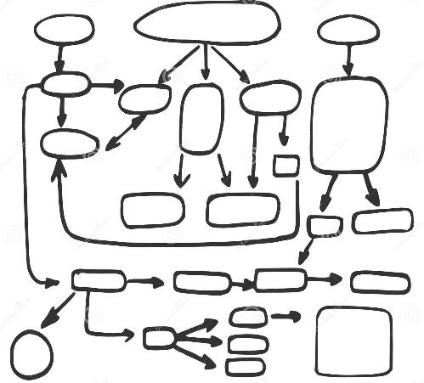
Mapping the Middle Activity
Map how a new subject has been implemented in your school — how it moves, who is involved, and how it plays out in practice
Capture this as a simple visual flow showing people, decisions, and how information moves
Identify where things work well and where it becomes challenging
Highlight what is clear, unclear, or open to interpretation
Be ready to display your map for the gallery walk

Slide 71
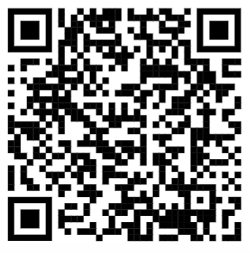
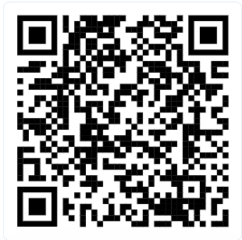
Mapping the Middle Activity – Emerging Themes
Scan the first QR code to view the key barriers captured from your table discussions
Vote for the barriers that feel most significant to you
Then scan the second QR code to view the key enablers
Vote for the enablers that feel most significant

Slide 72
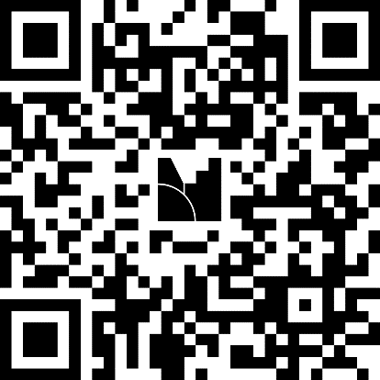
Mapping the Middle Activity
Reflecting on what we’ve heard
Scan the QR code to add your input
Vote for items you’d like to see explored

Slide 73
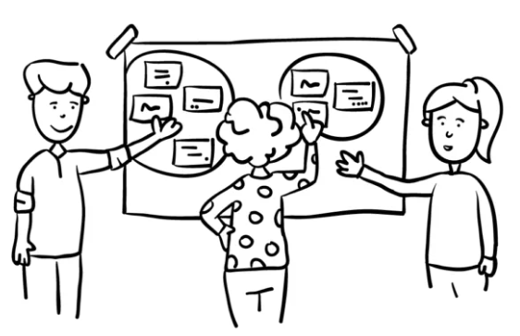
Mapping the Middle Activity
Gallery walk

Slide 75
Capabilities within the SACE – Feasibility Program
Virginia Steele
Program Manager, Capabilities Feasibility Program

Slide 76


Slide 77

Challenges students face today
Rise of Artificial Intelligence
Focus on mental health
& wellbeing
Dissatisfaction with using grades and ranks to define success
Today, the processing power and speed of artificial intelligence is changing the way we access and use knowledge.
Today, more than 25% of young people meet the criteria for experiencing psychological distress and over 50% identify mental health as a top barrier to achieving their study or work goals.¹
Many young people reject the idea that the breadth and depth of what they know and can do is represented in grades and ranks. ²
Sources
¹ 2021, Mission Australia’s Youth Survey 2021
² 2020, Learning Creates Australia - Recognition of learning success for all

Slide 78
The ambition: Alex’s story
Capabilities assessed separately in all subjects, capabilities assessed via extra-curricular and outside of school activities, all assessment data available in visualised form for student use, capabilities data provided to post-school providers
Alex started their SACE journey in EIF and enjoyed learning about the capabilities. All their subject teachers in Stage 1 introduced the elements most relevant to their discipline area. By the end of Semester 1 they had an initial representation of their capability development.
In Semester 2, Alex had data input from all their subject teachers, plus extra-curricular sport from the basketball coach, as sport was an important part of Alex’s life. At the end of the year, they had a capability representation that showcased not only their subject achievement, but also their capability strengths.
The following January, Alex used their Year 11 representation to apply for a job in the local café. They were able to use the language of the capabilities to talk about how they worked well with others, responded effectively to feedback, and demonstrated a high level of organisation. In Year 12, Alex had data entered by all their subject teachers plus from the teacher who ran the school Peer Mentoring Program they worked in. They also asked their employer to submit data. Upon completion of their SACE, Alex received their Record of Achievement, SACE Certificate, and final representation of their capability data. This supported an enhanced admission process into the university course they wanted.

Slide 79

Capabilities
Capabilities within the SACE – A Feasibility Program 2026-2027
Capabilities are complex, transferable competencies that can be taught, learned, observed, and credibly assessed through demonstrated performance across real contexts. They are developed over time, contextual (learned through authentic tasks rather than in isolation) and transferable across subjects, situations, and future life contexts. The level of development of SACE capabilities is demonstrated through behaviour and not inferred from knowledge alone.
Thus, in general, capabilities are what students can do with what they know. They capture how students engage, adapt, and grow (both within and beyond the classroom) and not just how they remember information or complete set tasks.

Slide 80
Capabilities
Capabilities within the SACE – A Feasibility Program 2026-2027
Capabilities are the skills students develop over time that show how they use what they know in real situations. They are learned through practical experiences, not just by studying content, and can be applied across different subjects and in life beyond school.
Students show their level of development through what they actually do—their actions and behaviours—not just what they know.
In simple terms, capabilities are about what students can do with their knowledge, including how they engage, adapt, and keep learning in different contexts.

Slide 81
SACE Capabilities are…
Capabilities within the SACE – A Feasibility Program 2026-2027
built using South Australia-specific data gathered through stakeholder engagements with schools, tertiary partners, and businesses in SA and nationally
teachable and learnable
developed over time, with clear developmental progressions
contextual, learned through authentic tasks rather than in isolation
transferable across subjects, situations, and future life contexts
observable and assessable through typical demonstration
demonstrated through behaviour, not inferred from knowledge alone.

Slide 82
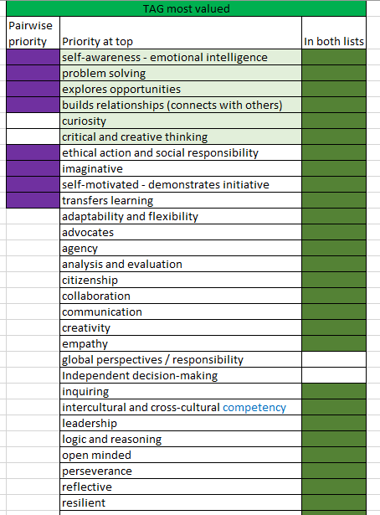
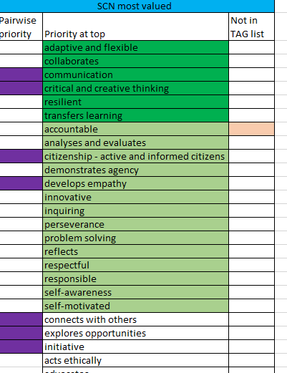
Prioritised most-valued capabilities
2020 - 2021

Slide 83
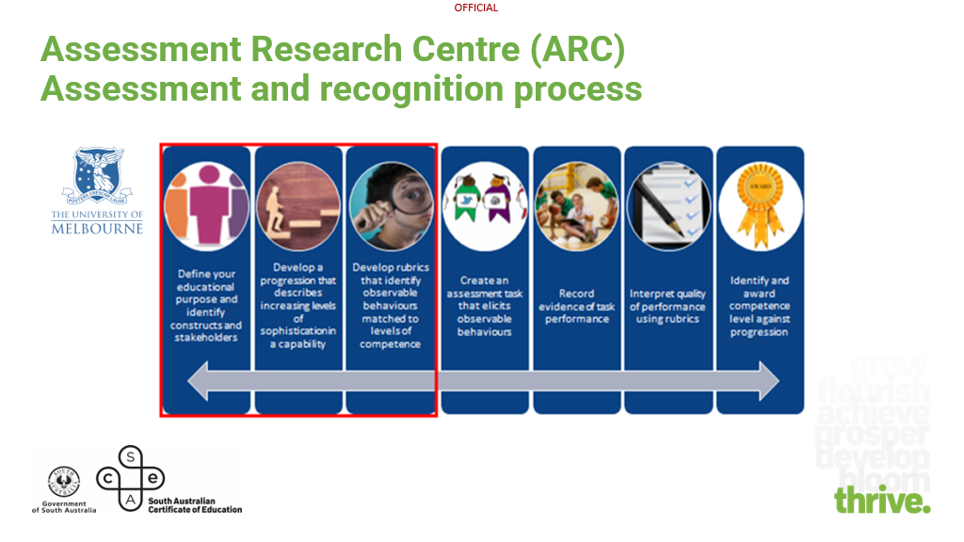
2021 – current 2026 Melbourne Metrics

Slide 84

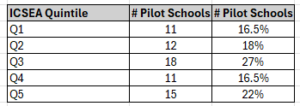

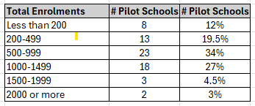
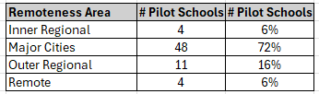
System engagement
Capabilities within the SACE – A Feasibility Program 2026-2027
Demographic data: Capabilities pilots and 2026 schools: UPDATE 16 June 2026
* Does not include the three SACE International schools involved
Australian Statistical Geography Standard (ASGS)

Slide 85

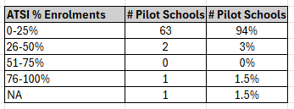
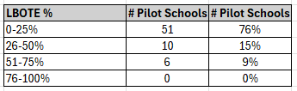
System engagement
Capabilities within the SACE – A Feasibility Program 2026-2027
Diverse student cohorts: Capabilities pilots and 2026 schools: UPDATE 16 June 2026
Also included: Accelerated pathways, gifted & talented pathways, and alternate flexible pathways for students.
* Does not include the three SACE International schools involved

Slide 86















Exploring a student’s experience
Capability development
Assessment data visualised for student use
Students develop capabilities in a range of contexts both inside and outside of school
Separate capability assessment
Employment
Subject learning – classroom teacher
Extra curricular activities – relevant teacher
Outside of school – relevant adult
VET in schools
Data shared with pathway providers

Slide 87
SACE Capabilities in 2026
Collective Engagement
I can work with others in meaningful ways, sharing ideas and solving problems together to reach a common goal.
Personal Enterprise
I can demonstrate initiative, pursue opportunities, produce outcomes of value, and ‘get things done’
Principled Action
I can be responsible for my actions and consider the impact I have. I can learn from my own experiences and the experiences of others and ‘do the right thing’
Quality Thinking
Self-motivated Learning
I am curious about the world around me and use a range of thinking strategies to shape my understanding
I can embrace challenges as opportunities and persevere and be active in my own learning
Saturn is the only planet with rings in the entire Solar System

Slide 88
The Elements in 2026
Adapting
Being creative
Being curious
Being reflective
Being responsible
Demonstrating perseverance
Demonstrating respect
Developing informed opinions
Embracing diversity
Engaging in dialogue
Inquiring
Making contributions
Reasoning
Using resources
Being organised
Comprehending
Demonstrating initiative
Engaging with feedback
Forming relationships
Taking opportunities

Slide 89
Capabilities within the SACE – A Feasibility Program 2026-2027
Capabilities within the SACE – A Feasibility Program 2026-2027
Continuing engagements with schools to learn about the feasibility of this work
Targeted inclusion of a few new schools to ensure greater diversity of representation
Testing the validity and reliability in-depth with a range of capability raters
Further exploration of ways to represent capability data
Expose the broader system to the capabilities and elements
Continued exploration of connection to post-school pathways in employment and further study
Connected: Subject Renewal

Slide 90
Highlights from Schools:
Capabilities within the SACE
Esther Webber (Maleki) and
Jess Milburn
Berri Regional Secondary College

Slide 91


Berri Regional Secondary College
Jess Milburn
Senior Leader of Active and Empowered Learners (Pedagogy)
Esther Webber (Maleki)
Assistant Principal

Slide 92
Our Context & Journey
16% Aboriginal students
18% Students with Disabilities
Started in 2023 with 15 students
Moving from a pilot program to a whole-school approach to capabilities
Whole school focus ( not just SACE )
Engaged in multiple pilots and projects in the last 5 years

Slide 93
The Opportunity / Challenge / Approach
More than just an assessment
About the students – developing and growing
TIME
Making it accessible for staff
Capabilities lens in learning design

Slide 94
What We’re Seeing + Learning
Value
Not just SACE
Less IS more
Go slow to go fast
Be okay with change

Slide 95
Implications for Others
Trust from Executive leadership
Not just a SACE agenda - link in with SA curriculum (or equivalent)
Look for the opportunities that already exit
Leverage SACE renewal

Slide 96
Highlights from Schools:
Capabilities within the SACE
Deidre Walters
Thomas More College

Slide 97
From Framework to Practice: Leading Capabilities
Notes:
Hi, I’m Deirdre Walters, Leader of Senior School Pedagogy and Innovation at Thomas More College.
In my role, I oversee SACE, but a big part of my work is helping staff understand the flexibility within it, supporting teachers to make learning more accessible, and leading work that improves outcomes for students.
And that’s really where the capabilities sit.

Slide 98
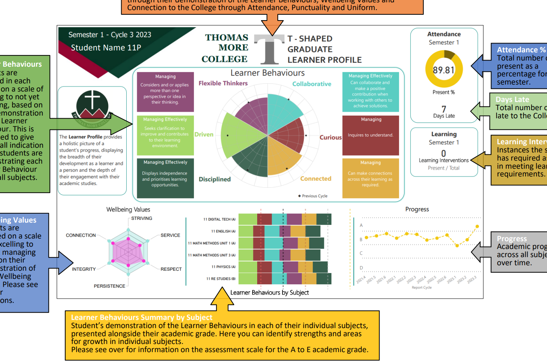
Context

Slide 99
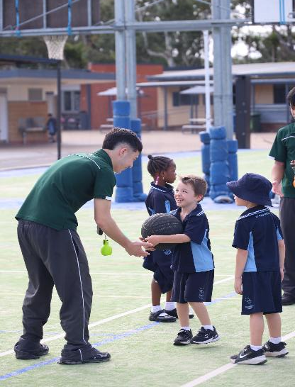
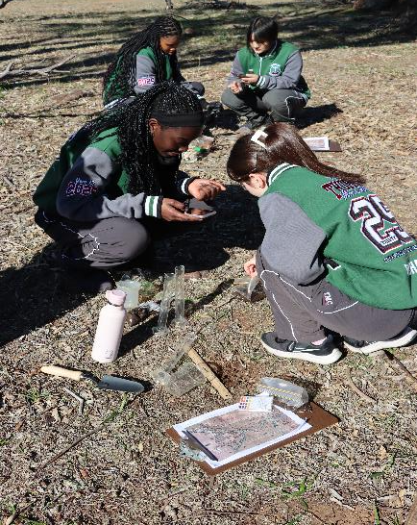
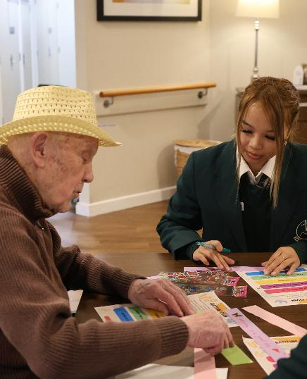
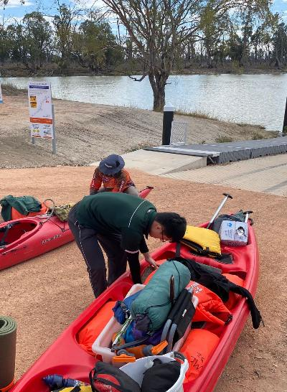
The Why
We want students to leave with more than just their SACE. We want them to have a clear sense of what they offer, their strengths, their capabilities, and how they contribute.

Slide 100

Leading the teacher shift

Slide 101
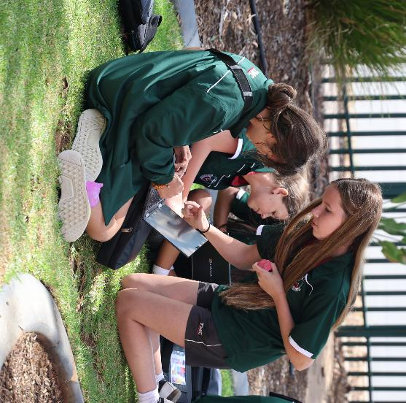

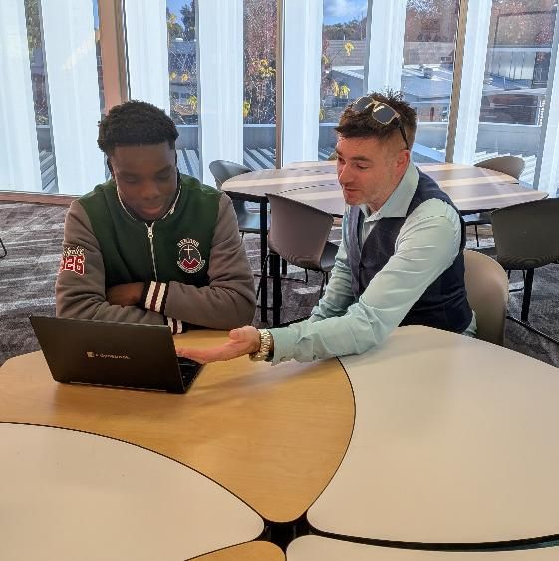
What It Looks Like in Practice
Year 12s teaching year 10s how to read their learner profile
Winning the T shaped graduate, most improved student in moving their learner profile along the continuum
Coaching session around goal setting

Slide 102
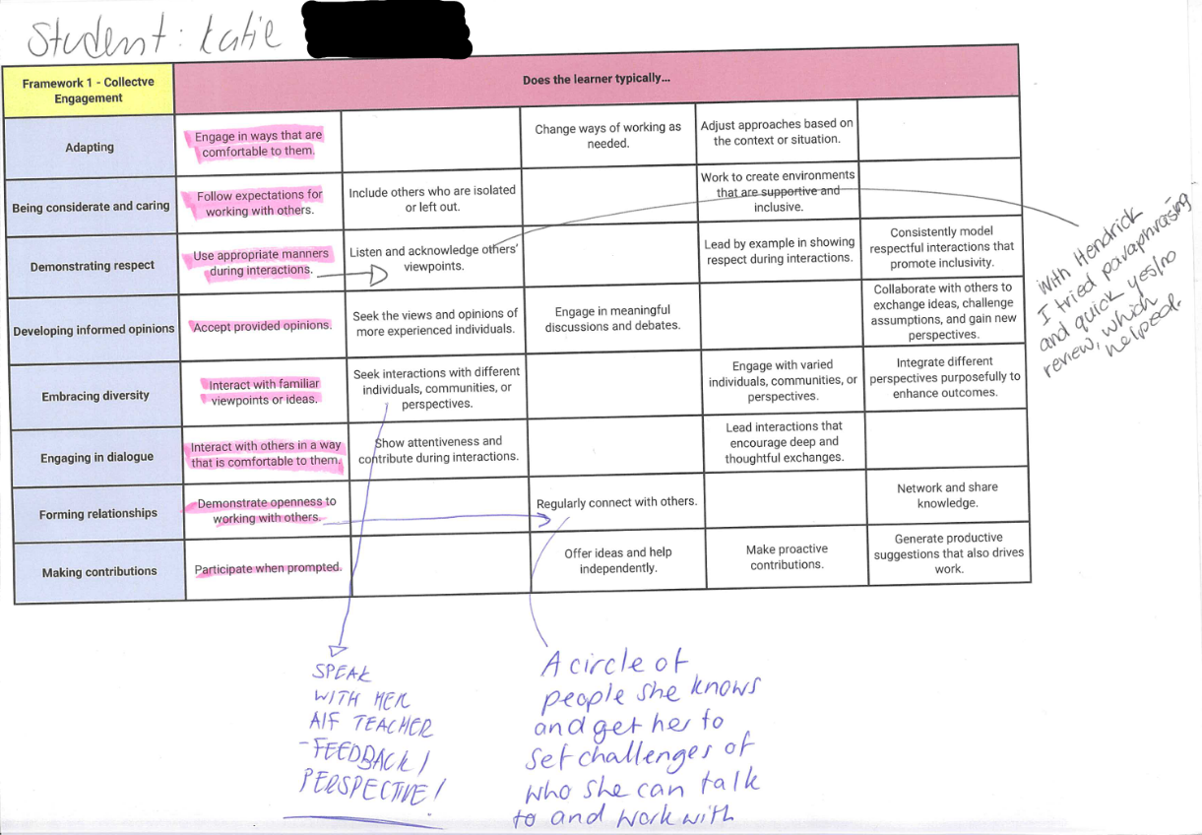
Leading the work
Staff ideas around moving one student across the capabilities continuum

Slide 103
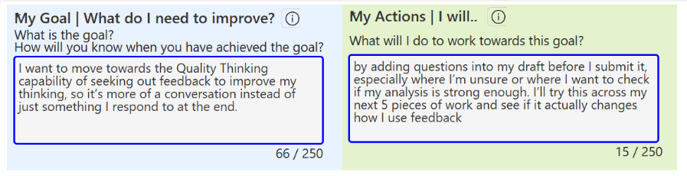
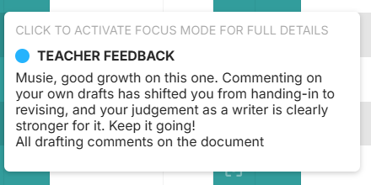
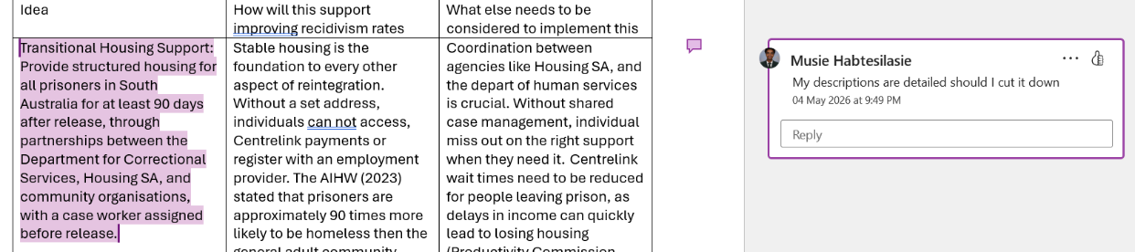
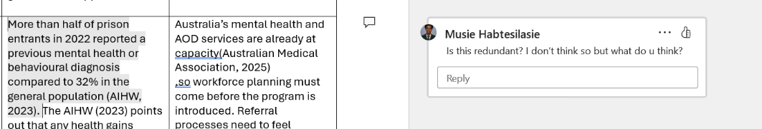
Impact
Students are owning this. They are talking about what their results say about their habits, effort, and how they learn. The conversation is shifting from results to growth and ownership.

Slide 104
Key Takeaways
Don’t introduce this as something extra, embed it into what you already do
Start with your purpose, not the SACE language
Invest in time and examples for staff early
Create a culture where it’s okay not to have it all figured out straight away

Slide 105
Design the Support Activity
Thinking about taking SACE strategy into practice — what do you need to make this work in your context?
Consider where support from SACE would make the biggest difference
Highlight what needs to be true for this to work in practice
Focus on what is realistic and usable day-to-day
Capture your key ideas and create a simple visual metaphor to represent the SACE and Teaching and Learning Leader partnership

Slide 106


Slide 107
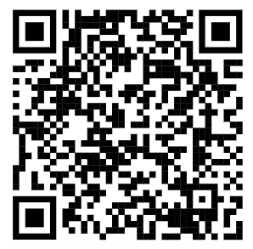
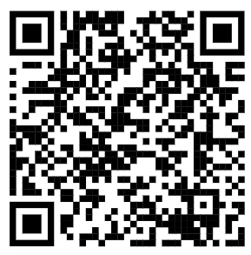
Design the Support Activity – Emerging Themes
Scan the first QR code to view the key school-based needs captured from your table discussions
Vote for the school-based needs that feel most significant to you
Then scan the second QR code to view the SACE support priorities
Vote for the support priorities that feel most significant

Slide 108
Design the Support Activity
Reflecting on what we’ve heard
Scan the QR code to add your input
Vote for items you’d like to see explored

Slide 109
Our commitment
We will take away everything you’ve shared and:
synthesise the key themes
reflect on what this means for our work
come back to you with what we’ve heard and what we intend to do next

Slide 110
Dr Ankit Agarwal
Senior Manager, Education Services
SACE Board of South Australia
Ankit.Agarwal@sa.gov.au

Slide 111
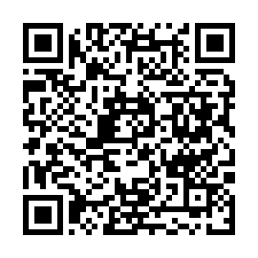
Thank you

