Slide 1

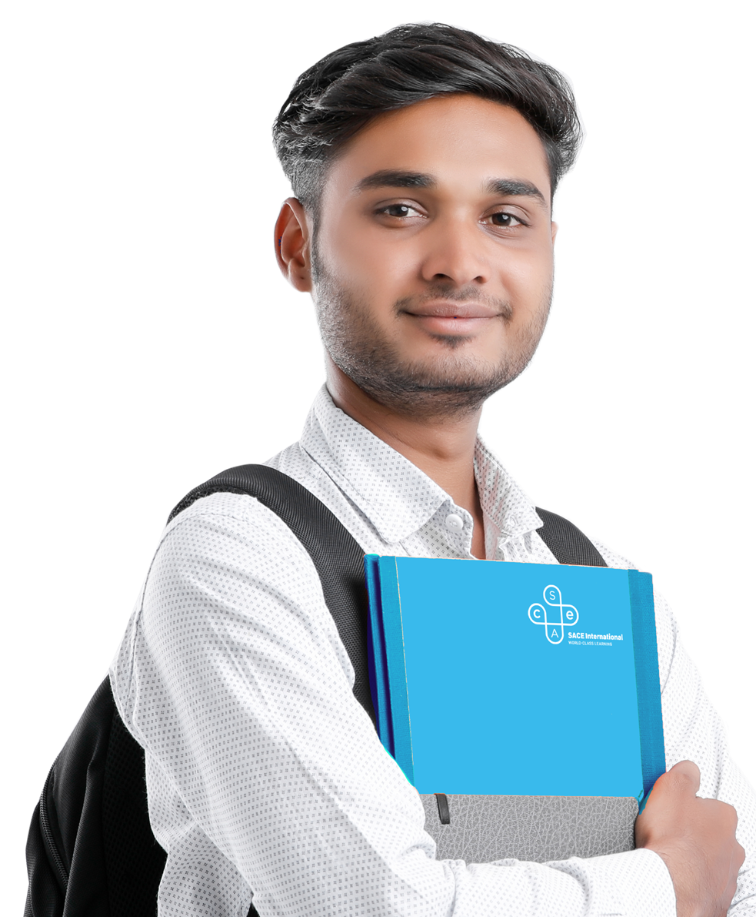


The SACE
Notes:
Good afternoon
My name is xxxxxxxxxxxxxx
SACE International (or SACEi) is the offshore delivery of the South Australian Certificate of Education for senior secondary students.
Today I will provide you with:
a brief overview of the program
outline its key features

Slide 2

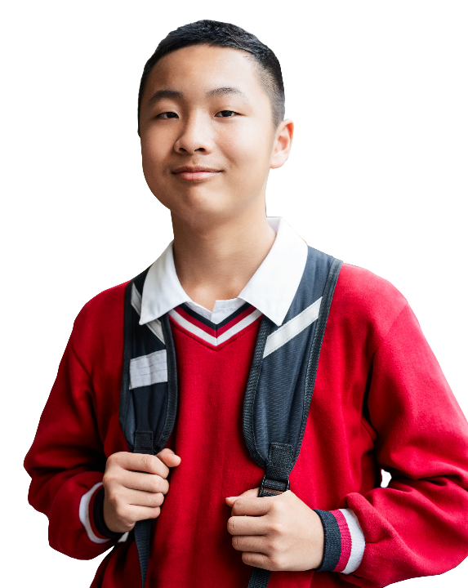
A globally recognised pre-university program that provides entry into the world’s top universities.

Slide 3

What is the SACE?
Official senior secondary qualification of the Government of South Australia.
Pre-university qualification studied in the final 2 years of schooling
Delivered in Australia since 1874 and internationally since 1982
Enabling success at university, not just access

Slide 4

How is the SACE different?
The SACE differs from other qualifications as it is not focused on remembering information for exams. The SACE allows students to develop the thinking and learning skills to succeed at university.
These include skills in working with others, being able to solve problems, research skills and the ability to present their ideas.
Our graduates say that these skills have helped them transition to university and will be used for the rest of their lives. It is about university success, not access.

Slide 5


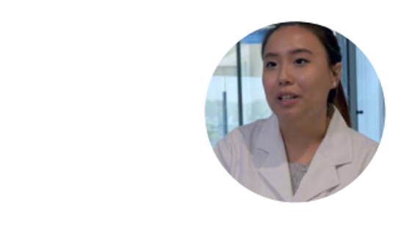
“
The SACE program provides opportunities for you to learn skills that you can use in your future, no matter where you go and who you are.
EDWYN – SACEi Teacher
The SACE international certificate is the best choice because it really prepares you so much better for university.
MELANIE – SACEi Graduate
Notes:
A key advantage of the SACEi program is that it doesn’t just get students in to university but it sets them up for success at university.
Teachers of the SACEi program and graduates talk about the effectiveness of the program in preparing students for university

Slide 6
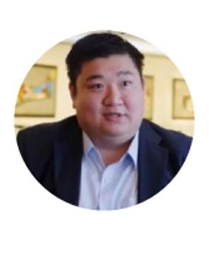
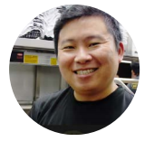
The SACE program laid the foundation and really built the skills to bring me up to where I am today.
ERIC – SACEi Graduate
“
I developed a knack for problem solving and in the business world you are always constantly problem-solving. Every day is exam day.
REN YI – SACEi Graduate
Notes:
SACEi alumni comment on the value of the skills they learnt in SACEi for their careers and lifelong learning

Slide 7
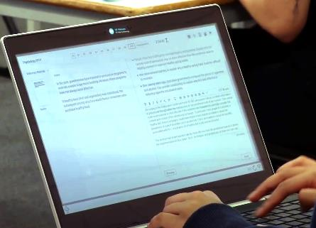
What subjects can I choose?
Each SACEi school will offer a series of subjects and students can choose the subjects that match their interests and university pathways.
Mathematics
Science
English
Business & Technology
Hospitality & Tourism
Creative Arts
Languages
Humanities
Physical Education
Research Project
Notes:
The only subjects that need to be completed are English – for the literacy component; and mathematics – for the numeracy component.

Slide 8
Who marks my work?
The SACE assessment is different from other senior school programs because it includes a school assessment process.
In Stage 1, student work is fully assessed by their school.
In Stage 2, student work is 70% assessed by their school and 30% by the SACE Board.
SACE Board assessed
School assessed
Notes:
The external assessment can be an exam, performance or an investigation.

Slide 9
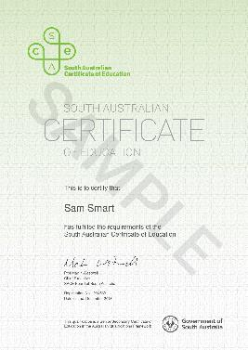
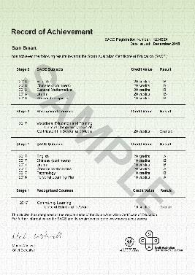
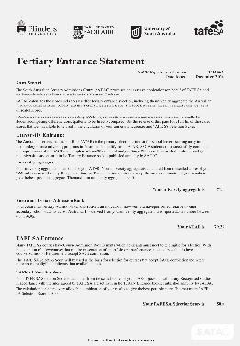
What do my results look like?
SACE Graduates receive:
SACE Certificate
SACE Record of Achievement
(results summary)
Tertiary Entrance Statement
(includes ATAR)
Notes:
Students who successfully complete the SACEi program receive:
SACE Certificate
Record of Achievement with their results for SACE subjects
Tertiary Entrance Statement (includes Australian Tertiary Admission Rank)
This documentation is exactly the same as the documentation received by South Australian students.

Slide 10


Which universities accept the SACE?
All Australian universities and many top international universities accept the SACE qualification. Our graduates are studying in prestigious universities in Australia, the United States, Canada, the United Kingdom and around Asia.
Since 1982, more than 40,000 students outside of Australia have been awarded the SACE. This has been their pathway to top universities in Australia and around the world.

Slide 11
SACEi graduates*
96%
of students
successfully complete
the program
838
SACEi
students
40,000+
SACEi Graduates since 1982
* 2019

Slide 12

Where have the graduates gone?
12%
UK & North American universities
North America
Europe
Asia
34%
Asian universities
Australia
54%
Australian universities
Notes:
Each year SACEi graduates enter universities in Australia and around the world
In 2019
54 % entered Australian universities
34% went to Asian universities
12% went the UK and North America

Slide 13

Who can study SACE?
Students who meet English language proficiency requirements
Students who have successfully completed Year 10 in their home country
Notes:
Students commencing the SACE are usually 15-19 years of age and have completed the equivalent of:
Year 10 in their own country if they are starting SACE Stage 1; or
ear 11 in their own country if they are undertaking only SACE Stage 2.
English requirements
The SACE is entirely taught in English. To be successful in the SACE, students need to have a suitable level of English language proficiency.
All SACEi schools are responsible for ensuring that students who start the SACE have the minimum level of English for the qualification.
This is at least 5.0 IELTS, 36 PTE Academic or 35-45 TOEFL iBT at the start of Stage 1.
Students who start Stage 2 of the SACE need to demonstrate a level of English equivalent to at least 5.5 IELTS, 42 PTE Academic or 46-59 TOFEL iBT.

Slide 14
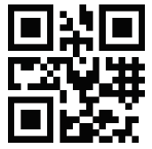
Further information
www.sacei.edu.au
Notes:
Or visit our website where you will find further information and testimonial videos for SACEi

Slide 15

Notes:
Or visit our website where you will find further information and testimonial videos for SACEi

